Slide 1
Unify Data Gov

Slide 2
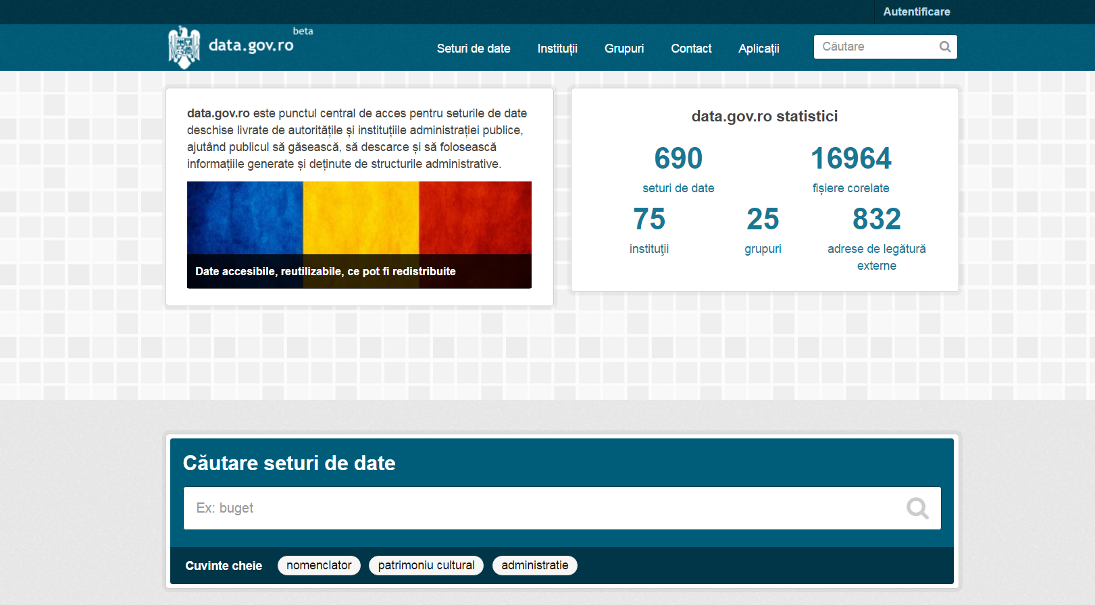
THE PROBLEM

Slide 3
KICK-OFF
Single format json
Same structure
Provide an API for all developers

Slide 4
CHALLENGES
Data.gov.ro API not very friendly
Different data structure and formats
Old standards use, hard to convert and parse

Slide 5
SOLUTION
Custom algorithms for parsing and converting data
REST API that each developer can consume in a standard manner
Web platform used as an API Viewer

Slide 6

DEMO

Slide 7
TODOs
Make the API public
NPM library for file parsing and transformation
Automatic tests for our parsing algorithms
Align with data.gov.ro maintainers for a standard format and data structure

