Slide 1

Problem
Lack of personalization and PA costs companies $756 billion (Accenture, 2016)

Slide 2

Notes:
Cause it helps you keep an eagle eye on your analytics
- Keep in mind that all you see in this presentation was done here (including the AMAZING LOGO), I came here with no idea of what to do

Slide 3
Our solution
Predictive
analytics
>
More
personalization
>
More profit
Notes:
Analyzing live data from analytics tools and providing powerful insights for clusters of customers
Personalization drives conversion/revenue

Slide 4





Competitors
Notes:
Main competitors’ weakness: long sales cycle (custom solutions)

Slide 5
How are we different?
Adaptability for a big range of industries
Cross-channel customer intelligence acquisition
2
4
1
3
Integration with various data providers
Leveraging AI to make predictions & provide actionable insights
Notes:
Data providers: CRMs, analytics tools, BI

Slide 6
Total Market for PA
$10.34 billion by 2023
Notes:
That’s like 10.34 billion more than I have in my bank account right now

Slide 7
How does it work?

Slide 8
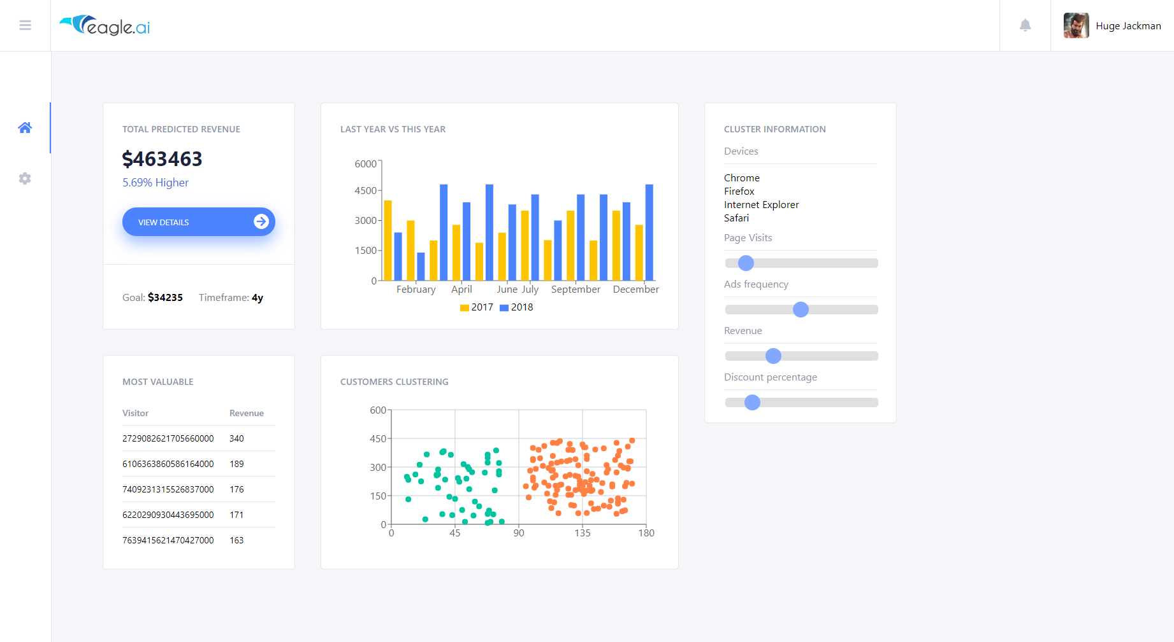
Notes:
This is a working demo!!
The main dashboard will provide all PA data and easy ways to action according to them
Talk about the heatmap visualization
Analytics integration in Settings

Slide 9







Tech stack

Slide 10
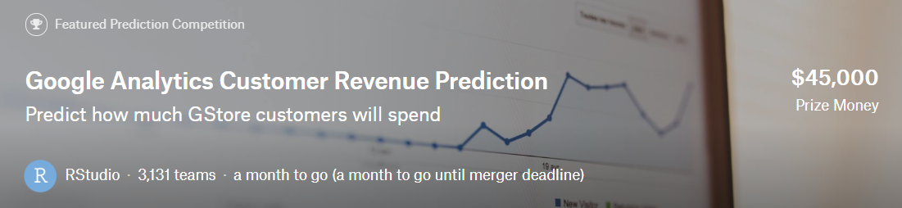
Where it all started: Kaggle challenge
Notes:
- Predicting the natural log of the revenue, evaluated via RMSE.
- Skewed classes.
- Train & test data provided

Slide 11
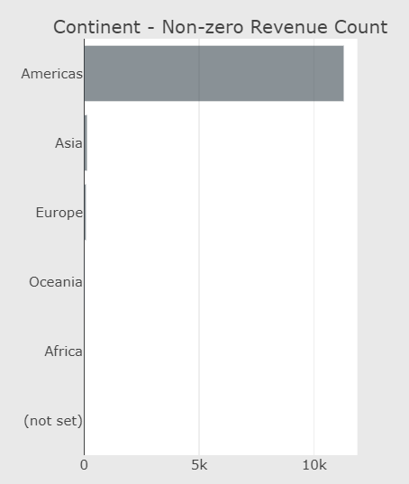
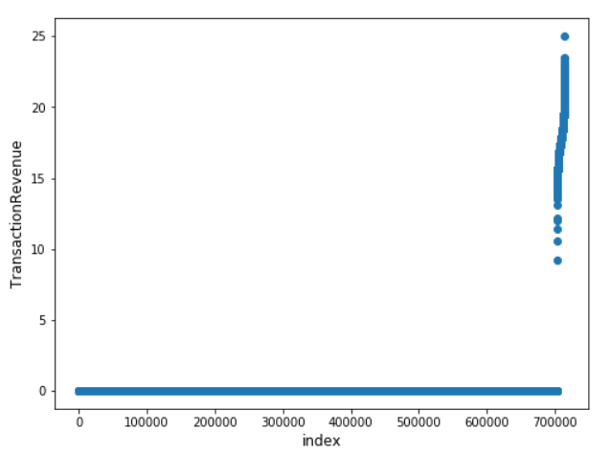
Exploratory data analysis

Slide 12
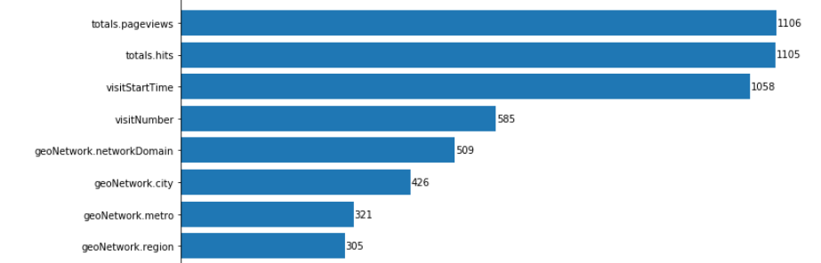
Exploratory data analysis

Slide 13
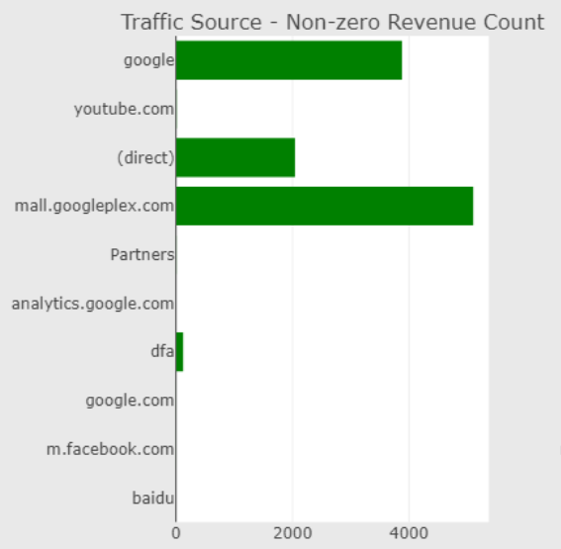
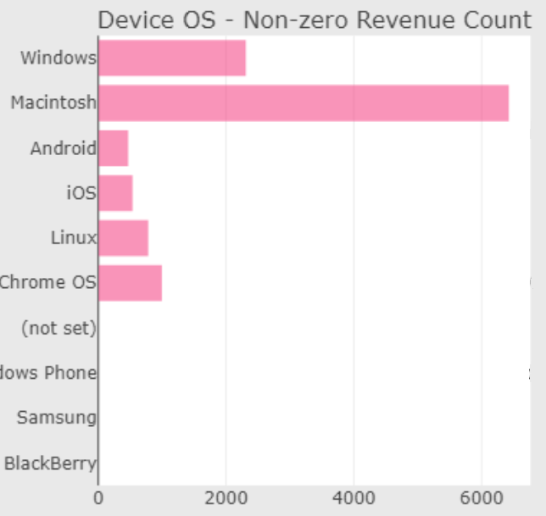
Exploratory data analysis

Slide 14
Data wrangling
One hot encodings
Collapsing visitor data
Increasing sample size sorting for RNN
Adding seasonality features
Intelligent embeddings
Notes:
One hot encodings for textual data (labeling outliers as other)
Collapsing visitor data for trivial regression methods
Increasing sample size sorting for training RNN models (to avoid padding)
Adding seasonality / time of day features when collapsing - any other type of fabricated features that could be relevant when collapsing
Intelligent embeddings for textual data (e.g. convert country to GDP)

Slide 15
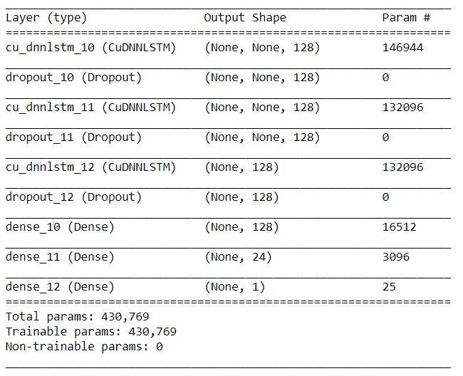
Best performing model: LSTM RNN
1 min / epoch on GTX970
Increasing batch size training
30 min CPU inference for the entire dataset

Slide 16
Model performance comparison
Model | logPredictedRevenue RMSE
Collapsed visitorId random forests | 3.47
Collapsed visitorId LinearSVR | 2.08
RNN LSTM | 1.77
Good Kaggle submission | ~1.2

Slide 17
Team

Slide 18
Notes:
LARGEST TEAM IN THE COMPETITION – we didn’t know each other before
Team members with complementary skills: ML/AI, UI/UX, Frontend, Product/Marketing
Driven to deliver an amazing product for our customers to grow their business through PA & personalization

