Slide 1







HipMCL Status and Future Directions Exabiome AHM, 2018
Ariful Azad¹, Oguz Selvitopi², and Aydın Buluç²
¹Indiana University
²Lawrence Berkeley National Laboratory
Paper: A. Azad, G. Pavlopoulos, C. Ouzounis, N. Kyrpides, and A. Buluç.
HipMCL: A high-performance parallel implementation of the Markov clustering algorithm for large-scale networks. Nucleic Acids Research, 2018
Software: https://bitbucket.org/azadcse/hipmcl/
Office of Science

Slide 2
Outline: from HipMCL 1.0 to HipMCL 2.0
HipMCL: High-performance Markov clustering algorithm for clustering protein similarity networks
HipMCL 1.0:
Current parallel algorithms
Performance summary
HipMCL 2.0:
Recent algorithmic improvements
GPU supports
Communication avoiding algorithms
Expected science impacts

Slide 3
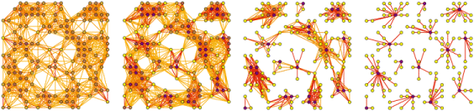
HipMCL goal: Identify gene/protein families
A protein family: group of proteins that share a common evolutionary origin, reflected by their related functions and similarities in sequence or structure
Desired scale: 10s of billions of genes/proteins, trillions of nonzero pairwise similarities (an exascale problem)
Input: pairwise similarities
between proteins (Sparse)
Output: clusters of
similar proteins

Slide 4
Markov clustering algorithm (MCL)
Input: Adjacency matrix A (sparse & column stochastic)
Photo credit: van Dongen
Initial network
Iteration 1
Iteration 2
Iteration 3
At each iteration:
1 [Expansion]: Random walks => Sparse matrix-matrix multiply
2 [Pruning]: Prune entries to keep the network sparse => k-selection
3 [Inflation]: Boost higher probability edges => Hadamard power
Step 4 (Output clusters): => Finding connected components
Stijn van Dongen, Graph Clustering by Flow Simulation, 2000

Slide 5
High-performance Markov clustering (HipMCL)
Highly-parallel algorithms in HipMCL:
Memory-efficient incremental Sparse matrix-matrix multiplication (SpGEMM)
Parallel k-selection: Idea similar to tournament pivoting – high bandwidth, low critical path
Parallel connected components for cluster identification (after MCL iterations converge): Awerbuch-Shiloach algorithm using SpMSpV and few other GraphBLAS operations

Slide 6
Performance of HipMCL 1.0. (January 2018)
Data | Proteins | Edges | #Clusters | HipMCL time | platform
Isolate-1 | 47M | 7 B | 1.6M | 1 hr | 1024 nodes Edison
Isolate-2 | 69M | 12 B | 3.4M | 1.66 hr | 1024 nodes Edison
Isolate-3 | 70M | 68 B | 2.9M | 2.41 hr | 2048 nodes Cori KNL
MetaClust50 | 282M | 37B | 41.5M | 3.23 hr | 2048 nodes Cori KNL
MCL can not cluster these networks

Slide 7
Under the hood: lots of algorithmic advancements Breakdown of runtime of HipMCL 1.0
3D SpGEMM
32 bit indexing
Hybrid Hash & Heap SpGEMM
Under development
LACC: under review @IPDPS
HipMCL 2
Graph: n = 24M nnz = 2.5B
Parallel SpGEMM
Pruning
CC

Slide 8
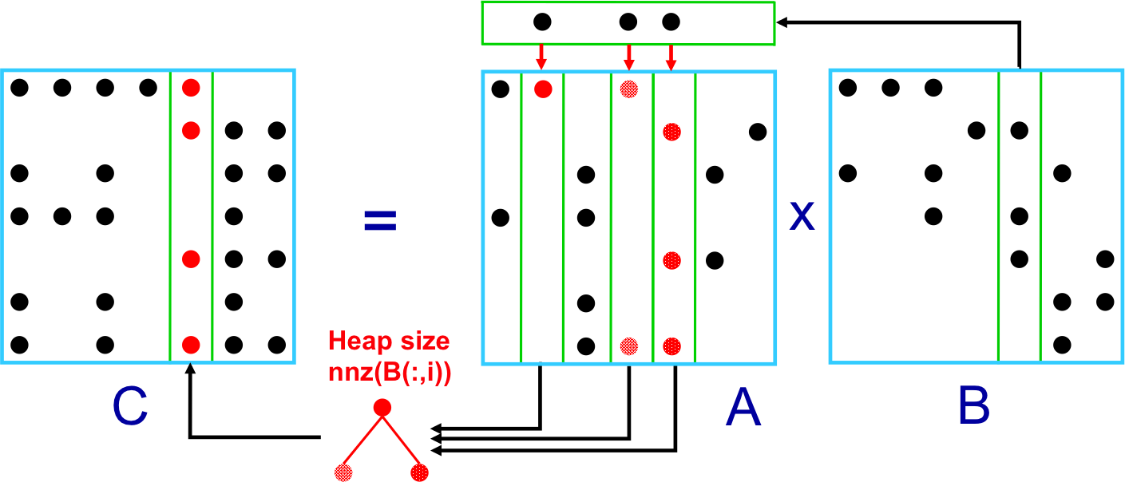
Recent development: Faster shared-memory SpGEMM
Heap SpGEMM: log(nnz(B(:,i))) heap operations
Hash SpGEMM: uses a hash table for merging. Better if the compression ratio = flop/(nnz of output) is large (usually true in the first few iterations of HipMCL).

Slide 9
Performance of shared-memory SpGEMM algorithms
Compression ratio (CR): flops/nnz(C)
Combinatorial BLAS and HipMCL use heap
Stable performance but significant gap in high CR
HipMCL inputs have high CR
We will integrate hash algorithms to CombBLAS and HipMCL
Yusuke Nagasaka, Satoshi Matsuoka, Ariful Azad, and Aydin Buluc. High-performance sparse matrix-matrix products on intel KNL and multicore architectures. In ICPPW, 2018.

Slide 10
Impact of improved SpGEMM on HipMCL
On a single KNL node of Cori
The hybrid approach selects heap or hash based on the compression ratio of a column.
Hash is significantly faster than heap because the first few iterations of HipMCL have high compression ratio.

Slide 11
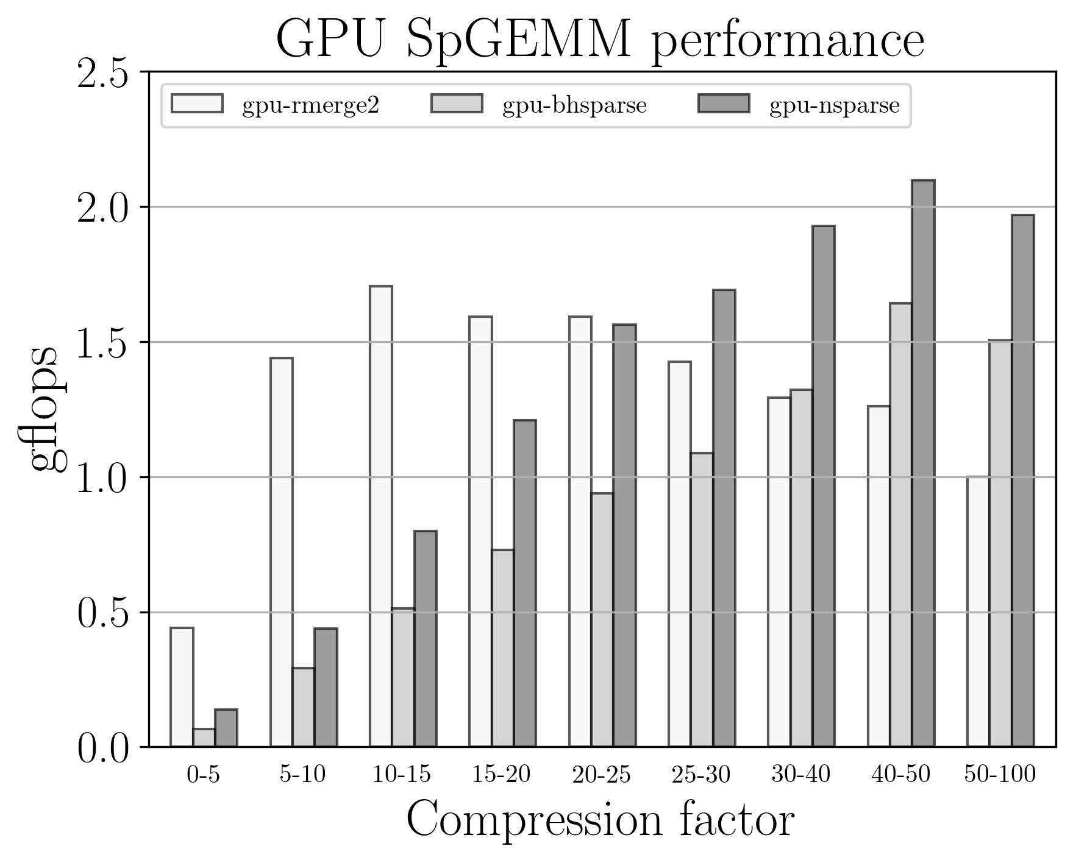
GPU support for HipMCL
Porting SpGEMM to GPU
Expansion dominates HipMCL time
most of the expansion time spent in SpGEMM
tested libraries: rmerge2, nsparse, bhsparse
performance dependent on compression ratio, matrix structure, GPU microarchitecture
Low compression ratio
rmerge2
High compression ratio
nsparse
bhsparse library not utilized

Slide 12
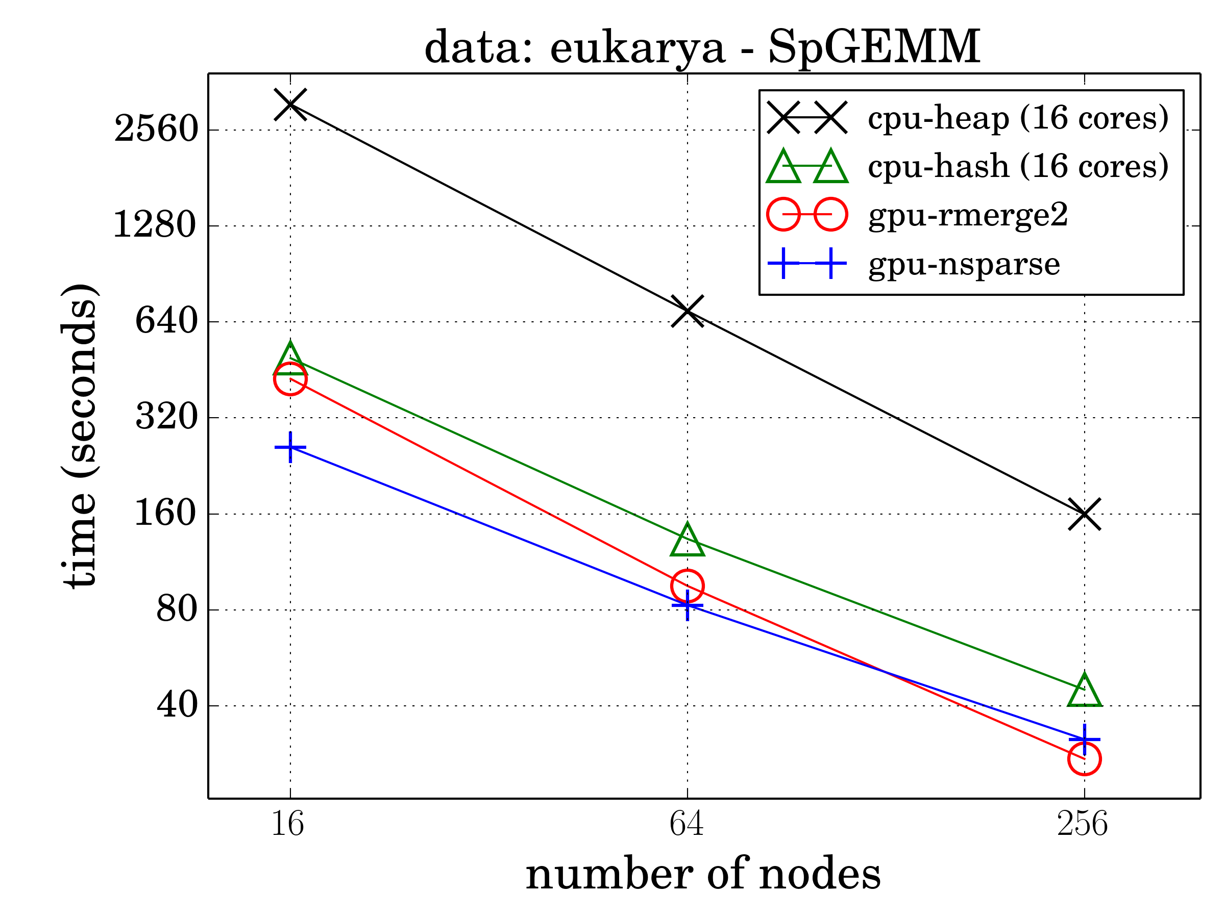
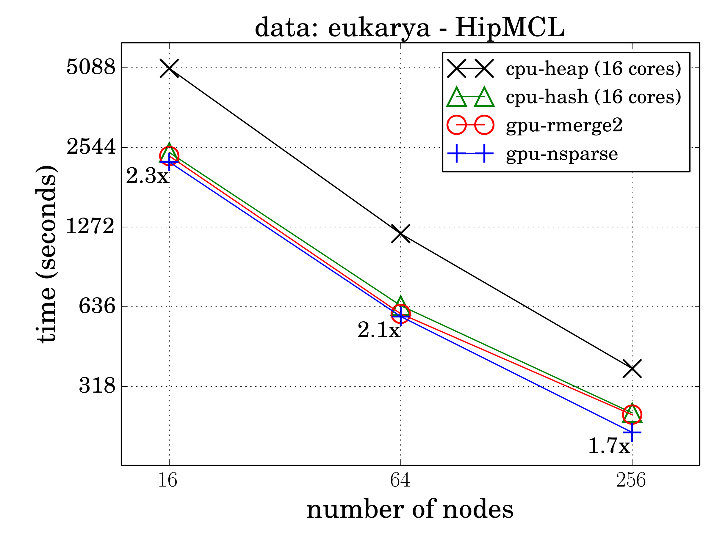
GPU support for HipMCL
SpGEMM on GPU is 1.5x-2x faster than hash SpGEMM on CPU
Communication overlap with GPU computations:
Save time in broadcasting matrices in Sparse SUMMA algorithm
#nodes | 16 | 64 | 256
HipMCL time improvement | 11% | 6% | 10%

Slide 13
Communication-avoiding schemes: 32 bit indexing
Already implemented the following options
Local indices: 32 bit or 64 bit integer
Weights: single-precision or double-precision floating point numbers
32 bit local indices
Can save communication by 50%
Can store 2B vertices on a node (not a problem at this moment)

Slide 14
Communication-avoiding schemes: 3D SpGEMM algorithm
Processor Grid
Input storage does not increase
3rd dimension (c=3)
A. Azad, G. Ballard, A. Buluc, J. Demmel, L. Grigori, O. Schwartz, S. Toledo, S. Williams. Exploiting multiple levels of parallelism in sparse matrix-matrix multiplication. SIAM Journal of Scientific Computing, 2016.
14

Slide 15
Communication-avoiding schemes: 3D SpGEMM algorithm
Squaring nlpkkt160 on Edison:
1.2 billion nonzeros in the A²
Expectation from
previous work
3D SpGEMM in HipMCL
Timeline: April 2019
A. Azad, G. Ballard, A. Buluc, J. Demmel, L. Grigori, O. Schwartz, S. Toledo, S. Williams. Exploiting multiple levels of parallelism in sparse matrix-matrix multiplication. SIAM Journal of Scientific Computing, 2016.
3D (threaded) beats 2D (non threaded) by 8X at large concurrencies
Notes:
While we use the 2D SpGEMM algorithm in HipMCL for compatibility with other pieces of the software, I have developed faster parallel 3D SpGEMM algorithms that are communication-avoiding, which we plan to integrate to HipMCL 2.0

Slide 16
HipMCL 2.0
HipMCL 2.0
Faster computations: improved local SpGEMM
Lower communication: Communication-avoiding algorithms
GPU support
Predicted performance improvement: at least 5x faster than HipMCL 1.0
More accessible: modules for supercomputers
Science impact
We have two massive datasets from JGI that HipMCL 1.0 can not handle even using half of Cori (~150 Million nodes and 242 Billion edges)
HipMCL 2.0 will be able to cluster those networks
A step forward toward our grand challenge (clustering 50B proteins)

Slide 17
Acknowledgements
HipMCL Collaborators:
Georgios Pavlopoulos (JGI), Nikos Kyrpides (JGI) and Christos Ouzounis (CERTH), Yusuke Nagasaka (Tokyo Tech)
Questions?

