Slide 1
Weekly Meeting
April 30, 2021

Slide 2
Outline
Speedup comparison of CAM vs hash in multithreaded kernel
Verification of computation time spent on compiler optimized CAM code
Roofline plot in terms of memory bandwidth
Note: All experiment results in the slides are executed on Cori KNL nodes

Slide 3
Performance Comparison of CAM vs hash in multithreaded kernel
Network Name | CAM (sec) | hash (sec) | Speedup
Amazon | 0.01 | 0.04 | 4
DBLP | 0.0096 | 0.053 | 5.52
Youtube | 0.036 | 0.33 | 9.167
Pokec | 0.44 | 3.99 | 9.07
LiveJournal | 0.41 | 3.42 | 8.34
Orkut | 1.25 | 12.18 | 9.74

Slide 4
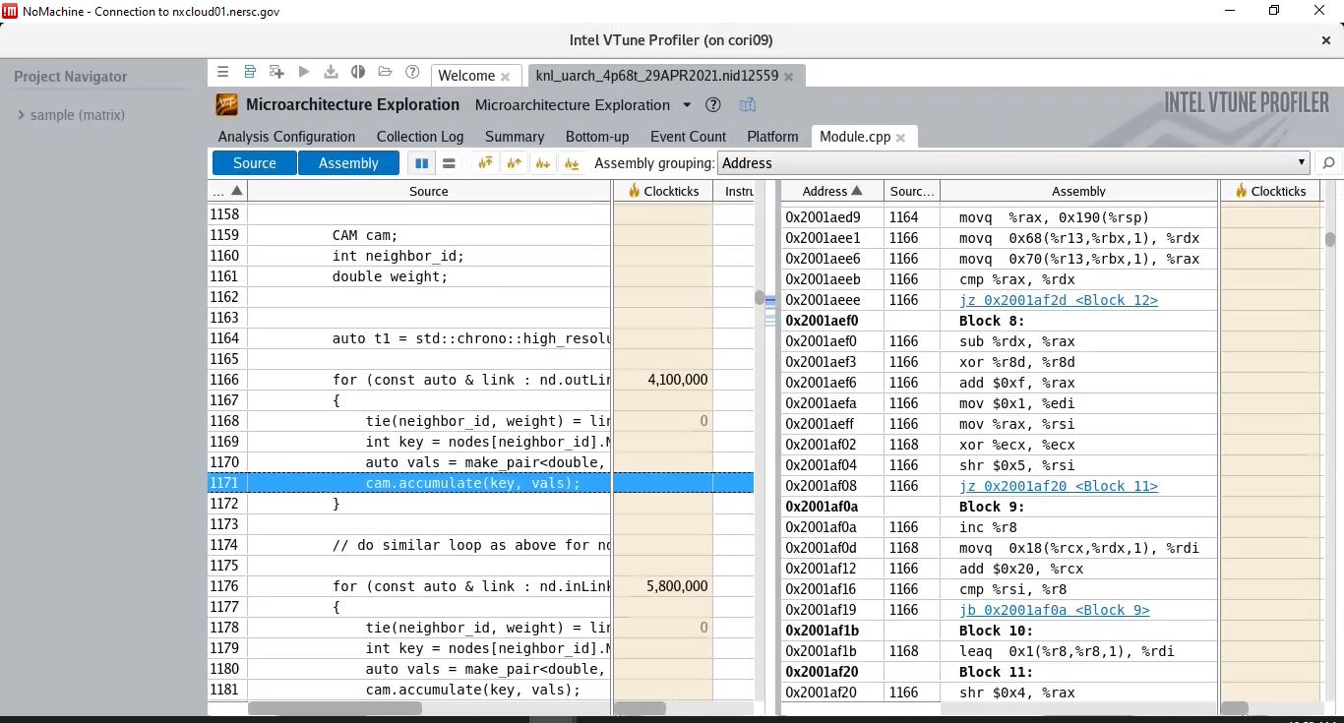
Verifying compiler optimization (Vtune) for local CAM

Slide 5
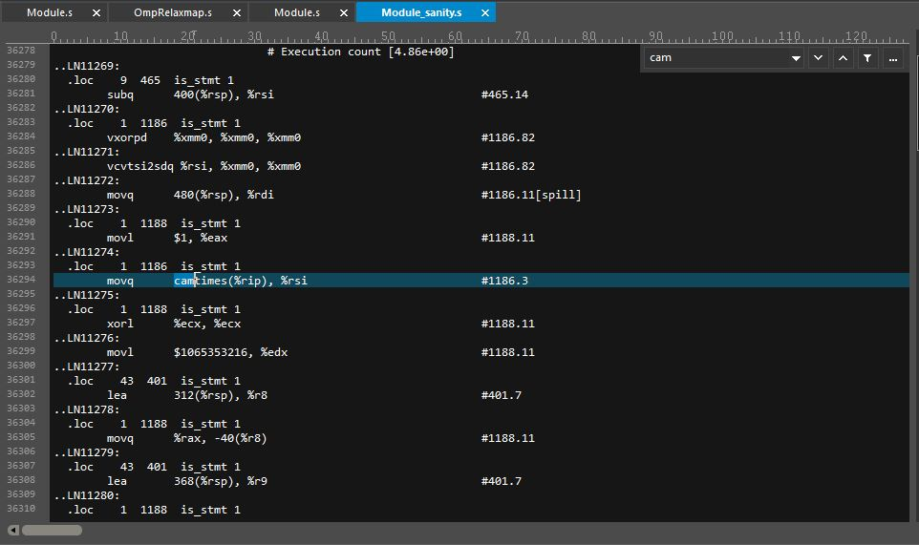
Verifying compiler optimization (Makefile generated) for local CAM

Slide 6
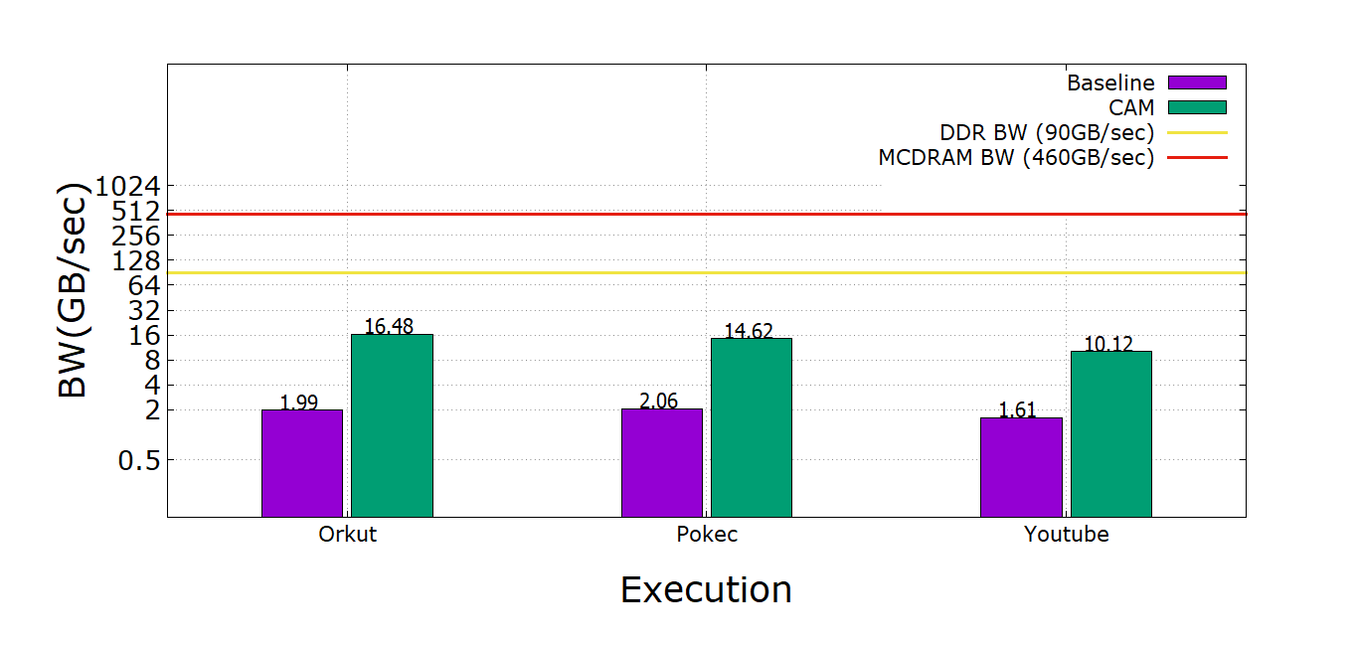
Roofline

Slide 7
Appendix

Slide 8
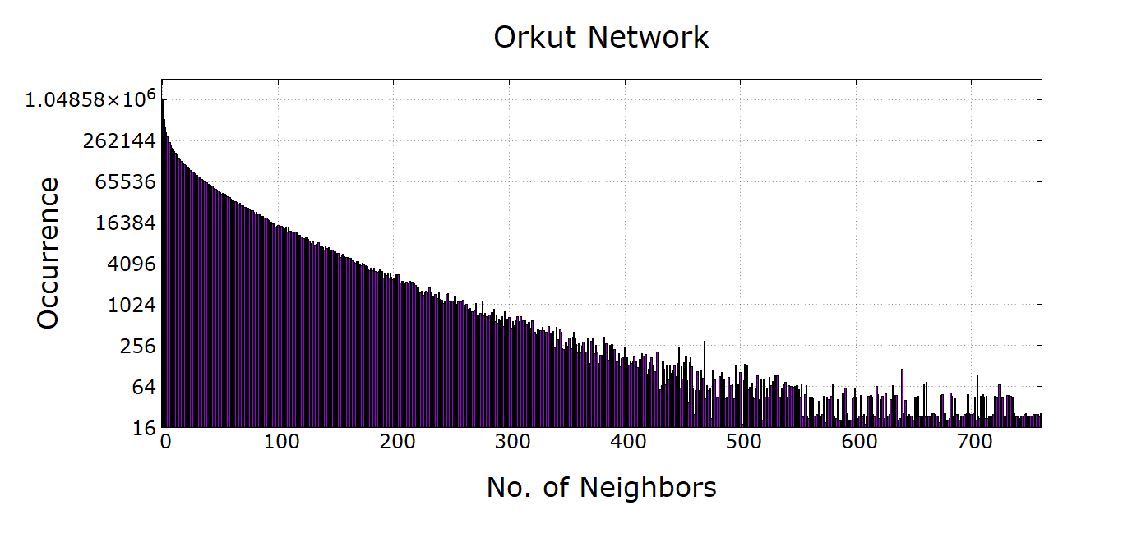
Neighbor Count VS Occurrence Histogram
For rank 0, vertices having 0 neighbors are iterated 1054733 times. Vertices having the number of neighbors more than 700 are very less. The highest number of neighbors a vertex has is found to be 2362.

Slide 9
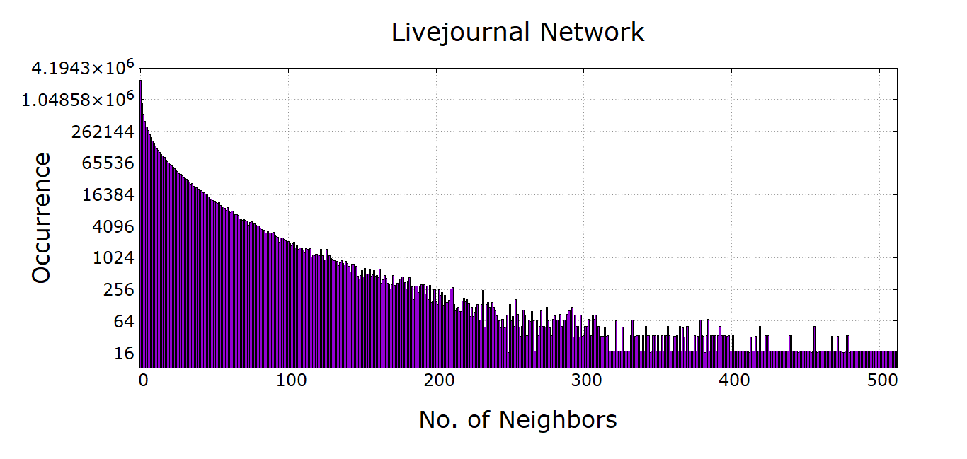
Neighbor Count VS Occurrence Histogram
For rank 0, vertices having 0 neighbors are iterated 2424347 times. Vertices having the number of neighbors more than 400 are very less frequent. The highest number of neighbors a vertex has is found to be 4334.

Slide 10
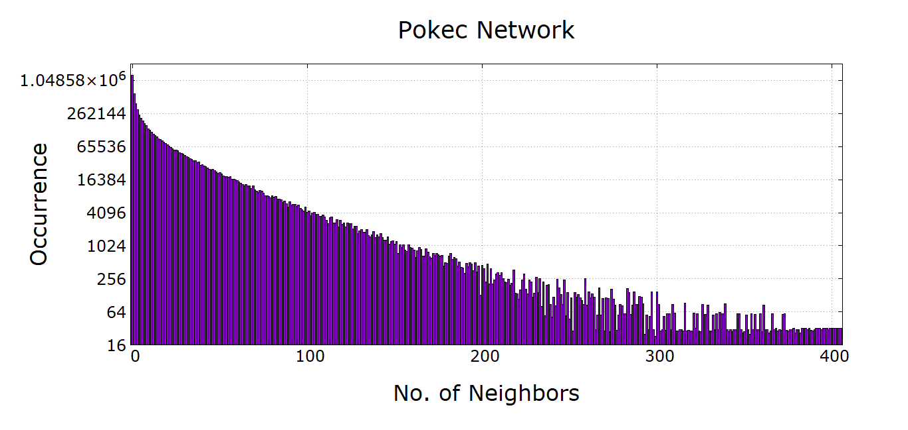
Neighbor Count VS Occurrence Histogram
For rank 0, vertices having 0 neighbors are iterated 1311993 times. Vertices having the number of neighbors more than 300 are very less frequent. The highest number of neighbors a vertex has is found to be 9609.

Slide 11
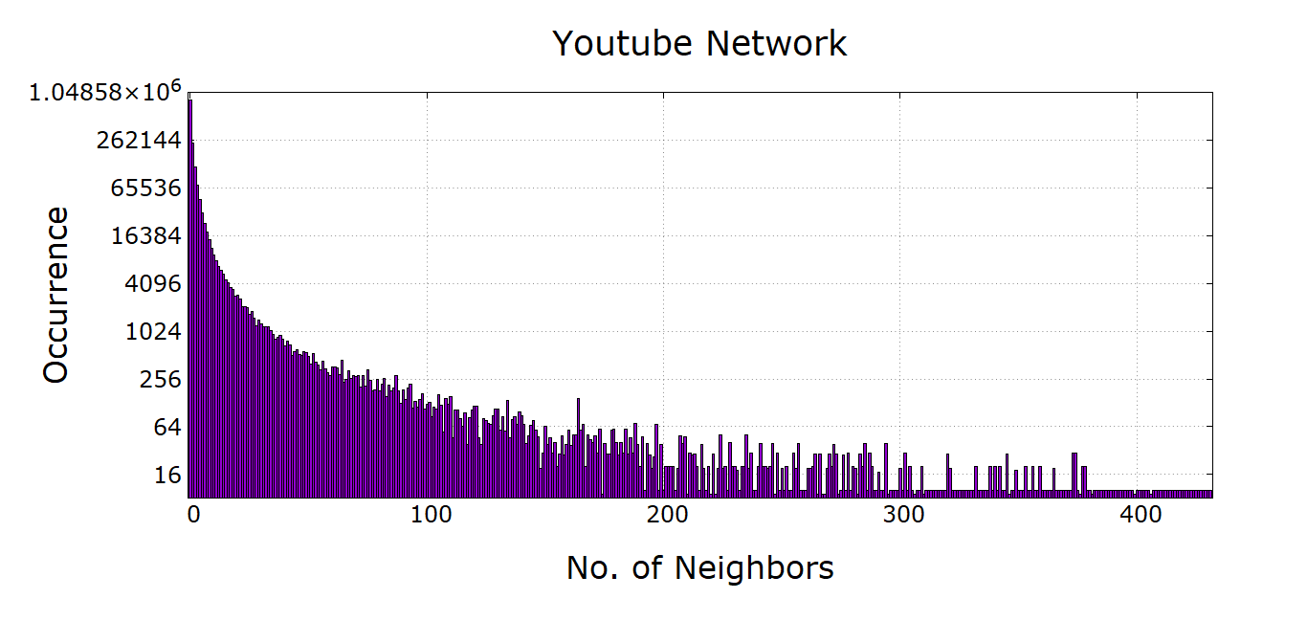
Neighbor Count VS Occurrence Histogram
For rank 0, vertices having 0 neighbors are iterated 829278 times. Vertices having the number of neighbors more than 200 are very less frequent. The highest number of neighbors a vertex has is found to be 28576.

Slide 12
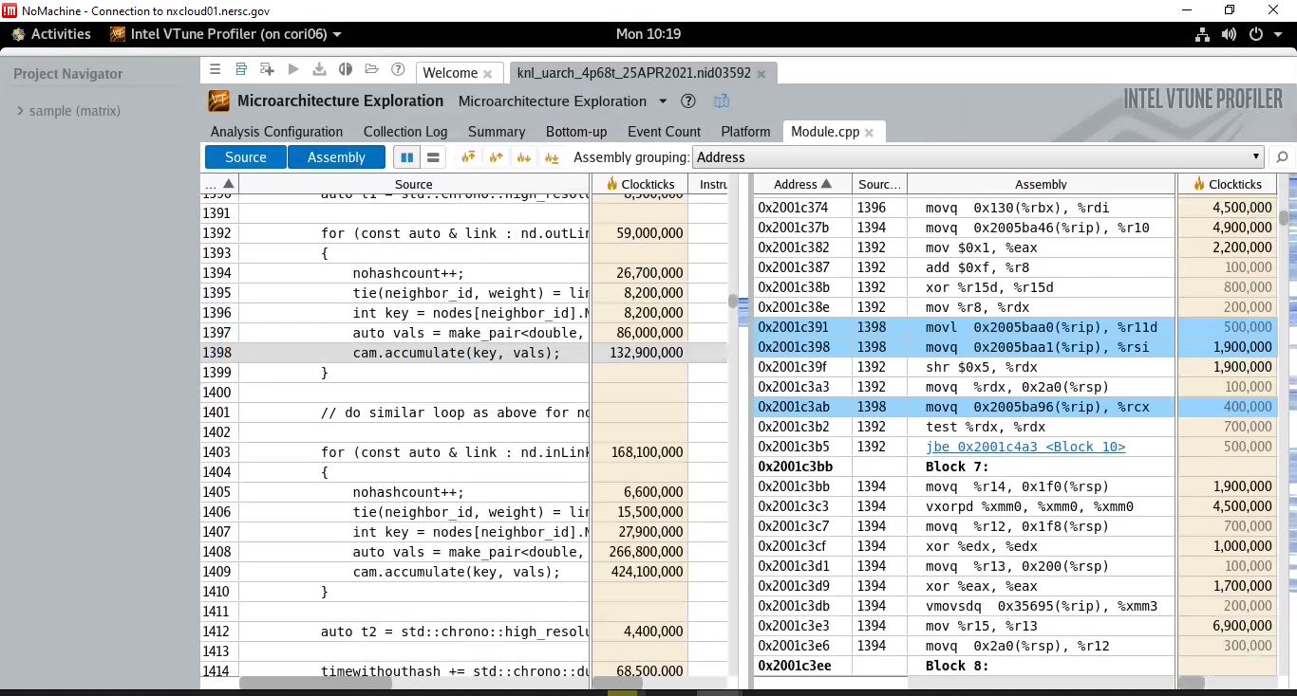
Verifying assembly code (Vtune) for CAM
Notes:
Note: The goal is to make sure the program is actually spending computational time inside the CAM block. During compiler optimization it might be a possibility that the compiler ignore the CAM block if the variables are not used anywhere else inside the program. To prevent this, the cam variable is made global and called at the end of main function.

Slide 13
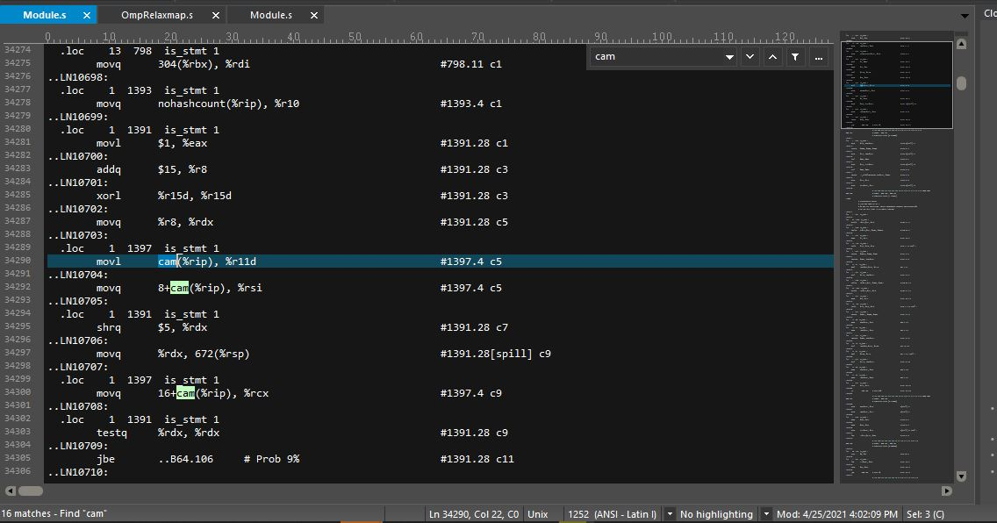
Verifying assembly code (Makefile generated) for CAM
Notes:
Note: Another view of the cam in assembly code generated by Makefile

Slide 14
Performance Comparison (hash vs CAM)
Network Name | CAM (sec) | hash (sec) | Avg Speedup | Minimum Speedup | Maximum Speedup
Amazon | 0.41 | 1.2 | 2.93 | 2.93 | 2.93
DBLP | 0.38 | 1.44 | 3.78 | 3.79 | 3.76
Youtube | 1.31 | 8.22 | 6.17 | 6.04 | 6.27
Pokec | 16.3 | 113.3 | 6.95 | 6.81 | 7.10
LiveJournal | 15.94 | 91.75 | 5.76 | 5.63 | 5.92
Orkut | 44.75 | 369.7 | 8.41 | 8.26 | 8.68
These experiments were run in KNL with 4 compute nodes. Each node running 1 MPI process. Please see the appendix for the results of previous week. The change in cam.accumulate() function seems to make the difference in the speedup

Slide 15
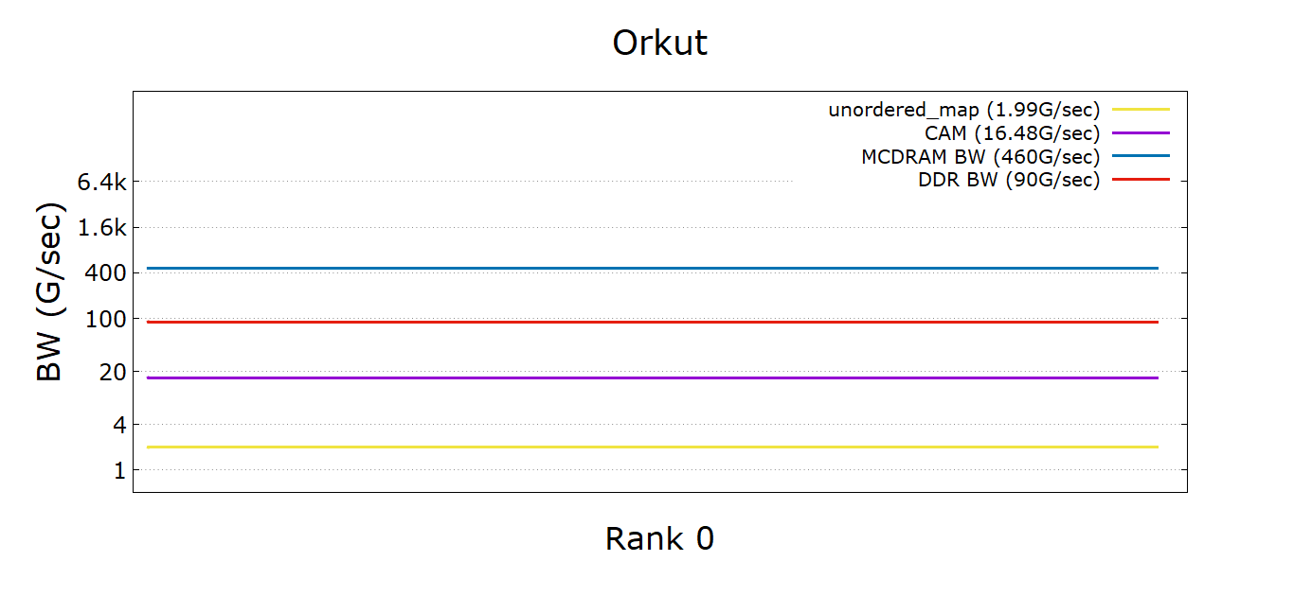
Roofline
The experiment is run on Cori KNL nodes. 4 compute nodes each running 1 MPI process and all 68 threads in each compute node are used.
Notes:
Note: each entry in the Cam is considered 16 bytes. The unordered_map code using <int, double> type flowmap (inFlowtoMod and outFlowtoMod) also considered to be 16 bytes.

Slide 16
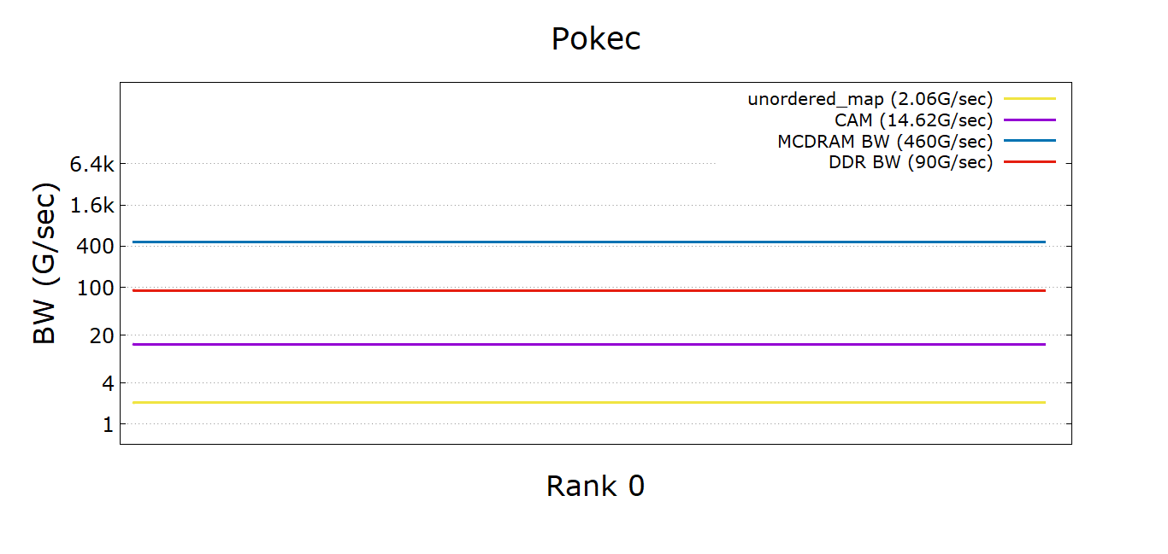
Roofline
The experiment is run on Cori KNL nodes. 4 compute nodes each running 1 MPI process and all 68 threads in each compute node are used.

Slide 17
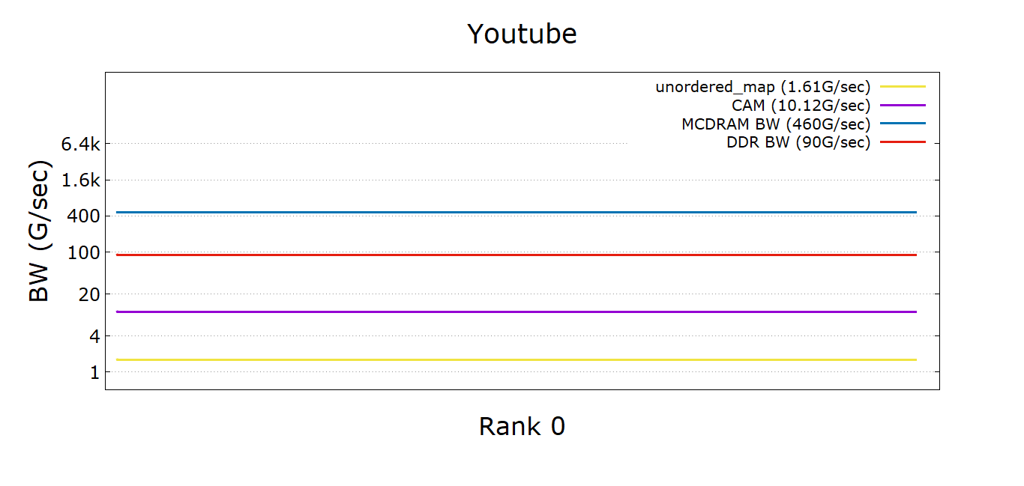
Roofline
The experiment is run on Cori KNL nodes. 4 compute nodes each running 1 MPI process and all 68 threads in each compute node are used.

Slide 18
Performance Comparison (hash vs CAM)
Network Name | CAM (sec) | hash (sec) | Avg Speedup | Minimum Speedup | Maximum Speedup
Amazon | 0.177 | 1.63 | 9.21 | 9.21 | 9.21
DBLP | 0.159 | 1.86 | 11.7 | 11.64 | 11.71
Youtube | 0.455 | 9.21 | 20.22 | 17.24 | 22.94
Pokec | 3.64 | 135.52 | 36.82 | 34.72 | 38.52
Wiki-top | 2.79 | 114.89 | 37.98 | 29.15 | 43.62
LiveJournal | 4.52 | 108.4 | 23.91 | 23.64 | 24.12
Orkut | 8.15 | 447.9 | 54.41 | 52.35 | 55.93
Note: These experiments were run in KNL with 4 compute nodes. Each node running 1 MPI process

