Slide 1
Weekly Meeting
11th February, 2021

Slide 2
Outline
Measuring STL map vs unordered_map insertion and access time performance
Performance analysis in target code segment
The target code segment is CommunityOptimization
Used Vtune ittnotify.h

Slide 3
STL map vs unordered_map in KNL
Note: The experiments are executed in KNL node
Each data entry is 12 bytes where 4 byte integer key and 8 byte double value
Number of Data | Insertion time in µs (map) | Insertion time in µs(unordered_map) | Read Time µs (map) |  | Read Time µs (unordered map)
 |  |  | Pre-Warmup | Post-Warmup | Pre-Warmup | Post-Warmup
2048 | 9485 | 5738 | 400 | 346 | 277 | 280
4096 | 20003 | 11436 | 793 | 745 | 563 | 556
8192 | 42092 | 23076 | 1574 | 1548 | 1115 | 1104
16384 | 88519 | 46380 | 3181 | 3132 | 2189 | 2225
32768 | 187226 | 93778 | 6393 | 6243 | 4427 | 4416
65536 | 395267 | 187954 | 12585 | 12508 | 8817 | 8808

Slide 4
STL map vs unordered_map in Haswell
Note: The experiments are executed in Haswell node
Each data entry is 12 bytes where 4 byte integer key and 8 byte double value
Number of Data | Insertion time in µs (map) | Insertion time in µs(unordered_map) | Read Time µs (map) |  | Read Time µs (unordered map)
 |  |  | Pre-Warmup | Post-Warmup | Pre-Warmup | Post-Warmup
2048 | 2878 | 1290 | 103 | 119 | 136 | 141
4096 | 5875 | 2857 | 202 | 213 | 216 | 216
8192 | 12636 | 5298 | 428 | 417 | 429 | 420
16384 | 26090 | 10159 | 741 | 738 | 738 | 658
32768 | 53631 | 22257 | 1609 | 1509 | 1388 | 1425
65536 | 110468 | 44923 | 3187 | 2910 | 2816 | 2749

Slide 5
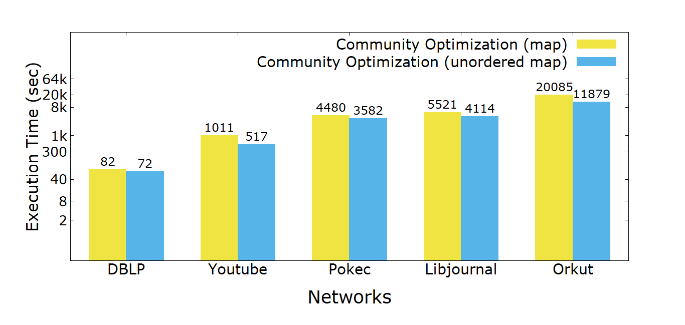
Community Optimization (map vs unordered_map)

Slide 6
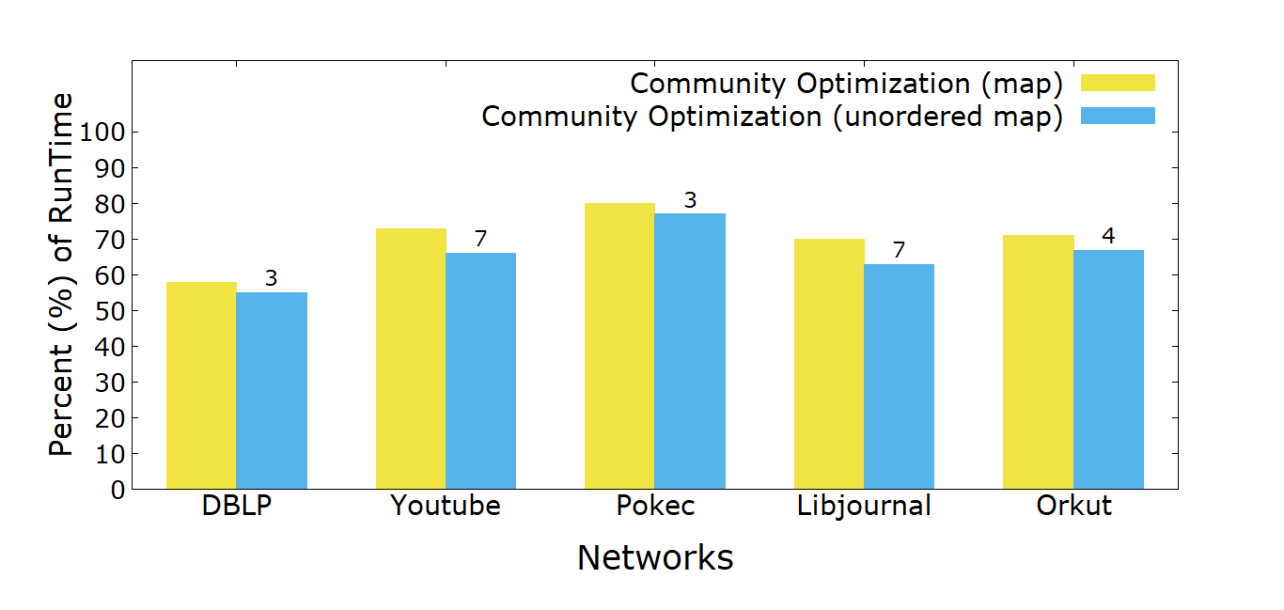
Community Optimization in % (map vs unordered_map) of Total Runtime

Slide 7
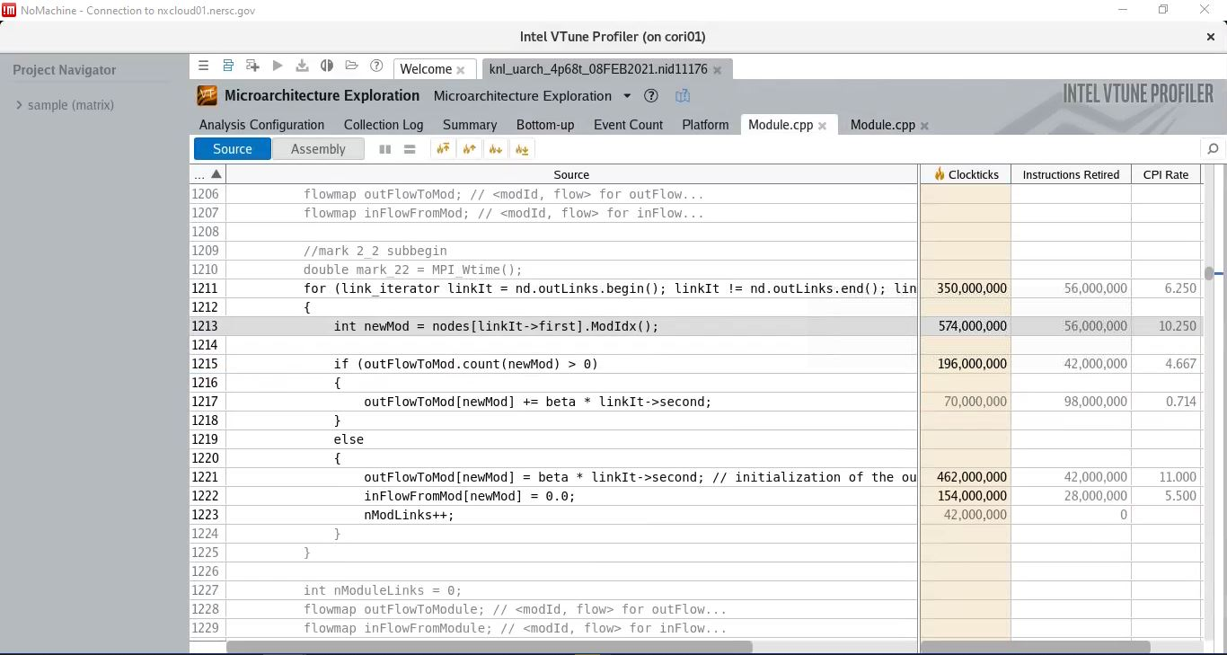
Cache Performance Measure (uarch) in duplicate code (before duplication) – 1st Run

Slide 8
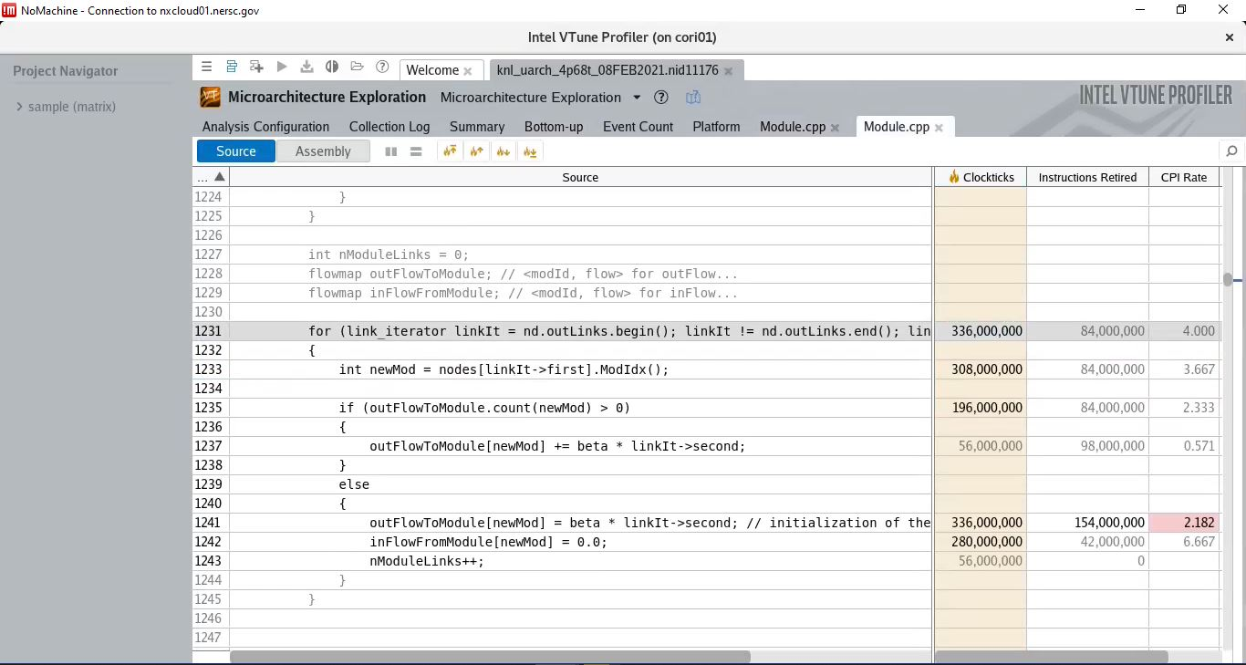
Cache Performance Measure (uarch) in duplicate code (after duplication) – 1st Run

Slide 9
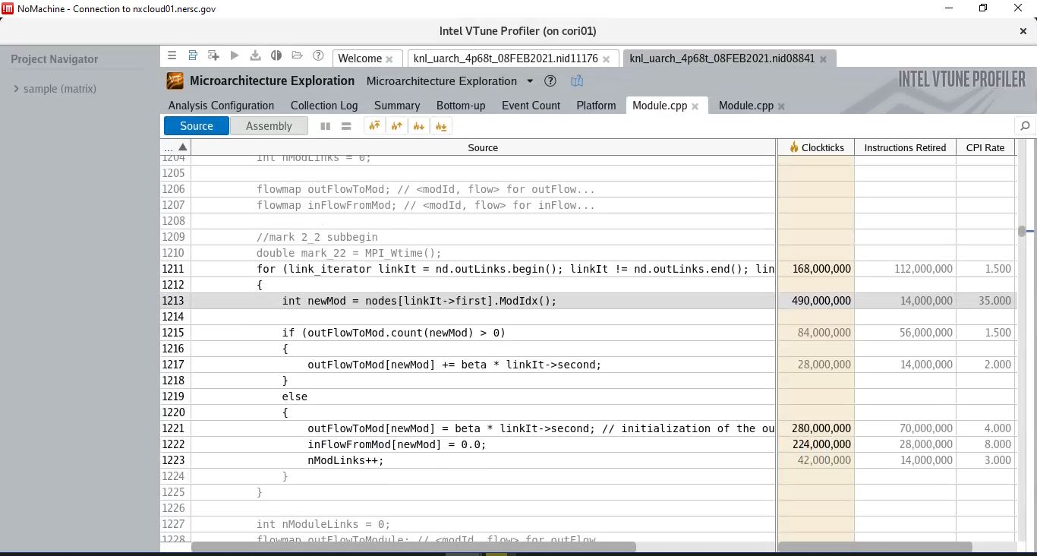
Cache Performance Measure (uarch) in duplicate code (before duplication)- 2nd Run

Slide 10
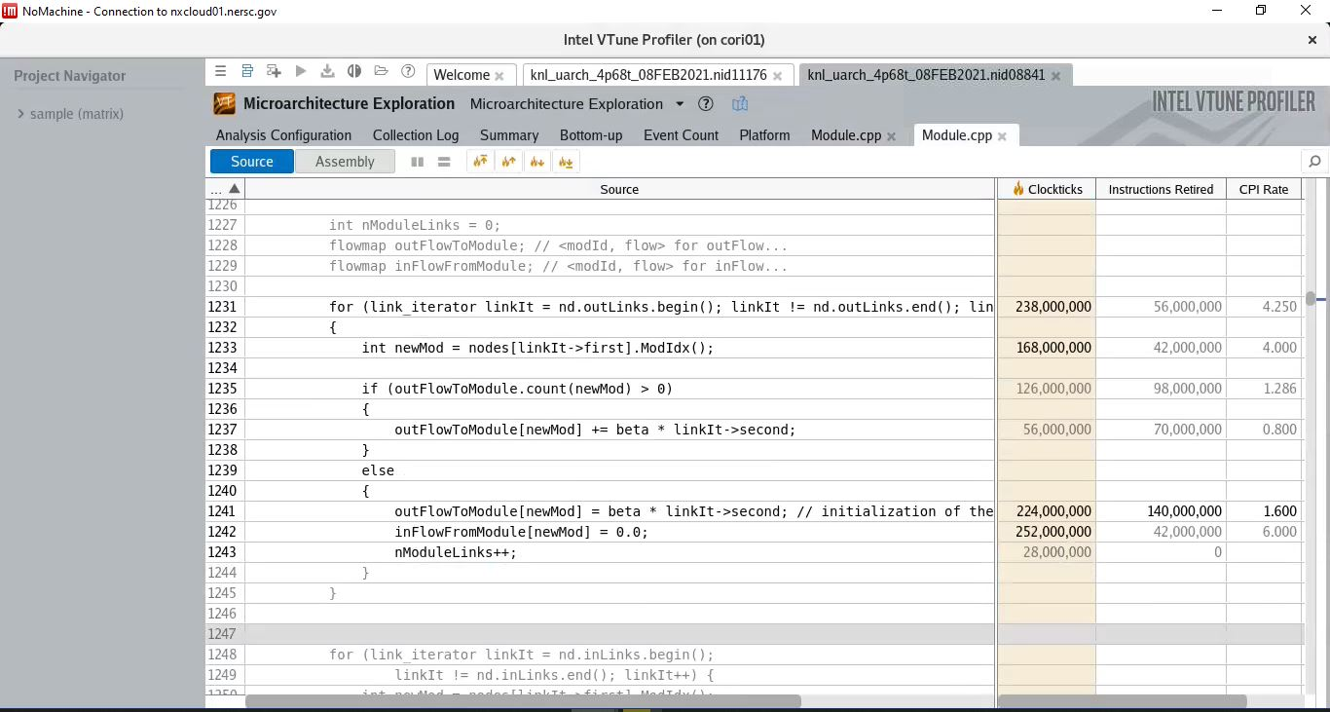
Cache Performance Measure (uarch) in duplicate code (after duplication)- 2nd Run

Slide 11
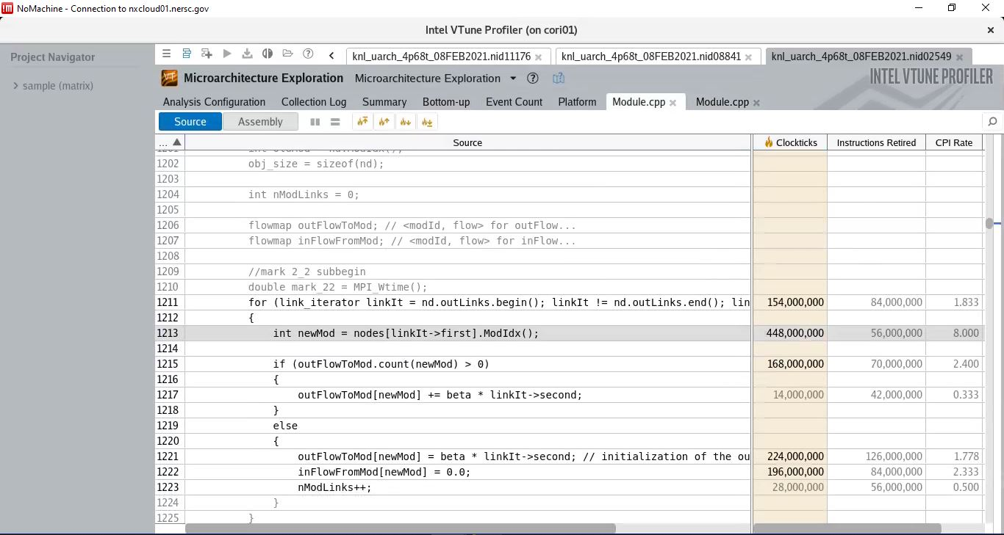
Cache Performance Measure (uarch) in duplicate code (before duplication)- 3rd Run
Notes:
Note: The target is to observe whether hardware prefetcher can help in boosting up execution time

Slide 12
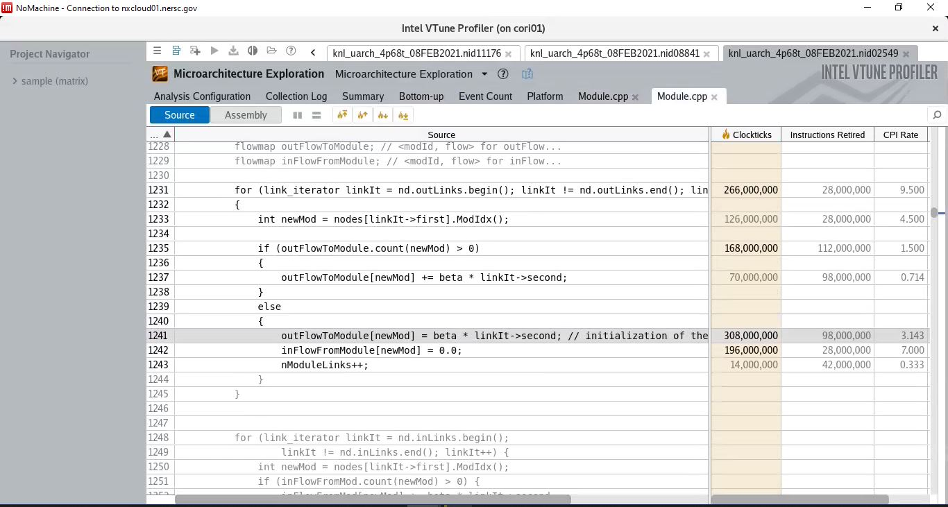
Cache Performance Measure (uarch) in duplicate code (after duplication) – 3rd Run

Slide 13
Appendix

