Slide 1
Weekly Meeting
2nd April, 2021

Slide 2
Outline
Performance Comparison of Community Optimization Kernels
Hash vs no-hash speedup comparison
Microarchitecture analysis of hash vs no-hash

Slide 3
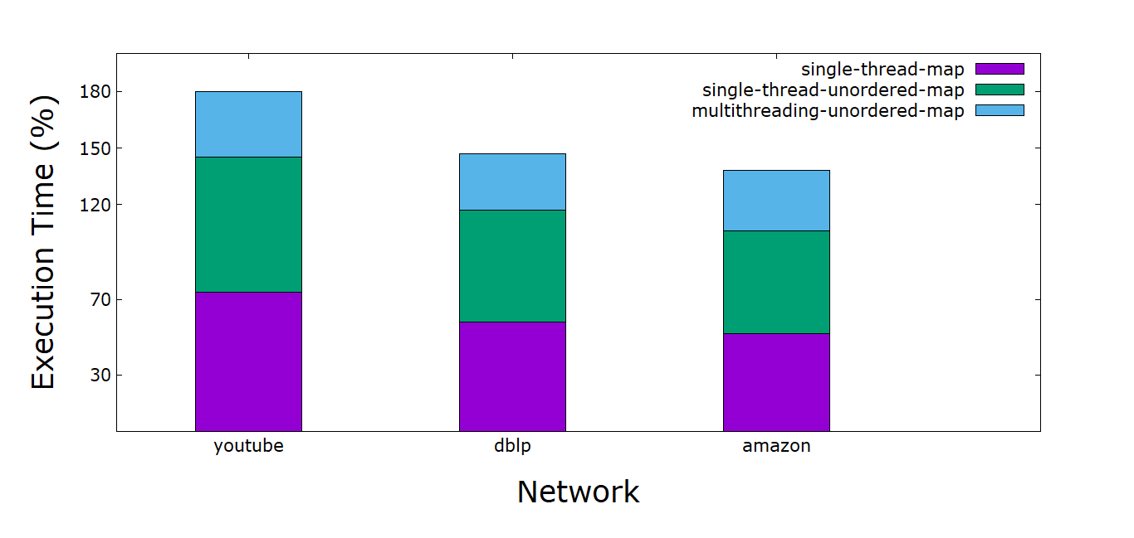
Percentage Breakdown of the Community Optimization Kernel
Note: Each network is run in 4 KNL compute node. For multithreading purpose in each compute node, all 68 threads are used

Slide 4
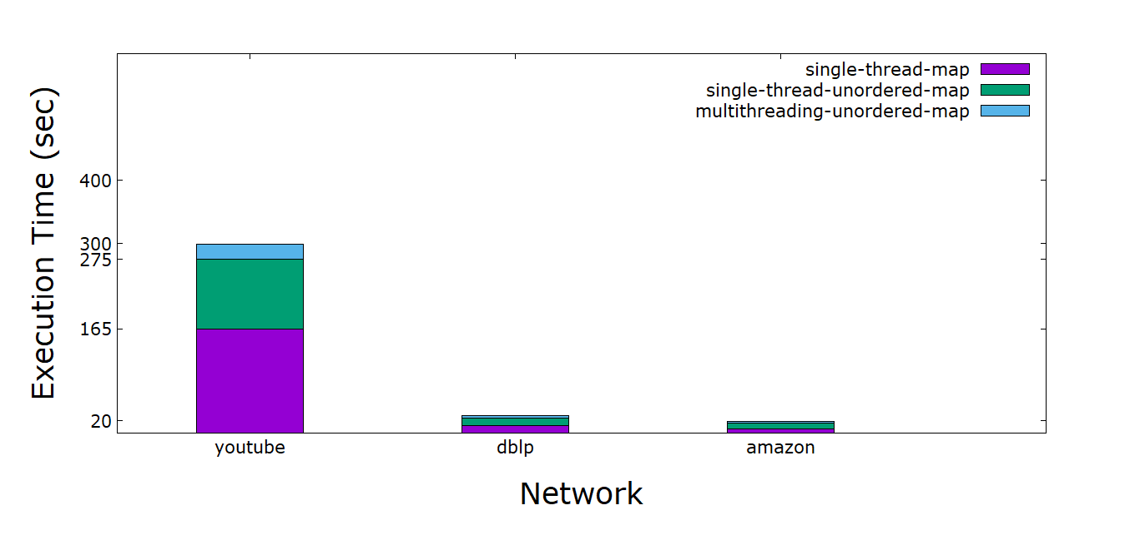
Execution Time Comparison of Community Optimization Kernel
Note: Each network is run in 4 KNL compute node. For multithreading purpose in each compute node, all 68 threads are used

Slide 5
Hash vs No-Hash Speedup Comparison
Network Name | No-hash time (sec) | Hash time (sec) | Avg Speedup | Minimum Speedup | Maximum Speedup
Youtube | 5.29 | 44.9 | 8.49 | 8.32 | 8.67
DBLP | 0.92 | 5.72 | 6.22 | 6.20 | 6.23
Amazon | 0.88 | 5.05 | 5.72 | 5.67 | 5.74
Notes:
Note: this is the speedup comparison of using the dummy no-hash code vs the regular hash code. Later, Cy replaced the dummy no-hash code with CAM code and shared in a google doc. For the updated results on this, please see later weeks’ slides.

Slide 6
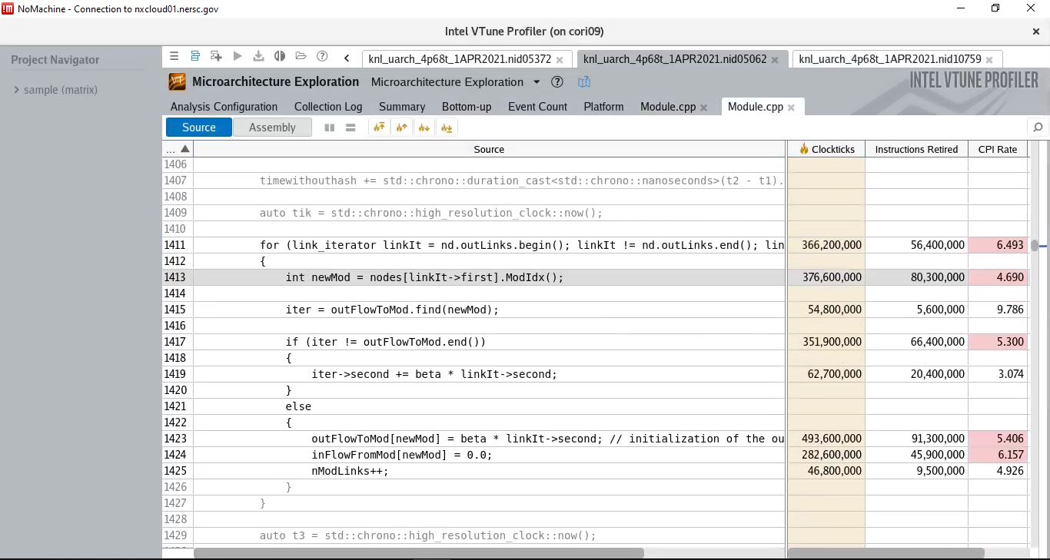
Vtune Microarchitecture Analysis (Hash)

Slide 7
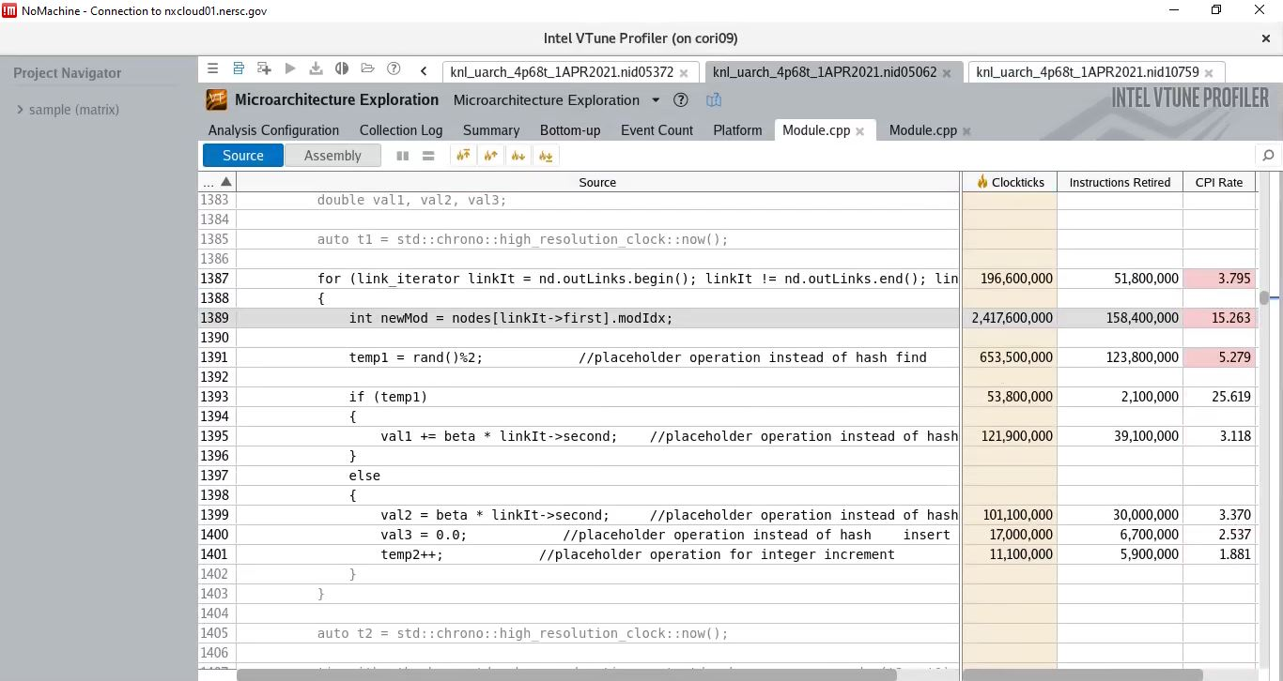
Vtune Microarchitecture Analysis (no-Hash)

Slide 8
Appendix

Slide 9
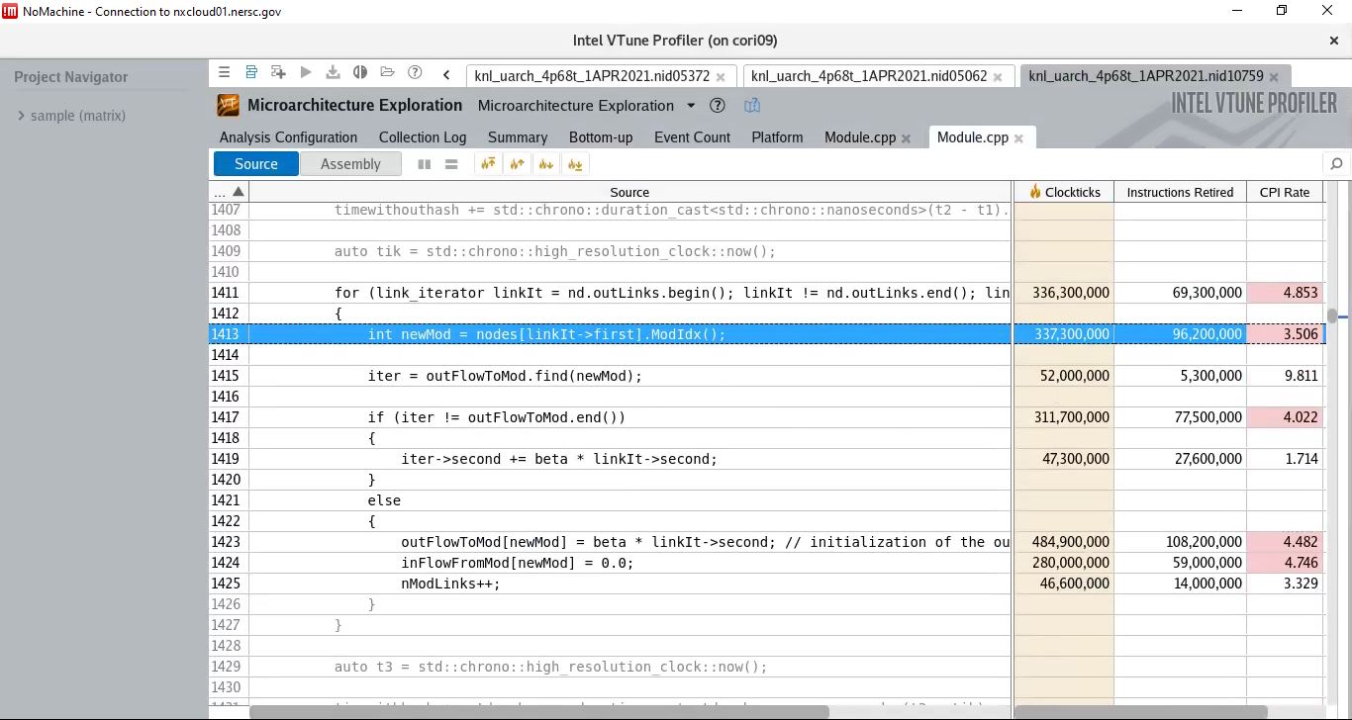
Vtune Microarchitecture Analysis (Hash)

Slide 10
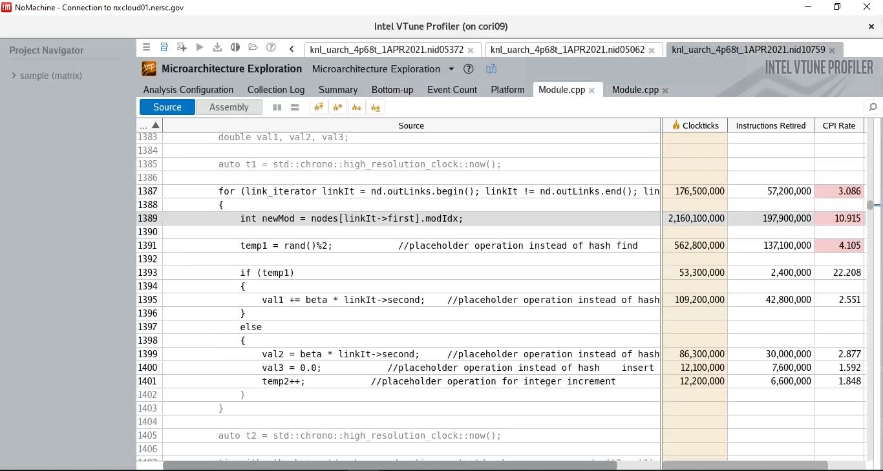
Vtune Microarchitecture Analysis (no-Hash)

