Slide 1
Weekly Meeting
April 16, 2021

Slide 2
Outline
Performance comparison of hash (unordered_map) vs CAM simulation
Roofline plot in terms of memory bandwidth

Slide 3
Performance Comparison (hash vs CAM)
Network Name | CAM (sec) | hash (sec) | Avg Speedup | Minimum Speedup | Maximum Speedup
Amazon | 0.177 | 1.63 | 9.21 | 9.21 | 9.21
DBLP | 0.159 | 1.86 | 11.7 | 11.64 | 11.71
Youtube | 0.455 | 9.21 | 20.22 | 17.24 | 22.94
Pokec | 3.64 | 135.52 | 36.82 | 34.72 | 38.52
Wiki-top | 2.79 | 114.89 | 37.98 | 29.15 | 43.62
LiveJournal | 4.52 | 108.4 | 23.91 | 23.64 | 24.12
Orkut | 8.15 | 447.9 | 54.41 | 52.35 | 55.93
Note: These experiments were run in KNL with 4 compute nodes. Each node running 1 MPI process

Slide 4
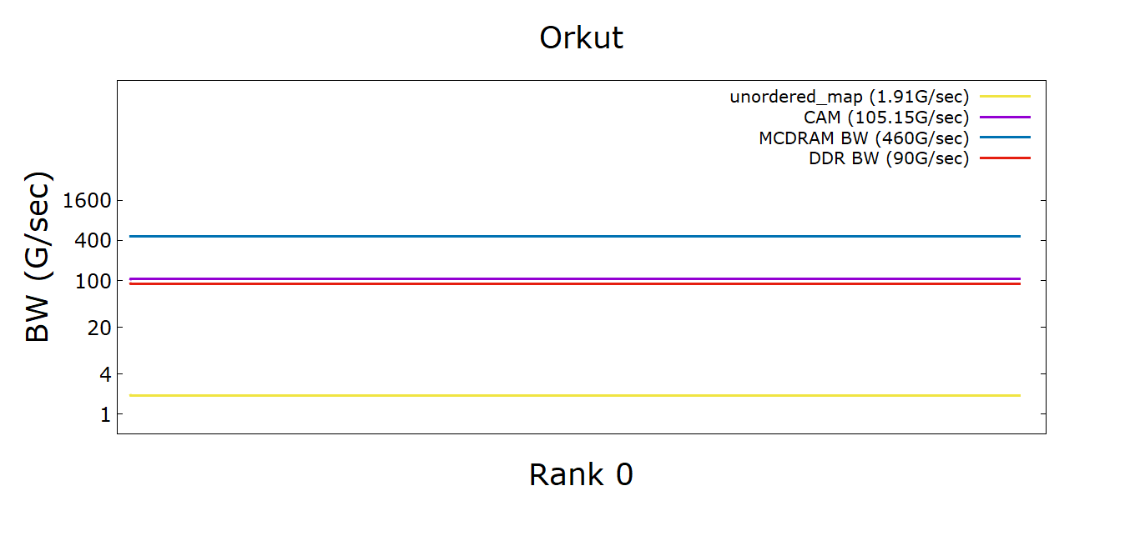
Roofline
Notes:
Note: each entry in the Cam is considered 20 bytes (int+double+double). For now, the unordered_map code using <int, double> type flowmap (inFlowtoMod and outFlowtoMod) also considered to be 20 bytes. Although, the flowmap are using 12 bytes + 4 bytes for modID access.

Slide 5
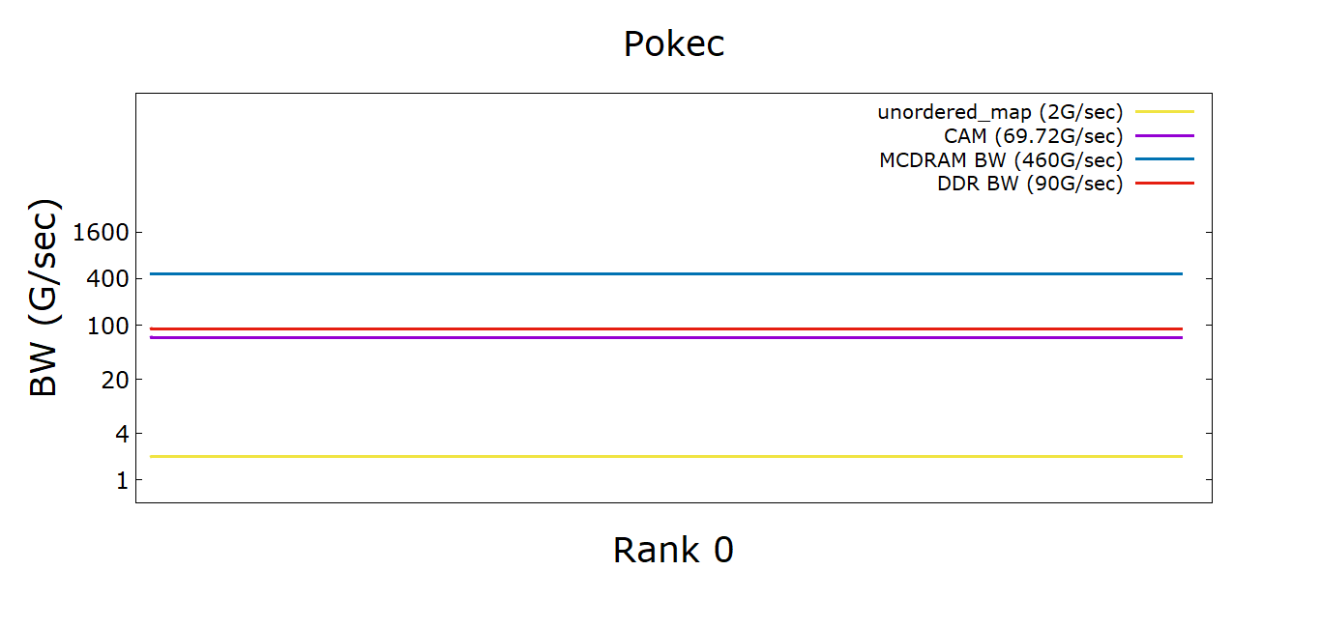
Roofline

Slide 6
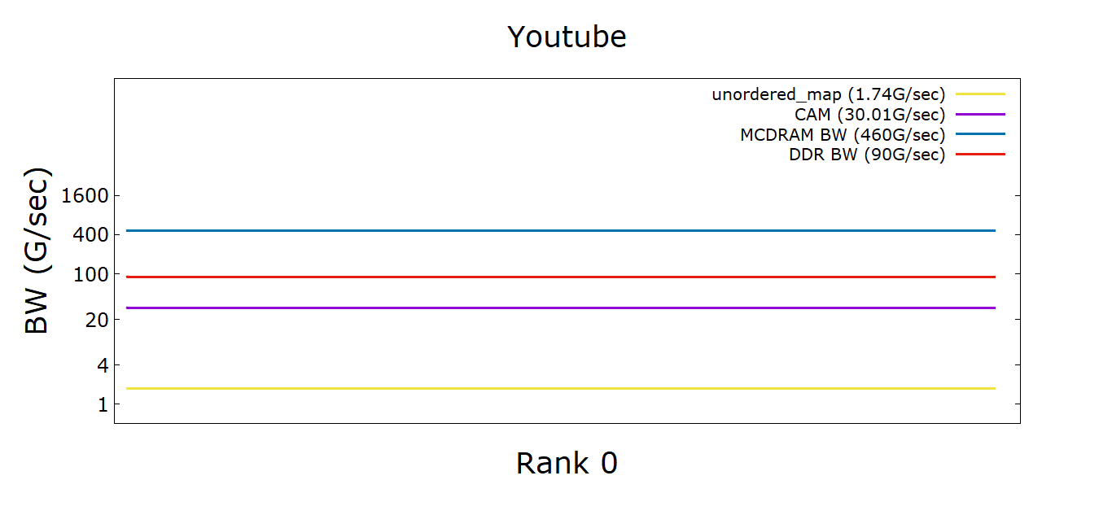
Roofline

Slide 7
Appendix

Slide 8
Profiling Cache Latencies (KNL)
Used the Intel Memory Latency Checker¹ and measured Idle cache Latencies
Latency type | Buffer Size (KB) | Clock Count (~approx) | Latency in Time (ns)
idle_latency | 32 | 4.0 | 2.8
 | 64 | 15.6 | 11.2
 | 512 | 19.4 | 13.8
 | 1024 | 115.7 | 82.7
 | 3072 | 185.9 | 132.8
Notes:
1. https://software.intel.com/content/www/us/en/develop/articles/intelr-memory-latency-checker.html

Slide 9
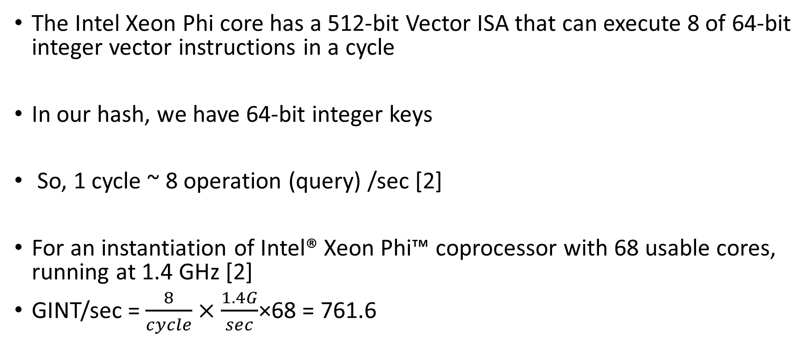
Computation for theoretical Peak
The Intel Xeon Phi core has a 512-bit Vector ISA that can execute 8 of 64-bit integer vector instructions in a cycle
In our hash, we have 64-bit integer keys
So, 1 cycle ~ 8 operation (query) /sec [2]
For an instantiation of Intel® Xeon Phi™ coprocessor with 68 usable cores, running at 1.4 GHz [2]
GINT/sec = $\frac{8}{cycle}×\frac{1.4G}{sec}$×68 = 761.6
Notes:
2. https://software.intel.com/content/www/us/en/develop/articles/intel-xeon-phi-core-micro-architecture.html#:~:text=The%20Intel%20Xeon%20Phi%20core,64%2Dbit%20integer%20vector%20instructions.

Slide 10
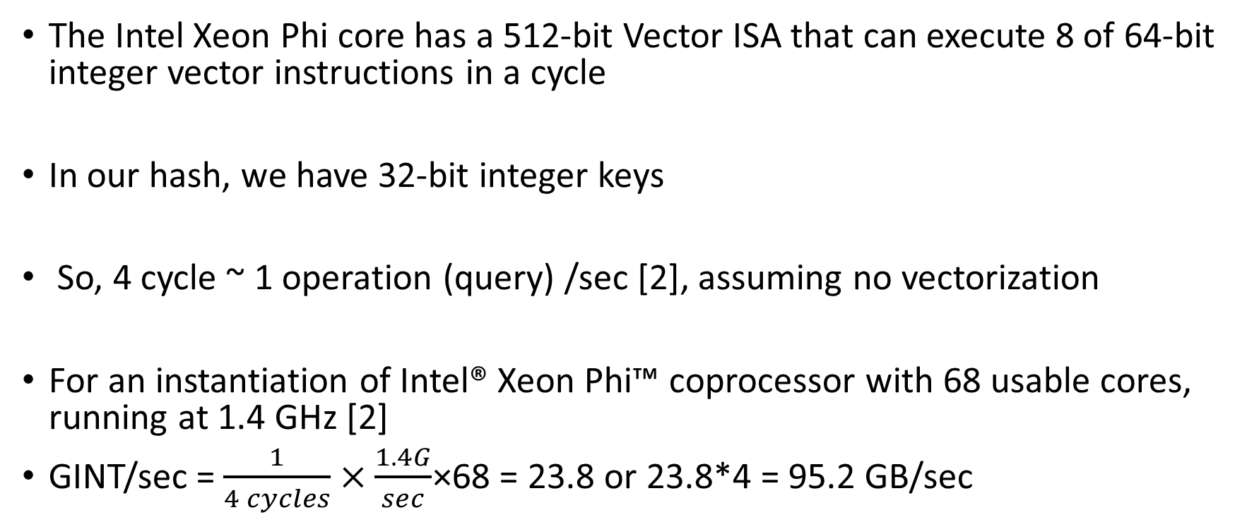
Computation for theoretical Peak (L1-cache)
The Intel Xeon Phi core has a 512-bit Vector ISA that can execute 8 of 64-bit integer vector instructions in a cycle
In our hash, we have 32-bit integer keys
So, 4 cycle ~ 1 operation (query) /sec [2], assuming no vectorization
For an instantiation of Intel® Xeon Phi™ coprocessor with 68 usable cores, running at 1.4 GHz [2]
GINT/sec = $\frac{1}{4 cycles}×\frac{1.4G}{sec}$×68 = 23.8 or 23.8*4 = 95.2 GB/sec
Notes:
2. https://software.intel.com/content/www/us/en/develop/articles/intel-xeon-phi-core-micro-architecture.html#:~:text=The%20Intel%20Xeon%20Phi%20core,64%2Dbit%20integer%20vector%20instructions.

