Slide 1
Weekly Meeting
19th March, 2021

Slide 2
Outline
Without using Vtune, reporting the execution time for different types of prefetches using a regular timer.
Report the microbenchmark information using
Different variation of prefetching

Slide 3
Microbenchmark using Regular Timer for different Prefetches (Including the time of prefetcher code itself)
Implementation Type | Average Time(sec)/Iteration
 | Avg | 1st run | 2nd run | 3rd run
No Prefetch | 3.449 | 3.448 | 3.447 | 3.451
Node prefetch, Outlinks prefetch | 3.454 | 3.455 | 3.453 | 3.454
Next iterator Node Prefetch | 3.622 | 3.617 | 3.625 | 3.623

Slide 4
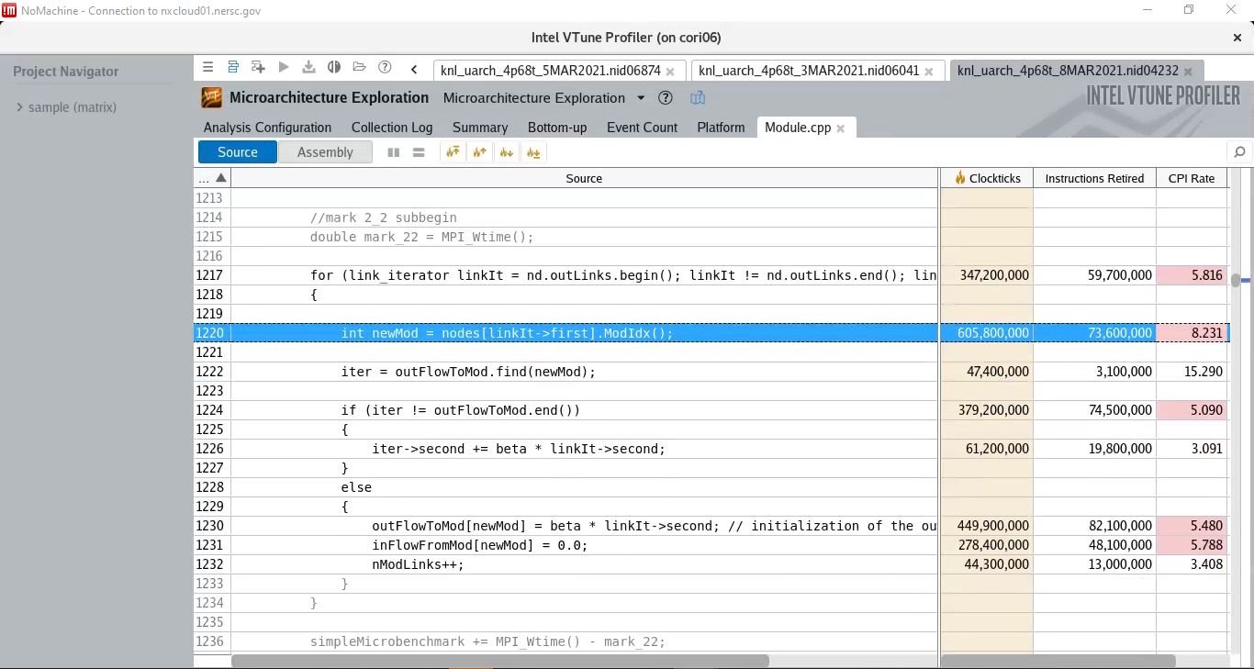
No Prefetching (Baseline)

Slide 5
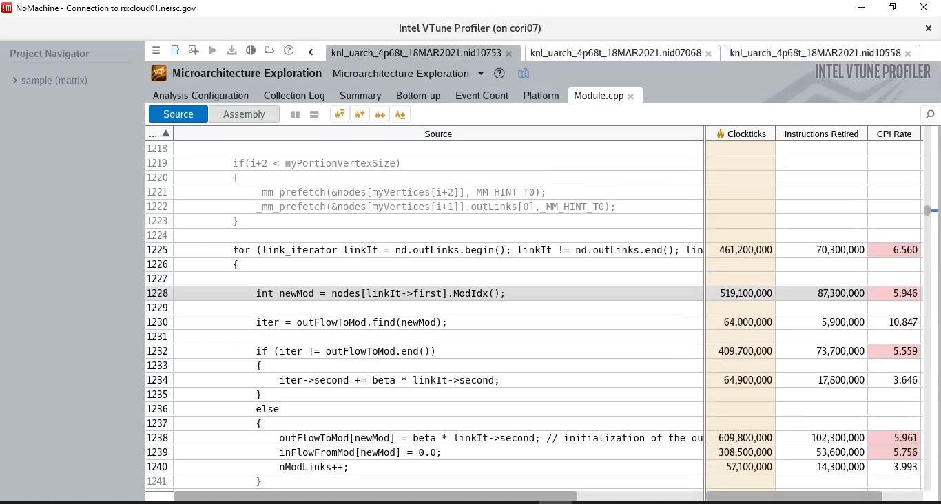
Node prefetch, Outlinks prefetch Combined

Slide 6
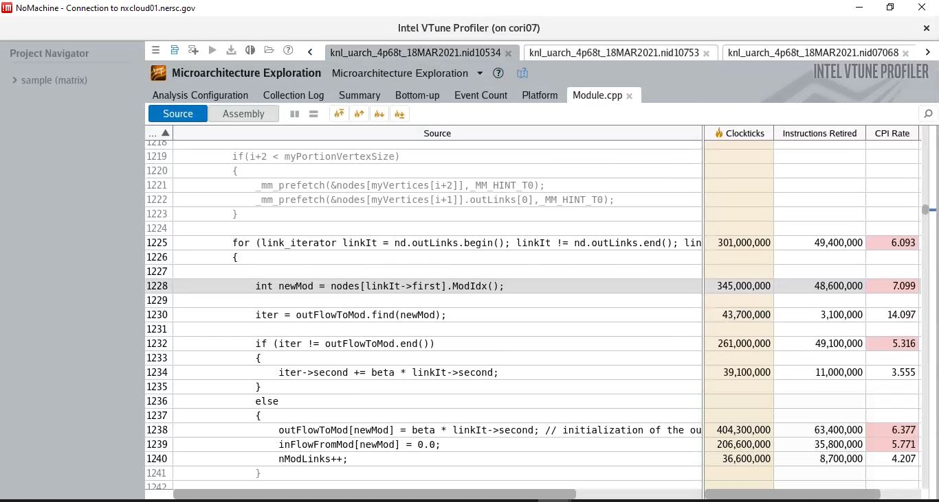
Node prefetch, Outlinks prefetch Combined

Slide 7
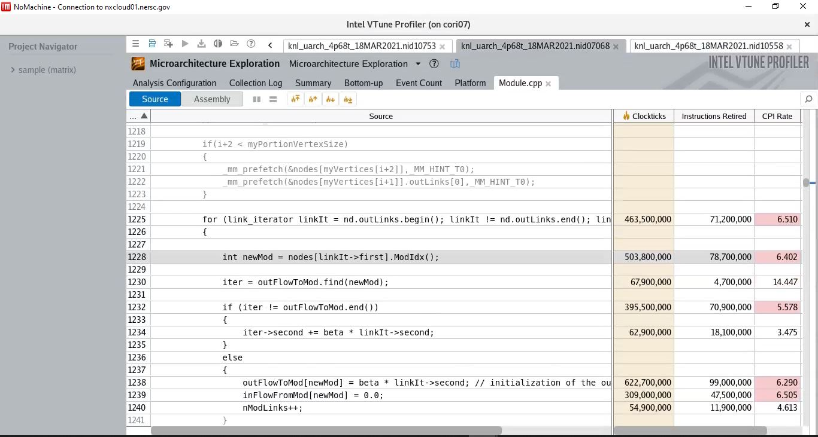
Node prefetch, Outlinks prefetch Combined

Slide 8
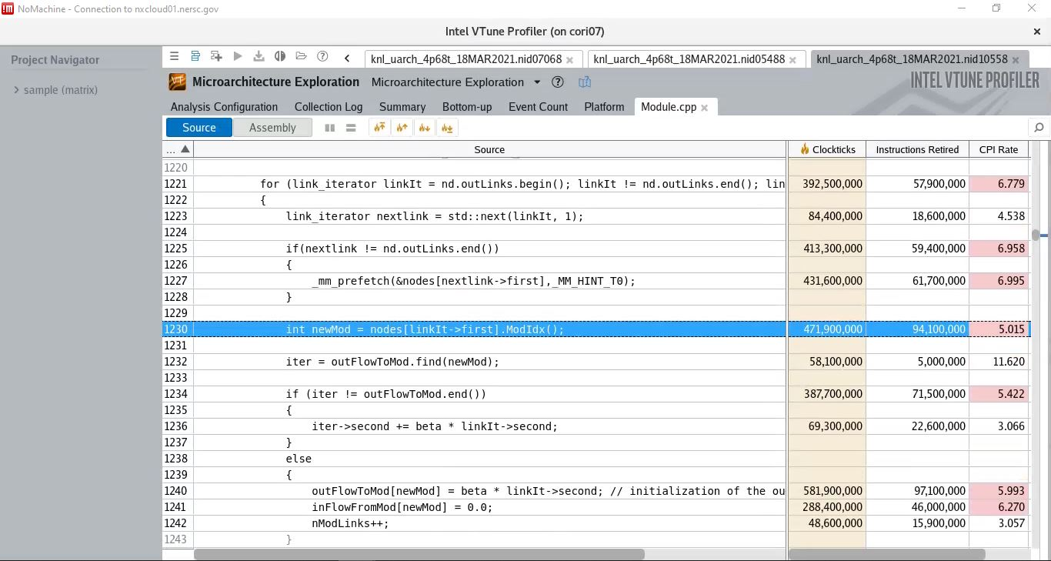
Next Iterator node prefetch of current Adjacency List (inside loop prefetch)

Slide 9
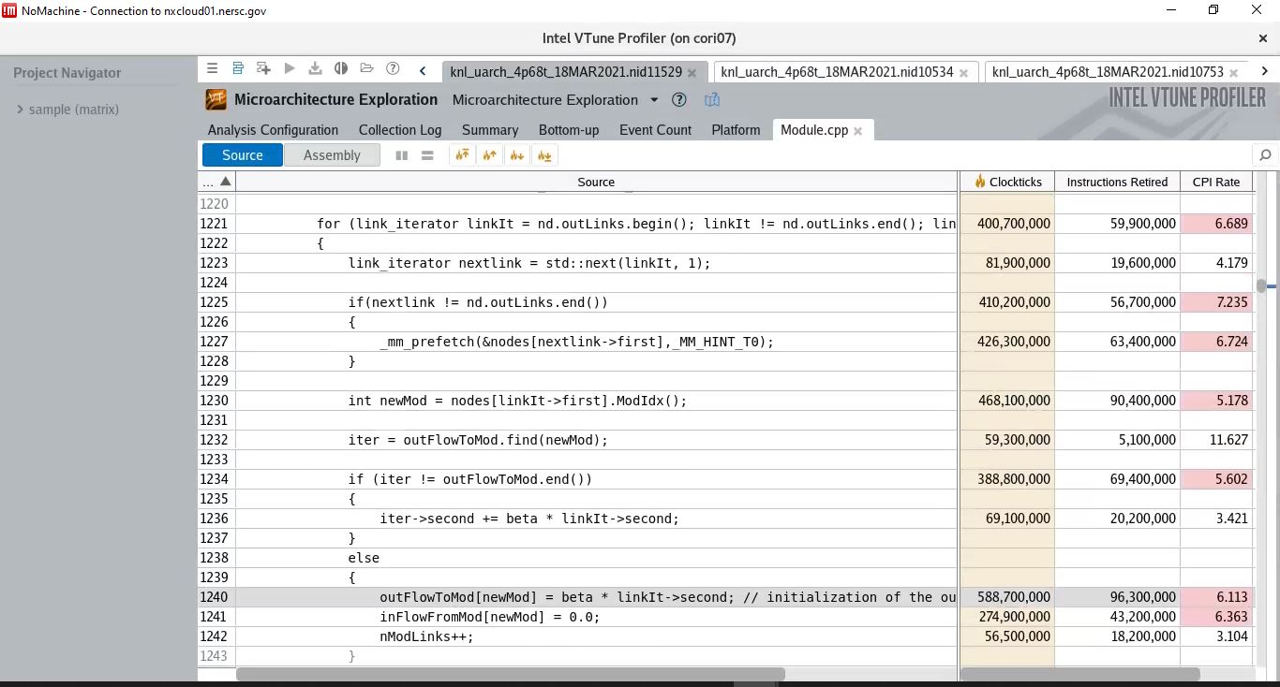
Next Iterator node prefetch of current Adjacency List (inside loop prefetch)

