Slide 1
Weekly Meeting
26th March, 2021

Slide 2
Outline
Performance Comparison of Old vs New code
Memory Access Analysis using Vtune
Verifying the effect of pre-allocating memory using Vtune

Slide 3
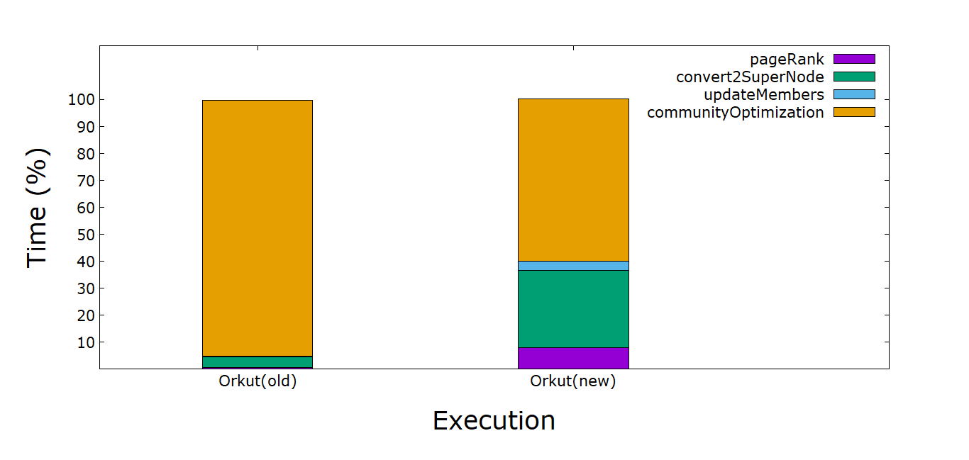
Percentage Breakdown of the Compute Kernels (Old Vs New)

Slide 4
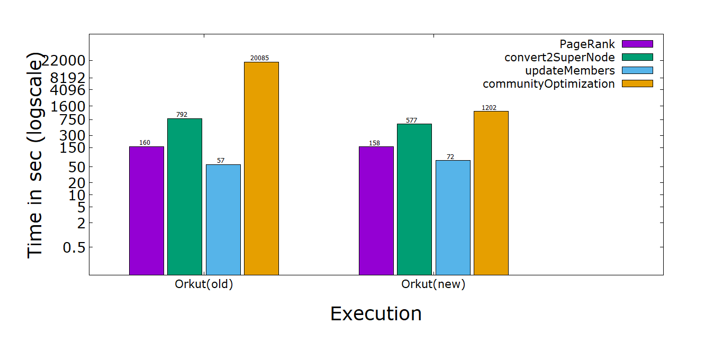
Execution Time Comparison (Old vs New)

Slide 5
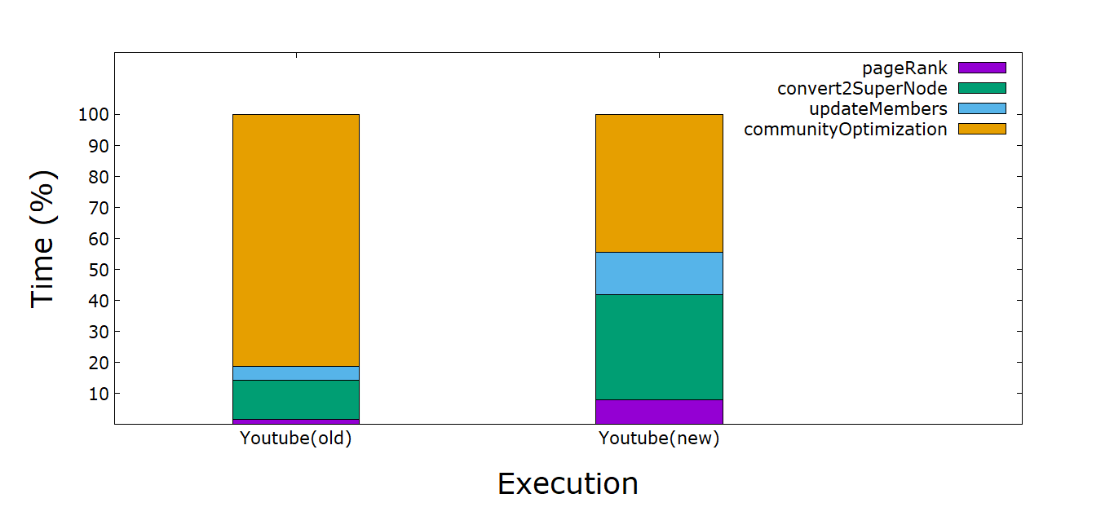
Percentage Breakdown of the Compute Kernels (Old vs New) Cont.

Slide 6
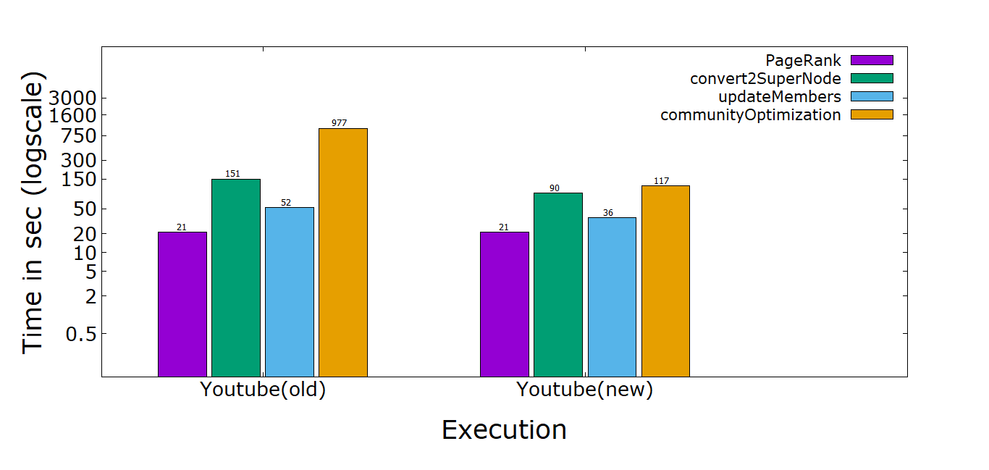
Execution Time Comparison (Old vs New)

Slide 7
Parallel vs Critical Section Runtime Comparison (Community Optimization)
Number of Compute Node | Parallel Section without multithreading (sec) | Parallel Section Runtime (68 threads) (sec) | Critical Section Runtime
4 | 388 | 15.045 | 0.11
8 | 215 | 7.49 | 0.052
16 | 115 | 3.68 | 0.0324
32 | 64 | 1.72 | 0.0259

Slide 8
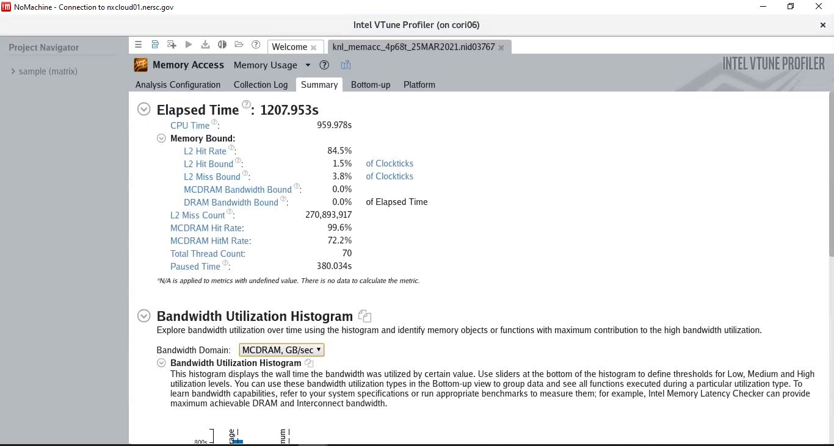
Vtune Memory Access Analysis Summary
From the Vtune MemoryAccess Analysis, it appears there is no major concern related to L1, L2 latency. From the Bottom up view (next slide), more bandwidth is consumed on Read than Write. This analysis is done on parallel communityOptimization Code.

Slide 9
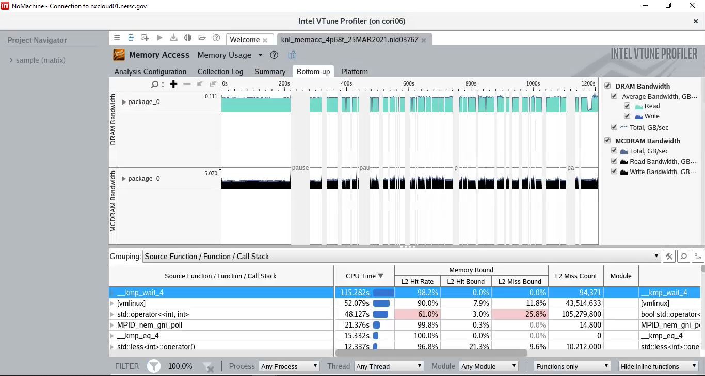
Vtune Memory Analysis Bottom up view
The bandwidth utilization is more on MCDRAM than the DRAM, in fact the DRAM has very low bandwidth utilization. The reason could be using small size network (youtube) that fit entirely on MCDRAM. To verify the assumption, I need to run bigger network such as Orkut.

Slide 10
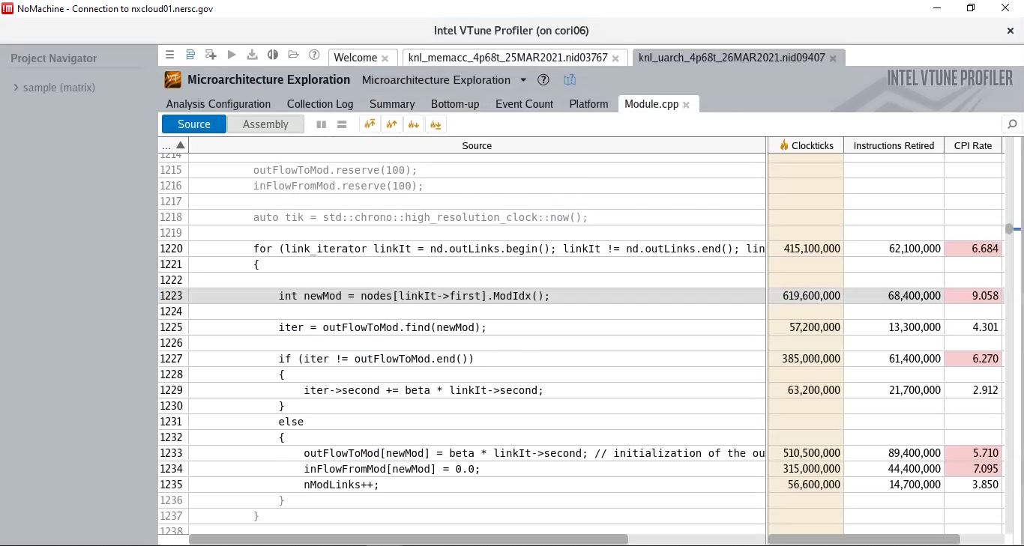
Effect of Unordered_Map Memory Pre-Allocation on CPI Rate
We wanted to see the high CPI rate in the “else” block (see all the appendix slides “else” blocks) was due to memory allocation issue in assigning new entry. However, we did the memory pre-allocation (line 1215,1216) and still the high CPI rate persists. Therefore, current understanding is because of the hash search/insert operation this high CPI is happening. Hardware CAM may be able to resolve this.

Slide 11
Appendix

Slide 12
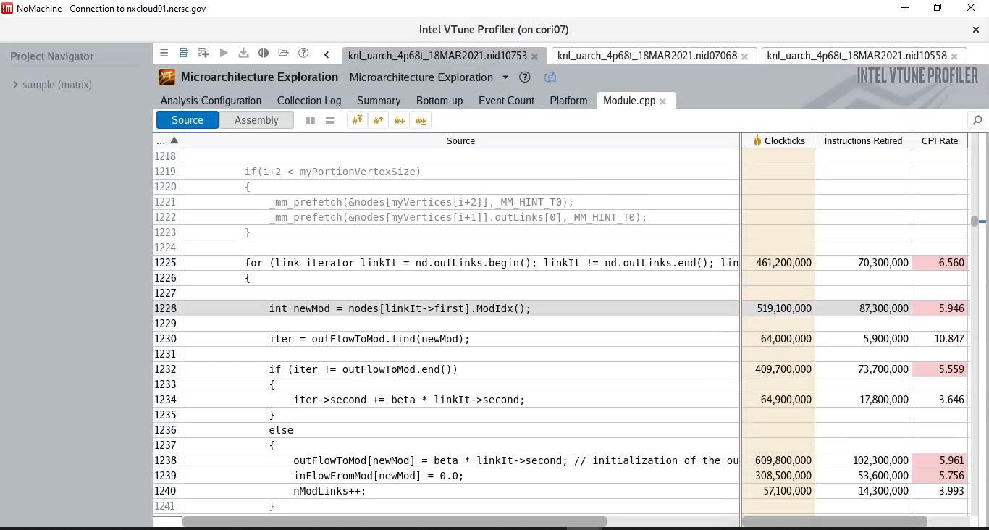
Node prefetch, Outlinks prefetch Combined

Slide 13
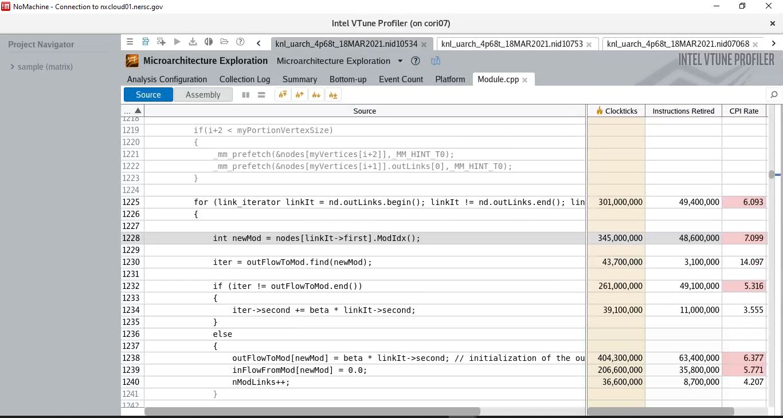
Node prefetch, Outlinks prefetch Combined

Slide 14
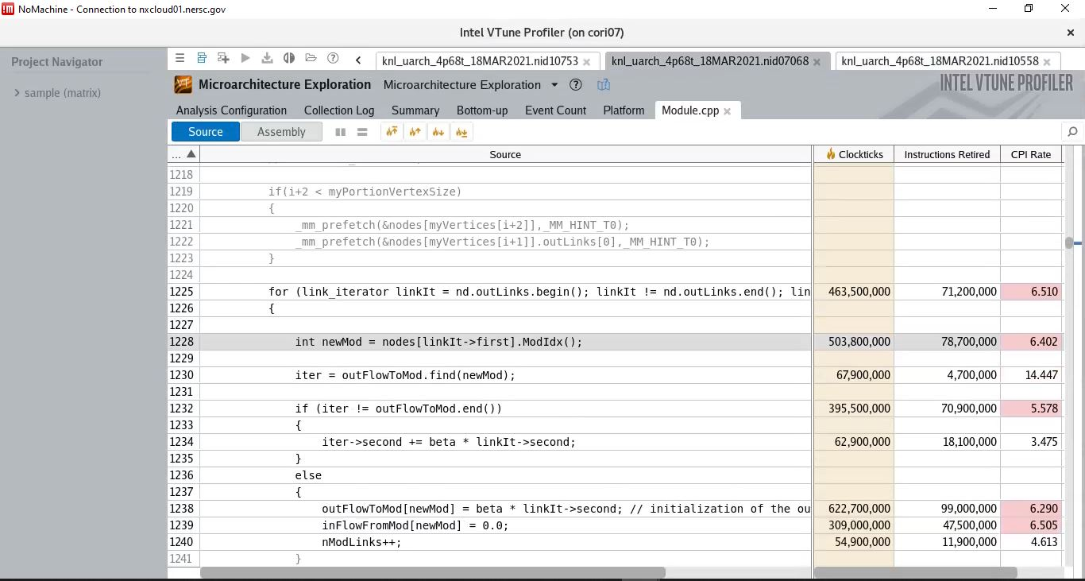
Node prefetch, Outlinks prefetch Combined

Slide 15
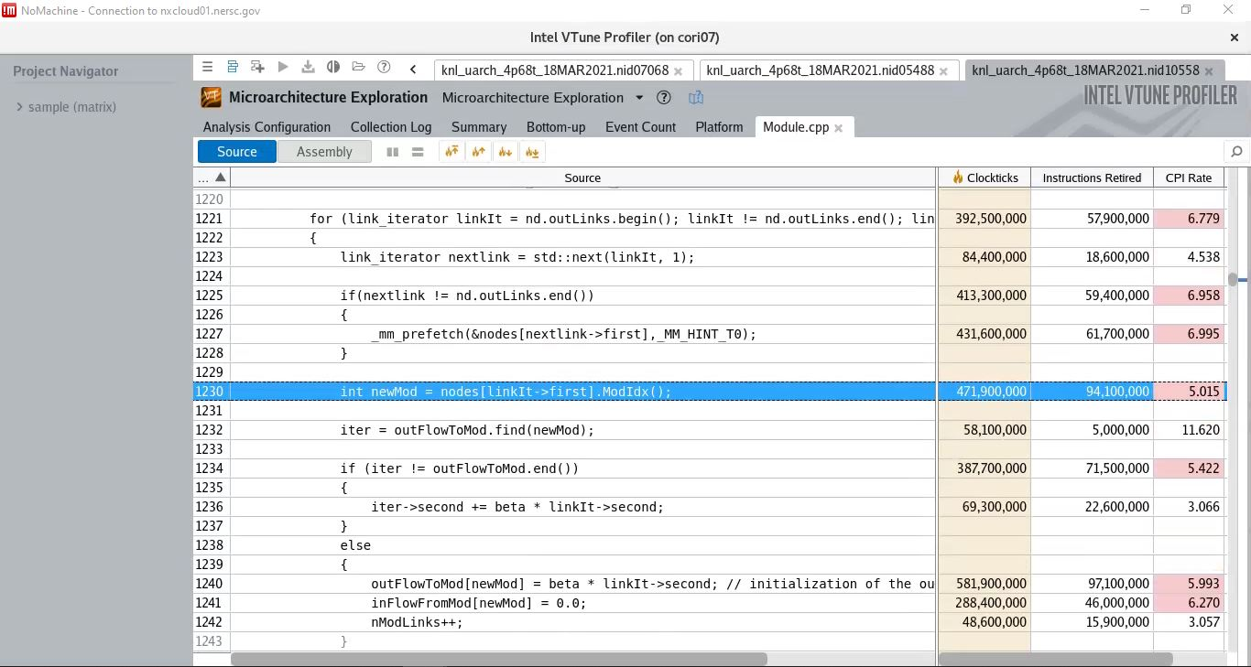
Next Iterator node prefetch of current Adjacency List (inside loop prefetch)

Slide 16
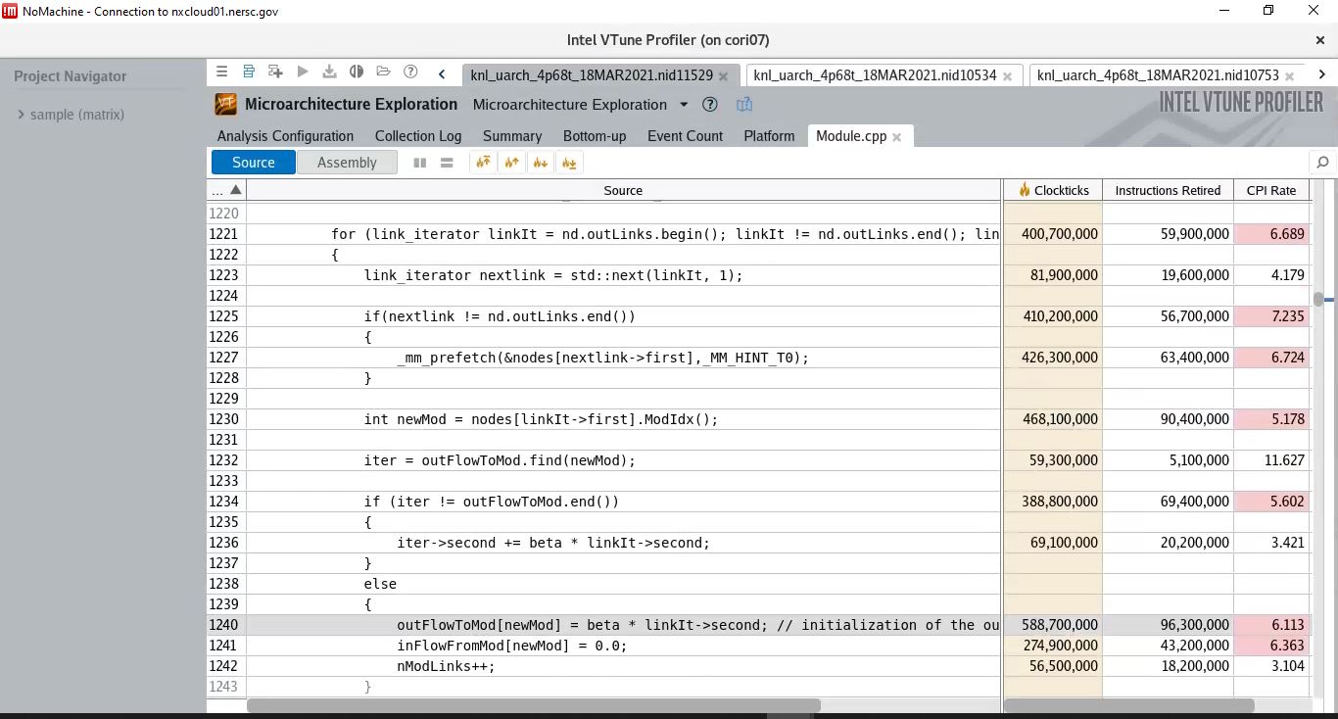
Next Iterator node prefetch of current Adjacency List (inside loop prefetch)

