Slide 1
Weekly Meeting
July 23, 2020

Slide 2
Outline
Estimation of alpha (α) and beta (β) parameter in Sparse SUMMA
Validation of T_{comm} of Sparse SUMMA

Slide 3
Description of the Dataset
Dataset | Number of Vertices (million) | Number of Edges (million)
Renamed subgraph5 | 0.58 | 67
subgraph5 | 1.79 | 82
archaea | 1.6 | 205
Eukarya | 3.2 | 360
subgraph4 | 3.8 | 327
Notes:
1. Renamed_subgraph5 – /global/project/projectdirs/m1982/www/HipMCL/subgraphs-1103/Renamed_subgraph5_set1103_MMSeqs_Qcov065_Hcov065_SBS_all
2. subgraph5 - /global/project/projectdirs/m1982/www/HipMCL/subgraphs/subgraph5_iso_vs_iso_30_70length_ALL.m100.indexed.mtx
3. subgraph4 - /global/project/projectdirs/m1982/www/HipMCL/subgraphs/subgraph4_iso_vs_iso_30_70length_ALL.m100.indexed.mtx

Slide 4
Finding Latency (α) and Inverse Bandwidth (β)
Ohio State University (OSU) benchmark suite is used http://mvapich.cse.ohio-state.edu/benchmarks/
Multiple runs and multiple iterations in each run are executed
Point to point pingpong latency test was also executed using self-written code

Slide 5
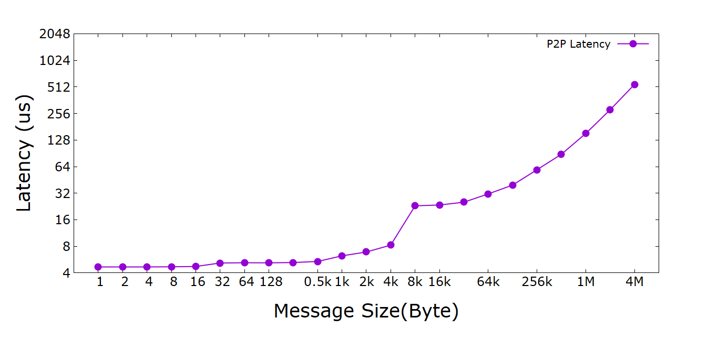
P2P Latency (α) vs Message Size
Note: Each MPI process (point) is run on separate compute node

Slide 6
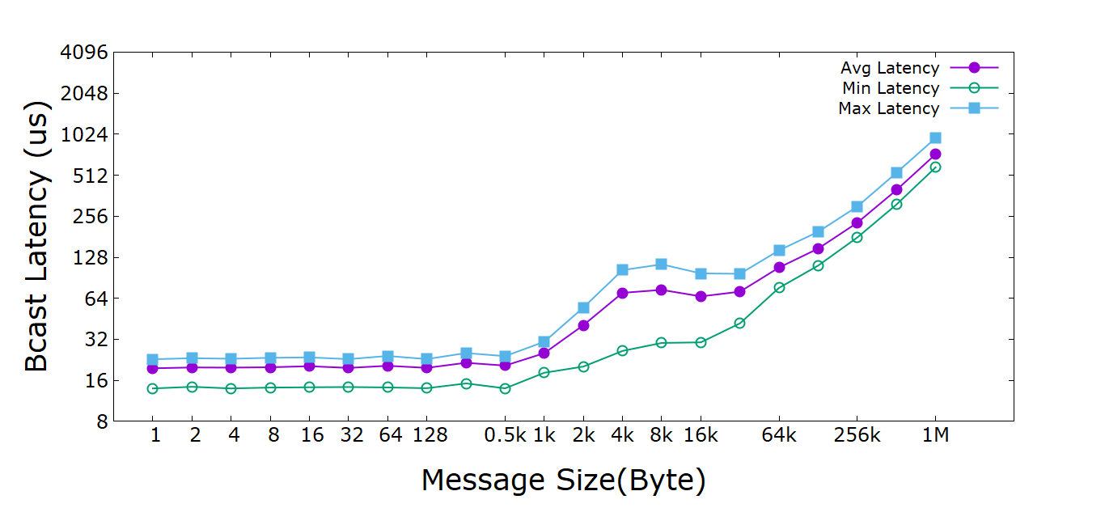
MPI_Bcast P2P Latency (α) vs Message Size
Note: 16 MPI processes running in 16 compute nodes are used for MPI_Bcast

Slide 7
Finding MPI_Bcast Latency (α) and Bandwidth (1/ β)
y₁= α + βx₁ ➔ 148.26 = α + β * 131072
y₂= α + βx₂ ➔ 229.5 = α + β * 262144
Solving for β,
131072* β = 81.24
or, β = 81.24/131072
or, β = 0.0006198 us/Byte
or, 1/β = 1613.39 Byte/us
or, 1/β = 1613.39 MB/Sec
Solving for α
α = 67 us
Notes:
https://stackoverflow.com/questions/15638244/how-to-calculate-the-latency-and-bandwidth-of-a-network

Slide 8
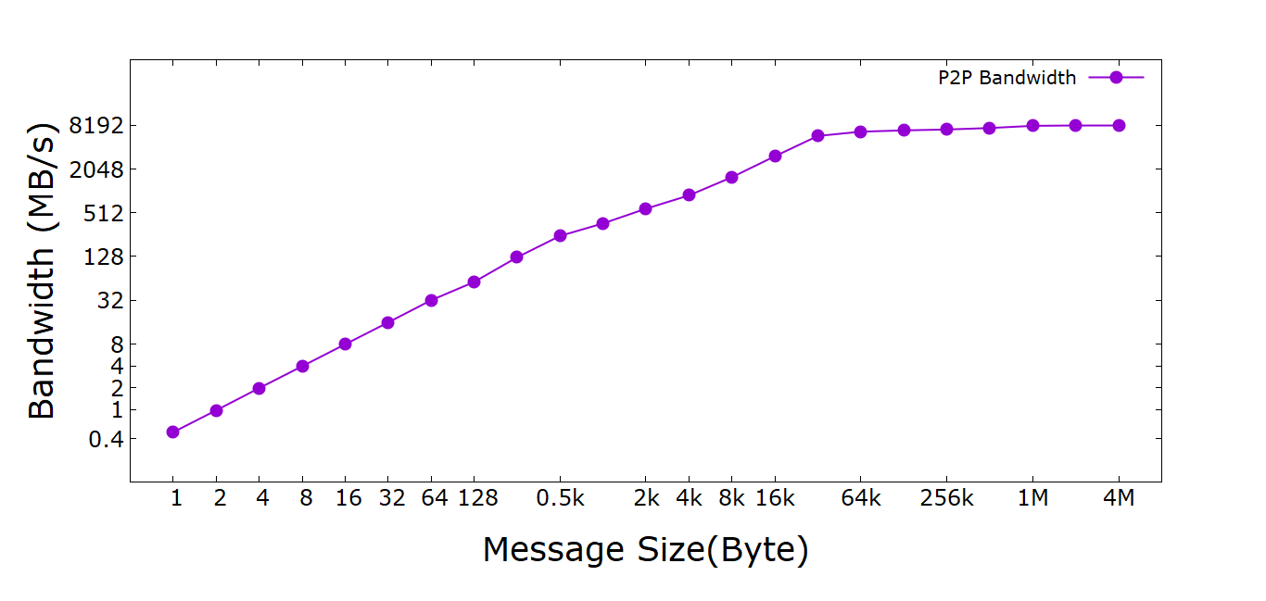
P2P Bandwidth (1/β) vs Message Size
Note: Each MPI process (point) is run on separate compute node

Slide 9
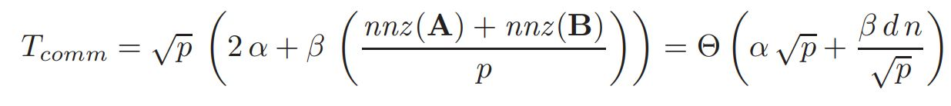
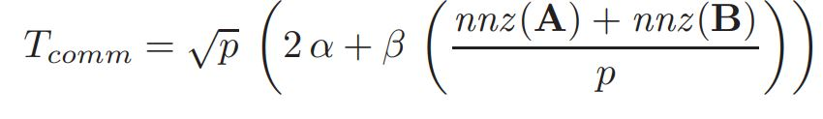
T_{comm} Validation of Sparse SUMMA
Attempted validation for the following equation

Slide 10
T_{comm} Validation of Sparse SUMMA
Network | T_{comm} (Observed) | nnz(A) | T_{comm}(1/β_{min}=0.49MB/s) | T_{comm}(1/β_{max}=8063.32MB/s) | T_{comm}(1/β_{word}=1.98MB/s)
Archaea | 7.72 | 206436881 | 1685.2 | 0.1024 | 417.04
Eukarea | 17.84 | 363007042 | 2963.3 | 0.18 | 733.35
Renamed_subgraph5 | 9.97 | 67337757 | 549.7 | 0.033 | 136.04
Subgraph4 | 17.80 | 331397685 | 2705.29 | 0.16 | 669.49
Subgraph5 | 5.28 | 83942413 | 685.24 | 0.042 | 169.58
All network run on 16 MPI processes in 16 compute nodes
Latency value (α) is ignored for Tcomm calculation as it has very little impact on the overall T_{comm}
Each of the T_{comm} value here is in seconds

Slide 11
T_{comm} Validation of Sparse SUMMA
Graph | T_{comm} (Observed) | nnz(A) | T_{comm}(1/β_{min}=0.49MB/s) | T_{comm}(1/β_{max}=8063.32MB/s) | T_{comm}(1/β_{word}=1.98MB/s)
Archaea | 8.8 | 206436881 | 3370.4 | 0.2048 | 834.08
Eukarea | 27.97 | 363007042 | 5926.65 | 0.36 | 1466.70
Renamed_subgraph5 | 4.75 | 67337757 | 1099.39 | 0.066 | 272.07
Subgraph4 |  | 331397685 | 5410.58 | 0.32 | 1338.98
Subgraph5 | 2.98 | 83942413 | 1370.48 | 0.084 | 339.16
All network run on 4 MPI processes in 4 compute nodes
Latency value (α) is ignored for Tcomm calculation as it has very little impact on the overall T_{comm}
Each of the T_{comm} value here is in seconds

