Slide 1
Weekly Meeting
August 13, 2020

Slide 2
Outline
Find the number of hits in cache hierarchy (L1, L2, L3) for the vertex-hash matching
Find the hash table size and how that affects the mem results
Find the outcome of roofline analysis

Slide 3
Cache Performance Analysis for KNL
Processor | Page Size | L1 hit (%) | L2 hit (%) | L2 miss count
KNL | 2M | 95.1 | 97.1 | 16306385376
 | 4M | 95.1 | 97.1 | 16335093464
 | 8M | 95.1 | 96.7 | 18019100786
 | 16M | 95.2 | 97.2 | 15722494815
 | 32M | 95.2 | 97.0 | 16829566393
The above table list the estimate for the function LocalHybridSpGEMM with the most usage of hash

Slide 4
Cache Performance Analysis for KNL
Processor | Page Size | L1 hit (%) | L2 hit (%) | L2 miss count
KNL | 2M | 90.4 | 66.6 | 154445644331
 | 4M | 90.2 | 66.3 | 155308261132
 | 8M | 90 | 66.0 | 157498337457
 | 16M | 90.4 | 65.9 | 157524409469
 | 32M | 90.1 | 66 | 156603741499
The above table list the estimate for the function estimateNNZ_Hash with the most usage of hash

Slide 5
Memory Access Analysis for Haswell
Processor | Page Size | NUMA: % of Remote Accesses | Local DRAM (%) | Remote DRAM (%) | Remote Cache (%)
Haswell | 2M | 5.1 | 0.1 | 0.0 | 0.1
 | 4M | 5.4 | 0.3 | 0.0 | 0.1
 | 8M | 0.0 | 0.3 | 0.0 | 0.1
 | 16M | 0.0 | 0.4 | 0.0 | 0.1
Notes:
NUMA: % of Remote Accesses
In NUMA (non-uniform memory architecture) machines, memory requests missing LLC may be serviced either by local or remote DRAM. Memory requests to remote DRAM incur much greater latencies than those to local DRAM. It is recommended to keep as much frequently accessed data local as possible. This metric shows percent of remote accesses, the lower the better.
Local DRAM
This metric shows how often CPU was stalled on loads from local memory. Caching will improve the latency and increase performance.
Remote DRAM
This metric shows how often CPU was stalled on loads from remote memory. This is caused often due to non-optimal NUMA allocations.
Remote Cache
This metric shows how often CPU was stalled on loads from remote cache in other sockets. This is caused often due to non-optimal NUMA allocations

Slide 6
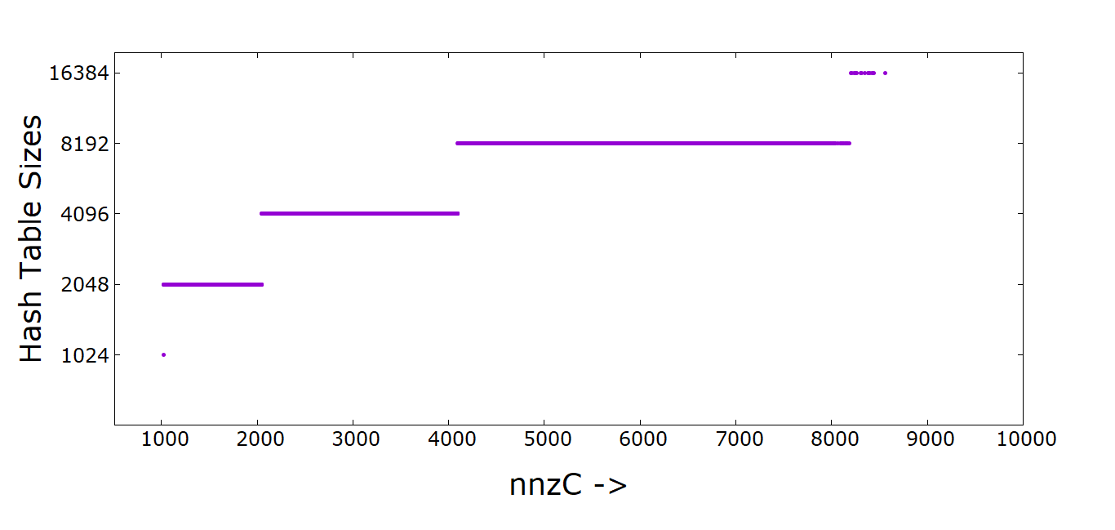
nnzC vs Hash Table size

