Slide 1
Weekly Meeting
September 25, 2020

Slide 2
Profiling Aspects
Hash table size for different network
For different size datasets, comparing the hash kernel with the theoretical and observed rooflines

Slide 3
Assumption for theoretical Peak
No hash table collision
Infinite L2 memory with latency (~ 196 cycles) [1]
No L1 cache, only L2 or lower level cache/memory exist
A hash query can be a search/insert
Notes:
1. https://stackoverflow.com/questions/21369381/measuring-cache-latencies

Slide 4
Profiling Cache Latencies (KNL)
L1 has latency 0 cycles
32 KB data
32 KB instruction
L2 has latency 196 cycles
1MB unified cache

Slide 5
Profiling Cache Latencies (Haswell)
L1 has latency of 6 cycles
32 KB data cache
L2 has latency of 22 cycles
264 KB unified cache
L3 has latency of 58 cycles
40 MB unified cache

Slide 6
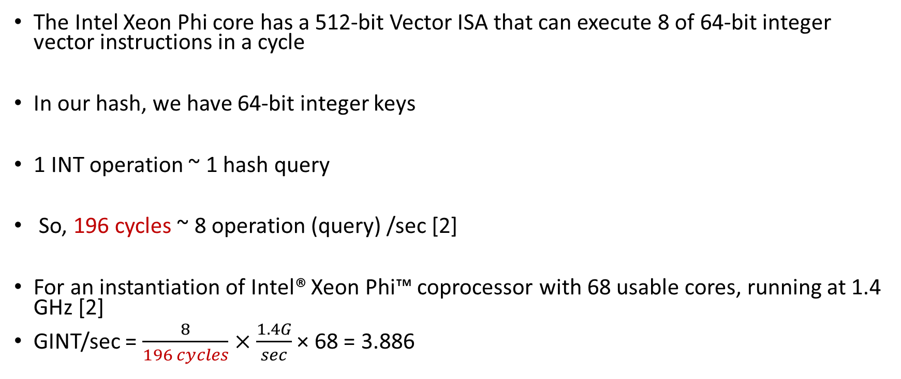
Computation for theoretical Peak
The Intel Xeon Phi core has a 512-bit Vector ISA that can execute 8 of 64-bit integer vector instructions in a cycle
In our hash, we have 64-bit integer keys
1 INT operation ~ 1 hash query
So, 196 cycles ~ 8 operation (query) /sec [2]
For an instantiation of Intel® Xeon Phi™ coprocessor with 68 usable cores, running at 1.4 GHz [2]
GINT/sec = $\frac{8}{196 cycles}×\frac{1.4G}{sec}$ × 68 = 3.886
Notes:
2. https://software.intel.com/content/www/us/en/develop/articles/intel-xeon-phi-core-micro-architecture.html#:~:text=The%20Intel%20Xeon%20Phi%20core,64%2Dbit%20integer%20vector%20instructions.

Slide 7
Maximum Hash Table Sizes
Dataset | #Compute Nodes (KNL) | Number of Vertices (million) | Number of Edges (million) | Hash Table Size/thread
virus | 1 | 0.22 | 4.58 | 32
subgraph5 | 4 | 1.79 | 82 | 256
archaea | 4 | 1.6 | 205 | 256
Eukarya | 4 | 3.2 | 360 | 512
subgraph4 | 4 | 3.8 | 327 | 512
subgraph3 | 16 | 7.9 | 1309 | 512

Slide 8
Estimate Hash Kernel Query Processing Performance
Dataset | Number of Vertices (million) | Number of Edges (million) | Max Observed Hash Table Size/thread | Query/s (M_Op/s) | L1 Roofline with SIMD (G_Op/s) | L2 Roofline with SIMD (G_Op/s)
virus | 0.22 | 4.58 | 32 | 1516.8 | 761 | 3.88
subgraph5 | 1.79 | 82 | 256 | 1561.3
archaea | 1.6 | 205 | 256 | 1486.6
Eukarya | 3.2 | 360 | 512 | 1520.8
subgraph4 | 3.8 | 327 | 512 | 1431.7
subgraph3 | 7.9 | 1309 | 512 | 1422.4
Notes:
Note: Without SIMD the L1 Roofline is 761/8 = 95.125 and the L2 Roofline is 3.88/8 = 0.49. The value 8 is coming from the following source
https://software.intel.com/content/www/us/en/develop/articles/intel-xeon-phi-core-micro-architecture.html#:~:text=The%20Intel%20Xeon%20Phi%20core,64%2Dbit%20integer%20vector%20instructions
The default key size for the hash table entry is a 64-bit integer. Considering just a lookup or just an insertion operation in the hash table to be an INT operation, KNL can compute 8 of such 64-bit INT operation per cycle in SIMD.
Please do provide suggestion if you see any area of improvement how the computation is done above.

Slide 9
Hash Kernel Query Processing Performance
Dataset | Number of Vertices (million) | Number of Edges (million) | Max Observed Hash Table Size/thread | Query/s (M_Op/s) | L1 Roofline with SIMD (G_Op/s) | L2 Roofline with SIMD (G_Op/s)
virus | 0.22 | 4.58 | 32 | 1516.8 | 761 | 3.88
subgraph5 | 1.79 | 82 | 256 | 1561.3
archaea | 1.6 | 205 | 256 | 1486.6
Eukarya | 3.2 | 360 | 512 | 1520.8
subgraph4 | 3.8 | 327 | 512 | 1431.7
subgraph3 | 7.9 | 1309 | 512 | 1422.4

Slide 10
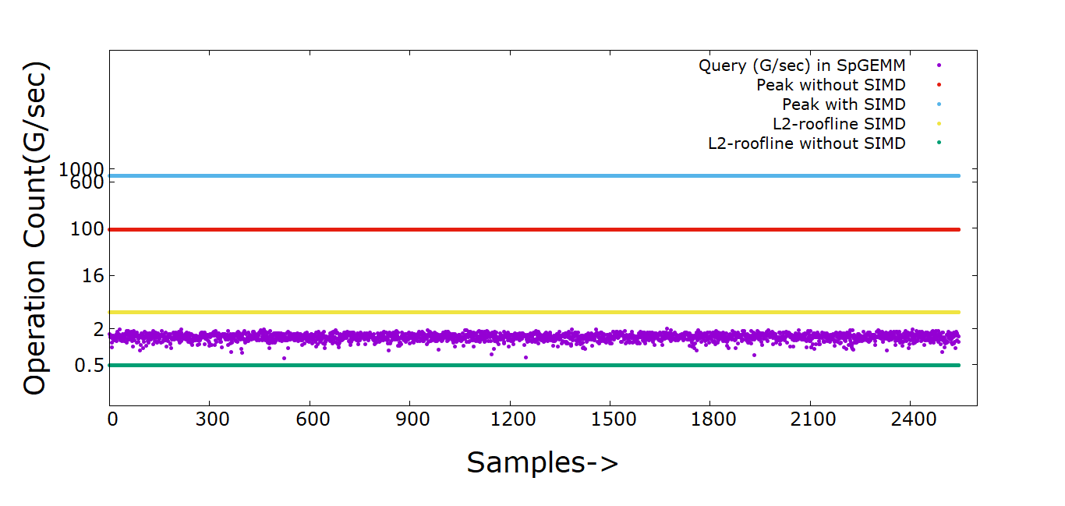
Estimate Hash Kernel (Archaea)

Slide 11
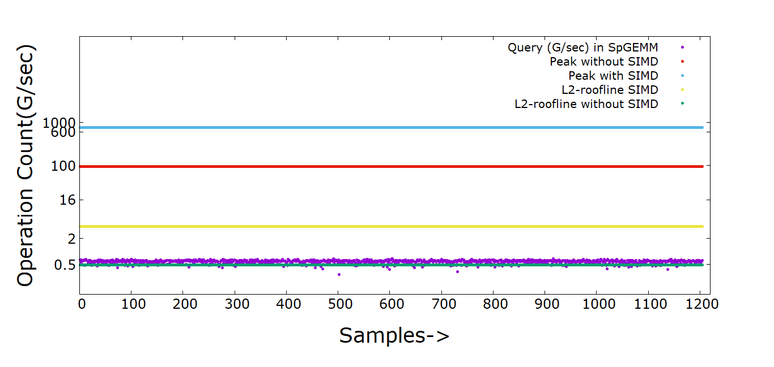
Hash Kernel (Archaea)

Slide 12
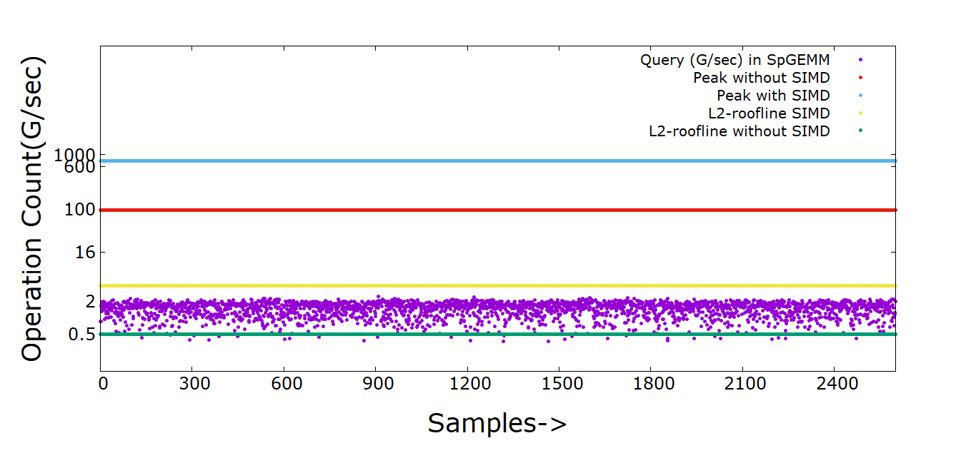
Estimate Hash Kernel (Eukarya)

Slide 13
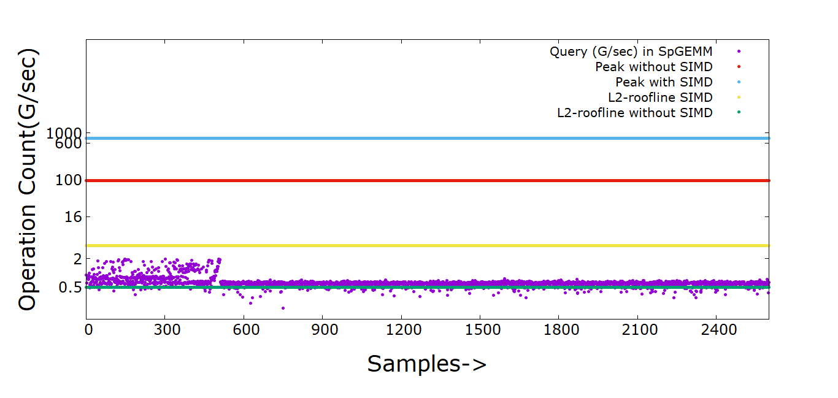
Hash Kernel (Eukarya)

Slide 14
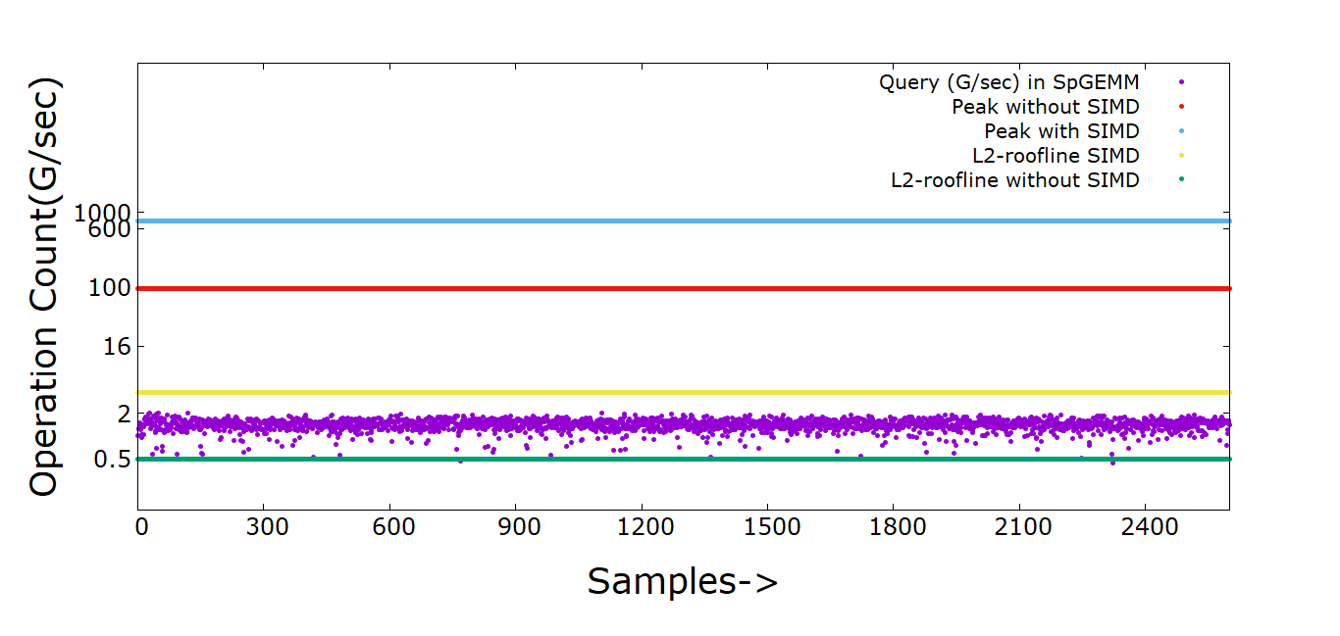
Estimate Hash Kernel (Subgraph3)

Slide 15
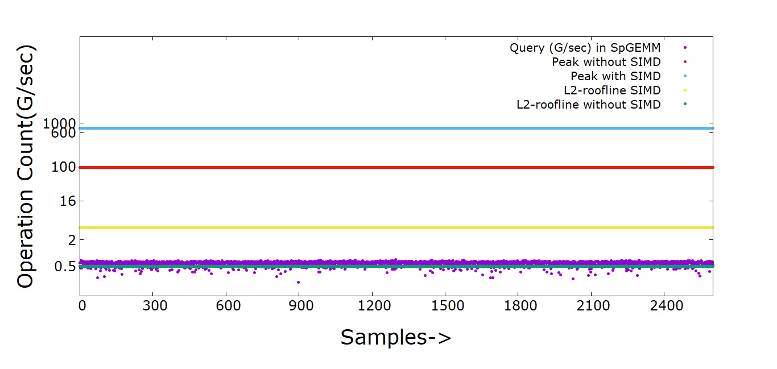
Hash Kernel (Subgraph3)

