Slide 1
Weekly Meeting
October 09, 2020

Slide 2
Profiling Aspects
Does the hash table size local to thread shrink with the increasing number of compute node?
Why the hash table size is discrete and how the sizes are computed?
L1 and L2 hit rate/miss rate

Slide 3
Profiling Aspects
Is there any vectorization available in the existing code that can utilize the AVX ISA?
Measuring L1 and L2 latency using the Intel tool
What is the purpose of the estimateHash kernel when there is hash kernel?
Adding roofline for the DRAM (Not done yet)

Slide 4
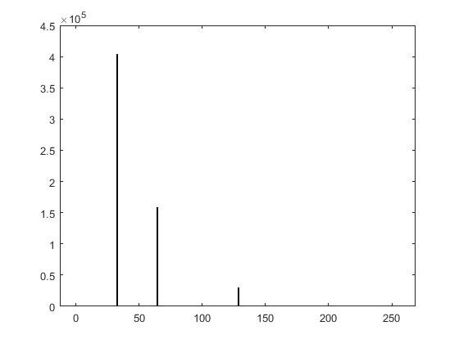
Hash Table Size vs #ComputeNode
64 KNL compute nodes used
Network: subgraph3 (7.9 M vertices & 1309 M edges)
Histogram plot on the right
On the x-axis, hash table sizes in KB and on the y-axis, frequency of hash table having that size

Slide 5
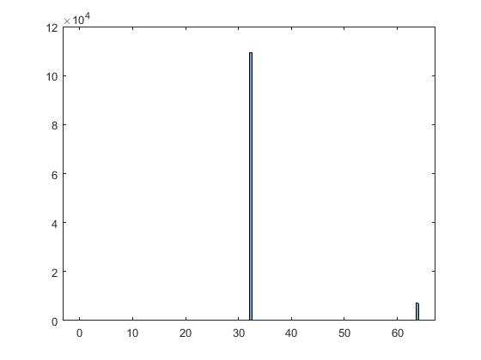
Hash Table Size vs #ComputeNode
256 KNL compute nodes used
Network: subgraph3 (7.9 M vertices & 1309 M edges)
Histogram plot on the right
On the x-axis, hash table sizes in KB and on the y-axis, frequency of hash table having that size

Slide 6
Cache Performance Analysis for KNL
Processor | Page Size | L1 hit (%) | L2 hit (%) | L2 miss count
KNL | 2M | 95.1 | 97.1 | 16306385376
 | 4M | 95.1 | 97.1 | 16335093464
 | 8M | 95.1 | 96.7 | 18019100786
 | 16M | 95.2 | 97.2 | 15722494815
 | 32M | 95.2 | 97.0 | 16829566393
The above table list the cache hit rate for the function LocalHybridSpGEMM

Slide 7
Cache Performance Analysis for KNL
Processor | Page Size | L1 hit (%) | L2 hit (%) | L2 miss count
KNL | 2M | 90.4 | 66.6 | 154445644331
 | 4M | 90.2 | 66.3 | 155308261132
 | 8M | 90 | 66.0 | 157498337457
 | 16M | 90.4 | 65.9 | 157524409469
 | 32M | 90.1 | 66 | 156603741499
The above table list the cache hit rate for the function estimateNNZ_Hash

Slide 8
Profiling Cache Latencies (KNL)
Used the Intel Memory Latency Checker¹ and measured Idle cache Latencies
Latency type | Buffer Size (KB) | Clock Count (~approx) | Latency in Time (ns)
idle_latency | 32 | 4.0 | 2.8
 | 64 | 15.6 | 11.2
 | 512 | 19.4 | 13.8
 | 1024 | 115.7 | 82.7
 | 3072 | 185.9 | 132.8
Notes:
1. https://software.intel.com/content/www/us/en/develop/articles/intelr-memory-latency-checker.html

Slide 9
Purpose of estimateHash kernel
Q: Is there any other purpose of the calling estimateNNZ_Hash function inside LocalHybridSpGEMM except it's helping in computing the compression ratio?
Oguz’s Answer:
Computing the compression ratio is actually secondary purpose of estimateNNZ_Hash.
The biggest challenge of SpGEMM is that you do not know the pattern of the output matrix.
There are several ways of approaching this issue.
One common way (that is also the one in the code) is to first determine the pattern and number of nonzeros in each column of the output matrix via a symbolic SpGEMM (i.e., estimateNNZ_Hash's output colnnzC), and then proceed to perform the numeric multiplication.
This way you know how to allocate the sparse data structures related to the output matrix.
In addition, you can also compute the compression ratio as you already know flops needed for each col

