Slide 1
Weekly Meeting
4th December,2020

Slide 2
Execution Result
4 MPI processes, youtube social network dataset with 1.1 million vertices and 3 million edges
2 MPI processes per compute node
10 threads per MPI process in LONI, 16 threads/MPI process in haswell, 34 threads/MPI process KNL
Kernel | LONI (sec) | Cori (haswell) (sec) | Cori (knl) (sec)
PageRank | 4.6 | 6.4 | 25.15
CommunityOptimization | 123.74 | 236.14 | 1078.56
Convert2SuperNodes | 23.66 | 39.6 | 153.67
updateMembership | 8.22 | 13.22 | 53.6

Slide 3
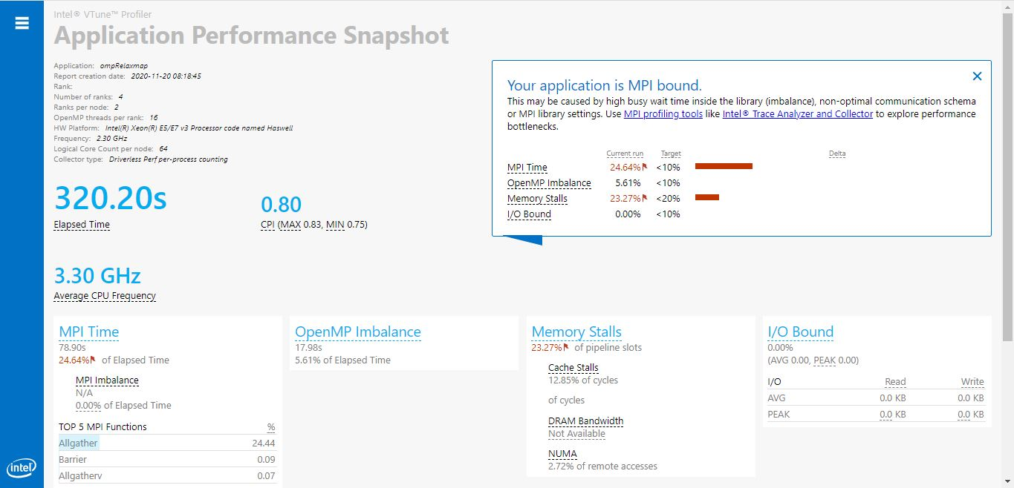
Application Performance Snapshot (haswell)

Slide 4
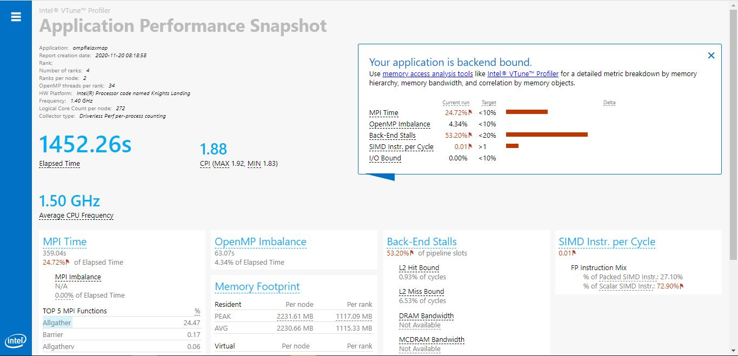
Application Performance Snapshot (knl)

Slide 5
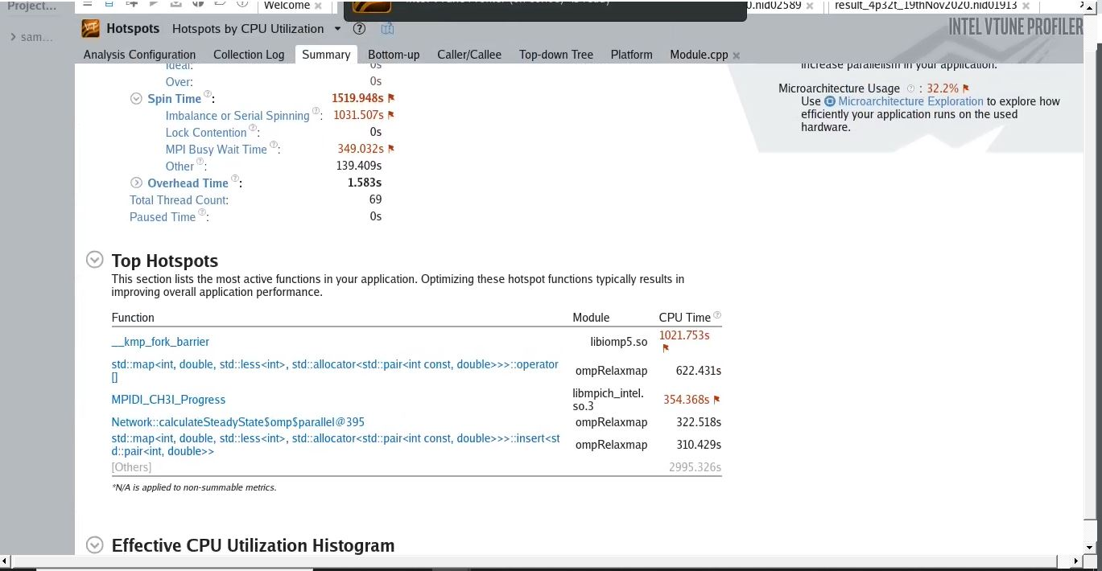
Sources of Performance bottleneck (KNL)

Slide 6
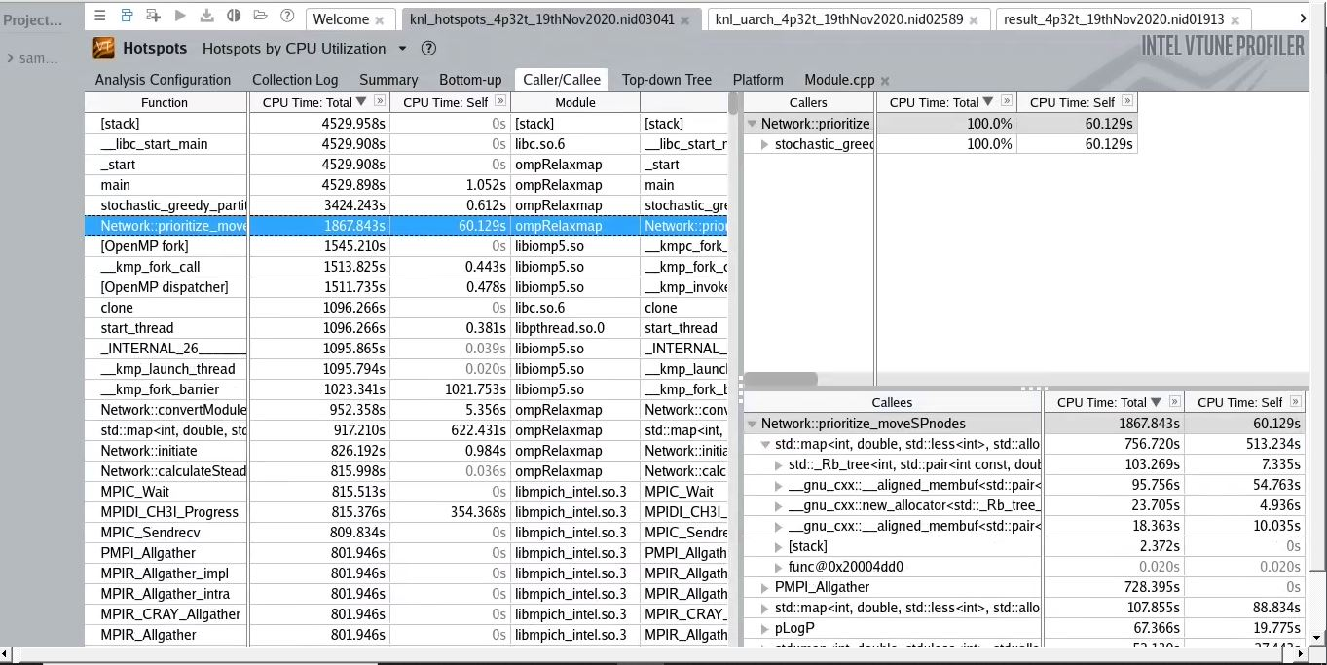
Call stack for the Optimization module

Slide 7
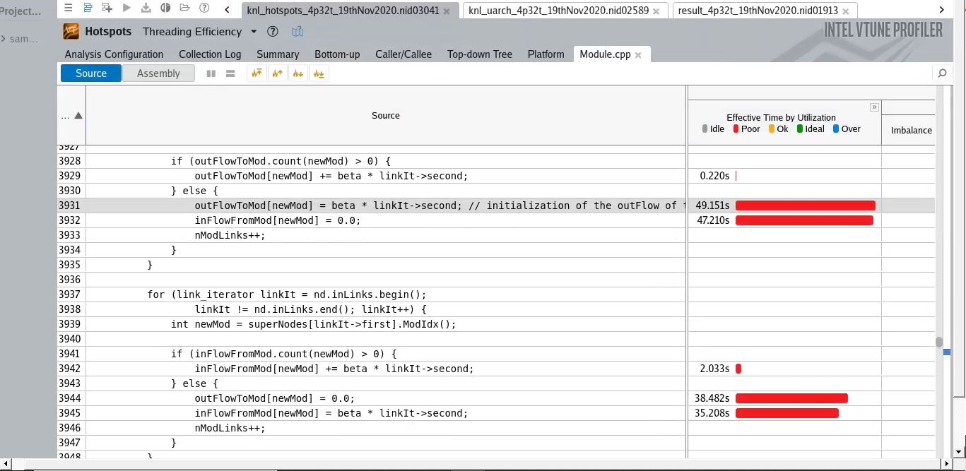
Accessing Map (Rb tree) in KNL node

Slide 8
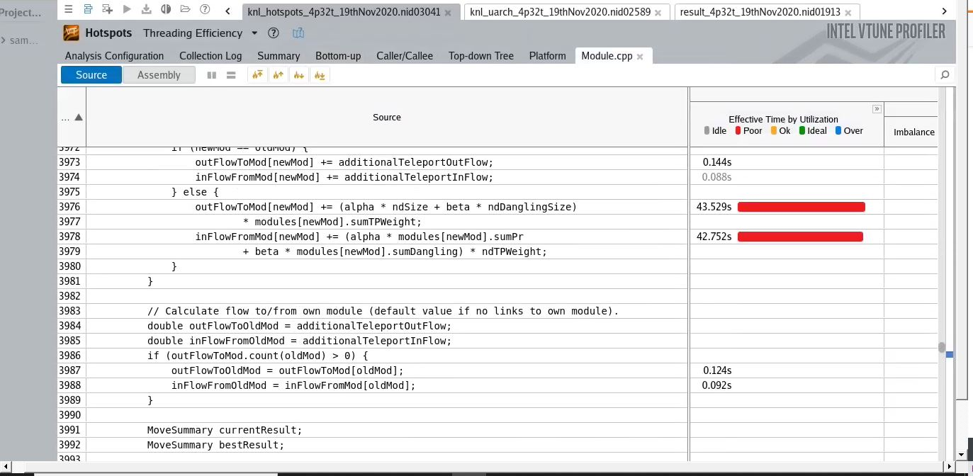
Accessing Map (Rb tree) in KNL node (Contd.)

Slide 9
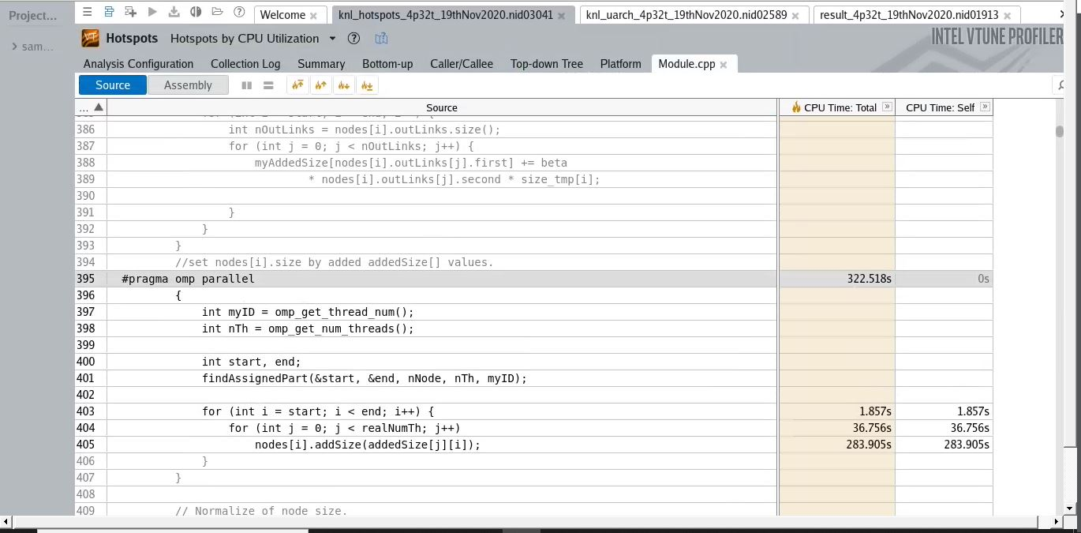
Thread Imbalance in KNL

Slide 10
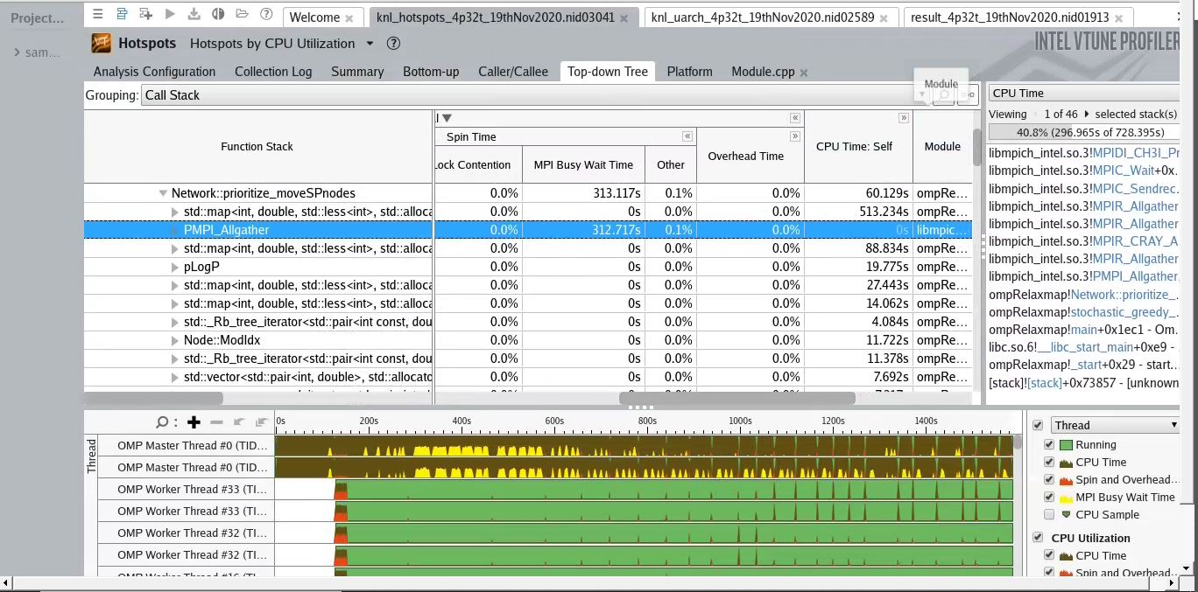
MPI Imbalance KNL

Slide 11
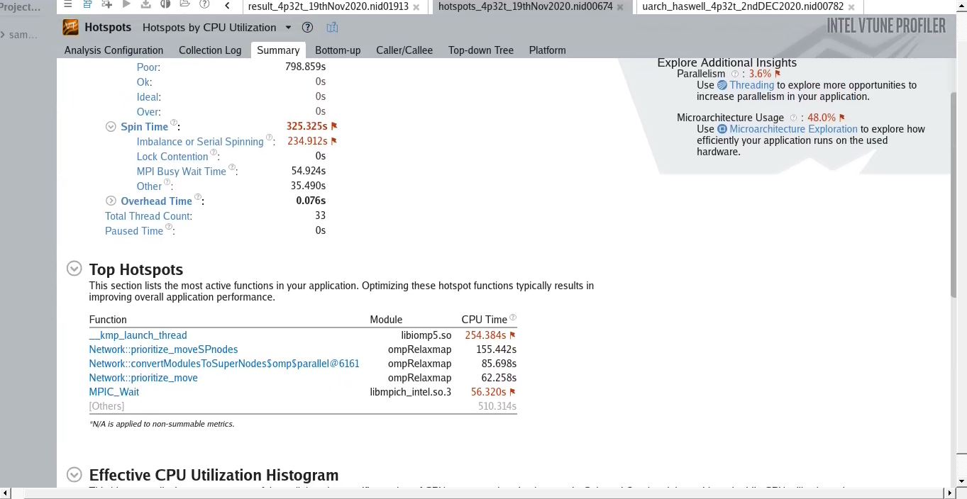
Infomap performance issues on Haswell

Slide 12
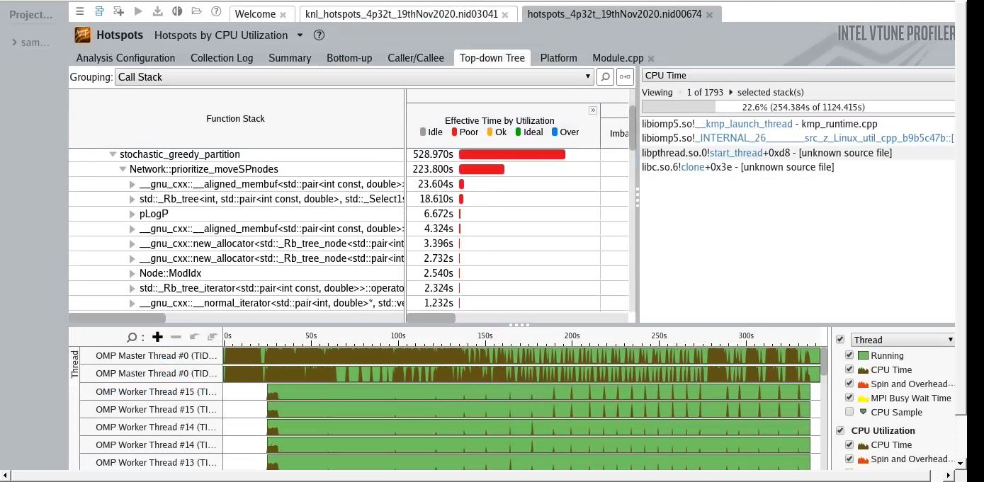
Community Optimization (Haswell)

Slide 13
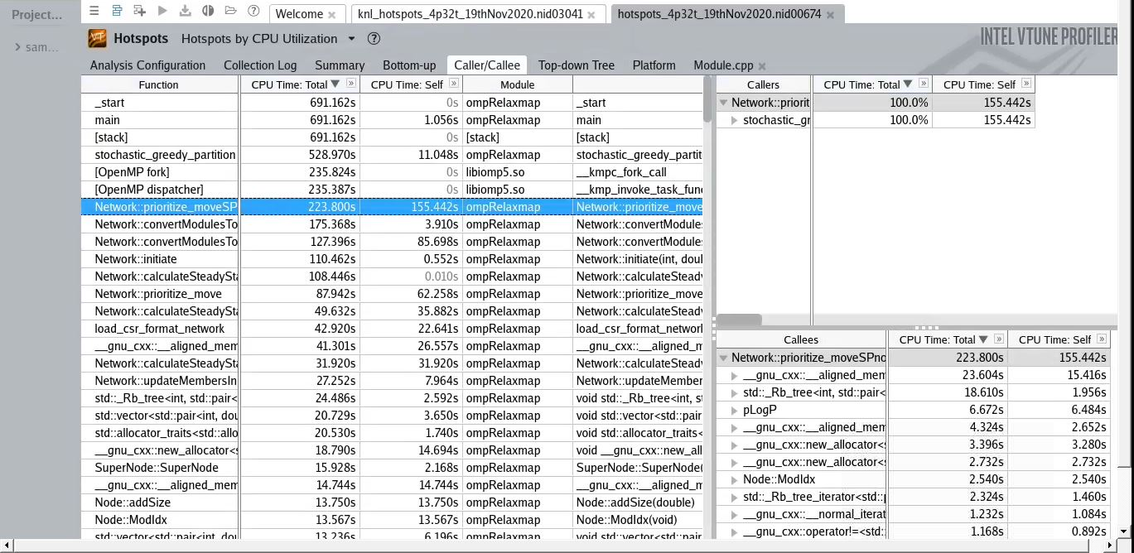
Community Optimization (Haswell)

Slide 14
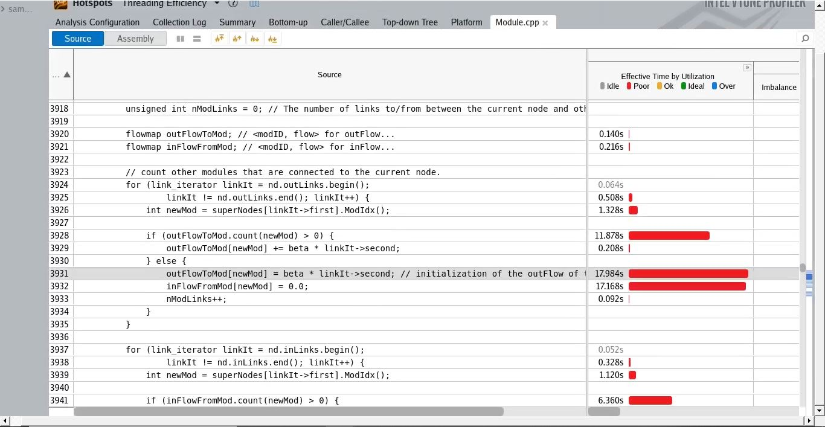
Accessing Map (Rb tree) in haswell node

Slide 15
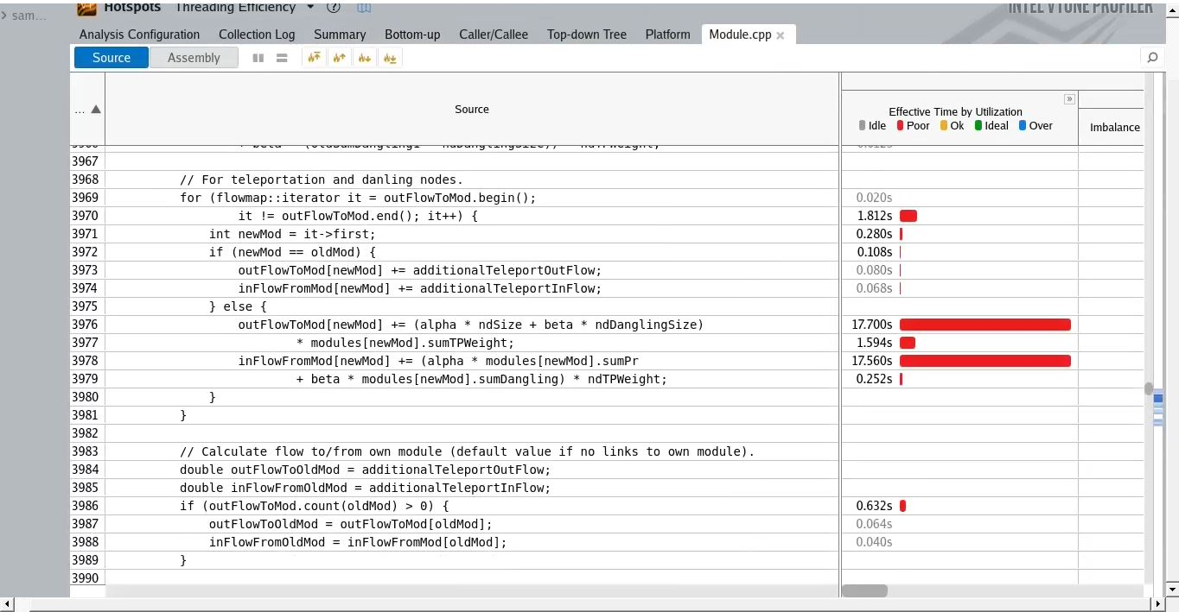
Accessing Map (Rb tree) in haswell node (contd.)
Notes:
1. B-tree stores data more compactly in memory (one node contains many values) there will be much fewer cache misses.
2. If you really care about performance, in which you case you'd ditch both AVL and Red-black trees, and go with B-trees
3. There are some cases where you can't use B-trees at all. One prominent case is std::map from C++ STL. The standard requires that insert does not invalidate existing iterators or references
4. More on that topic here https://cs.stackexchange.com/questions/41969/why-are-red-black-trees-so-popular

Slide 16
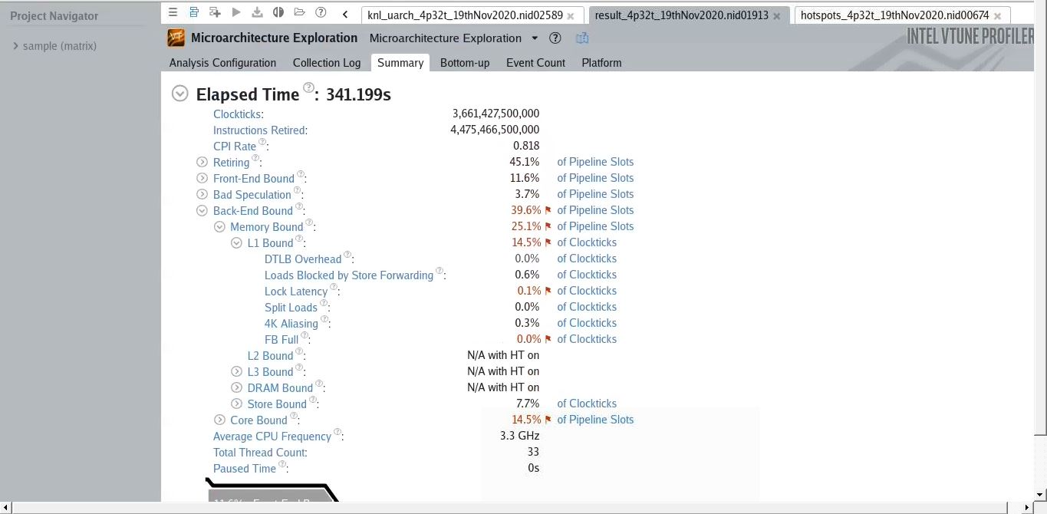
Haswell uarch summary

Slide 17
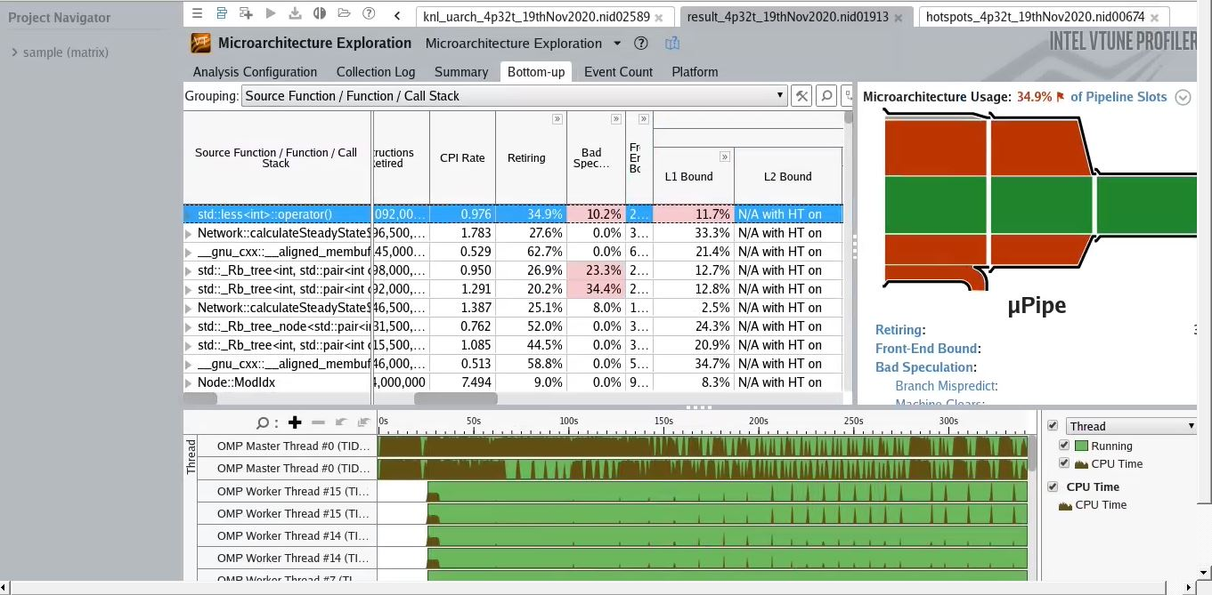
Haswell uarch memory analysis

Slide 18
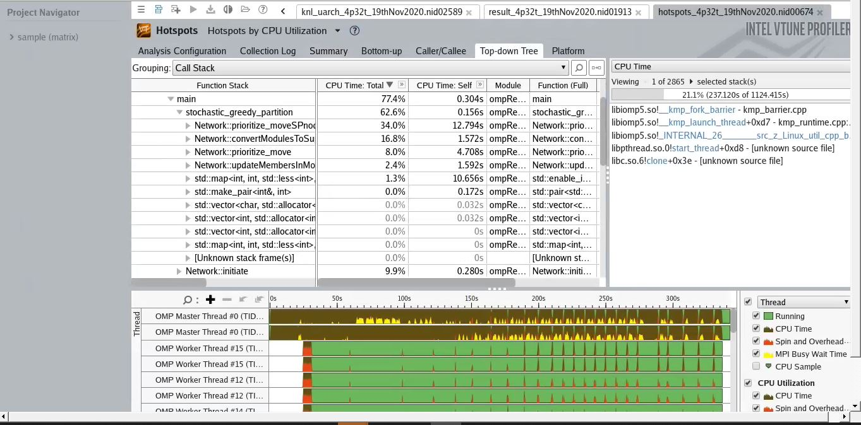
Haswell hotspots analysis (Topdown)

Slide 19
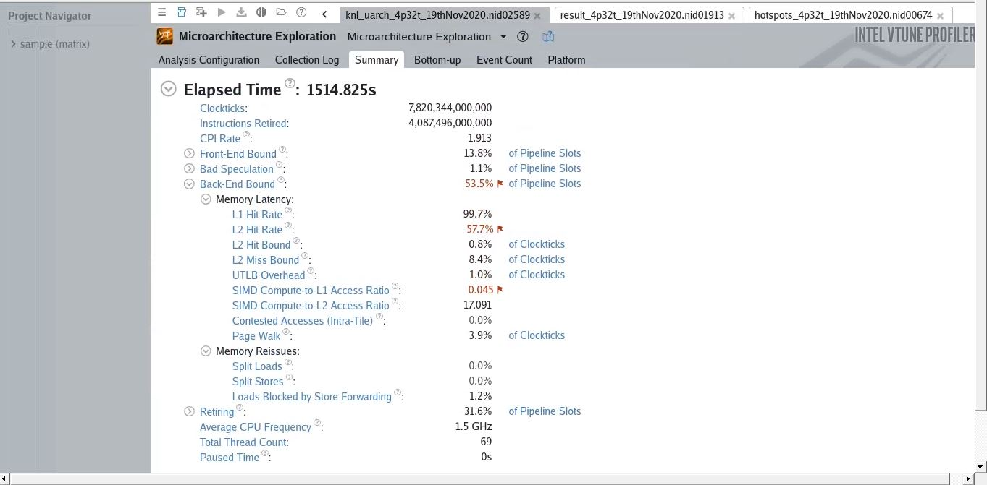
KNL uarch summary

Slide 20
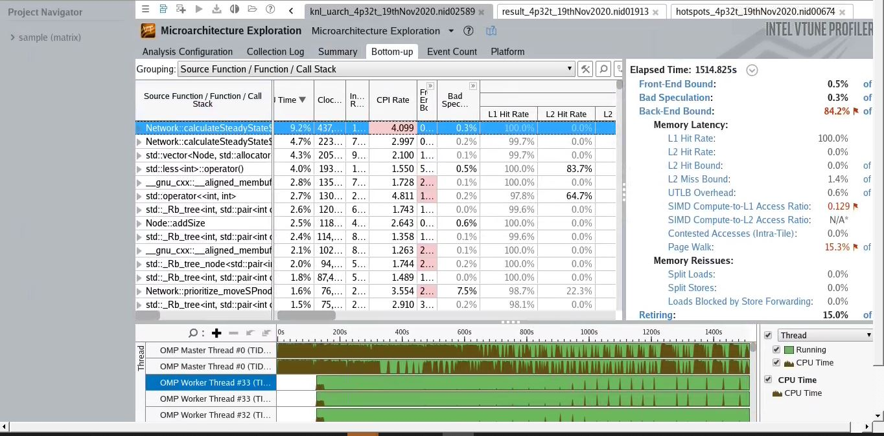
KNL uarch Bottomup view

Slide 21
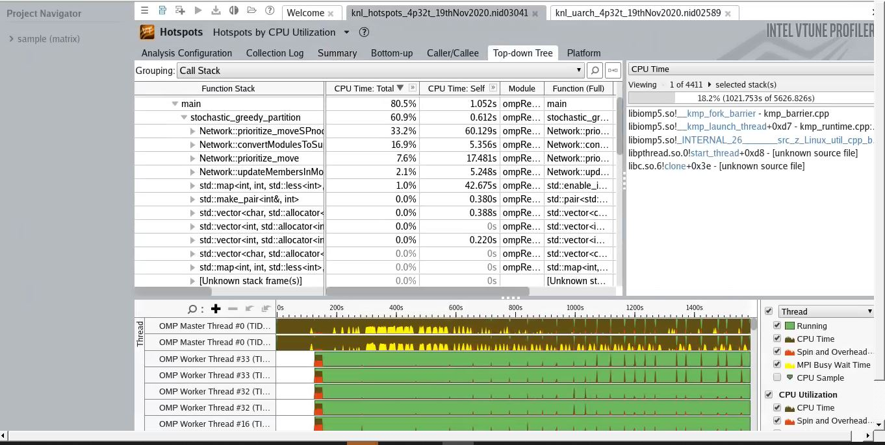
KNL hotspots analysis (Topdown)

