Slide 1
Weekly Meeting
December 18, 2020

Slide 2
Profiling Aspects
Stack graph for Infomap kernels

Slide 3
Network Dataset
Network | Total Vertices (millions) | Total Edges (millions)
Orkut | 3.07 | 117
Soc-Pokec | 1.63 | 30.6
Youtube | 1.13 | 2.98

Slide 4
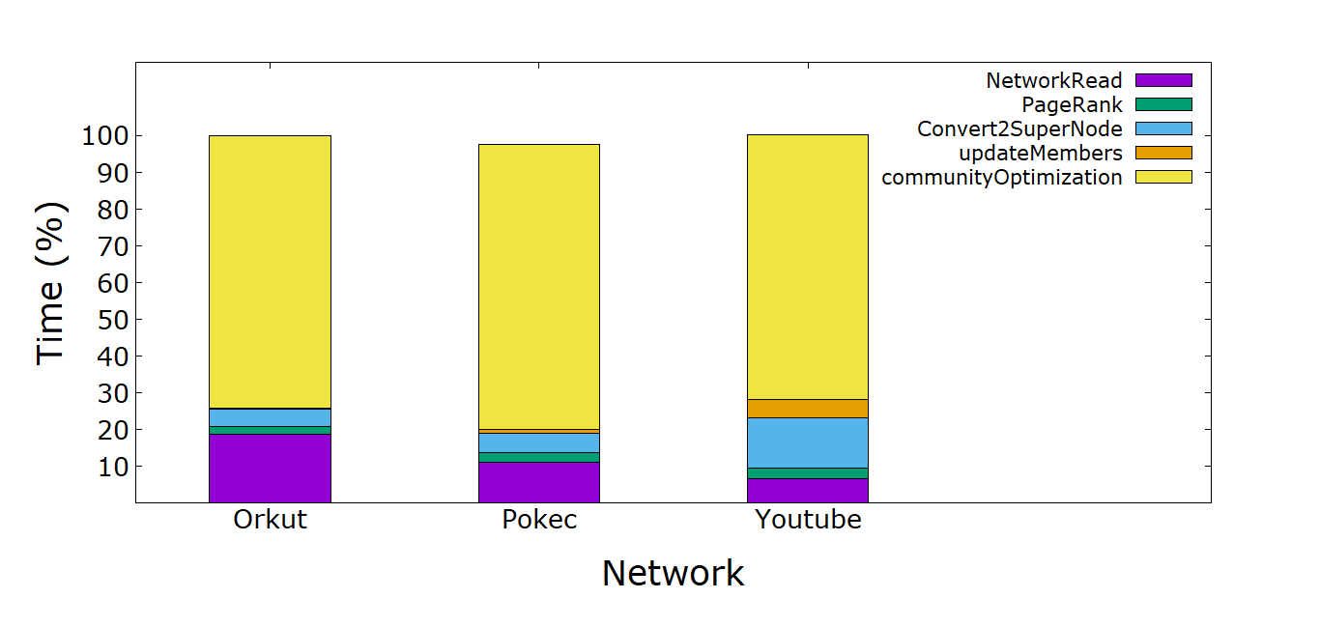
Time breakdown (%) of Infomap kernels
Note: The computation is done in 4 MPI processes, each running 10 OpenMP threads

Slide 5
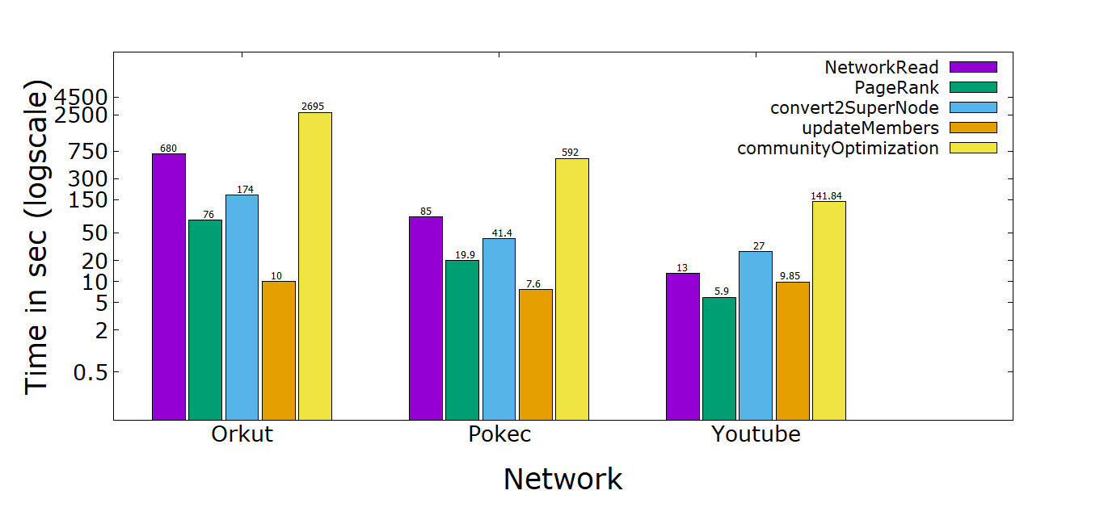
Time breakdown of Infomap kernels

