Slide 1
Weekly Meeting
January 8, 2021

Slide 2
Outline
Stack graph for Infomap kernels
Prefetching

Slide 3
Network Dataset
Graphname | Total Vertices (million) | Total Edges (million)
Orkut | 3.07 | 117
Libjournal | 4 | 34
Soc-Pokec | 1.63 | 30.6
Youtube | 1.13 | 2.98
DBLP | 0.31 | 1.05

Slide 4
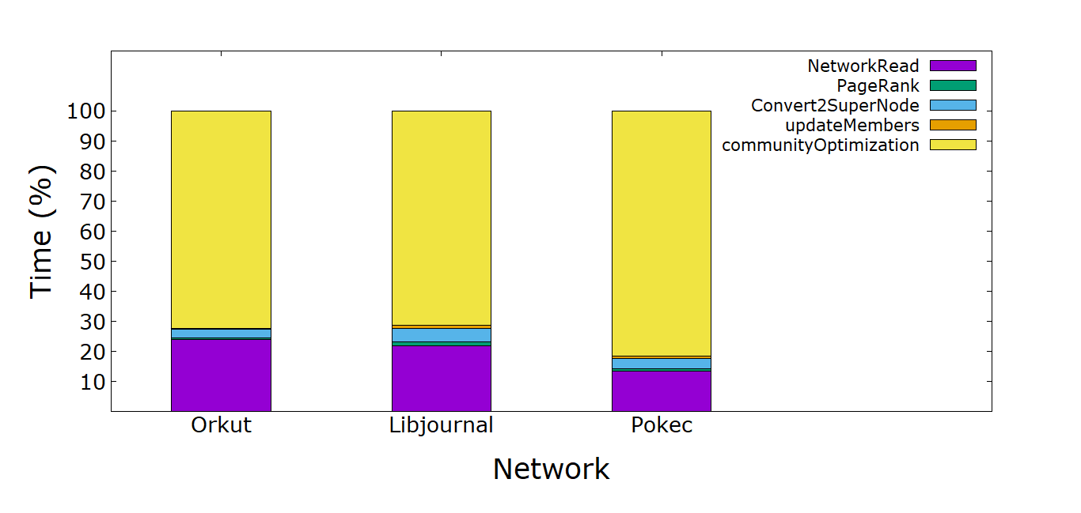
Time breakdown (%) of Infomap kernels (Cori KNL)
Note: The computation is done in 4 MPI processes, each running 68 OpenMP threads

Slide 5
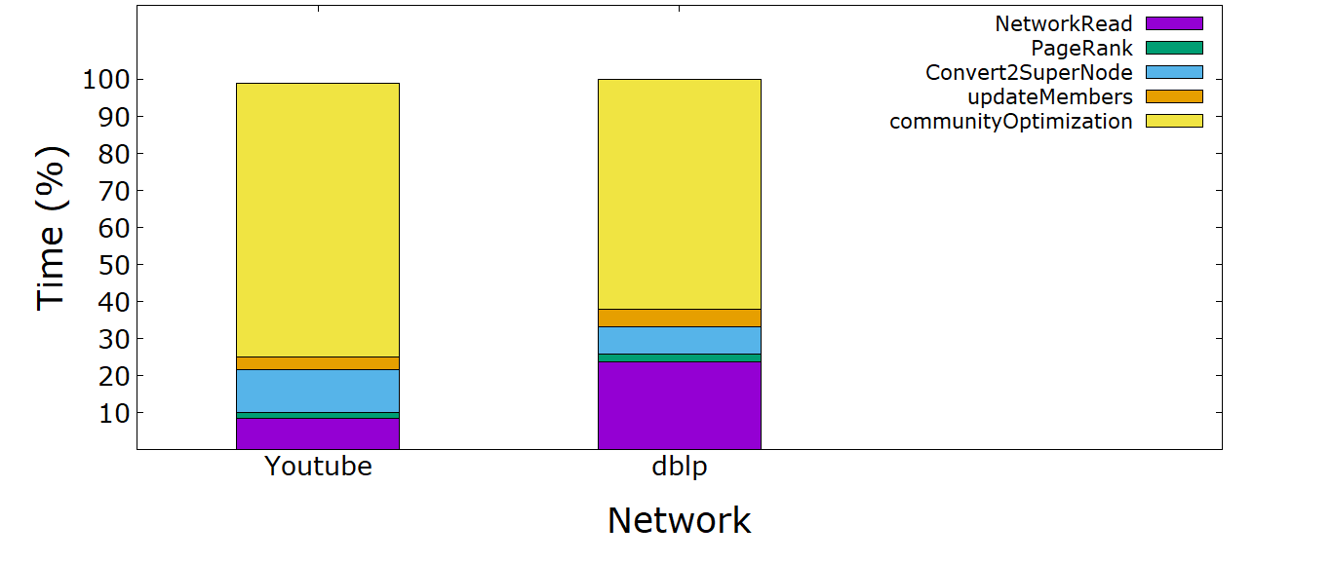
Time breakdown (%) of Infomap kernels (Cori KNL)
Note: The computation is done in 4 MPI processes, each running 68 OpenMP threads

Slide 6
Appendix

Slide 7
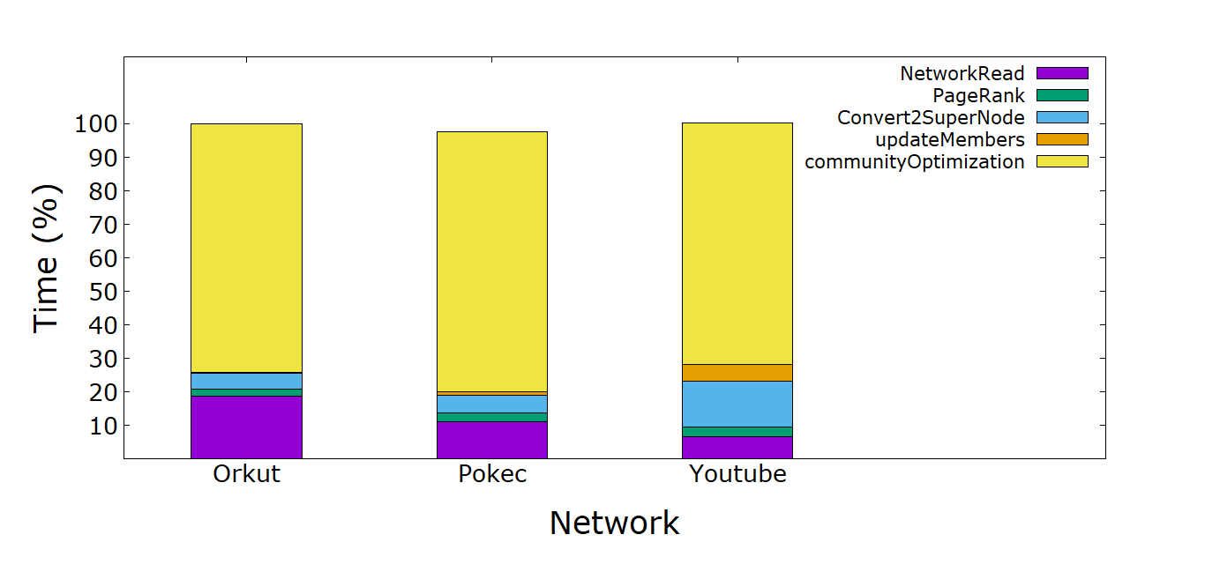
Time breakdown (%) of Infomap kernels (LONI)
Note: The computation is done in 4 MPI processes, each running 10 OpenMP threads

Slide 8
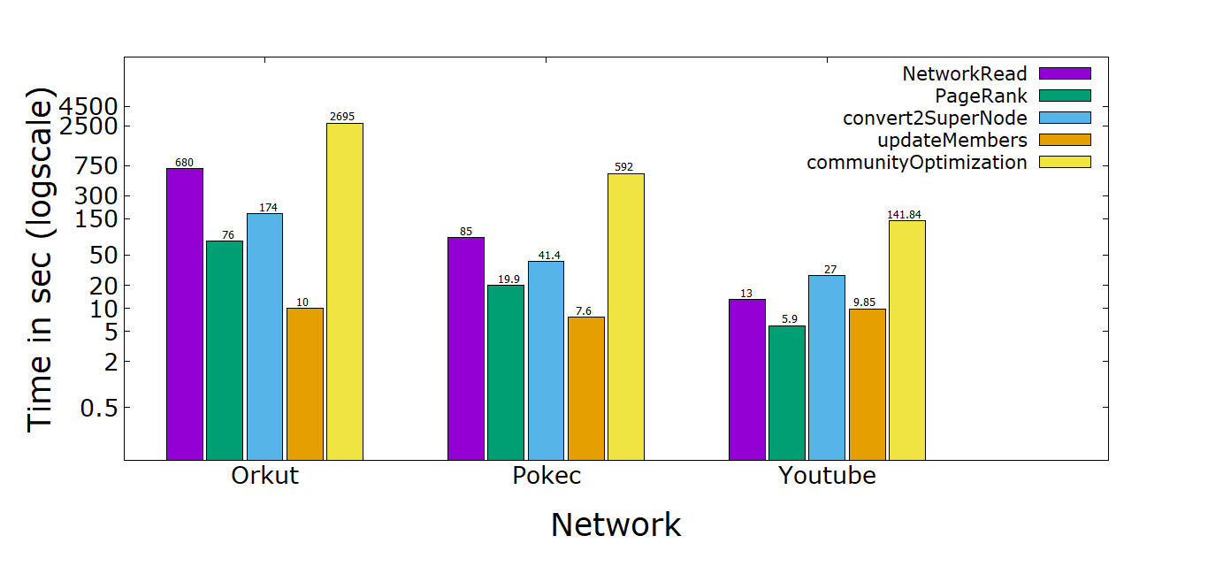
Time breakdown of Infomap kernels (LONI)

