Slide 1
Weekly Meeting
20th November,2020

Slide 2
Execution Result (previous week)
4 MPI processes, youtube social network dataset with 1.1 million vertices and 3 million edges
2 MPI processes per compute node
10 threads per MPI process
Kernel | LONI (sec) | Cori (haswell) (sec) | Cori (knl) (sec)
PageRank | 4.6 | 6.9 | 34.14
CommunityOptimization | 123.74 | 209.81 | 1049.57
Convert2SuperNodes | 23.66 | 39.32 | 187.50
updateMembership | 8.22 | 12.29 | 54.04

Slide 3
Execution Result (this week)
4 MPI processes, youtube social network dataset with 1.1 million vertices and 3 million edges
2 MPI processes per compute node
10 threads per MPI process in LONI, 16 threads/MPI process in haswell, 34 threads/MPI process KNL
Kernel | LONI (sec) | Cori (haswell) (sec) | Cori (knl) (sec)
PageRank | 4.6 | 6.4 | 25.15
CommunityOptimization | 123.74 | 236.14 | 1078.56
Convert2SuperNodes | 23.66 | 39.6 | 153.67
updateMembership | 8.22 | 13.22 | 53.6

Slide 4
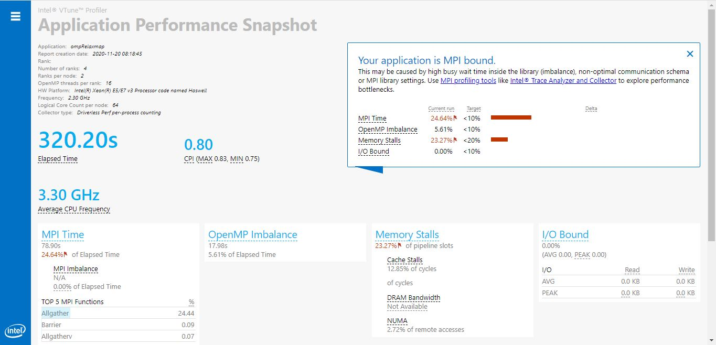
Application Performance Snapshot (haswell)

Slide 5
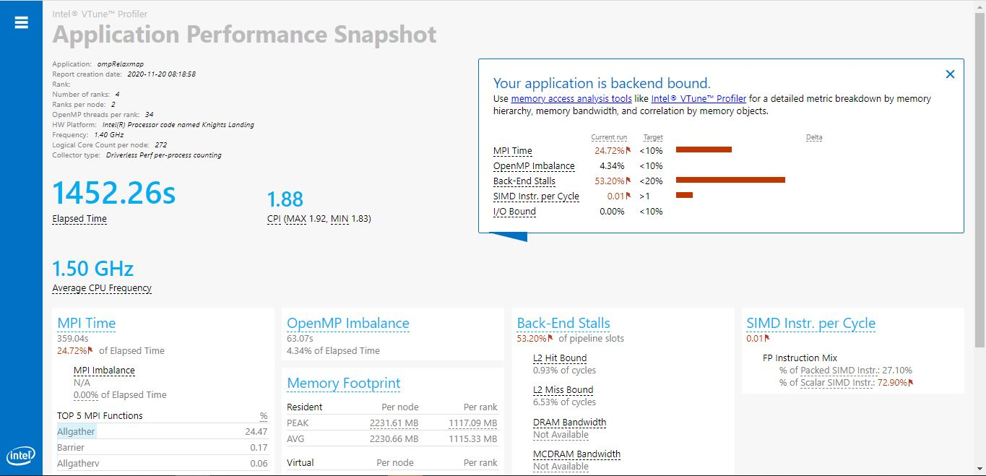
Application Performance Snapshot (knl)

Slide 6
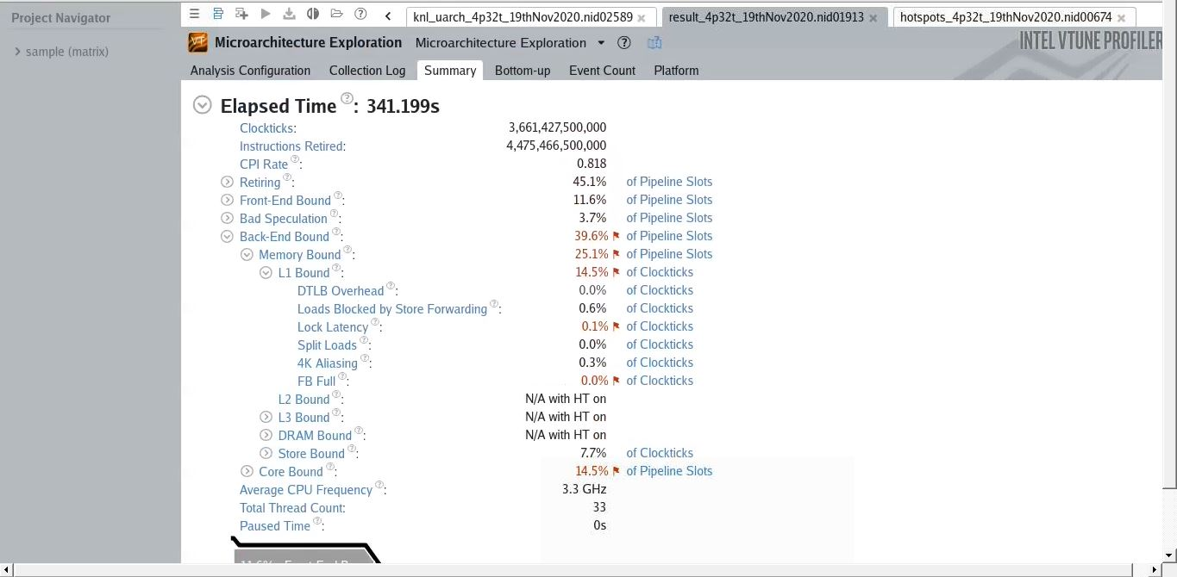
Haswell uarch summary

Slide 7
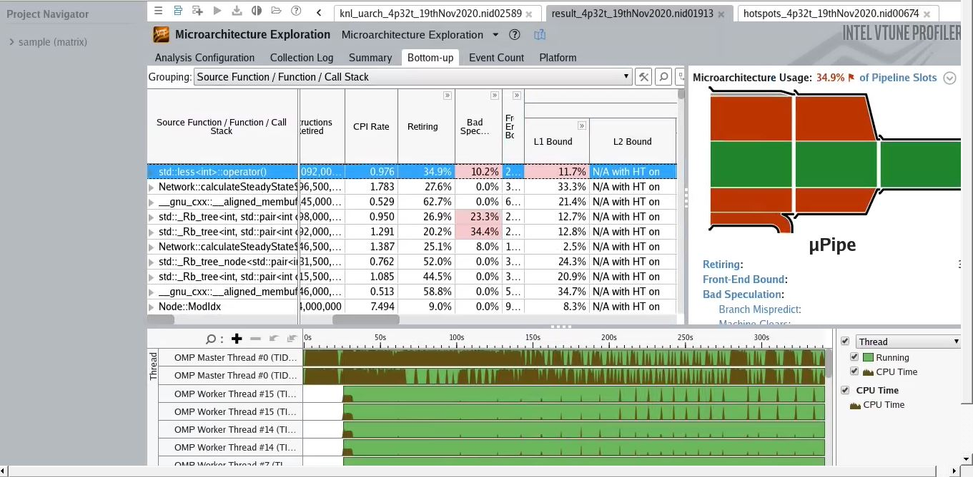
Haswell uarch Bottomup view

Slide 8
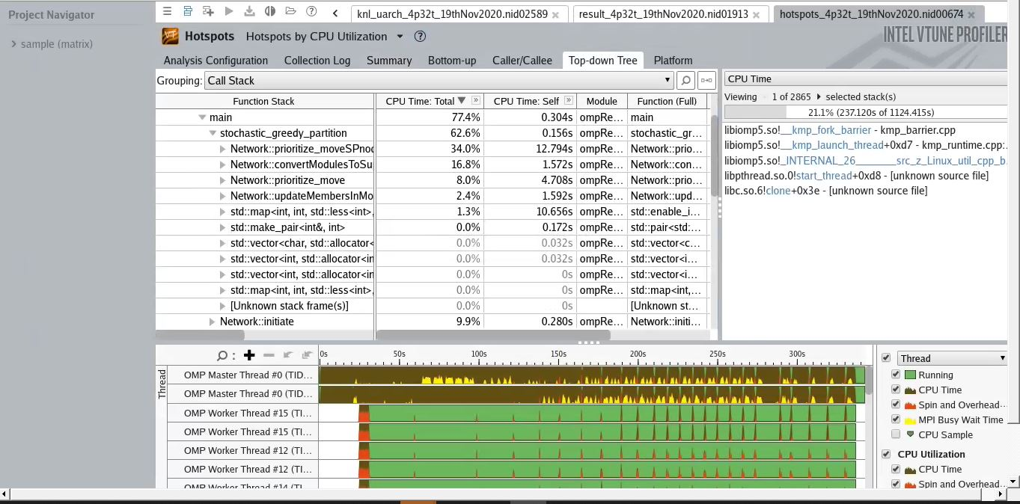
Haswell hotspots analysis (Topdown)

Slide 9
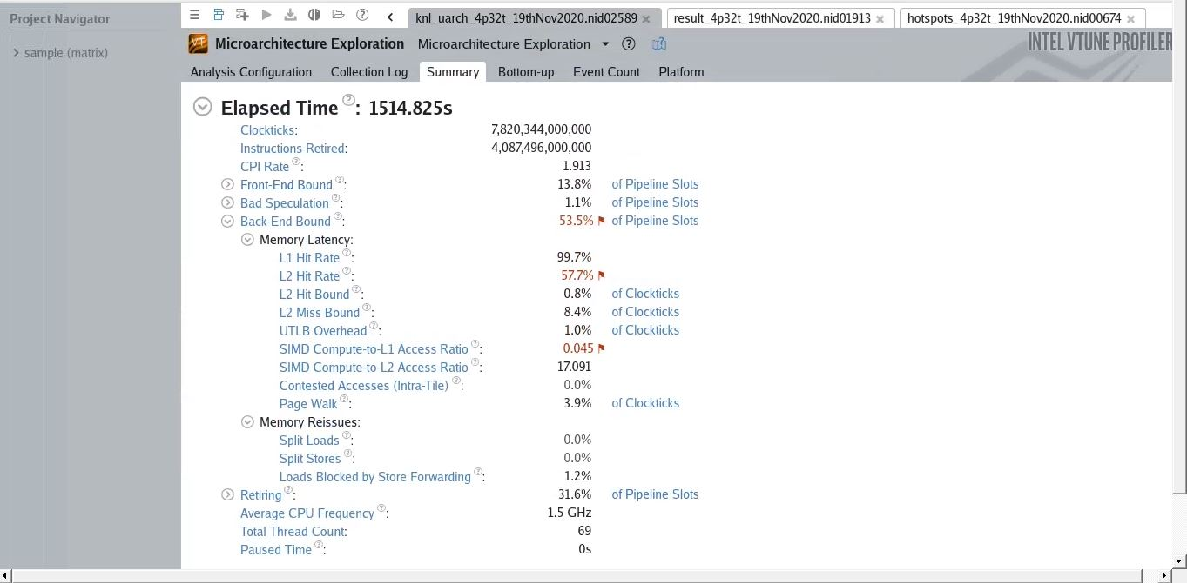
KNL uarch summary

Slide 10
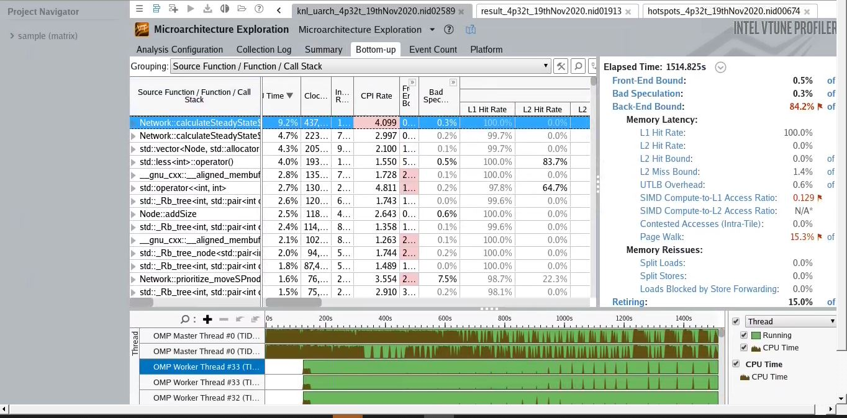
KNL uarch Bottomup view

Slide 11
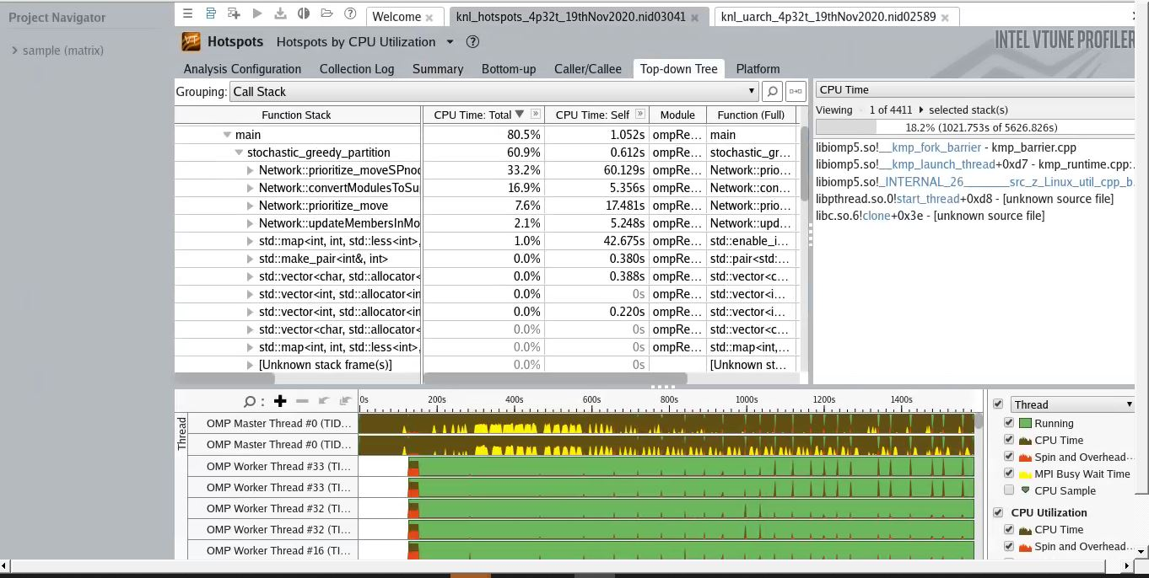
KNL hotspots analysis (Topdown)

