Slide 1
Weekly Meeting
May 07, 2021

Slide 2
Outline
Scatter plots of the degree of a vertex vs the number of CAM entries (CAM Capacity)
Plot of the percentage of the vertices satisfied vs the CAM capacity
For a degree threshold, estimate the time spent outside CAM and time spent in Hash
Note: All experiment results in the slides are executed on Cori KNL nodes

Slide 3
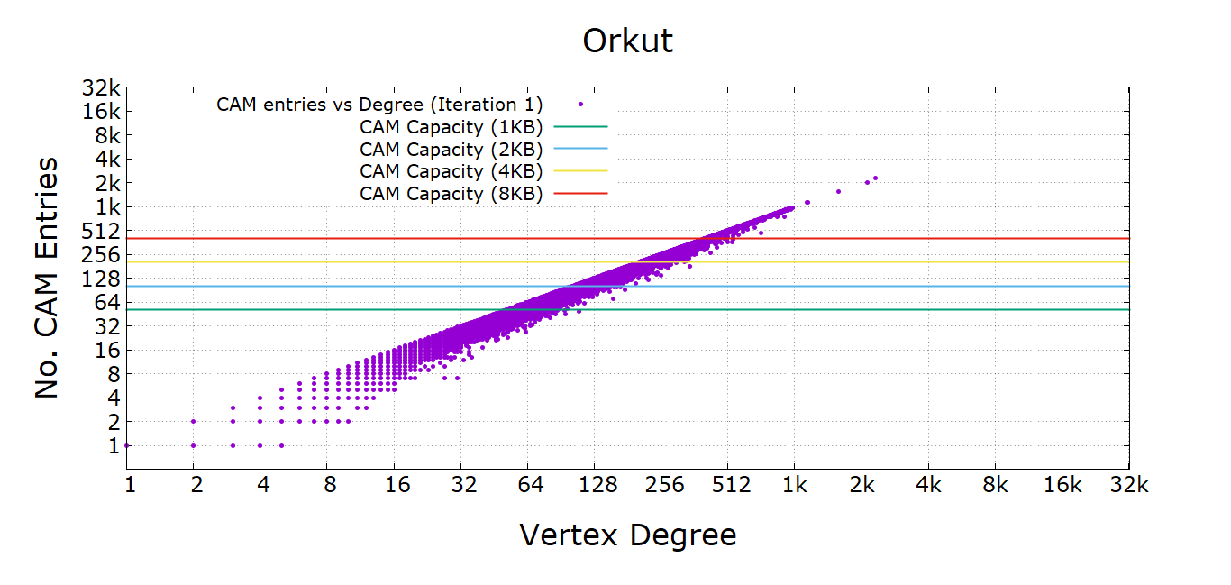
CAM Capacity vs Degree (Iteration 1)

Slide 4
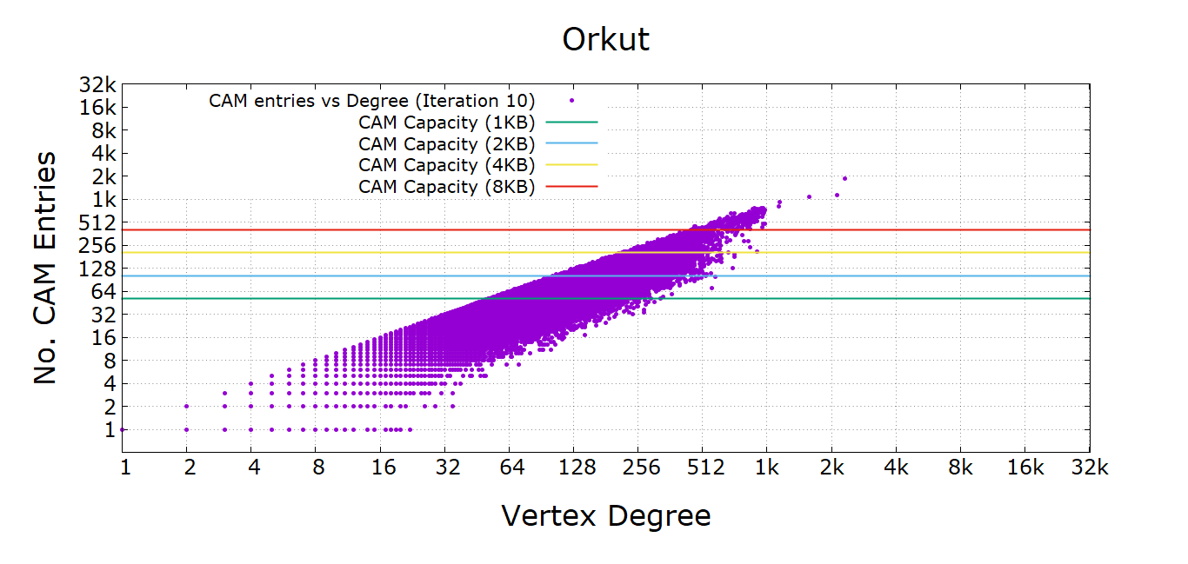
CAM Capacity vs Degree (iteration 10)

Slide 5
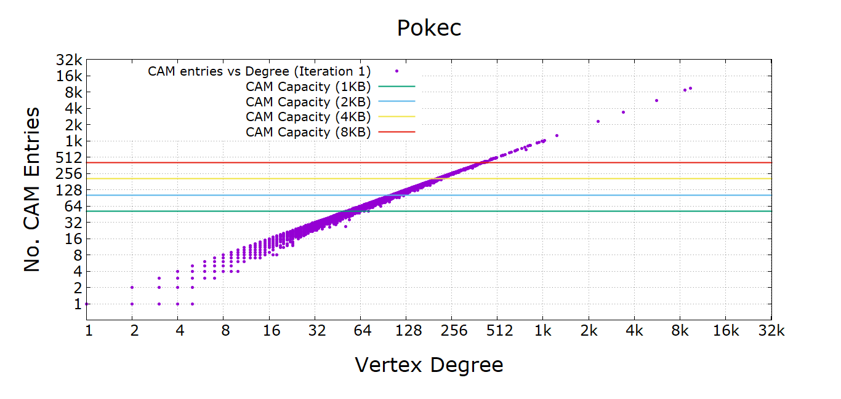
CAM Capacity vs Degree (Iteration 1)

Slide 6
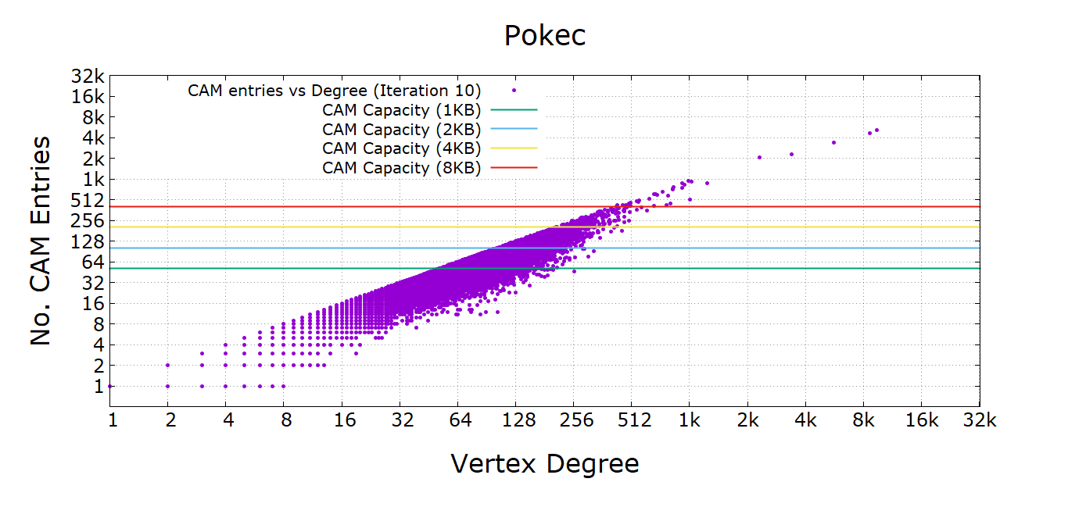
CAM Capacity vs Degree (iteration 10)

Slide 7
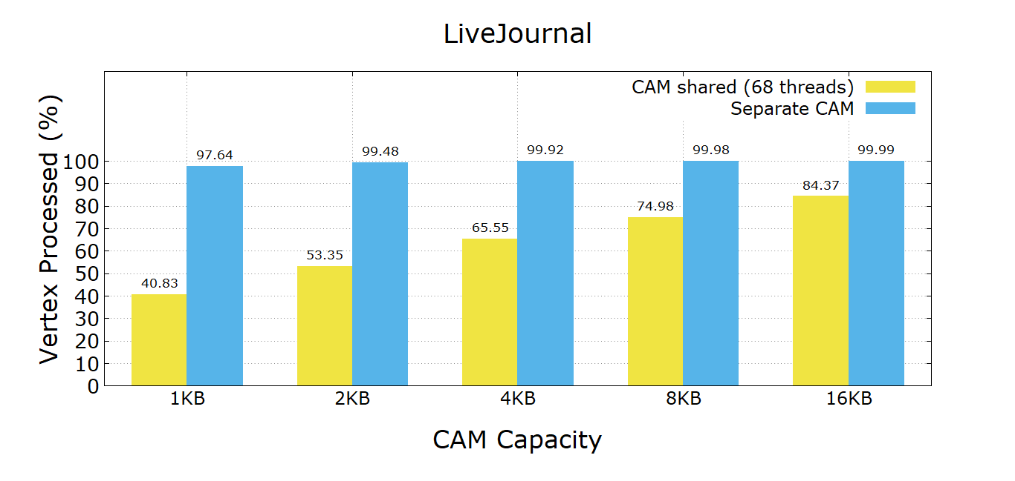
Percentage of Vertices Satisfied

Slide 8
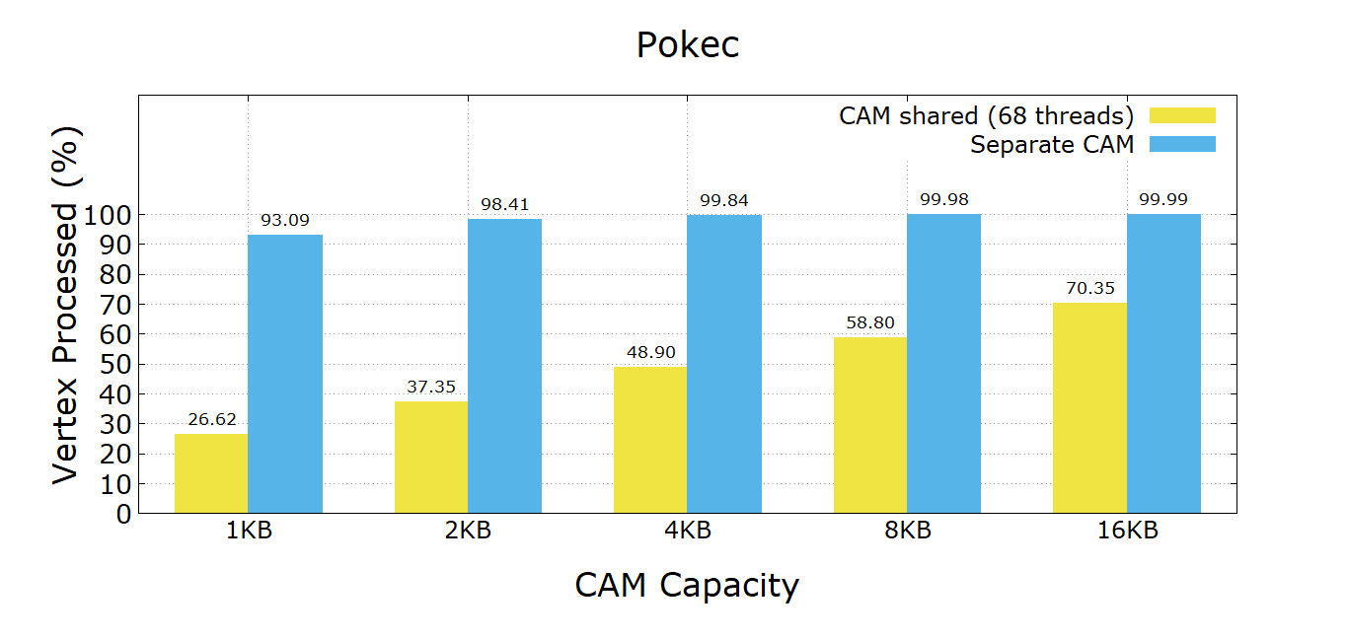
Percentage of Vertices Satisfied

Slide 9
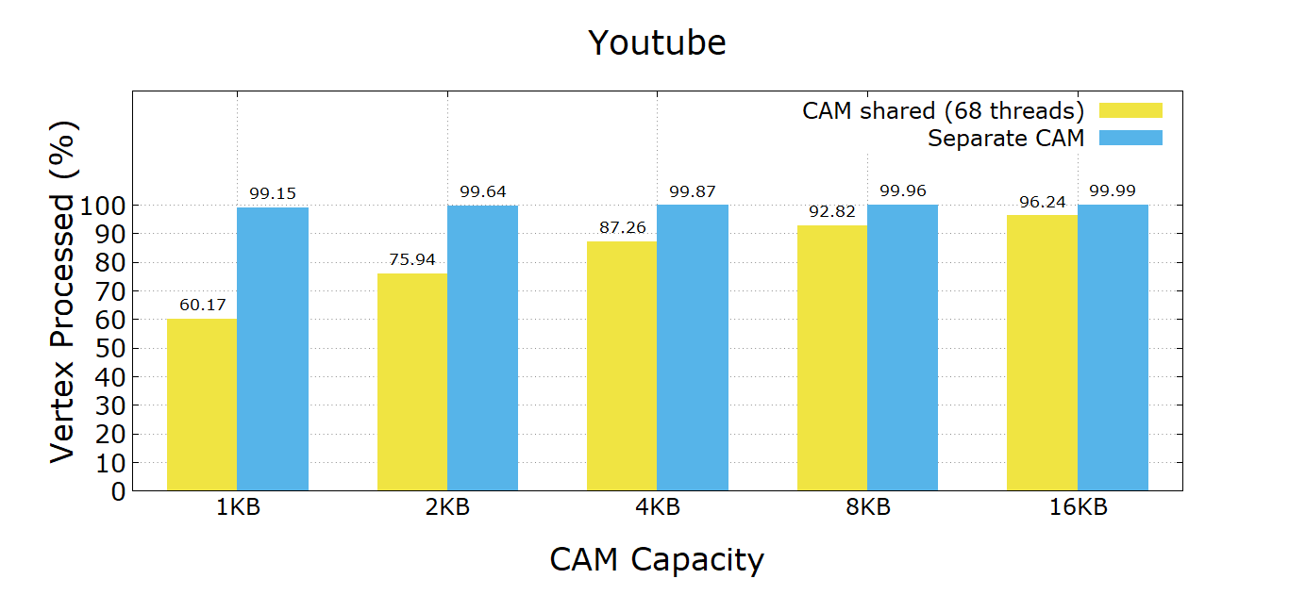
Percentage of Vertices Satisfied

Slide 10
Time spent inside and outside CAM for a degree threshold
Network Name | CAM only (sec) | Hash only (sec) | CAM (degree <= 200) (sec) | Hash ( degree > 200) (sec)
Youtube | 0.036 | 0.33 | 0.038 | 0.056
Pokec | 0.44 | 3.99 | 0.53 | 0.14
LiveJournal | 0.41 | 3.42
Orkut | 1.37 | 16.92 | 1.07 | 1.05

Slide 11
Appendix

Slide 12
CAM Capacity vs Degree

Slide 13
CAM Capacity vs Degree

