Slide 1
Weekly Meeting
May 28, 2021

Slide 2
Outline
Quality comparison of the community for float vs double
Percentage of time spent or number of vertices processed by CAM for 4KB, 8KB and 16KB sizes
Time spent in earlier iterations vs later iterations in communityOptimization kernel
Note: All experiment results in the slides are executed on Cori KNL nodes using 4 MPI processes, 1 process per node

Slide 3
Quality comparison for float vs double
Network Name | Modularity |  | Conductance
 | double | float | double | float
Amazon | 0.77 | 0.77 | 0.23 | 0.23
DBLP | 0.59 | 0.59 | 0.41 | 0.41
Youtube | 0.38 | 0.39 | 0.61 | 0.60
Pokec | 0.34 | 0.34 | 0.66 | 0.65
LiveJournal | 0.48 | 0.48 | 0.52 | 0.51
Orkut | 0.34 | 0.37 | 0.50 | 0.51

Slide 4
Time Percentage for CAM (4KB, 8KB, 16KB)
Network Name | 4KB CAM, time (sec) |  |  | 8KB CAM, time (sec) |  |  | 16KB CAM, time (sec)
 | CAM | Hash | CAM% | CAM | Hash | CAM% | CAM | Hash | CAM%
Amazon | 0.012 | 0.0 | 100 | 0.012 | 0.0 | 100 | 0.012 | 0.0 | 100
DBLP | 0.011 | 0.0 | 100 | 0.011 | 0.0 | 100 | 0.011 | 0.0 | 100
Youtube | 0.036 | 0.036 | 50 | 0.037 | 0.035 | 51 | 0.038 | 0.005 | 88
Pokec | 0.66 | 0.14 | 83 | 0.58 | 0.024 | 96 | 0.48 | 0.0 | 100
LiveJournal | 0.43 | 0.14 | 75 | 0.44 | 0.053 | 89 | 0.44 | 0.017 | 96.3
Orkut | 1.23 | 0.65 | 65 | 1.61 | 0.20 | 89 | 1.34 | 0.002 | 99.8

Slide 5
Vertex Processed (%) by CAM (4KB, 8KB, 16KB)
Network Name | 4KB CAM, vertex count |  |  | 8KB CAM, vertex count |  |  | 16KB CAM, vertex count
 | CAM | Hash | CAM% | CAM | Hash | CAM% | CAM | Hash | CAM%
Amazon | 334863 | 0 | 100 | 334863 | 0 | 100 | 334863 | 0 | 100
DBLP | 317078 | 2 | 99.99 | 317080 | 0 | 100 | 317080 | 0 | 100
Youtube | 1133695 | 1195 | 99.89 | 1134417 | 473 | 99.96 | 1134711 | 179 | 99.98
Pokec | 1630738 | 2065 | 99.87 | 1632497 | 306 | 99.98 | 1632778 | 25 | 99.99
LiveJournal | 3990102 | 7860 | 99.80 | 3996122 | 1840 | 99.95 | 3997620 | 342 | 99.99
Orkut | 3018473 | 53968 | 98.24 | 3059341 | 13100 | 99.57 | 3070056 | 2385 | 99.92

Slide 6
Time spent in communityOptimization kernel in earlier vs later iterations
Network Name | Time spent in i^{th} iteration (sec)
 | 1st | 2nd | 3rd | 4th | 5th | 6th | 7th | 8th | 9th
Amazon | 1.01 | 0.748 | 0.50 | 0.23 | 0.10 | 0.045 | 0.022 | 0.009 | 0.005
DBLP | 0.89 | 0.65 | 0.48 | 0.25 | 0.12 | 0.05 | 0.03 | 0.01 | 0.009
Youtube | 2.70 | 1.52 | 0.80 | 0.37 | 0.27 | 0.28 | 0.30 | 0.27 | 1.92
Pokec | 5.18 | 4.19 | 3.62 | 2.59 | 1.92 | 1.50 | 1.27 | 1.05 | 0.92
LiveJournal | 17.31 | 10.78 | 7.02 | 4.68 | 3.06 | 2.12 | 1.71 | 1.44 | 1.04
Orkut | 14.07 | 12.40 | 8.83 | 7.61 | 7.027 | 6.12 | 5.62 | 4.87 | 4.46

Slide 7
Appendix

Slide 8
Outline
Scatter plots of the degree of a vertex vs the number of CAM entries (CAM Capacity)
Plot of the percentage of the vertices satisfied vs the CAM capacity
For a degree threshold, estimate the time spent outside CAM and time spent in Hash
Note: All experiment results in the slides are executed on Cori KNL nodes

Slide 9
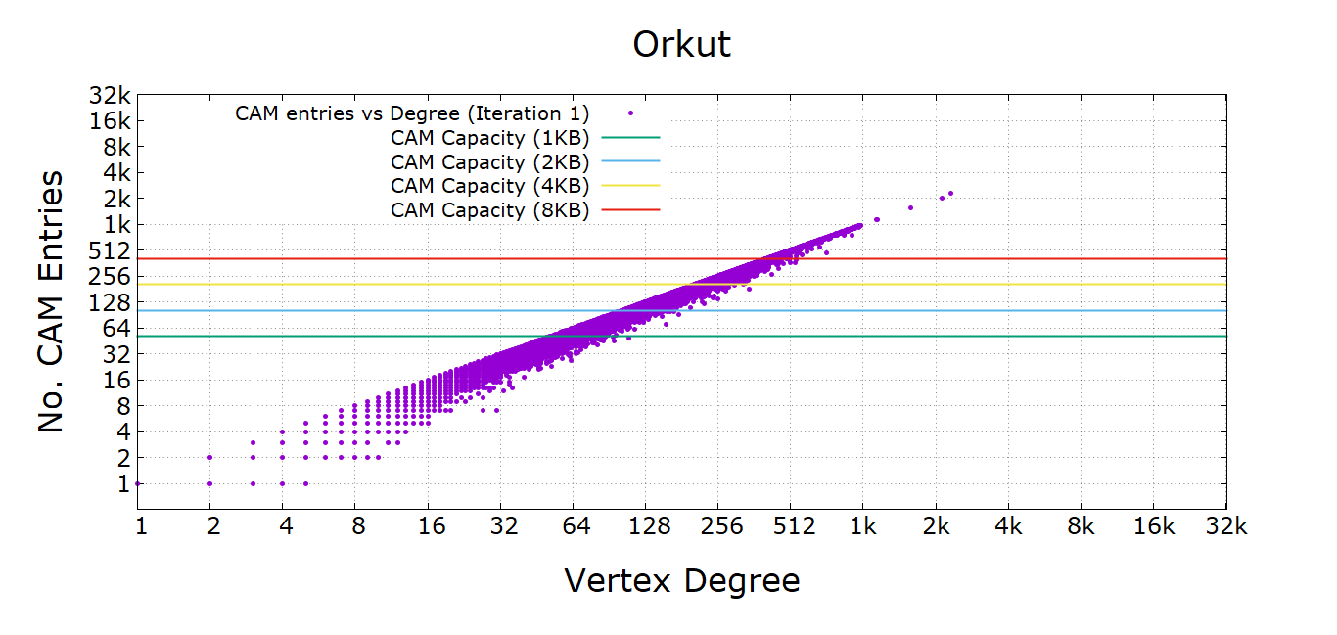
CAM Capacity vs Degree (Iteration 1)

Slide 10
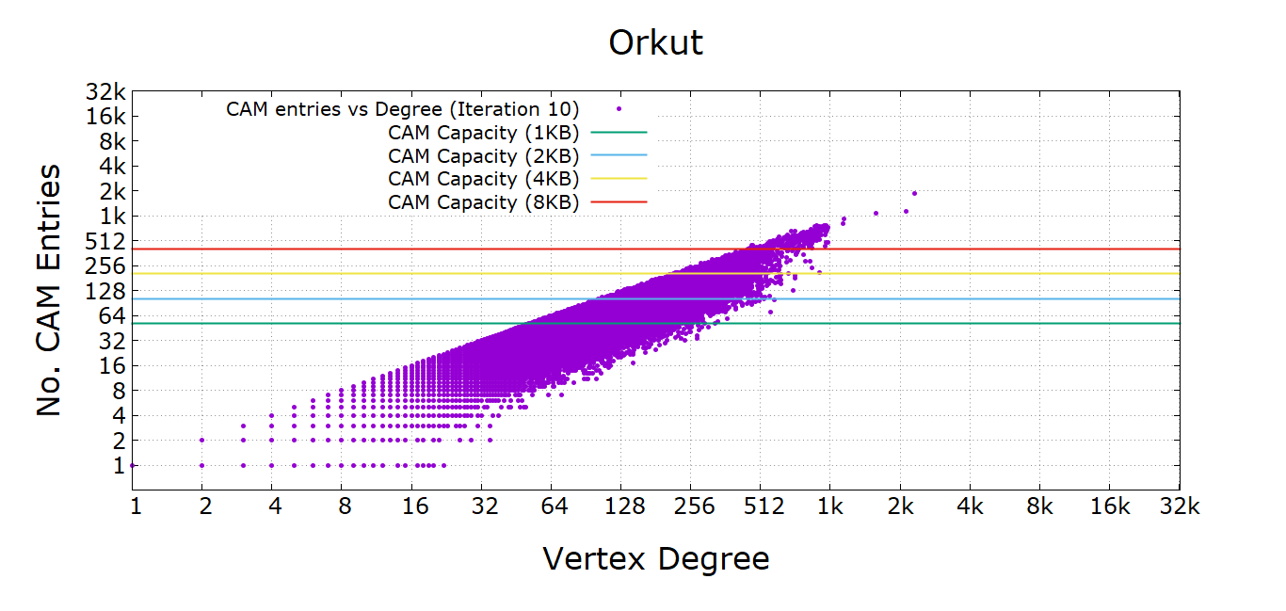
CAM Capacity vs Degree (iteration 10)

Slide 11
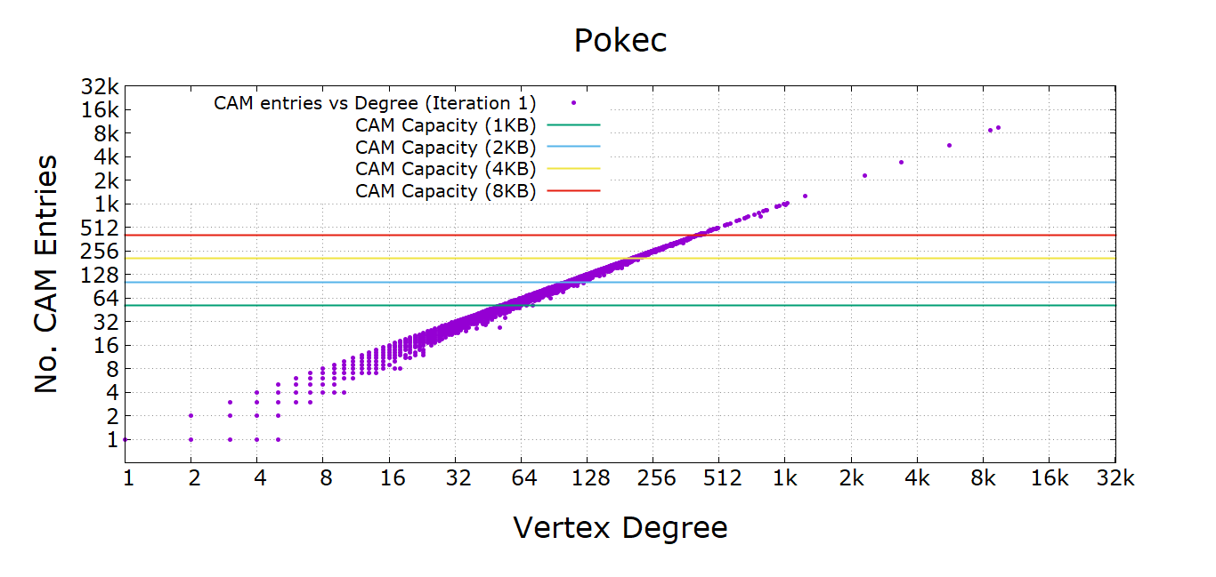
CAM Capacity vs Degree (Iteration 1)

Slide 12
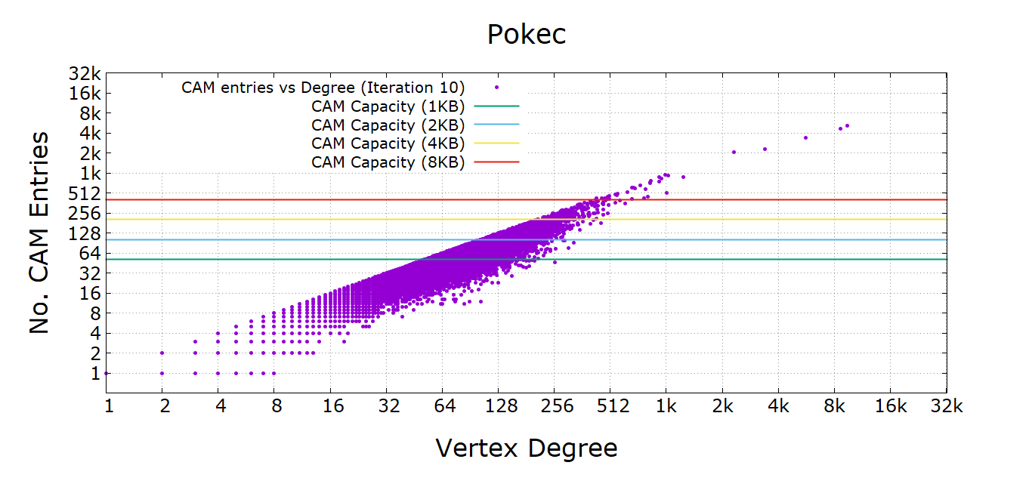
CAM Capacity vs Degree (iteration 10)

Slide 13
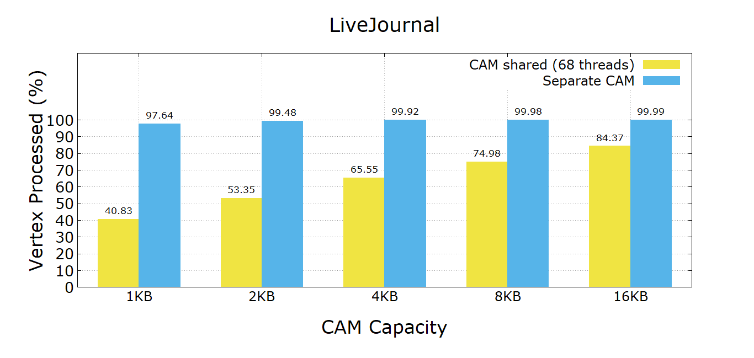
Percentage of Vertices Satisfied

Slide 14
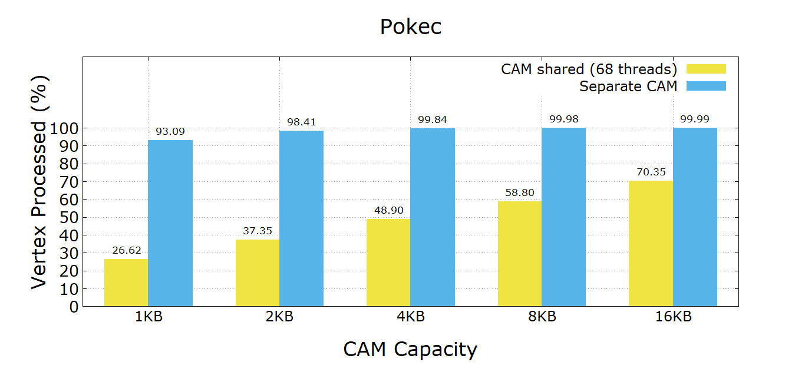
Percentage of Vertices Satisfied

Slide 15
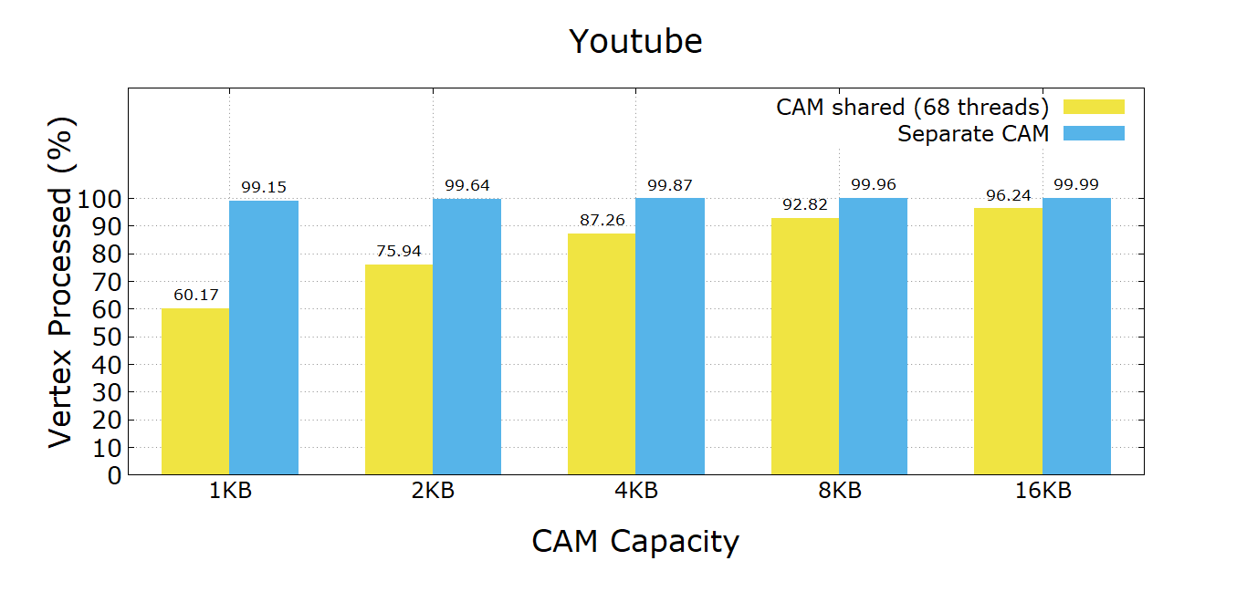
Percentage of Vertices Satisfied

Slide 16
Time spent inside and outside CAM for a degree threshold
Network Name | CAM only (sec) | Hash only (sec) | CAM (degree <= 200) (sec) | Hash ( degree > 200) (sec)
Youtube | 0.036 | 0.33 | 0.038 | 0.056
Pokec | 0.44 | 3.99 | 0.53 | 0.14
LiveJournal | 0.41 | 3.42
Orkut | 1.37 | 16.92 | 1.07 | 1.05

Slide 17
Appendix

Slide 18
CAM Capacity vs Degree

Slide 19
CAM Capacity vs Degree

