Slide 1
Weekly Meeting
15th January, 2021

Slide 2
Assumption for theoretical Peak (KNL)
Infinite L2 memory with latency (~ 115 cycles)
Infinite MCDRAM memory with latency (~ 185 cycles)
No L1 cache, only L2 or lower level cache/memory exist
Notes:
1. https://stackoverflow.com/questions/21369381/measuring-cache-latencies

Slide 3
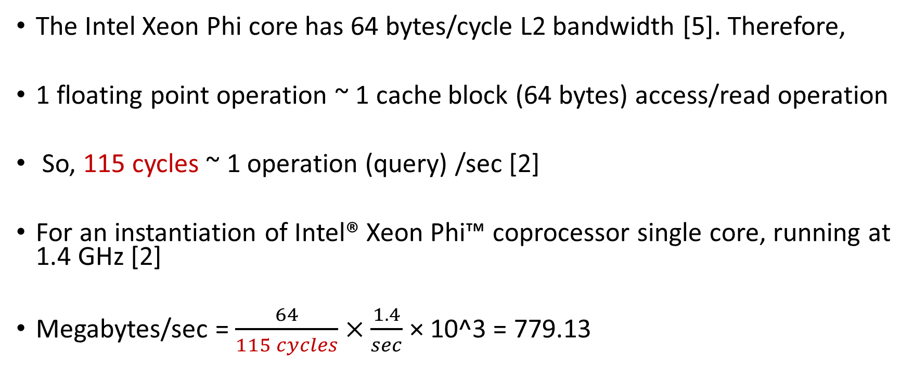
Computation for theoretical Peak (L2)
The Intel Xeon Phi core has 64 bytes/cycle L2 bandwidth [5]. Therefore,
1 floating point operation ~ 1 cache block (64 bytes) access/read operation
So, 115 cycles ~ 1 operation (query) /sec [2]
For an instantiation of Intel® Xeon Phi™ coprocessor single core, running at 1.4 GHz [2]
Megabytes/sec = $\frac{64}{115 cycles}×\frac{1.4}{sec}$ × 10^3 = 779.13
Notes:
2. https://software.intel.com/content/www/us/en/develop/articles/intel-xeon-phi-core-micro-architecture.html#:~:text=The%20Intel%20Xeon%20Phi%20core,64%2Dbit%20integer%20vector%20instructions.
5. https://www.nersc.gov/assets/Uploads/Using-KNL-Processors-Feb2019.pdf

Slide 4

Computation for theoretical Peak (MCDRAM)
The Intel Xeon Phi core has 64 bytes/cycle L2 bandwidth [5]. Therefore,
1 floating point operation ~ 1 cache block (64 bytes) access/read operation
So, 185 cycles ~ 1 operation (query) /sec [2]
For an instantiation of Intel® Xeon Phi™ coprocessor single core, running at 1.4 GHz [2]
Megabytes/sec = $\frac{64}{185 cycles}×\frac{1.4}{sec}$ × 10^3 = 484.32
Notes:
2. https://software.intel.com/content/www/us/en/develop/articles/intel-xeon-phi-core-micro-architecture.html#:~:text=The%20Intel%20Xeon%20Phi%20core,64%2Dbit%20integer%20vector%20instructions.

Slide 5
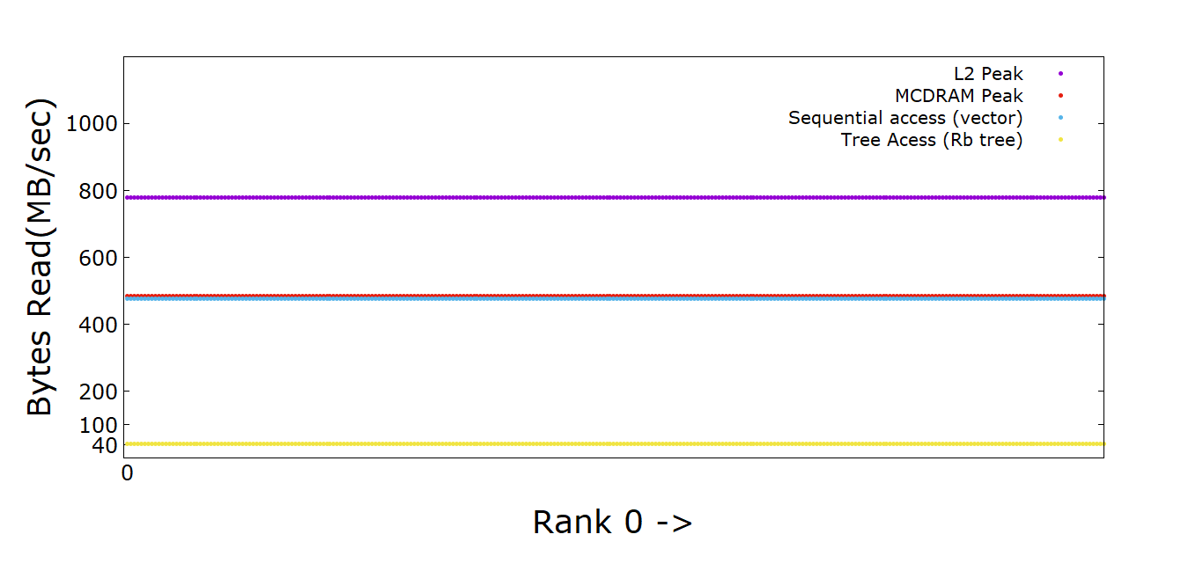
Performance Plot (KNL)
Notes:
1. Difference between sequential read and non-sequential read is 11 times

Slide 6
Sequential Memory Access (vector in c++)
Time = 0.583 sec, total object (node) accesses = 1829162
Accesses per second = 1829162/0.583 = 3137499
Each node object 152 bytes
Therefore, Bytes accessed/read per second = 3137499*152 = 476899848
I.e. 476899848/10^6 = 476.9 MB/sec

Slide 7
Rb Tree Access (map in c++)
Time = 3.29 sec, total object (link) accesses = 11769734
Accesses per second = 11769734/3.29 = 3577426
Each link object 12 bytes
Therefore, Bytes accessed/read per second = 3577426 *12 = 42929112
I.e. 42929112/10^6 = 42.93 MB/sec

Slide 8
Haswell Compute Node

Slide 9
Assumption for theoretical Peak (Haswell)
Infinite L2 memory with latency (~ 22 cycles)
Infinite L3 memory with latency (~ 58 cycles)
No L1 cache, only L2 or lower level cache/memory exist
Notes:
1. https://stackoverflow.com/questions/21369381/measuring-cache-latencies

Slide 10
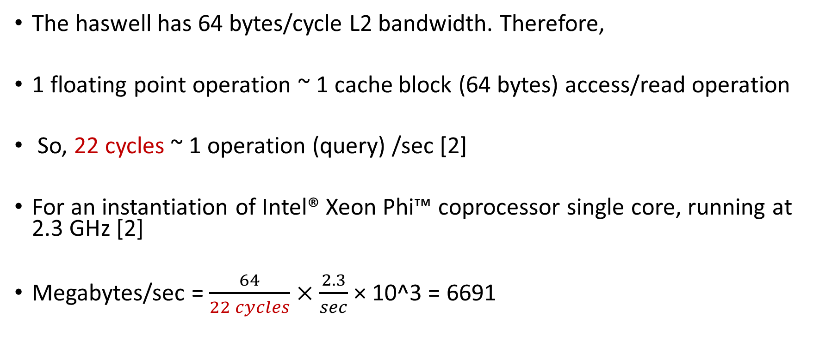
Computation for theoretical Peak (L2)
The haswell has 64 bytes/cycle L2 bandwidth. Therefore,
1 floating point operation ~ 1 cache block (64 bytes) access/read operation
So, 22 cycles ~ 1 operation (query) /sec [2]
For an instantiation of Intel® Xeon Phi™ coprocessor single core, running at 2.3 GHz [2]
Megabytes/sec = $\frac{64}{22 cycles}×\frac{2.3}{sec}$ × 10^3 = 6691
Notes:
2. https://software.intel.com/content/www/us/en/develop/articles/intel-xeon-phi-core-micro-architecture.html#:~:text=The%20Intel%20Xeon%20Phi%20core,64%2Dbit%20integer%20vector%20instructions.

Slide 11
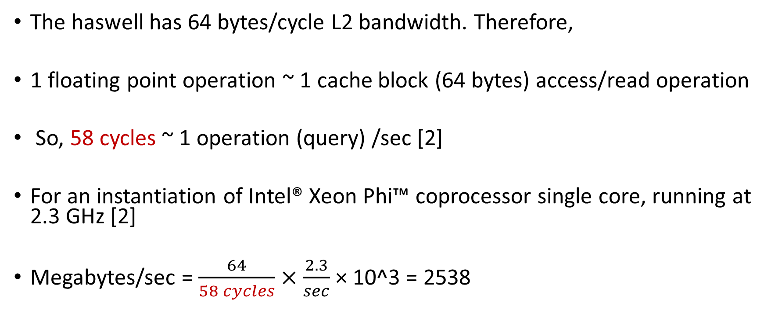
Computation for theoretical Peak (L2)
The haswell has 64 bytes/cycle L2 bandwidth. Therefore,
1 floating point operation ~ 1 cache block (64 bytes) access/read operation
So, 58 cycles ~ 1 operation (query) /sec [2]
For an instantiation of Intel® Xeon Phi™ coprocessor single core, running at 2.3 GHz [2]
Megabytes/sec = $\frac{64}{58 cycles}×\frac{2.3}{sec}$ × 10^3 = 2538
Notes:
2. https://software.intel.com/content/www/us/en/develop/articles/intel-xeon-phi-core-micro-architecture.html#:~:text=The%20Intel%20Xeon%20Phi%20core,64%2Dbit%20integer%20vector%20instructions.

Slide 12
Sequential Memory Access (vector in c++)
Time = 0.167 sec, total object (node) accesses = 1846588
Accesses per second = 1846588/0.167 = 11057413
Each node object 152 bytes
Therefore, Bytes accessed/read per second = 11057413*152 = 1680726776
I.e. 1680726776/10^6 = 1680 MB/sec

Slide 13
Rb Tree Access (map in c++)
Time = 0.6 sec, total object (link) accesses = 12300945
Accesses per second = 12300945/0.6 = 20501575
Each link object 12 bytes
Therefore, Bytes accessed/read per second = 20501575*12 = 246018900
I.e. 246018900/10^6 = 246.02 MB/sec

Slide 14
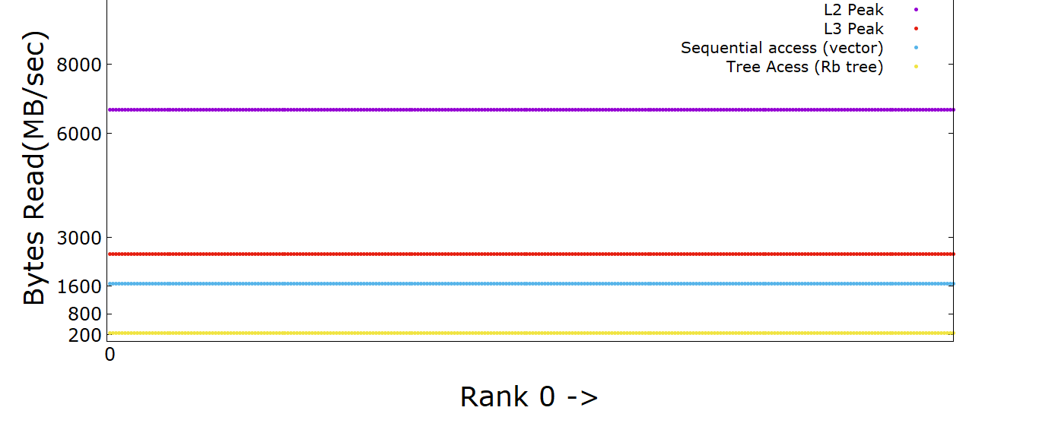
Performance Plot (Haswell)
Notes:
1. Difference between sequential read and non-sequential read is 6.8 times

