Slide 1
Weekly Meeting
4th February, 2021

Slide 2
Outline
Measuring STL map vs unordered_map insertion and access time performance for different cache sizes
Performance analysis in target code segment
The target code segment is CommunityOptimization
Used Vtune ittnotify.h

Slide 3
STL map vs unordered_map
Note: The experiments are executed in KNL node
Each data entry is 12 bytes where 4 byte integer key and 8 byte double value
Number of Data Entry | Insertion (map) | Insertion (unordered_map) | Read Time (map) |  | Read Time (unordered map)
 |  |  | Pre-Warmup | Post-Warmup | Pre-Warmup | Post-Warmup
2048 | 0.00944 | 0.0056 | 0.00037 | 0.00038 | 0.00028 | 0.00030
4096 | 0.0199 | 0.0111 | 0.00080 | 0.0008 | 0.00058 | 0.00055
8192 | 0.042 | 0.0224 | 0.00165 | 0.00161 | 0.0011 | 0.0011
16384 | 0.0883 | 0.0452 | 0.00326 | 0.00314 | 0.00222 | 0.00222
32768 | 0.186 | 0.0914 | 0.00635 | 0.00628 | 0.00442 | 0.00444
65536 | 0.393 | 0.184 | 0.0127 | 0.0125 | 0.00903 | 0.00880

Slide 4
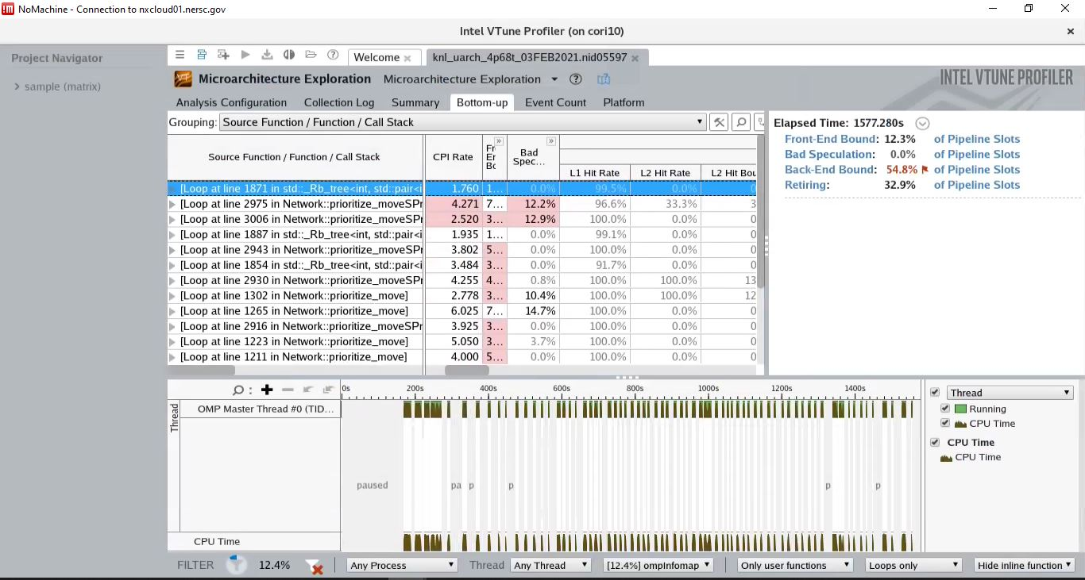
Cache Performance Measure (uarch)

Slide 5
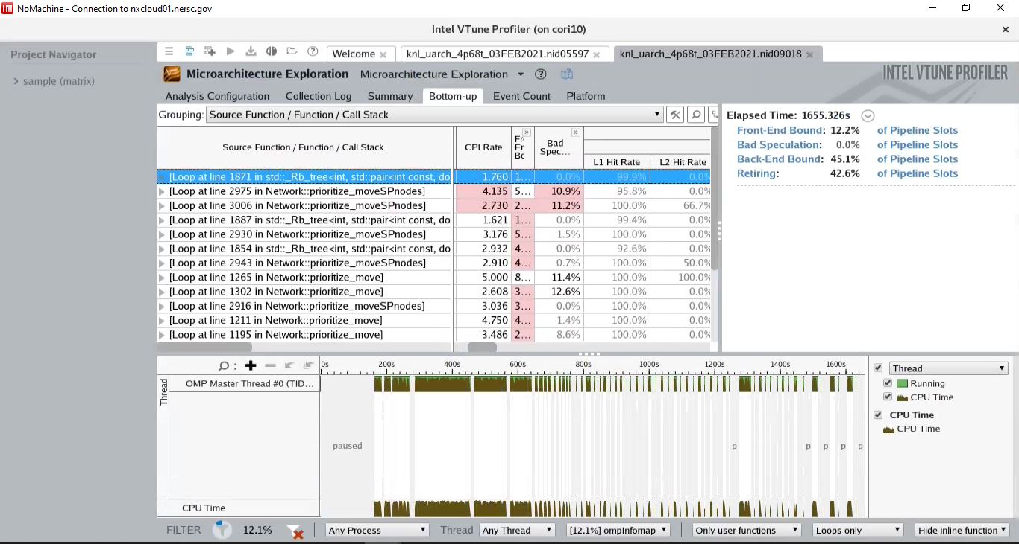
Cache Performance Measure (uarch)

Slide 6
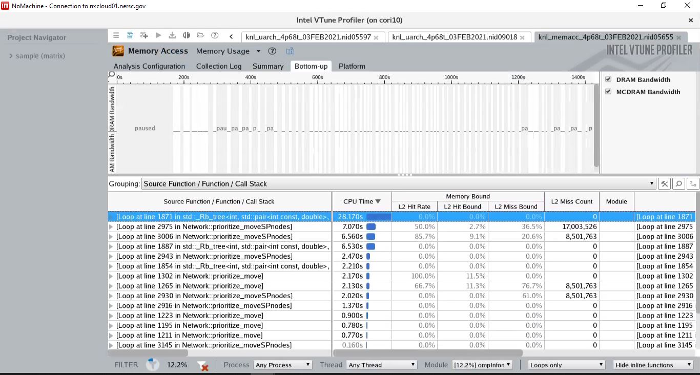
Cache Performance Measure (Memory Access)

Slide 7
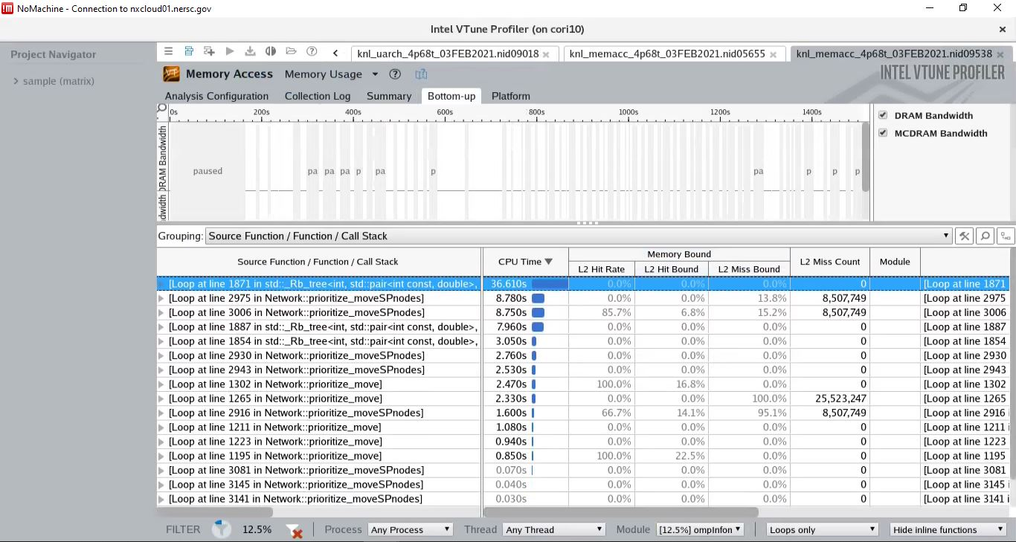
Cache Performance Measure (Memory Access)

Slide 8
Appendix

Slide 9
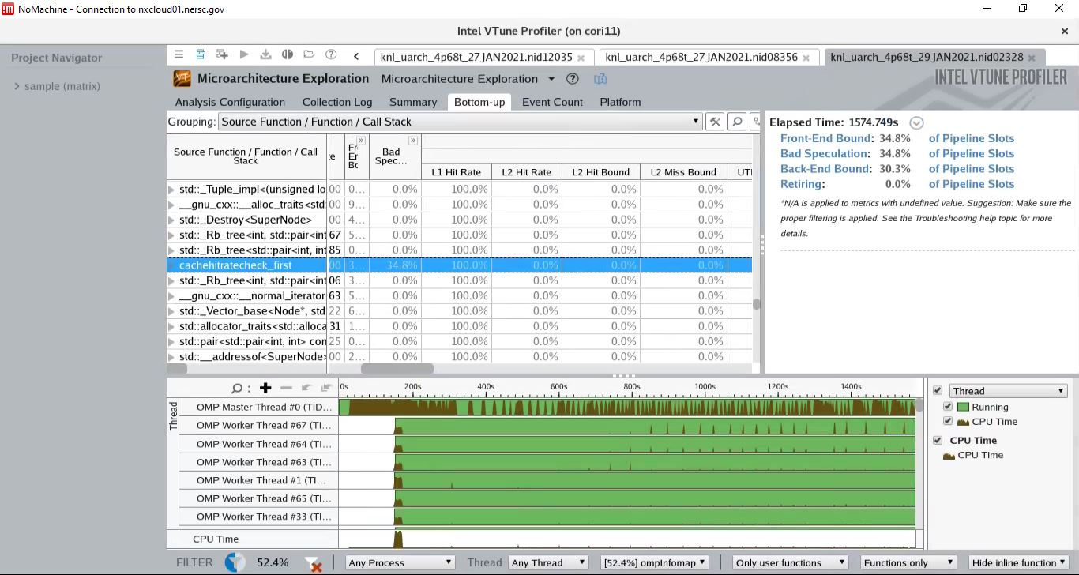
Cache Hit Rate (Pre-Warmup and Fixed Iteration)
Note: The traversal loop was executed 32768 times. Given each map access is 12 bytes, the total size of the memory access is 32768*12 = 384 KB. L2 cache size is 512 KB, therefore all the map access data should fit into L2 cache

Slide 10
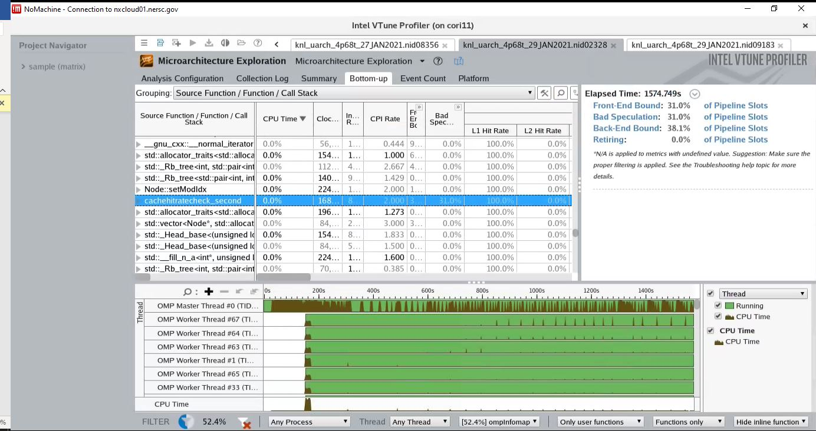
Cache Hit Rate (Post-Warmup and Fixed Iteration)
Note: The traversal loop was executed 32768 times. Given each map access is 12 bytes, the total size of the memory access is 32768*12 = 384 KB. L2 cache size is 512 KB, therefore all the map access data should fit into L2 cache

Slide 11
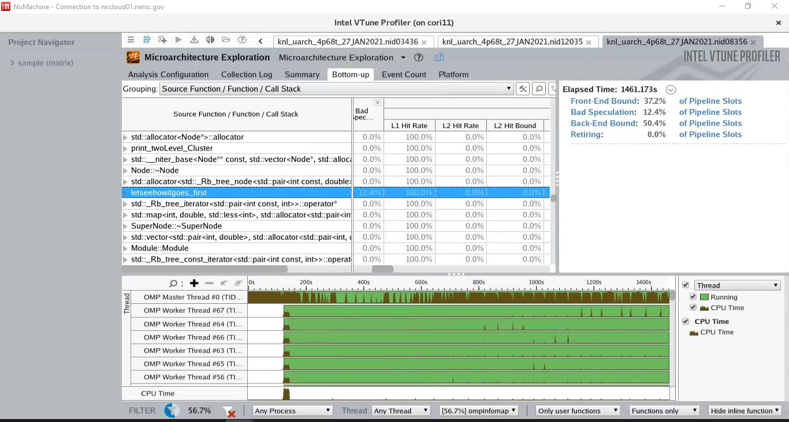
Cache Hit Rate (Pre-Warmup and Random Iteration)

Slide 12
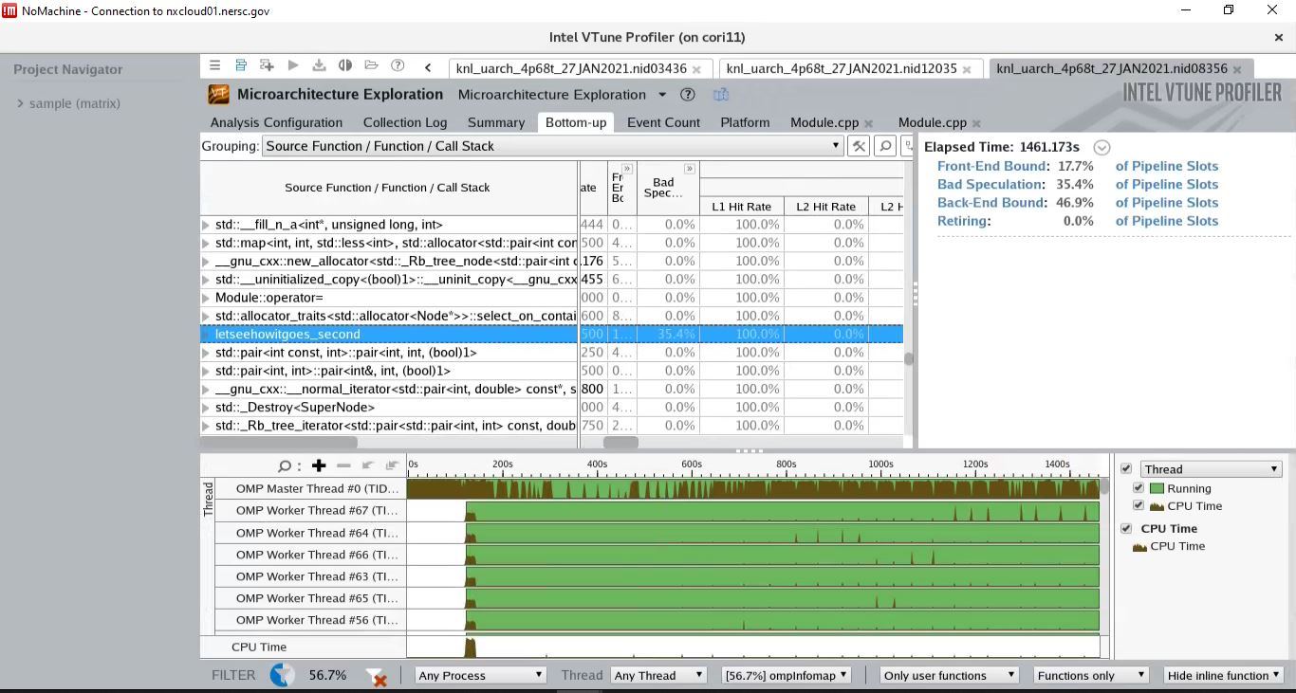
Cache Hit Rate (Post-Warmup and Random Iteration)

Slide 13
Information on MAP time
Community Optimization (sec) | Map Operation Time (sec) | >= Percentage (%)
183.73 | 103.86 | 56
206.63 | 113.79 | 55

Slide 14
Sample Code Snippet for Map Operation
flowmap outFlowToMod; // <modId, flow> for outFlow...
flowmap inFlowFromMod; // <modId, flow> for inFlow...
//mark 2_2 subbegin
double mark_22 = MPI_Wtime();
for (link_iterator linkIt = nd.outLinks.begin();
linkIt != nd.outLinks.end(); linkIt++) {
int newMod = nodes[linkIt->first].ModIdx();
if (outFlowToMod.count(newMod) > 0) {
outFlowToMod[newMod] += beta * linkIt->second;
} else {
outFlowToMod[newMod] = beta * linkIt->second; // initialization of the outFlow of the current newMod.
inFlowFromMod[newMod] = 0.0;
nModLinks++;
}
}

Slide 15
Assumption for theoretical Peak (KNL)
Infinite L2 memory with latency (~ 115 cycles)
Infinite MCDRAM memory with latency (~ 185 cycles)
No L1 cache, only L2 or lower level cache/memory exist
Notes:
1. https://stackoverflow.com/questions/21369381/measuring-cache-latencies

Slide 16
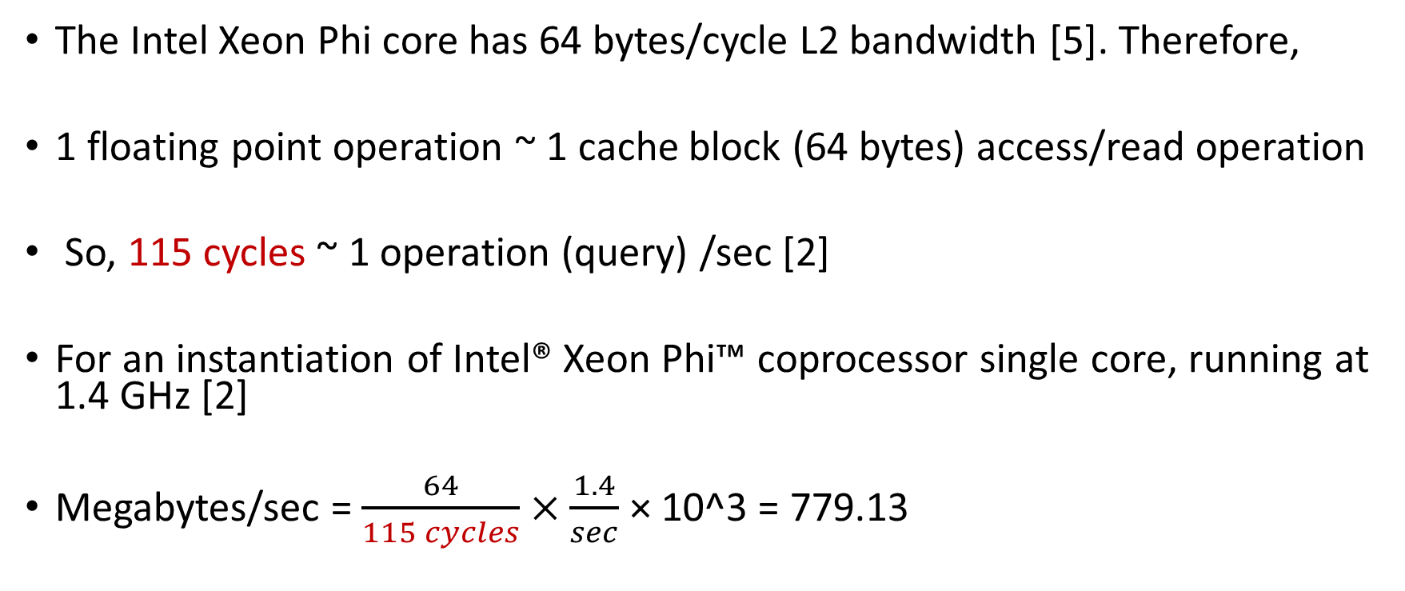
Computation for theoretical Peak (L2)
The Intel Xeon Phi core has 64 bytes/cycle L2 bandwidth [5]. Therefore,
1 floating point operation ~ 1 cache block (64 bytes) access/read operation
So, 115 cycles ~ 1 operation (query) /sec [2]
For an instantiation of Intel® Xeon Phi™ coprocessor single core, running at 1.4 GHz [2]
Megabytes/sec = $\frac{64}{115 cycles}×\frac{1.4}{sec}$ × 10^3 = 779.13
Notes:
2. https://software.intel.com/content/www/us/en/develop/articles/intel-xeon-phi-core-micro-architecture.html#:~:text=The%20Intel%20Xeon%20Phi%20core,64%2Dbit%20integer%20vector%20instructions.
5. https://www.nersc.gov/assets/Uploads/Using-KNL-Processors-Feb2019.pdf

Slide 17

Computation for theoretical Peak (MCDRAM)
The Intel Xeon Phi core has 64 bytes/cycle L2 bandwidth [5]. Therefore,
1 floating point operation ~ 1 cache block (64 bytes) access/read operation
So, 185 cycles ~ 1 operation (query) /sec [2]
For an instantiation of Intel® Xeon Phi™ coprocessor single core, running at 1.4 GHz [2]
Megabytes/sec = $\frac{64}{185 cycles}×\frac{1.4}{sec}$ × 10^3 = 484.32
Notes:
2. https://software.intel.com/content/www/us/en/develop/articles/intel-xeon-phi-core-micro-architecture.html#:~:text=The%20Intel%20Xeon%20Phi%20core,64%2Dbit%20integer%20vector%20instructions.

Slide 18
Rb Tree Access (map in c++) Before Cash Warmup
Time = 80.67 sec, total object (link) accesses = 351602917
Accesses per second = 351602917/80.67 = 4358533
Each link object 12 bytes
Therefore, Bytes accessed/read per second = 4358533 *12 = 52302396
I.e. 52302396 /10^6 = 52.30 MB/sec

Slide 19
Rb Tree Access (map in c++) After Cash Warmup
Time = 77.62 sec, total object (link) accesses = 351602917
Accesses per second = 351602917/77.62 = 4529797
Each link object 12 bytes
Therefore, Bytes accessed/read per second = 4529797 *12 = 54357564
I.e. 54357564 /10^6 = 54.36 MB/sec

