Slide 1
Weekly Meeting
19th February, 2021

Slide 2
Outline
Measuring the distribution of the size of the neighborhood (outlinks /adjacency list) vector
Performance measurement in terms of CPI using prefetch and no prefetch. Following are the 2 aspects of the prefetch
Prefetch the neighborhood information (outlinks vector) of the immediate next vertex
Prefetch the neighborhood information (outlinks vector) of the current vertex in the iteration a stride (a few number of neighbors ahead in the adjacency list) ahead

Slide 3
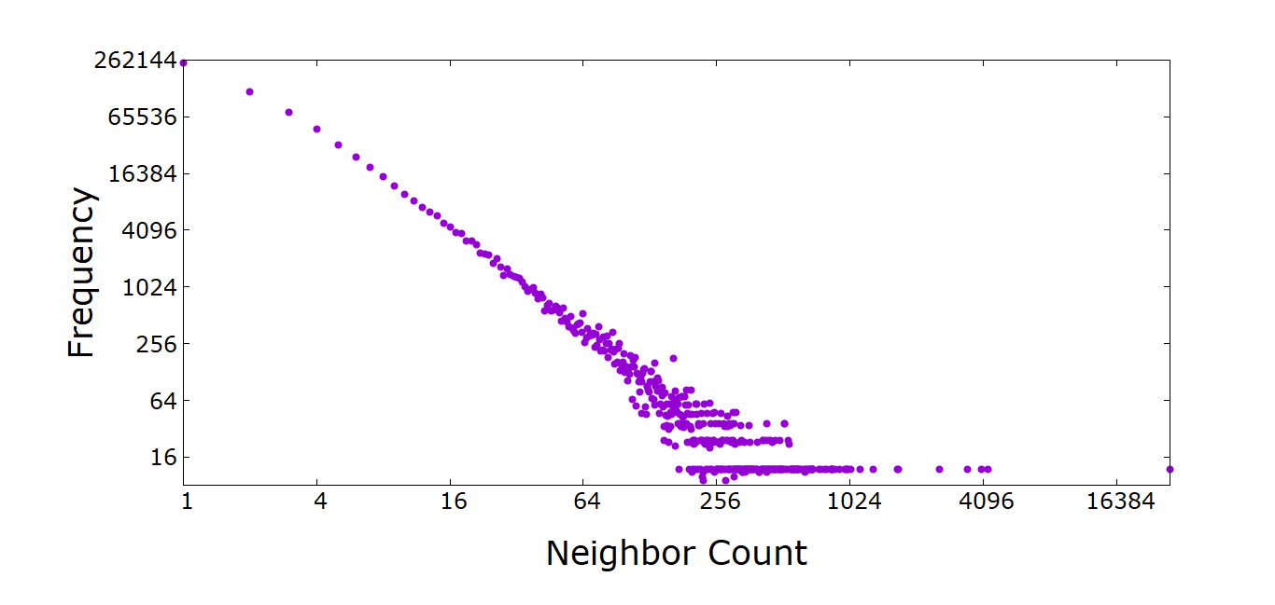
Frequency of the Neighborhood size (Youtube network)

Slide 4
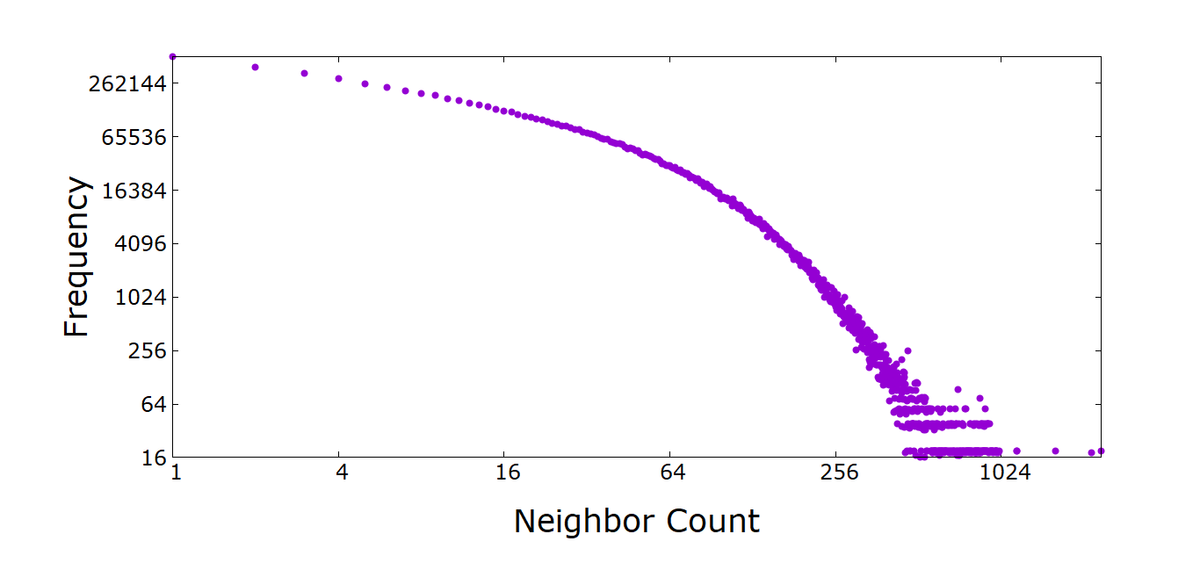
Frequency of the Neighborhood size (Orkut network)

Slide 5
Performance (CPI) Comparison among (No-Prefetch, Next-Vertex-Prefetch and Adjacency-List-Prefetch)
Line No. | Code | Nextnode prefetch CPI | No prefetch CPI | Current Neighborhood prefetch CPI (stridesize 6)
1216 | for (link_iterator linkIt = nd.outLinks.begin(); | 6.77 | 6.68 | 6.53
1218 | int newMod = nodes[linkIt->first].ModIdx(); | 7.39 | 8.23 | 7.61
1220 | iter = outFlowToMod.find(newMod); | 4.45 | 17.186 | 16.376
1222 | if (iter != outFlowToMod.end()) | 6.36 | 5.687 | 5.579
1224 | iter->second += beta * linkIt->second; | 3.05 | 3.251 | 3.25
1228 | outFlowToMod[newMod] = beta * linkIt->second; | 5.05 | 6.185 | 5.45
1229 | inFlowFromMod[newMod] = 0.0; | 6.647 | 6.699 | 6.011

Slide 6
Appendix

