Slide 1
Weekly Meeting
5th March, 2021

Slide 2
Outline
Without using Vtune, reporting the execution time for different types of prefetches using a regular timer.
Report the microbenchmark information using
Inside loop prefetcher and outside loop prefetcher combined
A few number of neighboring list prefetch ahead

Slide 3
Microbenchmark using Regular Timer for different Prefetches (Excluding the time of prefetcher code itself)
Implementation Type | Average Time (sec)/Iteration
No Prefetch | 3.39
Neighborhood links prefetch | 3.35
Neighborhood node prefetch | 3.33 | 3.33 | 3.33
Next Node Prefetch | 3.33 (1st node) | 3.33 (2nd node) | 3.33 (3rd node) | 3.33 (4th node)
Combined (current Neighbor + Next Node) prefetch | 3.36

Slide 4
Microbenchmark using Regular Timer for different Prefetches (Including the time of prefetcher code itself)
Implementation Type | Average Time/Iteration
No Prefetch | 3.66
Neighborhood links prefetch | 3.63
Neighborhood node prefetch | 3.80 | 3.80 | 3.81
Next Nodes Prefetch | 3.60 (1st node) | 3.60 (2nd node) | 3.60 (3rd node) | 3.60 (4th node)
Combined (current Neighbor + Next Node) prefetch | 3.84

Slide 5
Performance (CPI) Comparison among (No-Prefetch, A few Vertices-Prefetch, Adjacency-List-Prefetch and A Neighbor Vertex Prefetch)
Line No. | Code | No prefetch CPI | Next 4 node ahead prefetch CPI (A) | Current Neighborhood Links prefetch CPI (stridesize 64) | Next neighborhood node prefetch CPI (B) | Next 2nd Neighborhodd Prefetch | Combined (A and B) Prefetch
1216 | for (link_iterator linkIt = nd.outLinks.begin(); | 5.816 | 6.366 | 6.57 | 6.92 | 7.47 | 6.683
1218 | int newMod = nodes[linkIt->first].ModIdx(); | 8.231 | 7.79 | 7.68 | 5.34 | 5.11 | 5.217
1220 | iter = outFlowToMod.find(newMod); | 15.29 | 16.50 | 15.163 | 11.815 | 13.977 | 13.388
1222 | if (iter != outFlowToMod.end()) | 5.090 | 5.737 | 5.408 | 5.549 | 5.672 | 5.163
1224 | iter->second += beta * linkIt->second; | 3.091 | 3.351 | 3.39 | 3.136 | 3.556 | 3.115
1228 | outFlowToMod[newMod] = beta * linkIt->second; | 5.480 | 5.482 | 5.497 | 5.814 | 5.997 | 5.968
1229 | inFlowFromMod[newMod] = 0.0; | 5.788 | 6.503 | 6.47 | 6.92 | 6.468 | 5.412

Slide 6
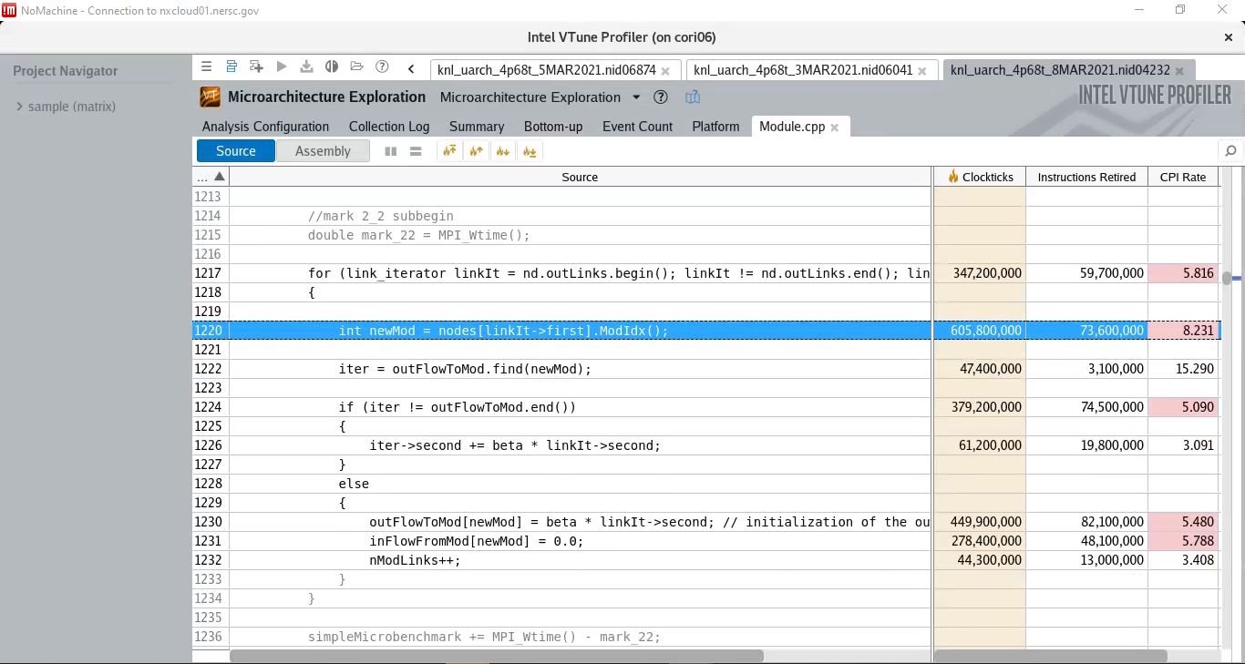
No Prefetching (Baseline)
Note: This is column 3 of the comparison table in slide 5

Slide 7
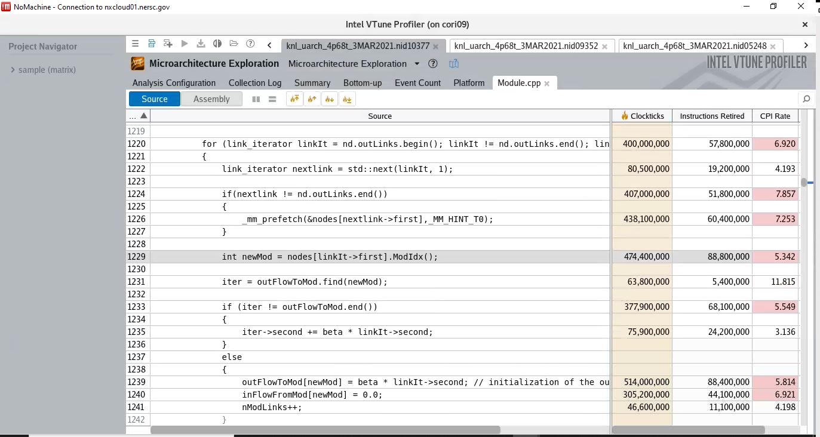
Neighborhood prefetch of current Adjacency List (inside loop prefetch)
Note: This is column 6 of the comparison table in slide 5

Slide 8
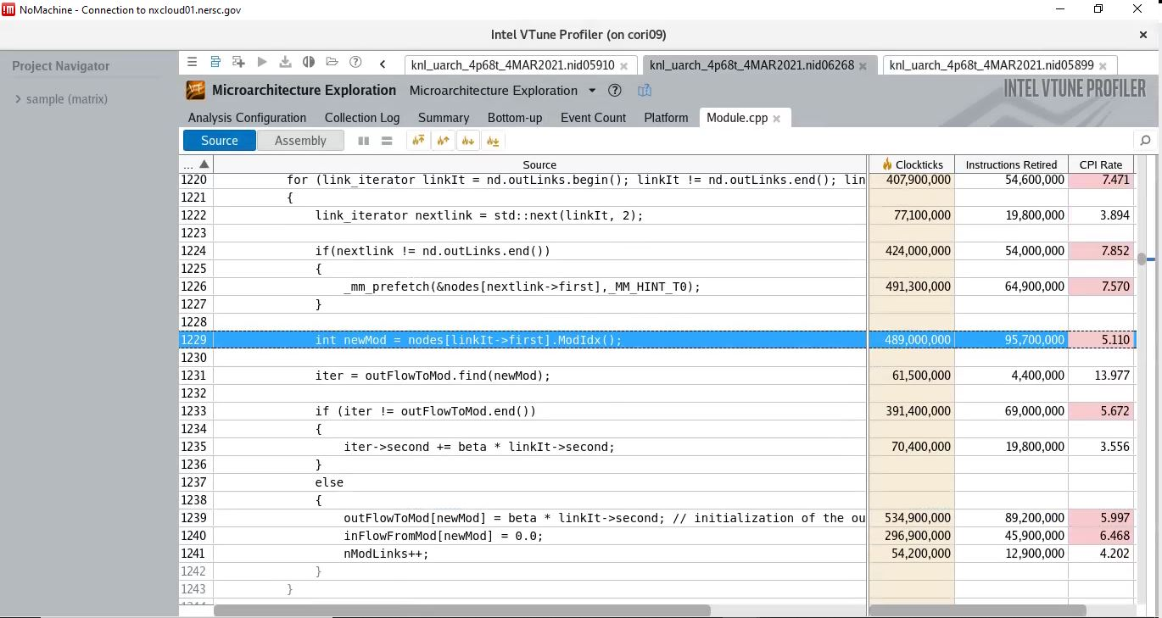
2nd Neighborhood prefetch of current Adjacency List (inside loop prefetch)
Note: This is column 7 of the comparison table in slide 5

Slide 9
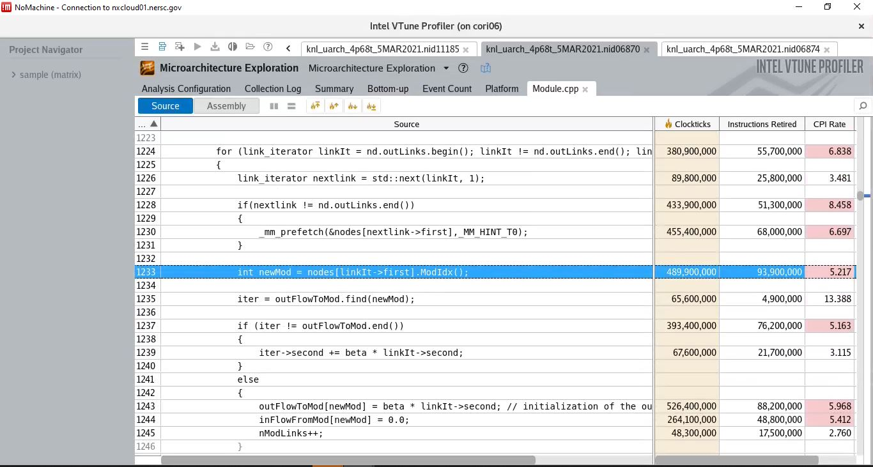
Combined (Outside Loop + Inside Loop) Prefetch
Note: This is column 8 of the comparison table in slide 5. The outside loop is not displayed in the screenshot

