Slide 1
Weekly Meeting
October 23, 2020

Slide 2
Outline
Micro-benchmarking of streaming access pattern
Micro-benchmarking of steaming + stanza access pattern

Slide 3
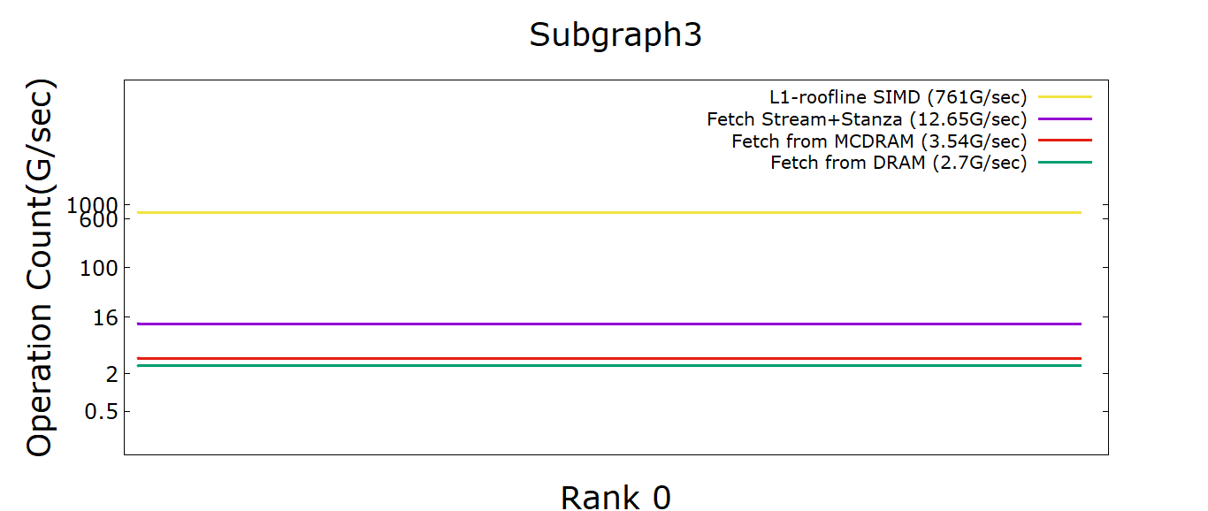
Roofline (streaming+stanza) Access

Slide 4
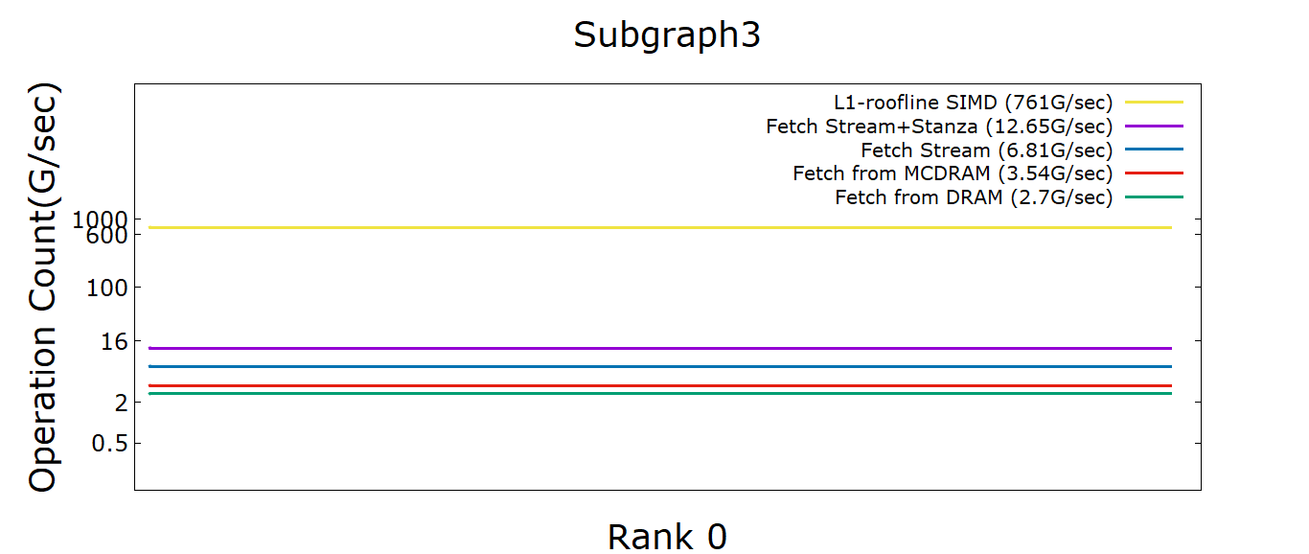
Roofline (streaming+stanza) vs streaming

Slide 5
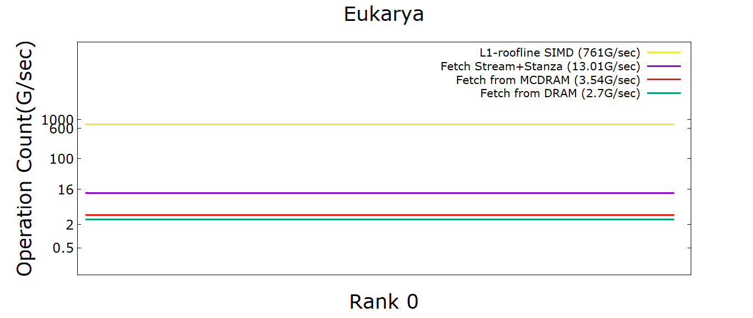
Roofline (streaming+stanza) Access

Slide 6
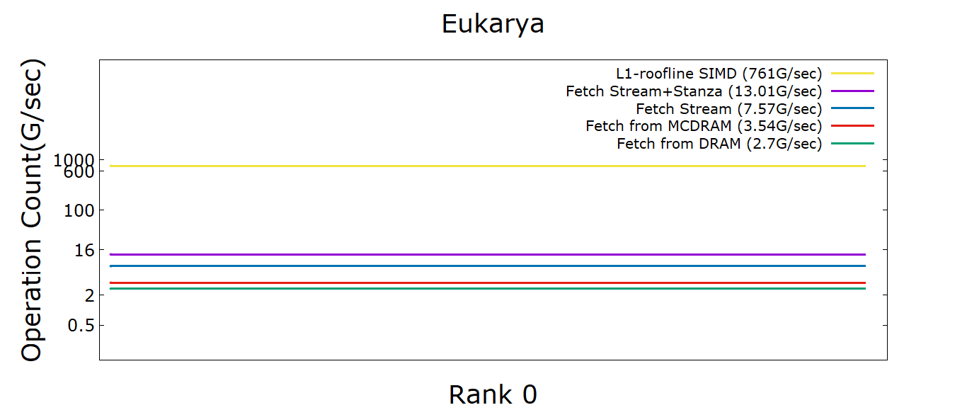
Roofline (streaming+stanza) vs stanza

Slide 7
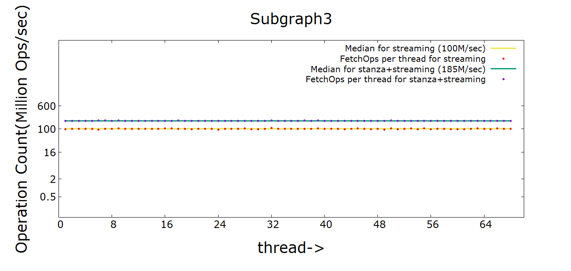
Load Imbalance for (Stream+Stanza) vs Stream Only

Slide 8
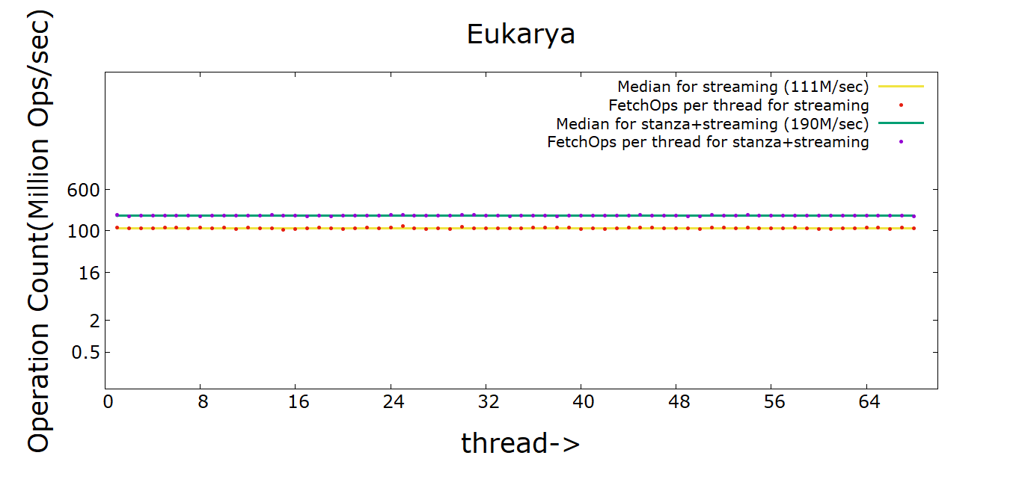
Load Imbalance for (Stream+Stanza) vs Stream Only

Slide 9

Appendix

Slide 10
Memory Latencies (KNL)
MCDRAM latency ~215 cycles
DRAM latency ~283 cycles

Slide 11
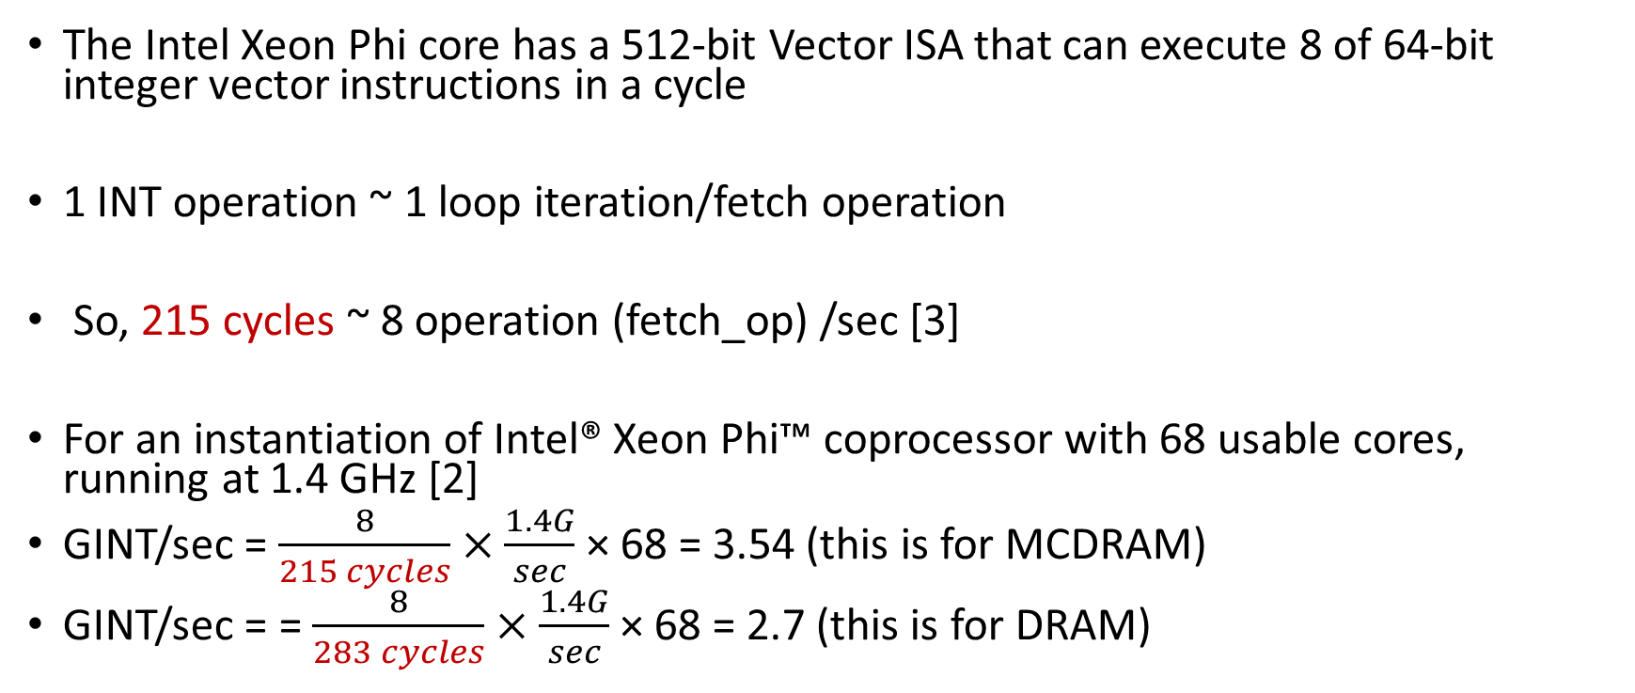
Computation for theoretical Peak
The Intel Xeon Phi core has a 512-bit Vector ISA that can execute 8 of 64-bit integer vector instructions in a cycle
1 INT operation ~ 1 loop iteration/fetch operation
So, 215 cycles ~ 8 operation (fetch_op) /sec [3]
For an instantiation of Intel® Xeon Phi™ coprocessor with 68 usable cores, running at 1.4 GHz [2]
GINT/sec = $\frac{8}{215 cycles}×\frac{1.4G}{sec}$ × 68 = 3.54 (this is for MCDRAM)
GINT/sec = = $\frac{8}{283 cycles}×\frac{1.4G}{sec}$ × 68 = 2.7 (this is for DRAM)
Notes:
L1 roofline is (8/cycles)*1.4*68 = 761.6
Latency measured for MCDRAM is 215 cycles and for DRAM is ~283 cycles using intel latency checker tool https://software.intel.com/content/www/us/en/develop/articles/intelr-memory-latency-checker.html
3. https://software.intel.com/content/www/us/en/develop/articles/intel-xeon-phi-core-micro-architecture.html#:~:text=The%20Intel%20Xeon%20Phi%20core,64%2Dbit%20integer%20vector%20instructions.

Slide 12
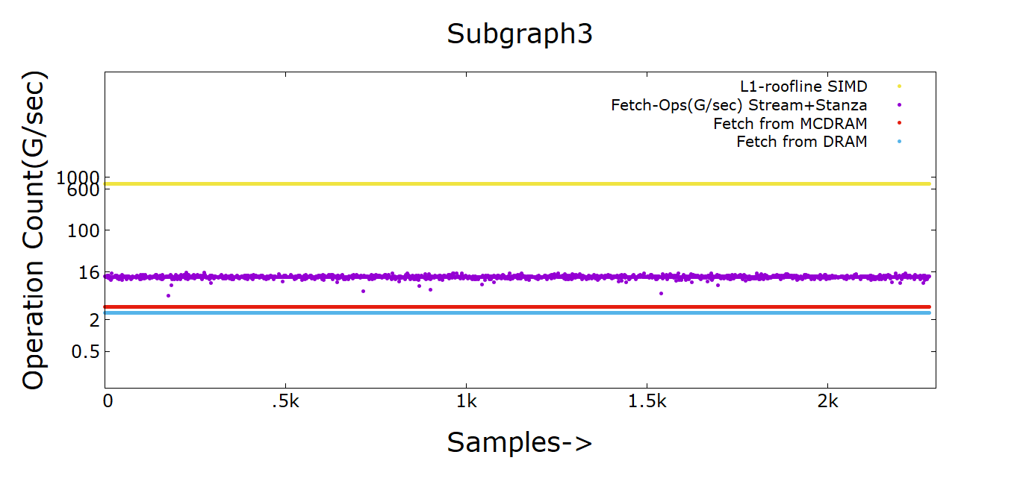
Roofline (streaming+stanza) Access

Slide 13
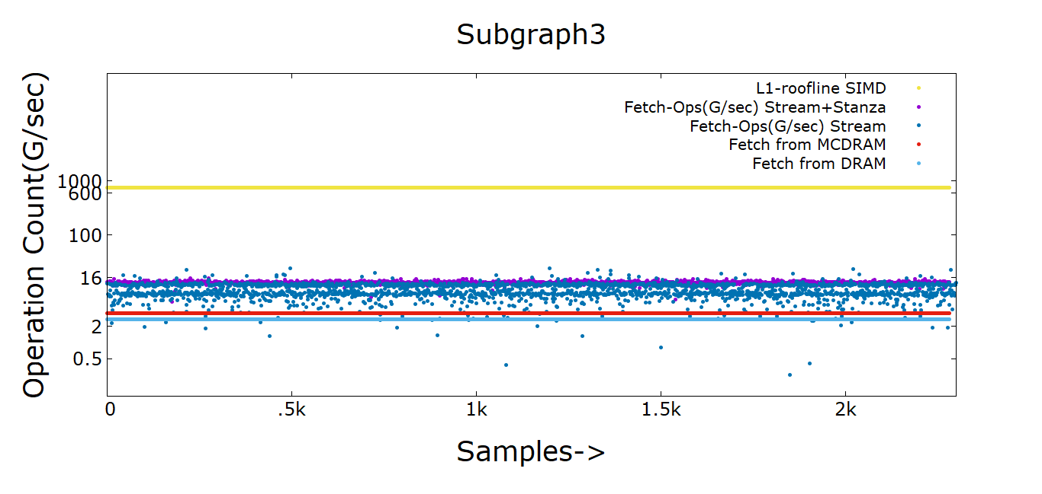
Roofline (streaming+stanza) vs stanza

Slide 14
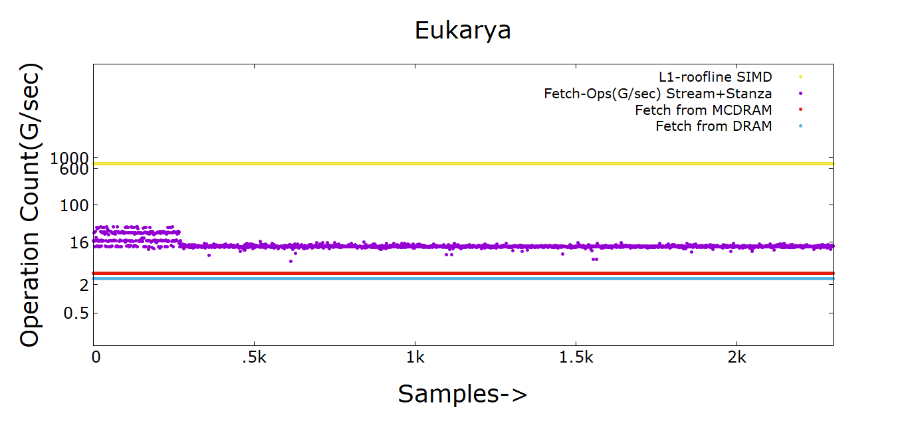
Roofline (streaming+stanza) Access

Slide 15
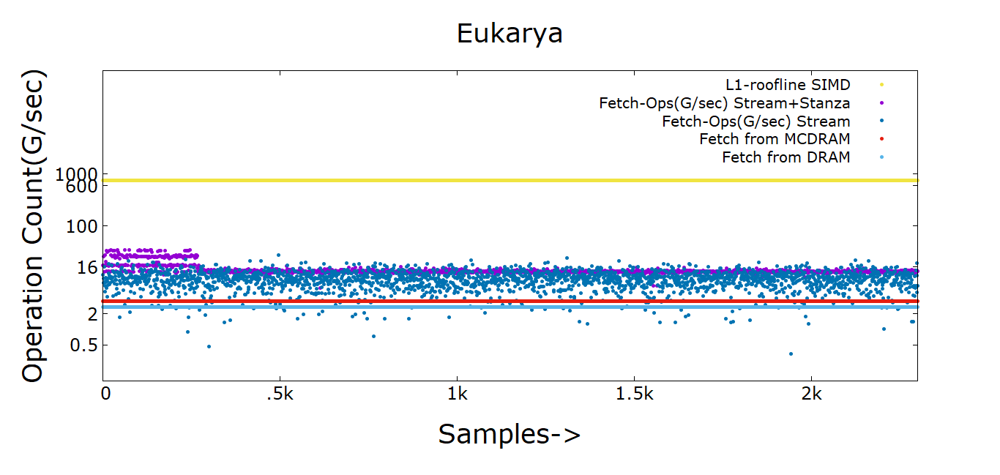
Roofline (streaming+stanza) vs stanza

Slide 16
Maximum Hash Table Sizes
Dataset | #Compute Nodes (KNL) | Number of Vertices (million) | Number of Edges (million) | Hash Table Size/thread
virus | 1 | 0.22 | 4.58 | 32
subgraph5 | 4 | 1.79 | 82 | 256
archaea | 4 | 1.6 | 205 | 256
Eukarya | 4 | 3.2 | 360 | 512
subgraph4 | 4 | 3.8 | 327 | 512
subgraph3 | 16 | 7.9 | 1309 | 512

Slide 17
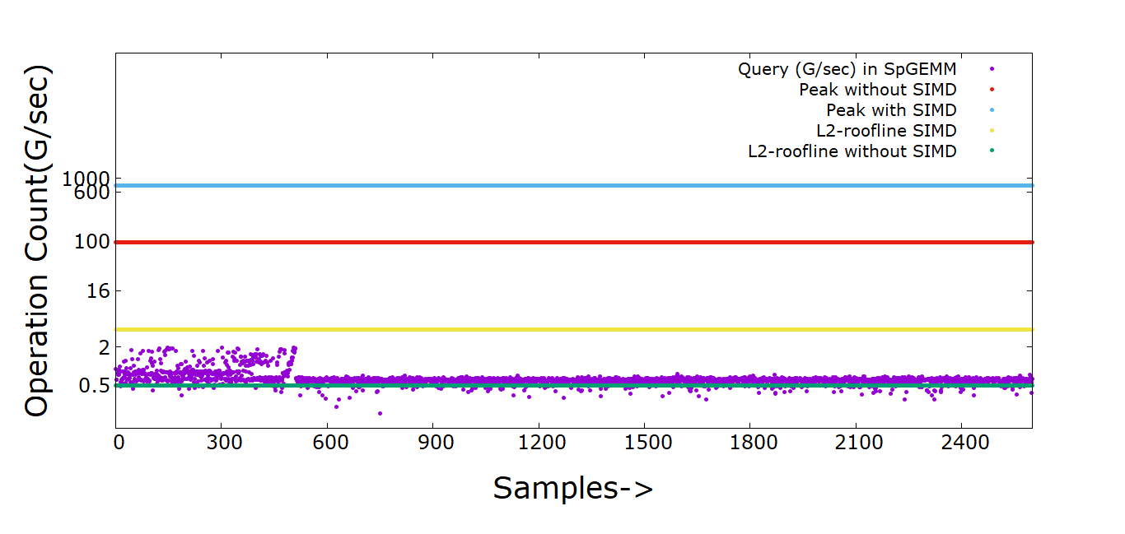
Hash Kernel (Eukarya)

