Slide 1
Weekly Meeting
September 11, 2020

Slide 2
Profiling Aspects
Build the theoretical roofline based on assumptions
Compare the hash kernel with the theoretical roofline

Slide 3
Assumption for theoretical Peak
No hash table collision
Infinite on-chip memory with very low latency (~ 1 cycle) [1]
A hash query can be a search/insert
1 INT operation ~ 1 hash query
Notes:
1. Yang Y., Kuppannagari S.R., Srivastava A., Kannan R., Prasanna V.K. (2020) FASTHash: FPGA-Based High Throughput Parallel Hash Table. In: Sadayappan P., Chamberlain B., Juckeland G., Ltaief H. (eds) High Performance Computing. ISC High Performance 2020. Lecture Notes in Computer Science, vol 12151. Springer, Cham. https://doi.org/10.1007/978-3-030-50743-5_1

Slide 4
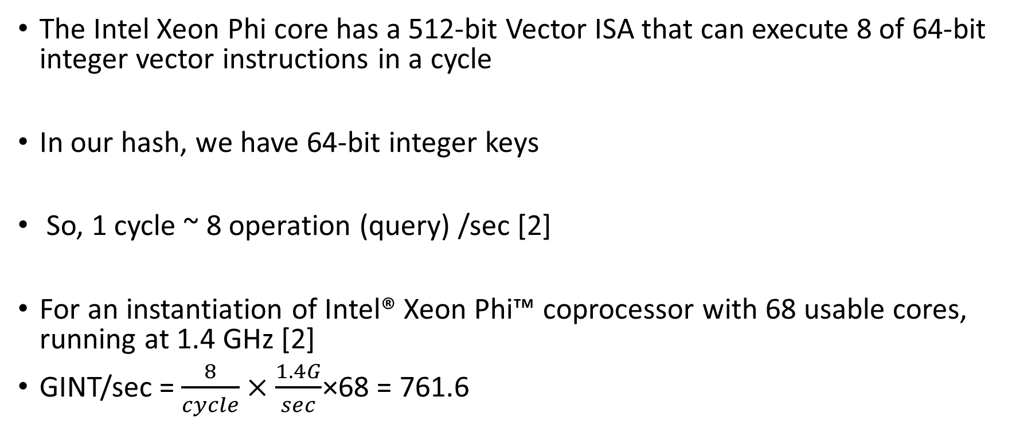
Computation for theoretical Peak
The Intel Xeon Phi core has a 512-bit Vector ISA that can execute 8 of 64-bit integer vector instructions in a cycle
In our hash, we have 64-bit integer keys
So, 1 cycle ~ 8 operation (query) /sec [2]
For an instantiation of Intel® Xeon Phi™ coprocessor with 68 usable cores, running at 1.4 GHz [2]
GINT/sec = $\frac{8}{cycle}×\frac{1.4G}{sec}$×68 = 761.6
Notes:
2. https://software.intel.com/content/www/us/en/develop/articles/intel-xeon-phi-core-micro-architecture.html#:~:text=The%20Intel%20Xeon%20Phi%20core,64%2Dbit%20integer%20vector%20instructions.

Slide 5
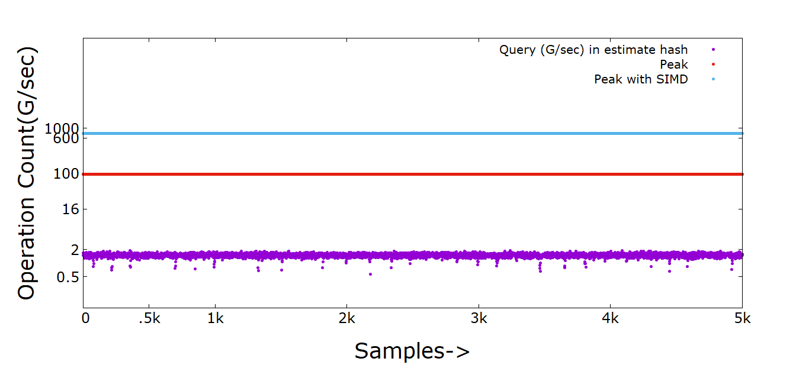
Hash Kernel for Estimate Hash Size

Slide 6
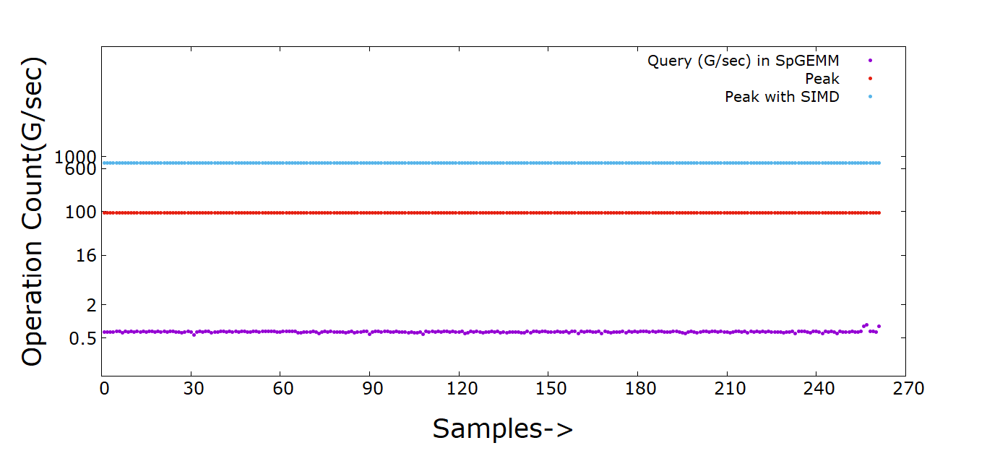
Hash Kernel for local SpGEMM

Slide 7
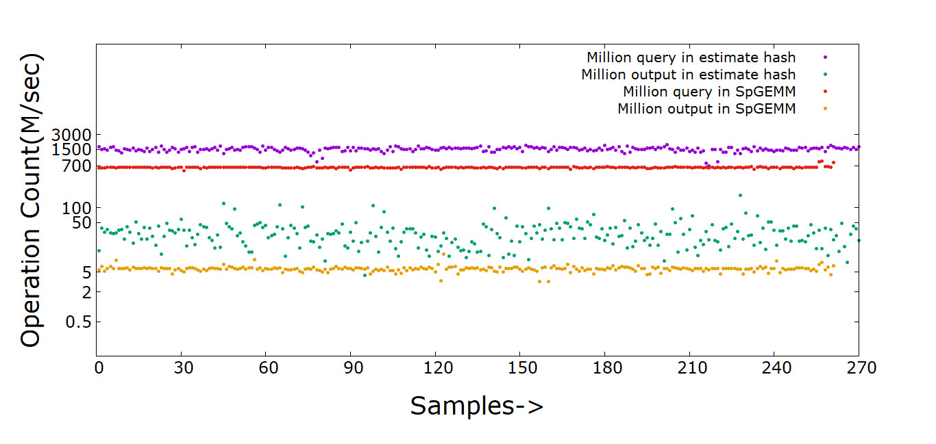
Hash Comparison SpGEMM and Estimate Hash

