Slide 1
Weekly Meeting
September 18, 2020

Slide 2
Profiling Aspects
Build the theoretical roofline based on assumptions and observed latency
Compare the hash kernel with the theoretical and observed rooflines
Time breakdown of the different kernel of localSpGEMM

Slide 3
Assumption for theoretical Peak
No hash table collision
Infinite L2 memory with latency (~ 196 cycles) [1]
No L1 cache, only L2 or lower level cache/memory exist
A hash query can be a search/insert
Notes:
1. https://stackoverflow.com/questions/21369381/measuring-cache-latencies

Slide 4
Profiling Cache Latencies (KNL)
L1 has latency 0 cycles
32 KB data
32 KB instruction
L2 has latency 196 cycles
1MB unified cache

Slide 5
Profiling Cache Latencies (Haswell)
L1 has latency of 6 cycles
32 KB data cache
L2 has latency of 22 cycles
264 KB unified cache
L3 has latency of 58 cycles
40 MB unified cache

Slide 6
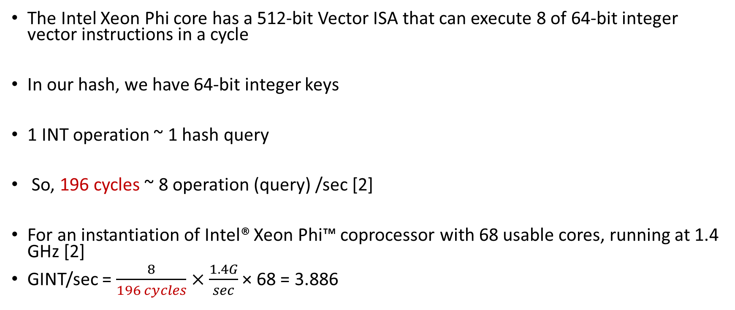
Computation for theoretical Peak
The Intel Xeon Phi core has a 512-bit Vector ISA that can execute 8 of 64-bit integer vector instructions in a cycle
In our hash, we have 64-bit integer keys
1 INT operation ~ 1 hash query
So, 196 cycles ~ 8 operation (query) /sec [2]
For an instantiation of Intel® Xeon Phi™ coprocessor with 68 usable cores, running at 1.4 GHz [2]
GINT/sec = $\frac{8}{196 cycles}×\frac{1.4G}{sec}$ × 68 = 3.886
Notes:
2. https://software.intel.com/content/www/us/en/develop/articles/intel-xeon-phi-core-micro-architecture.html#:~:text=The%20Intel%20Xeon%20Phi%20core,64%2Dbit%20integer%20vector%20instructions.

Slide 7
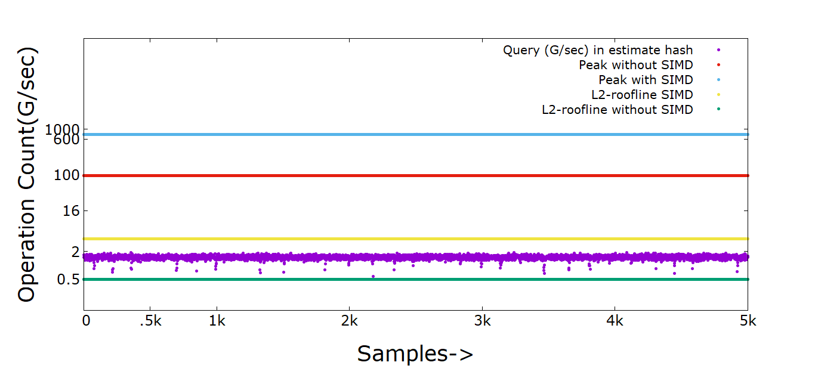
Hash Kernel for hash size estimation

Slide 8
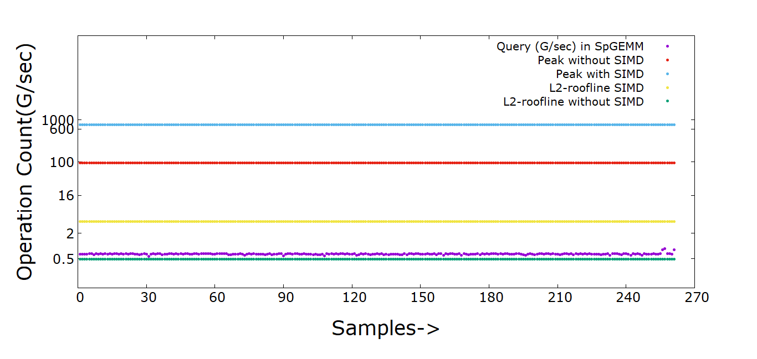
Hash Kernel for localSpGEMM

Slide 9
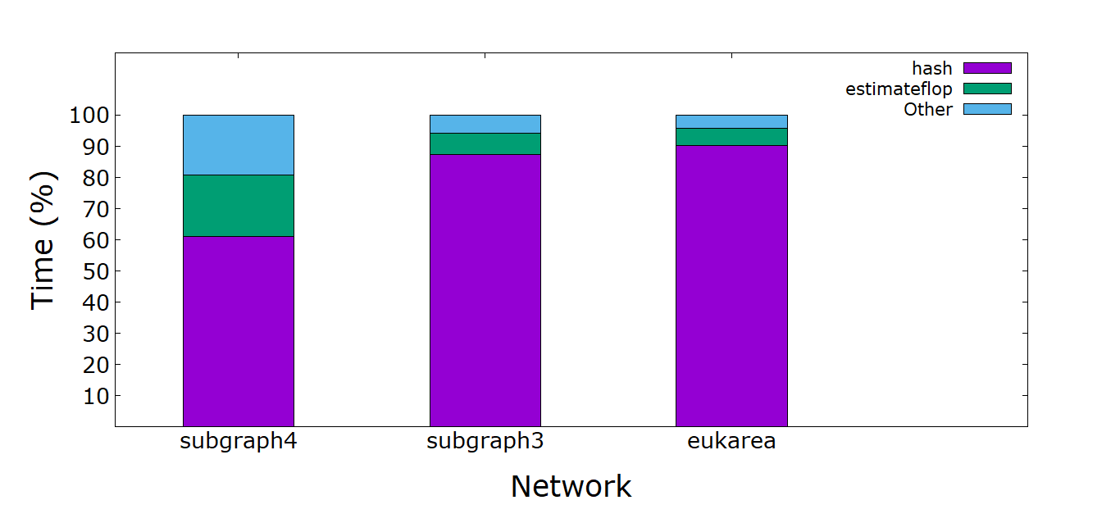
Time breakdown (%) of localSpGEMM kernels

Slide 10
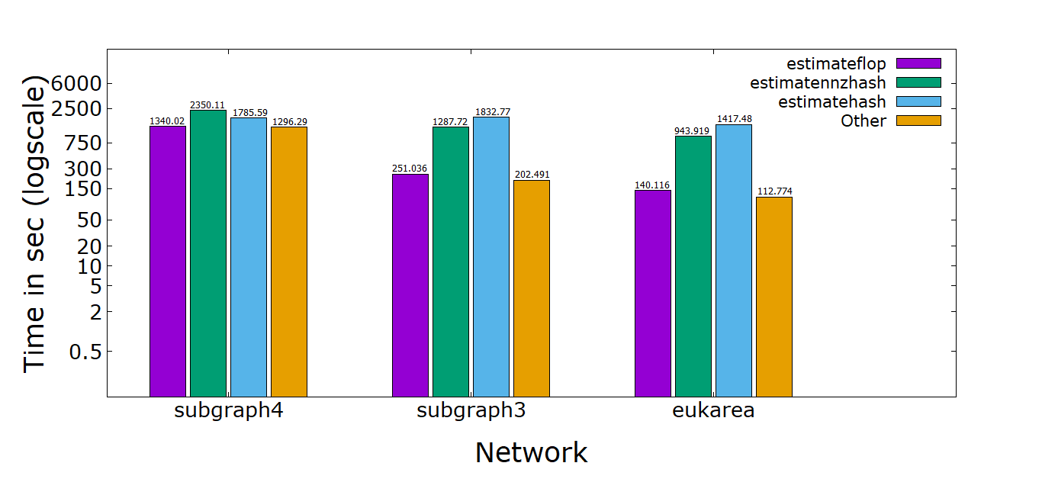
Time breakdown of localSpGEMM kernels

Slide 11
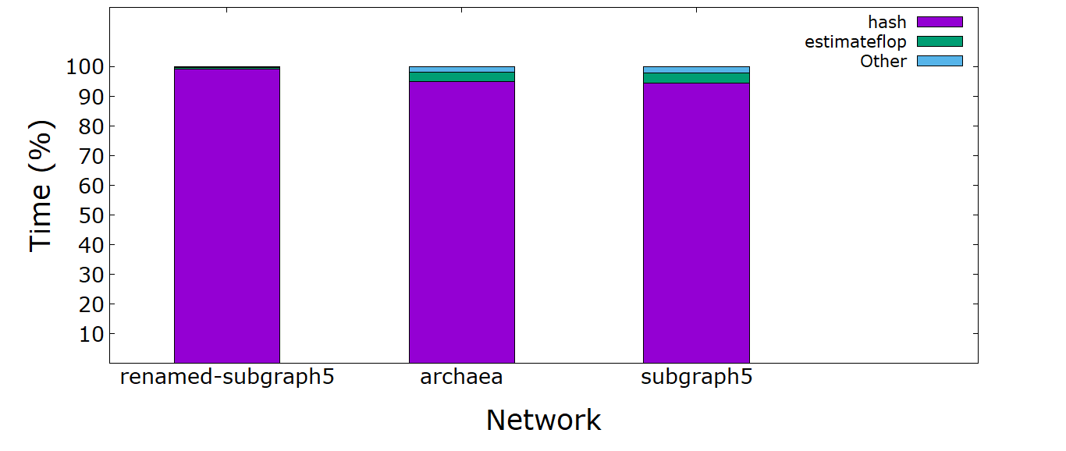
Time breakdown (%) of localSpGEMM kernels

Slide 12
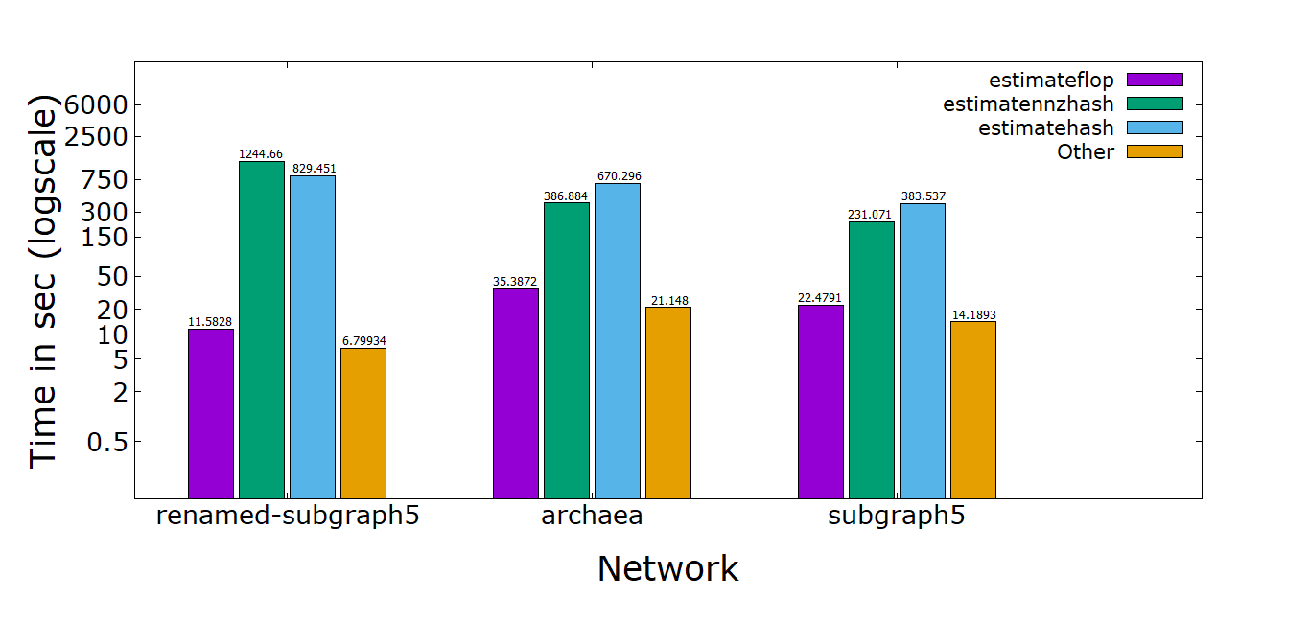
Time breakdown of localSpGEMM kernels

Slide 13
Datasets
Dataset | Number of Vertices (million) | Number of Edges (million)
Renamed subgraph5 | 0.58 | 67
subgraph5 | 1.79 | 82
archaea | 1.6 | 205
Eukarya | 3.2 | 360
subgraph4 | 3.8 | 327
subgraph3 | 7.9 | 1309

