Slide 1
Weekly Meeting
July 30, 2020

Slide 2
Outline
Estimation of alpha (α) and beta (β) parameter in Sparse SUMMA
T_{comm} validation using observed alpha (α) and beta parameter (β)
Finding vertex-hash matching performance for SpGEMM

Slide 3
Finding the Observed Bandwidth (1/β)
Solving linear equation for latency and bandwidth using observed message transfer delay and message size
Look at this discussion for details https://stackoverflow.com/questions/15638244/how-to-calculate-the-latency-and-bandwidth-of-a-network

Slide 4
Observed Bandwidth for 64 compute nodes
Datasize in MB (x1) | Datasize in MB (x2) | (x1-x2) | 1/β (MB/sec)
335.508728 | 291.93343 | 43575296 | 3816.702812
204.19204 | 124.15433 | 80037712 | 2358.642769
66.948728 | 34.940056 | 32008672 | 1725.627904
18.620152 | 10.832008 | 7788144 | 2005.759627
7.202568 | 5.456296 | 1746272 | 4850.486084
4.57164 | 4.068728 | 502912 | 692.9548743
3.598216 | 3.509048 | 89168 | 193.0837357
18.620152 | 10.832008 | 7.788144 | 2005.759627

Slide 5
Observed Bandwidth for 16 compute nodes
Datasize in MB (x1) | Datasize in MB (x2) | (x1-x2) | 1/β (MB/sec)
1310.595496 | 1138.046056 | 172549440 | 3304.025735
787.338488 | 468.483384 | 318855104 | 3969.364787
243.361256 | 119.756024 | 123605232 | 3955.759835
59.952024 | 33.679992 | 26272032 | 3715.582886
22.103912 | 16.596328 | 5507584 | 4347.120249
13.797592 | 12.286664 | 1510928 | 12574.30093
10.853688 | 10.573848 | 279840 | 139.1504977
10.323608 | 10.304392 | 19216 | 78.78315772
41.027968 | 25.13816 | 15.889808 | 3835.67136

Slide 6
Observed Bandwidth for 4 compute nodes
Datasize in MB (x1) | Datasize in MB (x2) | (x1-x2) | 1/β (MB/sec)
874.733704 | 184.904936 | 689828768 | 11129.68116
3084.846296 | 1815.957864 | 1.269E+09 | 9596.433594
1815.957864 | 924.496136 | 891461728 | 6026.647701
435.797384 | 205.429256 | 230368128 | 5364.259588
109.563848 | 71.18036 | 38383488 | 11875.34435
54.06644 | 45.554152 | 8512288 | 7250.856495
40.877752 | 38.170184 | 2707568 | 1573.124789
36.520056 | 35.66484 | 855216 | 5702.580516
34.919704 | 34.867368 | 52336 | 1050.290989
109.563848 | 71.18036 | 38.383488 | 6026.647701

Slide 7
T_{comm} Validation
Network | NNZ(A) | #Processes = P | NNZ(A)/P | NNZ(A)/P in Byte | Median Bandwidth (1/β) Byte/Sec | βmedian*(NNZ(A)/P) | Tcomm (sec) calculated | Tcomm (sec) reported
Subgraph4 | 331397685 | 4 | 82849421.25 | 662795370 | 6026650000 | 0.109977412 | 0.219954824 | 249.795
Subgraph4 | 331397685 | 16 | 20712355.31 | 165698842.5 | 3835670000 | 0.043199452 | 0.172797808 | 7.84076
Subgraph4 | 331397685 | 64 | 5178088.828 | 41424710.63 | 2005760000 | 0.020652875 | 0.165223 | 7.39252
Note: The latency (α) is ignored in the Tcomm computation as it is in the microsecond range

Slide 8
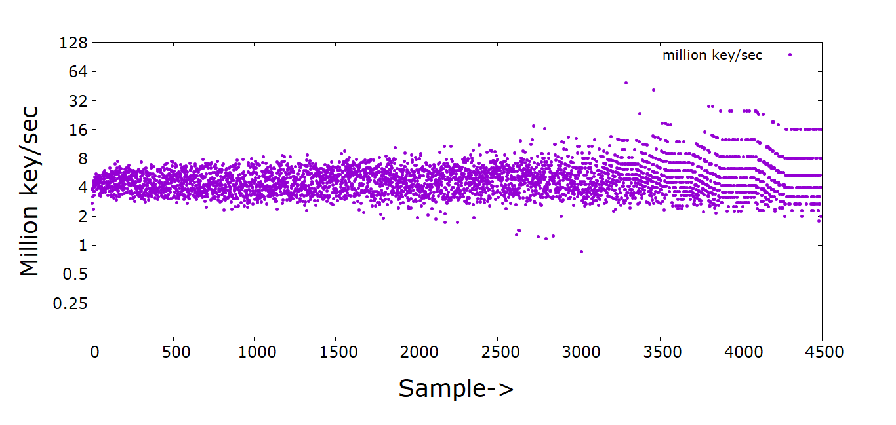
Hash performance for Virus dataset
Note:- Mean:5.11, Median:4.65

Slide 9
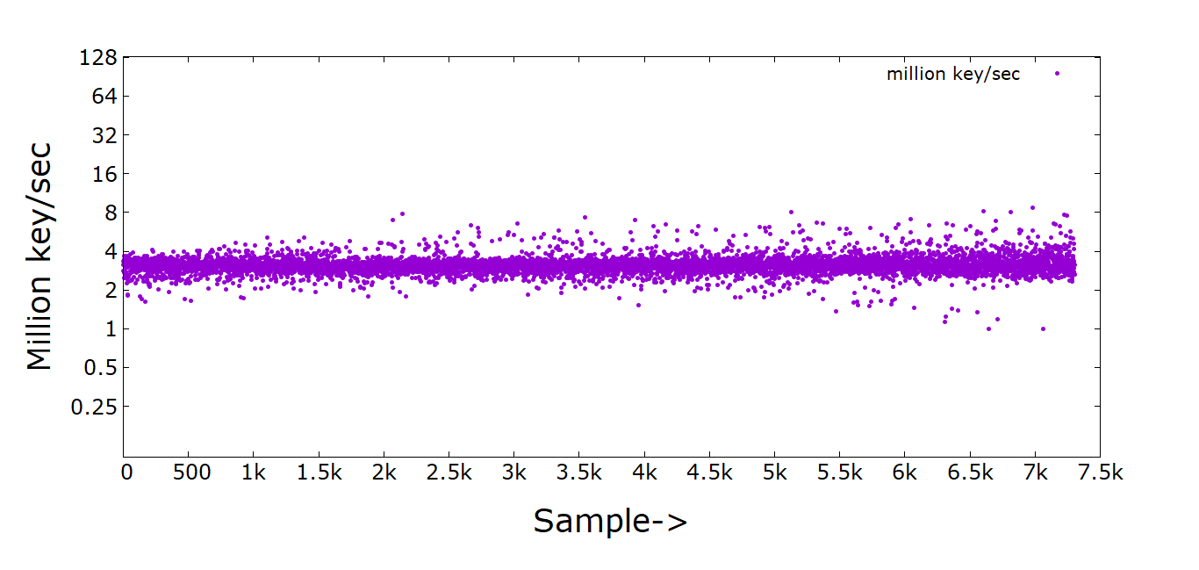
Hash performance for subgraph4 dataset
Note:- Mean:3.15, Median:3.11, Min:1, Max:8.75

