Slide 1
Weekly Meeting
September 4, 2020

Slide 2
Profiling Aspects
How good the current hash function?
Is current L2 size limiting the performance?
What is current throughput for the hash kernel?
Roofline analysis for the hash kernel

Slide 3
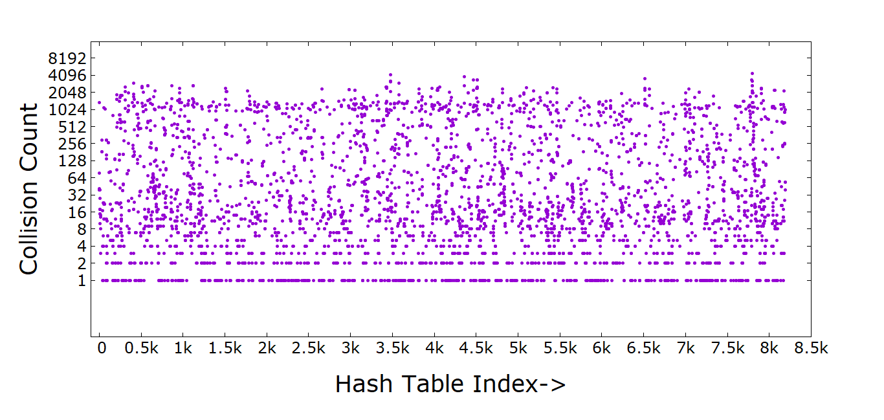
How good the hash kernel
The quality of the hash function is measured in terms of the collision happening. Ideal hash function should have no collision

Slide 4
Profiling Aspects
How good the current hash function?
Is current L2 size limiting the performance?
What is current throughput for the hash kernel?
Roofline analysis for the hash kernel

Slide 5
L2 size limitation
Is current L2 size limiting the performance?
Yes, for a graph of size 7.95M vertices and 1.31B edges, the maximum hash table size is 512k.¹
Each processor in a two-core tile has 512k of 1MB shared L2 cache
For this size or bigger graph, the current L2 cache is not sufficient
1:For 32768 entry and each entry taking 16 bytes. The total size is 32768*16/1024 KB = 512 KB

Slide 6
Profiling Aspects
How good the current hash function?
Is current L2 size limiting the performance?
What is current throughput for the hash kernel?
Roofline analysis for the hash kernel

Slide 7
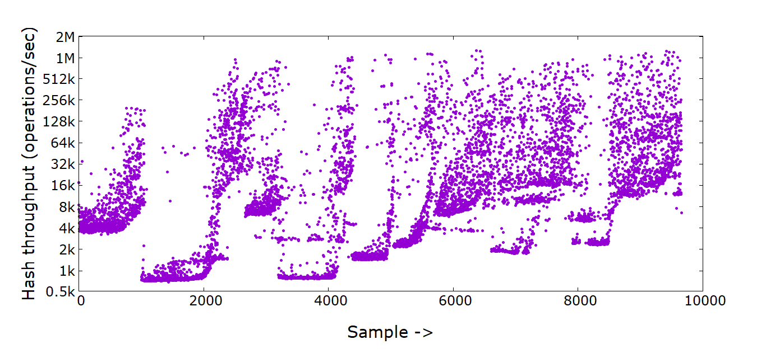
Hash Kernel Throughput
Note: Here 1 operation means computing one entry of the output matrix in each iteration.

