Slide 1
Outline
Executed hipMCL with medium size networks
Observation points to the underlying data structure for memory-bound problem
Extracted standalone SpGEMM from the hipMCL codebase
Increased memory in distribute processes improves stalling on SpGEMM

Slide 2
Weekly Meeting July 2nd, 2020

Slide 3
Work Summary
Profiling HipMCL and SpGEMM on Cori using Vtune
Profiling analysis type
Microarchitecture analysis with…
Medium size networks
Higher number of cores and threads

Slide 4
Description of the Dataset
Dataset | Number of Vertices | Number of Edges
Renamed subgraph5¹ | 581607 | 67337723
subgraph5² | 1791380 | 82151035
subgraph4³ | 3793394 | 327604293
Notes:
1. Renamed_subgraph5 – /global/project/projectdirs/m1982/www/HipMCL/subgraphs-1103/Renamed_subgraph5_set1103_MMSeqs_Qcov065_Hcov065_SBS_all
2. subgraph5 - /global/project/projectdirs/m1982/www/HipMCL/subgraphs/subgraph5_iso_vs_iso_30_70length_ALL.m100.indexed.mtx
3. subgraph4 - /global/project/projectdirs/m1982/www/HipMCL/subgraphs/subgraph4_iso_vs_iso_30_70length_ALL.m100.indexed.mtx

Slide 5
HipMCL Runtime Analysis in KNL
Dataset | # Processes | Total #Threads | Processor | Network Read Time (sec) | Computing Time(sec)
Renamed_subgraph5 | 1 | 64 | KNL | 826.864 | 2748.3
 | 4 | 256 |  | 199.813 | 451.222
subgraph5 | 1 | 64 |  | 1029.56 | Out-of-memory
 | 4 | 256 |  | 243.964 | 663.312
subgraph4 | 4 | 256 |  | 1039.26 | 4451.04
 | 16 | 1024 |  | 255.044 | 740.716

Slide 6
HipMCL Memory Analysis with Different Processes and Threads in Default Page Size (4k) in KNL
Dataset | Processor | PageSize | Number of MPI Process | Number of OpenMP Threads | Range
 |  |  |  |  | CPI Rate | L1 Hit Rate (%) | L2 Hit Rate (%)
Renamed_subgraph5 | KNL | 4k | 1 | 64 | 3.93-23.31 | 45.7-94.4 | 67.2-92.9
 |  |  | 4 | 256 | 3.81-12.295 | 51.8-99.9 | 0-100
subgraph5 |  |  | 1 | 64 | 1.29-18.05 | 51.6-94.4 | 0-91.3
 |  |  | 4 | 256 | 2.71-17.11 | 56-100 | 12.6-100
subgraph4 |  |  | 4 | 256 | 2.63-8.08 | 53.3-100 | 61.4-100
 |  |  | 16 | 1024 | 2.43-17.46 | 60.3-100 | 12.3-99.1

Slide 7
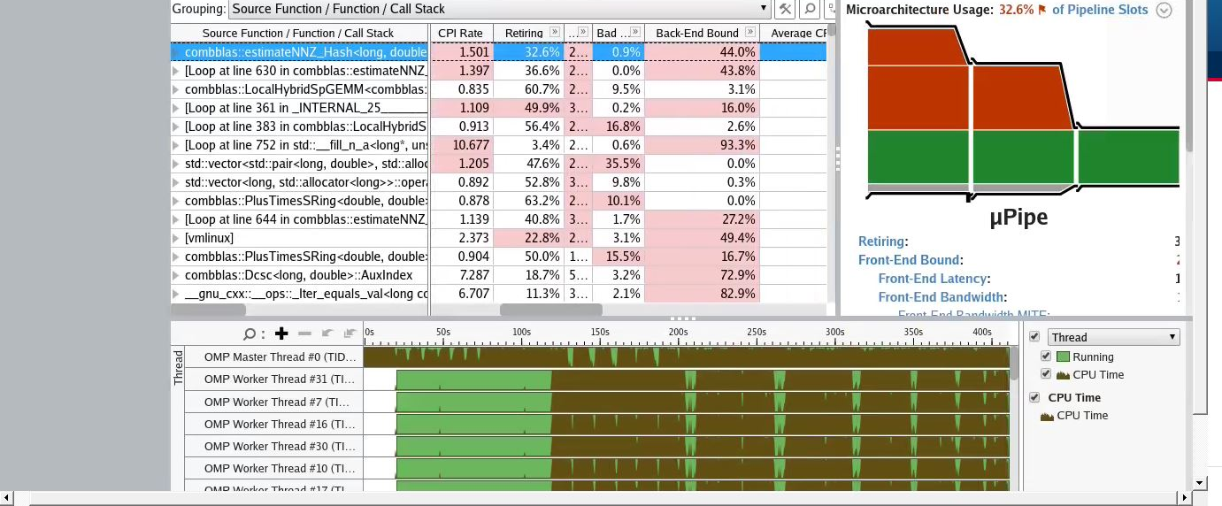
HipMCL Microarchitecture Benchmarking Snapshot in Haswell
Notes:
Network : renamed_subgraph5
Execution configurations: 4 MPI processes in 4 Compute Nodes, 128 OpenMP threads, 128 GB memory in each compute node

Slide 8
Observation
Hash data structure is responsible for creating memory stall
Changing processor number/thread number does not seem to affect the memory stall problem

Slide 9
Weekly Meeting July 9th, 2020

Slide 10
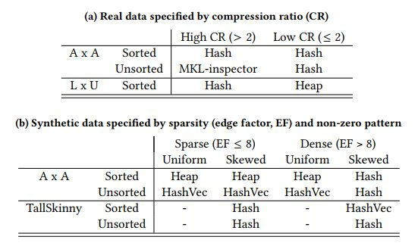
Motivation Behind Hash in SpGEMM
Notes:
The article link is here https://arxiv.org/pdf/1804.01698.pdf
Compression ratio cr = flop/number of non-zero elements of output
The term edge factor refers to the ratio of number of non zero element to the number of rows n, i.e., edge factor = nnz/n

Slide 11
SpGEMM Runtime Analysis
Dataset | # Processes | Total #Threads | Processor | Network Read Time (sec) | Computing Time(sec)
Renamed_subgraph5 | 1 | 64 | KNL | 1365.84 | 2118.8
 | 4 | 256 |  | 336.515 | 361.348
subgraph5 | 1 | 64 |  | 1675.18 | 585.668
 | 4 | 256 |  | 399.481 | 195.995
Subgraph4 | 4 | 256 |  | 1702.85 | 930.137
 | 16 | 1024 |  | 423.102 | 291.669

Slide 12
SpGEMM Memory Analysis with Different Processes and Threads in Default Page Size (4k)
Dataset | Processor | PageSize | Number of MPI Process | Number of OpenMP Threads | Range
 |  |  |  |  | CPI Rate | L1 Hit Rate (%) | L2 Hit Rate (%)
Renamed_subgraph5 | KNL | 2M | 1 | 64 | 2.81-34.17 | 59.1-95.5 | 18.2-92.9
 |  |  | 4 | 256 | 2.61-16.49 | 60.4-97.9 | 0-99.2
subgraph5 |  |  | 1 | 64 | 2.26-4.4 | 81.4-98.9 | 0-97.9
 |  |  | 4 | 256 | 2.71-17.11 | 56-100 | 12.6-100
Subgraph4 |  |  | 4 | 256 | 2.68-4.34 | 80.8-100 | 73-100
 |  |  | 16 | 1024 | 2.76-3.19 | 91.4-100 | 50.7-97.7

Slide 13
Observation
Running SpGEMM on multiple compute nodes in KNL seems to overcome the memory bound issue
Hash is not exhibiting bottleneck
A single run of SpGEMM on moderate size networks does not overwhelm the underlying memory architecture of KNL

