Slide 1
CpE 403 Final Project
Dayton Flores
Joseph Sharp-Halpin

Slide 2
Goal
Main Goal
To setup a remote system for embedded application development to collect temperature and lux data
Objectives
The goal was accomplished by interfacing sensors with a CC1350 board to collect temperature and lux data, and sending the data via RF to a second CC1350 board (CoProcessor) which sent the data to the BBB. The BBB then uploads to the TI-15.4 Stack Collector App.

Slide 3
Outcome - Accomplishments
Outcome – result of your project?
The built-in temperature sensor analyzed the data through ADC conversions
The external lux sensor communicated the data with the CC1350 through I2C
Could be used as a short-term thermometer if necessary
Could provide long-term data collection of house temperature/light usage and help monitor energy efficiency

Slide 4
Components Used in Design
1 BBB
https://cdn-shop.adafruit.com/datasheets/BBB_SRM.pdf
2 CC1350s
http://www.ti.com/lit/ds/symlink/cc1350.pdf
1 TSL2561
https://cdn-shop.adafruit.com/datasheets/TSL2561.pdf

Slide 5
Tools used in Design
CCS 7.2 (Code Composer Studio)
http://www.ti.com/lit/ug/slau157ap/slau157ap.pdf
TI-15.4 Stack Example Application
https://unlv.instructure.com/courses/5342/files/4949433/download?verifier=CJWkj6ZZF5GmKzPhujWqDWnywhxJSQbOksHMOwmS&wrap=1
Arago Project
http://arago-project.org
Uniflash
http://www.ti.com/tool/UNIFLASH

Slide 6
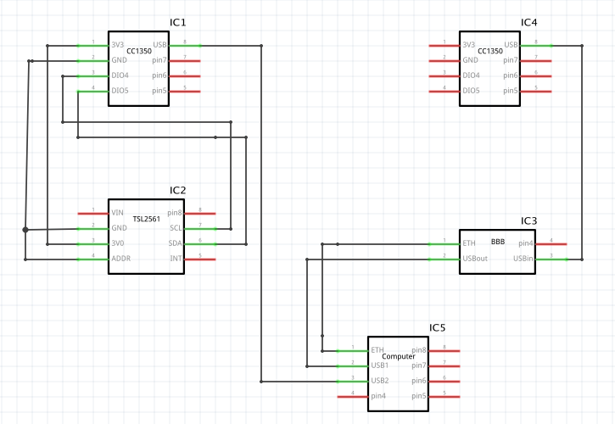
Schematics

Slide 7
Prerequisites used in Design
Prerequisites
Sensor + CoProcessor Firmware (CC1350)
Arago Project (BBB)
Commands to install prerequisites
$ screen /dev/tty.modem1423 115200 (serial connection to BBB)
$ ssh root@10.34.49.162 (SSH connection to BBB)
$ tar –xvf bbb-prebuilt.tar.gz (extract bbb_prebuilt.tar.gz)
$ rm bin/nv-simulation.bin
$ ./run_demo.sh

Slide 8
Implementation Details
Steps used in design:
Flash CC1350 Sensor + CC1350 CoProcessor
Setup Beaglebone Board with Arago Project
Wire lux sensor to CC1350 Sensor
Activate Collector App on browser
Debug and run program through CCS 7.2
Connect Sensor + CoProcessor through RF
Observe values in Collector App

Slide 9
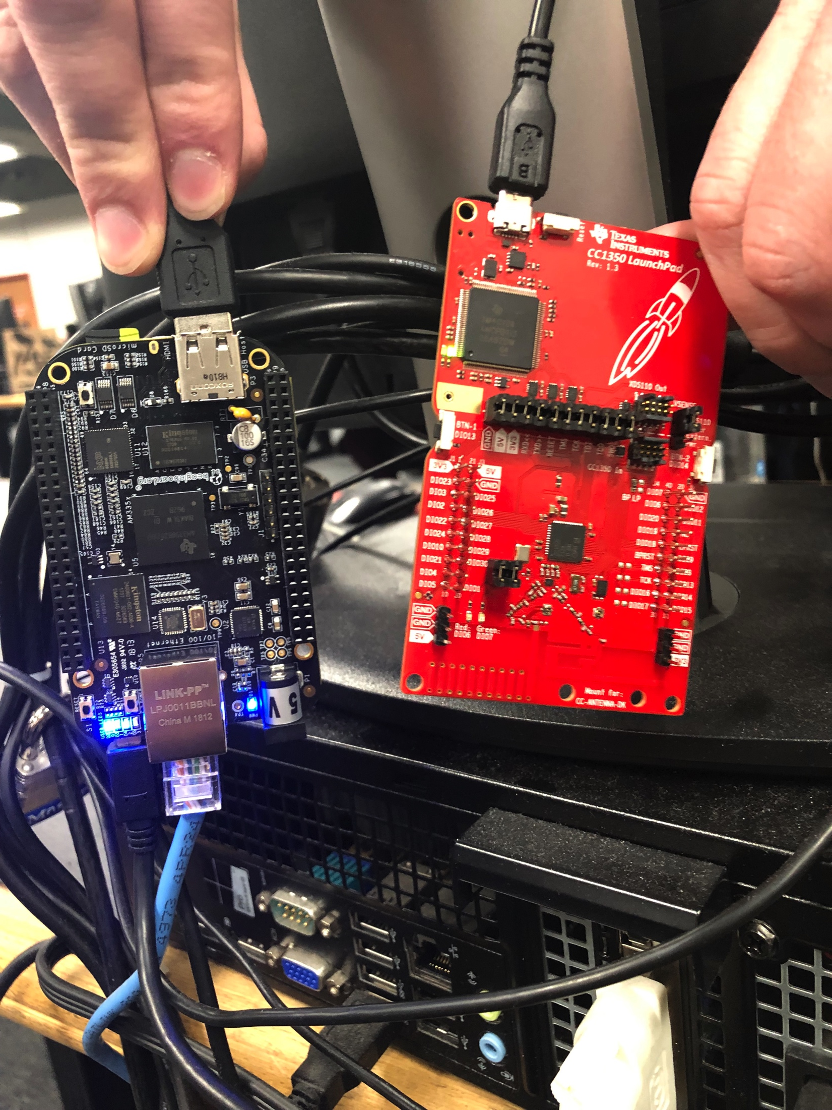
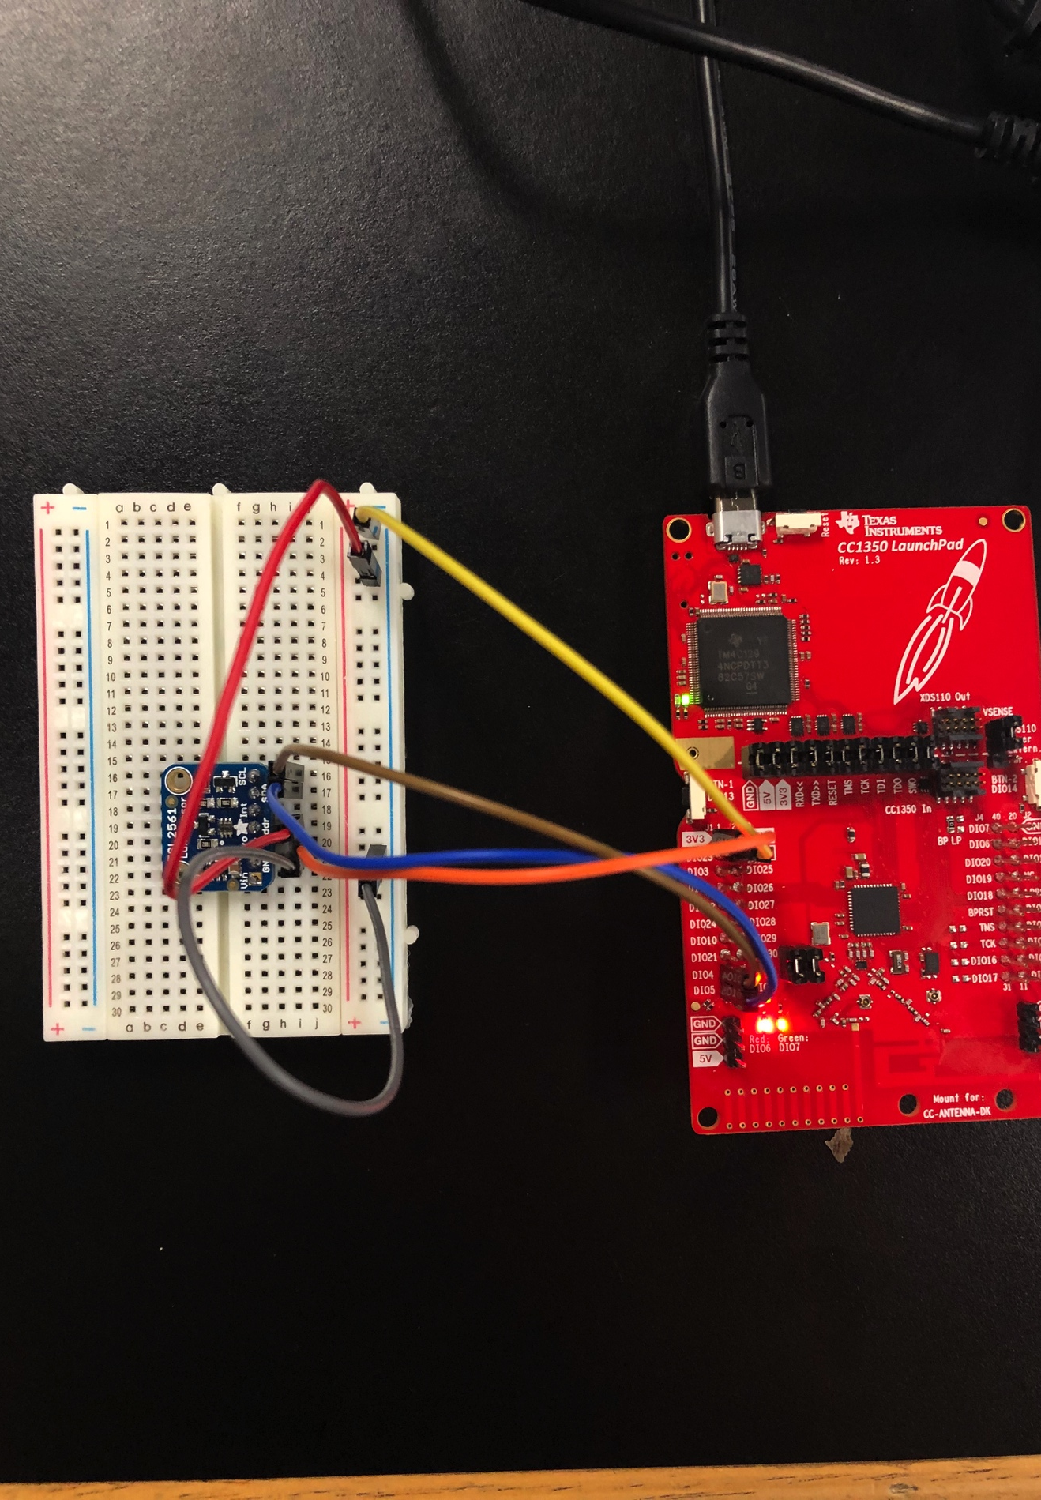
Actual project set-up

Slide 10
Demo
https://www.youtube.com/watch?v=HwtS9RuG0Ac&list=PLOWewY7_3-gMMc_-rHnzRPomB3qFueNhZ&t=0s&index=33

Slide 11
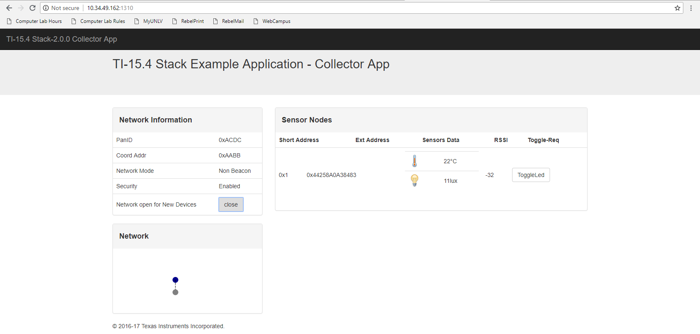
Results and Conclusions
The figure below shows the temperature sensor reading of 22˚C and a lux value of 11

Slide 12
Reference
https://www.element14.com/community/roadTestReviews/2590/l/sub-1-ghz-sensor-to-cloud-iot-gateway-review
http://processors.wiki.ti.com/index.php/Adding_New_Sensor_Support_To_Sub1GHz_Sensor_To_Cloud_Linux_Gateway

