Slide 1
CPE 301 Project Presentation
Dayton Flores
Joseph Sharp-Halpin
flored1@unlv.nevada.edu
sharphal@unlv.nevada.edu

Slide 2
AIM & ACCOMPLISHMENT
AIM:
Create a circuit that can use multiple lux sensors to measure differing lux values, which will then be transmitted through RF and displayed through USART.
ACCOMPLISHMENT
Successful implementation of the TSL2591 to read lux values
Successful implementation TCA9548A to select between multiple TSL2591
Successful implementation nRF24L01 to send raw data through RF

Slide 3
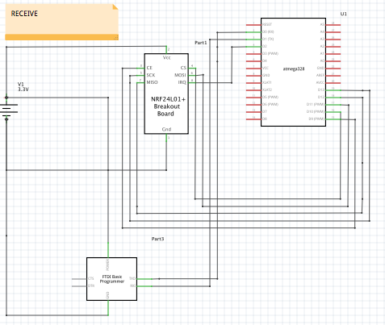
SCHEMATICS

Slide 4
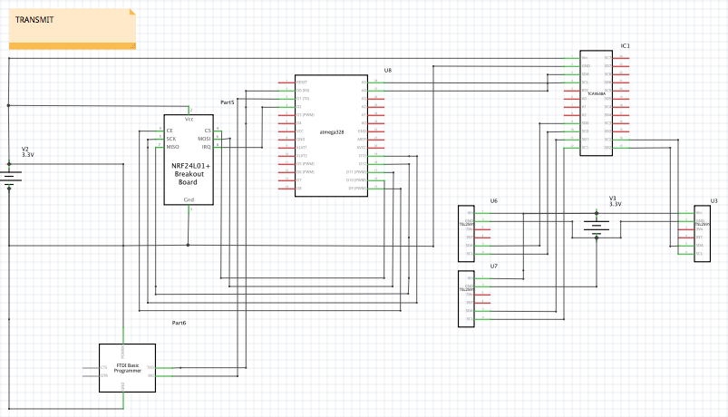
SCHEMATICS

Slide 5
DESIGN STAGES
Components
ATmega328p Xplained Mini (x2)
TSL2591 (x3)
TCA9548A
nRF24L01(x2)
Interfaces
ATmega328p - TSL2591 using I2C - Address (0x29)
ATmega328p - nRF24L01 using SPI
ATmega328p – FTDI using USART
HOSTs
Data Visualizer in Atmel Studio 7.0

Slide 6

CODE DEVELOPMENT
Initialization
Code was created to be used with I2C communications as well as RF and USART
I2C libraries was adapted from g4lvanix’s Github repository
nRF24L01 libraries was adapted from antoineleclair’s Github repository
USART functions were adapted from Lecture 11 class notes
TSL2591 functions were adapted from Lecture 17 class notes

Slide 7
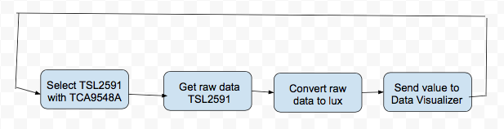
CODE DEVELOPMENT
Data Collection
TSL2591 raw data was collected using I2C interface and shown on terminal using USART
Raw data was converted to ‘lux’ values to better use for graphing implementation

Slide 8
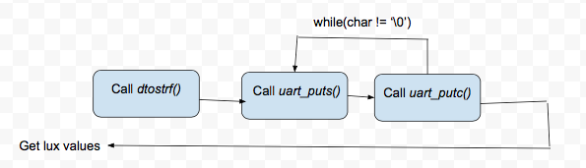
CODE DEVELOPMENT
Networking/Visualization
Send to Data Visualizer for USART printing and graphing purposes

Slide 9
DEMO SNAPSHOT/VIDEO
Demo Links:
https://www.youtube.com/watch?v=kE_EY3_Hkgs&feature=youtu.be
https://www.youtube.com/watch?v=l2gM2lUtcB0&list=UUc3Y_f20-g3ll-FvewTRxaw

Slide 10
Group Projects
Student Name: Dayton Flores
Task Completed:
→ Task 1
→ Task 2
→ Task 3
→ Task 4
Contribution % towards the project: 50%
Coding (%): 40%
Implementation (%): 60%
Testing/Demo (%): 70%
Documentation (%): 30%
Presentation (%): 50%

Slide 11
Group Projects
Student Name: Joseph Sharp-Halpin
Task Completed:
→ Task 1
→ Task 2
→ Task 3
→ Task 4
Contribution % towards the project: 50%
Coding (%): 60%
Implementation (%): 40%
Testing/Demo (%): 30%
Documentation (%): 70%
Presentation (%): 50%

