Slide 1
urTinerary
CHANDLER CICERON
PATRICK JETT
JUSTIN SHEERIN

Slide 2
APPLICATIONS CONCEPT
urTinerary provides users with a five day weather forecast to help plan their itinerary when traveling.
User inputs a “keyword”, then the term is matched against available fields, such as name, type, and address
Once the user successfully selects a known match, the five day weather forecast is displayed along with a map of the surrounding area

Slide 3
Motivation _{behind urtinerary}
Weather is Uncontrollable but Somewhat Predictable?
Change of Plans?
What to pack?
What to do?
Where to go?
Notes:
Knowing the upcoming weather allows travelers to plan accordingly for the trip and make any necessary adjustments whether it may be packing the necessary clothes or drifting away from planned itinerary due to unexpected weather conditions.

Slide 4
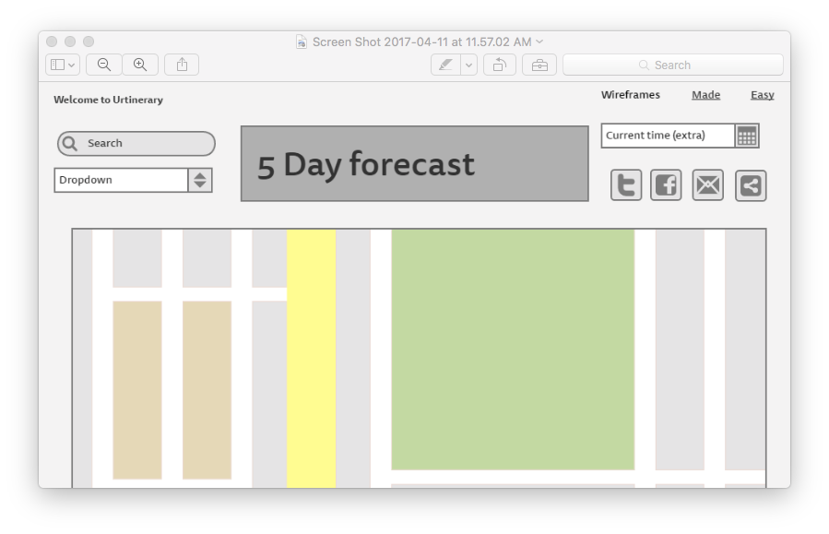
Design Process_gomockingbird.com
Created the framework for the beta version of the app using the tools provided at gomockingbird.com
Notes:
We decided that it would be best practice to lay out what we wanted the app to look like before coding. The current slide reflects what we had in mind the first day the project was assigned. As we built the app the group learned the importance of being able to pivot direction at times. In order to meet as many requirements as possible, with the end result being a functioning application.

Slide 5
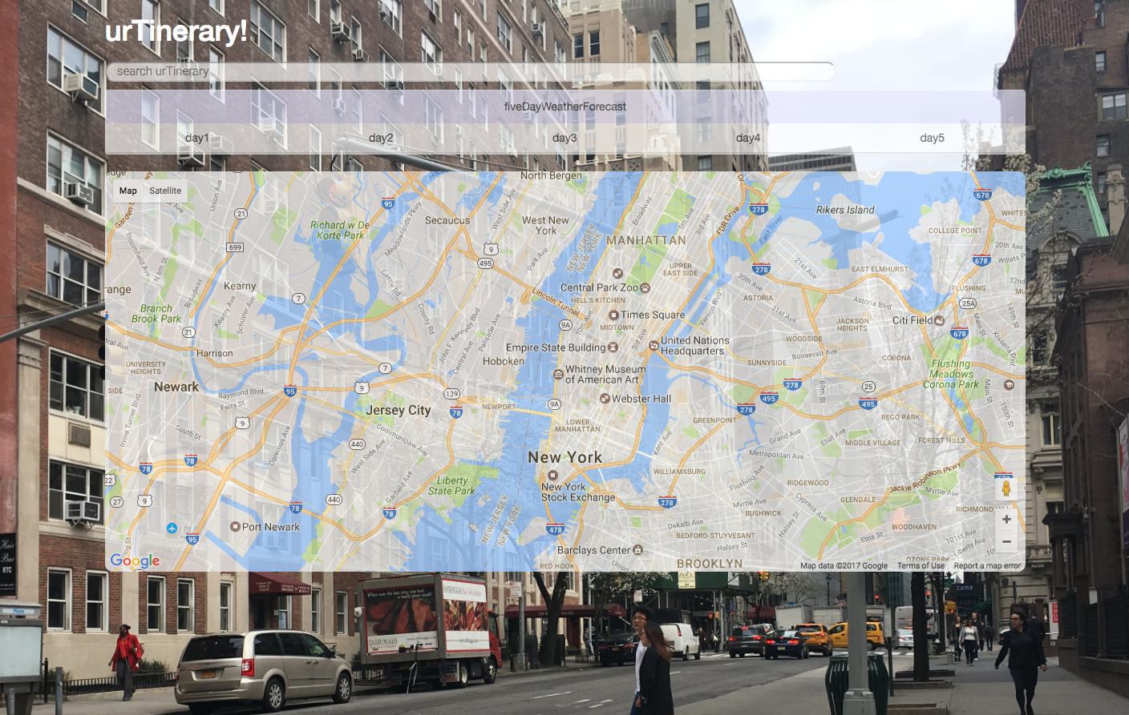
How the app looked in the end….

Slide 6
Technologies used
API’s: Google Places & Dark Sky
jQuery $
Firebase- Persistent Data Storage
JSON- required by Heroku
BootStrap
GitHub- seamless group integration
Notes:
The two APIs which are being utilized are Google Places and Dark Sky.
The app begins with user input validation of a keyword which may be a general or specific place, city, town, etc. The keyword is used to reference the Google API and pull the longitude and latitude coordinates associated with that specific key word match. This information is pushed to the Dark Sky API in order to reference the five day weather forecast displaying the high and low temperatures for the day as well as a short description of the daily weather conditions for the pushed longitude and latitude coordinates.
Let us show you the working application using Heroku!
Bring up site loaded up on Heroku! Let some one pick a key word anywhere in the world to search.

Slide 7
The highs and lows of building urTinerary
Longitude & Latitude
Decimal Points!
Centering the Map
Switched Places
Stuck to What we Knew
Was able to avoid some stress by sticking to the basics
Deployment
Feeling good!
Firebase
Authentication- Anonymous & Google- this was supposed to be new technology
Persistent Data Storage- attempted as a reach but unsuccessful
Notes:
The longitude and latitude which was pulled from the referenced Google API was pulled to push to the Dark Sky API to fit the coordinates parameter to display the five day weather forecast. I had to use the slice method on lines 129 & 132 on app.js in order to debug the error caused by longitude and latitude coordinates being to long for the Dark Sky Parameters.
Another small issue was centering the map, I had noticed that an average of the coordinates needed to be used in order for the key word coordinates to be displayed in the center of the map element of the application. Lines 111 & 112.
Another issue with the longitude and latitude was that the coordinates were being pushed to the dark cloud API in reverse order so I had to switch the variable names on the app.js file for it to receive the correct parameters.
The group was all in agreement to apply what we had learned in class to make a functioning app which makes sense to all of us while meeting all of the criteria. We failed to accomplish meeting all the criteria but are still happy with what we accomplished in the alloted time and it felt great to load it up on Heroku and use it on a live URL not on local storage.

Slide 8
Ideas for future development
Hold off displaying the map until the key word is searched
Display weather icons rather than a short description
Add in more parameters of the Google API like language, reviews, photos
Get Firebase Functioning
Add user authentication
Notes:
Here are a list of some functionality ideas which would be cool to incorporate if there were more time allotted towards the application.

