Slide 1
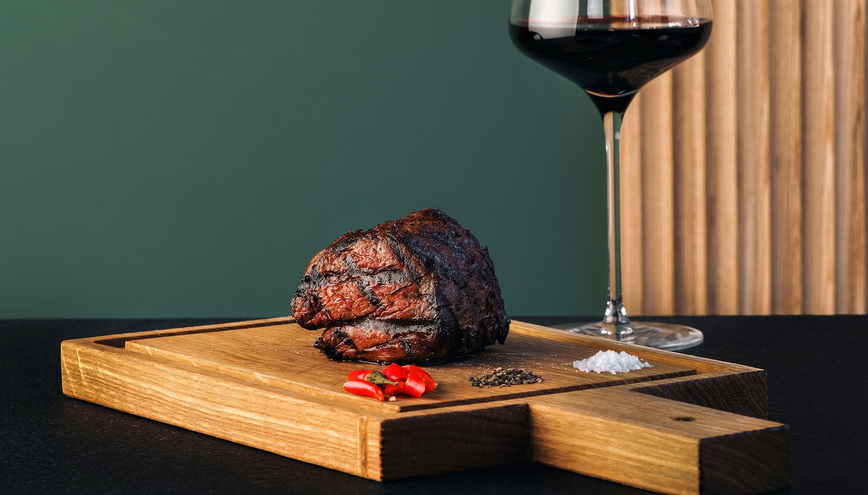


Slide 2
Ramping Quota & Commission & Expectations

Slide 3
Ramp gives you time to learn and fail
ASK QUESTIONS!!!
Reach out to your peers
You will not know everything right away, don’t pretend you do - be PATIENT with yourself as you are learning.
The most important things during your ramp period is your attitude, effort and coachability - the three things you can control
Embrace the learning curve - embrace the discomfort
Listen to your manager
The more you put into it the more you will get out of it
Set the bar high
Your brand

Slide 4
M1 BDRs
Prospecting
25%
50%
75%
100% 🎯
September
October
November
December
January
February
Master the script &
own the demo —
no practicing on prospects
Get really good at
booking meetings that
hold
October
25% of FR Quota
November
50% of quota
December
75% of quota
Five months to build your foundation — then it's game time. Full quota hits January 1.

Slide 5
Daily KPI Expectations following your second week
Daily Activity
Required
Excellent
Unique Accounts to add to your cadence per day
35
45
Dials / Calls
90+
120+
Call : DM Ratio
15:1 or better
< 12:1 or better
Talk Time
90 min
120+ min
Owner / DM Connects
6
10+
DM→ Meeting Conversion
33%
40%+
Meetings Scheduled
~2/ day
4/ day potential
Hold Rate
40%
50%+

Slide 6
5
DAILY OPERATING RHYTHM
How to Run Your Day
Prime call time is for calling. Clean and build tomorrow's list in the dead zone, not the power blocks.
Time
Focus
Output
9:00 – 9:30
Prep + callbacks
Know exactly who you're attacking first
9:30 – 11:30
Call Block #1
~40–45 calls / ~3 DMs / 1 meeting
11:30 – 12:00
Immediate follow-up
Only priority follow up: promised emails, texts, calendar work
12:00 – 1:00
Clean + build leads
Clean/add 20–25 fresh accounts
1:00 – 2:00
Lunch / demos / admin
Meetings + CRM
2:00 – 2:30
Clean + queue
Finish remaining 10–15 accounts
2:30 – 4:30
Call Block #2
~40–50 calls / ~3 DMs / 1 meeting
4:30 – 5:00
Callbacks / follow-up
Work today's warmest threads
5:00 – 6:00
Tomorrow setup + wrap
All open loops closed; tomorrow’s call list ready
Prime call time = call. Lunch and dead time = clean and build. End of day = tomorrow is ready.

Slide 7




6
DAILY OPERATING RHYTHM
2 meetings is the goal; everything else is how to get there
The goal is 2 meetings; the activity tells you where the day is breaking.
CHECKPOINTS
Checkpoint
Target
By 11:30
40 calls / 3 DMs / 1 meeting
By 2:30
35 fresh accounts cleaned + queued
By 4:30
90 calls / 6 DMs / ~2 meetings
By 6:00
Follow-up closed/ tomorrow fully ready
WHAT THE NUMBERS TELL YOU
Not enough calls:
Time management problems
90 calls, not enough DM connects:
data/ list/ value proposition/ timing problems
6+ DMs, not enough meetings:
skill/ product mastery/ value proposition problems
2+ meetings, poor hold rate:
Confirmation or follow-up problems

Slide 8


The Behaviors That Drive Points
The comp model and the playbook are the same pitch — you can't separate them.
Phone Over Email
Callback / Calendar Method
Email is comfortable. Phones create holds.
Can't reach the DM? Don't hang up — schedule a callback.
→ Live conversations qualify instantly — you find out if there's real interest and can lock in a time the DM will actually show.
→ Push for a specific reconnect time before you end the call. Get it on both calendars.
→ Phone-set demos hold at a dramatically higher rate than email-set demos.
→ A scheduled callback holds at a far higher rate than a cold follow-up email.
→ More calls = more sets = more holds = more closes. Every point starts here.
→ This is how you convert outbound dials into meetings that actually stick.
Full details + earning scenarios Tuesday. Questions? Come find us.

Slide 9




YOUR FUEL
The Calendar Callback Method: Key to Your Plan
Every 30 min: a DM convo, a booking, or a callback confirmed.
TIER 01
TIER 02
GOLD
INTEL
· Owner/GM by name — DM their schedule
· Org structure — who handles marketing/ops
· Best time to call + callback confirmed
· Who owns partnerships & promos
· Vacation / return date captured
· New location opening soon
· Always log in Salesloft
· Renovation or re-brand underway
TIER 03
TIER 04
TRIGGER
SOFT
· New menu or patio opening
· "Call me next month" → push back hard
· Holiday or seasonal event hook
· "Send me something" → why not now?
· World Cup city, summer travel, local events
· "We're slammed" → book for after the rush
· Calendar event = urgency to act now
· Note it — but don't accept it as final
THE 30-MIN CHALLENGE: Every block ends with a DM conversation, a booked meeting, or a confirmed callback — minimum 10 callbacks/day, goal 2/hour.
Notes:
A callback should require NEW information. For restaurant sales this is gold.
I would almost rather have:
1 meeting
5 named DMs
than
2 meetings
Because the named DMs compound.
After 60 days your territory becomes:
Tony owns it
Sarah runs ops
Mike handles marketing
Jennifer opens location #2 in August
Now connect rates explode.
Otherwise, you start gaming yourself.
Bad:
"Call back Friday"
"Try again later"
"Owner wasn't there"
Good:
"Owner Tony is in Tues/Thurs after 2pm."
"GM Sarah reviews marketing vendors on Mondays."
"Owner returns from vacation June 15."
"Restaurant group meeting is next Wednesday."
My rule would be:
No new information = no callback credit.

Slide 10
September Quota

Slide 11
Your Month 1 Comp Plan
How you earn, what drives points, and how to win every day.
uncapped
EFFORT / OKR
ACHIEVEMENT
TOTAL OTE
$1,000
$2,000
$3,000
+
=
capped
uncapped
per month

Slide 12
How Your Variable Pay Is Structured
EFFORT BUCKET
ACHIEVEMENT BUCKET
$1,000 / month
$2,000 / month
Earned through consistent effort & hitting daily KPI expectations
Uncapped → no ceiling
→ 90+ calls per day
+
→ 1 pt per meeting scheduled
→ 90+ min talk time per day
→ 2 pts per meeting held
→ 6+ callbacks scheduled per day
→ 3 pts per closed win
→ Ace your coaching sessions
Daily KPI targets: 90 calls | 90 min talk | 6 callbacks
Monthly target: 66 pts = $2,000 | 30 sets + 12 holds + 4 closes

Slide 13
Every Deal Stage Earns Points — No Ceiling
SCHEDULE
HOLD
CLOSED WIN
1 pt
2 pts
3 pts
Meeting confirmed on calendar
Prospect shows, meeting runs
Restaurant signs with Seated
Monthly target
Monthly target
Monthly target
40 / month
16 / month
6 / month
40 sets → 40 pts
40 sets × 40% → 16 holds → 32 pts
16 holds × 35% → 6 closes → 18 pts
Monthly pts target
Monthly variable
No cap
90 pts 80 pts
$2,000
Uncapped
40+ 34 + 16: s/b 90, 10 pt reduction
at 100% attainment
exceed target = earn more

Slide 14
Accelerator: Beat Target, Earn More
THIS MATH IS WRONG BUT WE’RE GOING TO TALK ABOUT IT BECAUSE IT’S ILLUSTRATIVE
Same structure as the AE accelerator — exceeding 80 pts unlocks a boosted rate on your full monthly payout.
Attainment
Points / Mo
Accelerator
Monthly Variable
Annual vs. OTE
100%
80 pts
—
$1,833
OTE ($70K)
110%
88 pts
+5%
$2,108
+$3.3K ($73K)
115%
101 pts
+10%
$2,291
+$5.5K ($76K)
120%
137 pts
+15%
$2,475
+$7.7K ($78K)
130%
148 pts
+15%
$2,658
+$9.9K ($80K)
150%+
171 pts
+20%
$3,116
+$15.4K ($85K)
Accelerator applies to total monthly payout, not just points above target. At 150 pts (132% attainment), +15% kicks in → $2,686/mo.

Slide 15
Expectations

Slide 16
Expectations

Slide 17
Performance Improvement Plans
A PIP is intended for performance that appears recoverable with clear expectations and coaching.
Severe underperformance may result in immediate corrective action, up to and including termination, without a PIP.
Examples may include:
Performance materially below 50% of quota, including results around 30% of quota
Repeated failure to meet core activity expectations
A performance trend that demonstrates the employee is unlikely to meet the requirements of the role
Below 50% of quota in a single month
→ May result in a PIP or other performance action depending on the severity and circumstances.
Below 70% on a rolling 3-month average
→ PIP may be initiated for fully ramped reps.
And at the bottom:
A PIP is one tool for addressing performance; it is not a required step before termination.

Slide 18
Performance Expectations and Performance Improvement Plans
What can trigger a PIP
Below 50% of quota in any single month
Applies during ramp and once fully ramped.
Consistently missing required daily KPIs / activity expectations
Including calls, DM connects, meetings scheduled, lead creation, or other defined activity standards.
Below 70% of quota on a rolling 3-month average
Applies once fully ramped.
Repeated quality / execution issues
Examples: onboarding failure rate above 5% or high-risk account rate above 10%, where applicable.
What happens on a PIP
A PIP is a defined improvement period with clear expectations, coaching, and frequent check-ins.
It will include:
Specific performance targets
A defined timeframe
Daily/weekly activity expectations
Manager coaching and regular check-ins
Clear checkpoints to measure progress
Successful improvement = return to good standing.
Failure to meet the expectations of the plan may result in further corrective action, up to and including termination.
Two PIPs within a 6-month period may result in termination.

Slide 19
Performance Improvement Plans
If you are trending towards a PIP based on your performance your manager proactively communicate your performance standings so there are no surprises
If placed on a PIP there will be a formal conversation and plan
PIPs can range anywhere from 30 days to 60 days
In order to get off a PIP you will need to hit at least 80% To Goal for the months you are on a PIP

Slide 20
Working hours
You are expected to work 40 hours per week (8 per day)
You log the hours worked
Submit PTO for anything 2+ hours away from your computer
OVERTIME must be written and approved by your manager AHEAD OF WORKING OT
  If approved working hours can be adjusted throughout the week to stick to 40 hour weeks

Slide 21
Your Brand = Your Reputation at Scale
What people believe about: - How you show up - What you stand for - What it’s like to work with you - Whether they trust you
We work in a remote environment, how you show up to work is your brand.
Your brand is important
What showing up looks like:
  How you engage and interact with your coworkers on peers through slack and CRMs - body language / tone of voice matters
  How you show up professionally
    Being on on time for meetings - if you aren’t communicate
    Be camera on for meetings - if you can’t let your manager know ahead of time
    Accepting calendar invites
    Following through on tasks and doing what you said you would do
    How you engage with your manager and leaders
    Performance
    Attitude & Effort - two things you can control

