Slide 1
How should we quote EUR/SEK?
A model for FX market making

Slide 2
We are a price-maker
Our role
Clients call us wanting to buy or sell euros.
We quote two prices — a bid (we buy) and an ask (we sell).
We make money on the gap between them, called the spread.
The challenge
Every trade changes what we hold — our inventory.
Too much inventory exposes us to losses if the market moves.
The model tells us how to adjust our quotes to stay in control.
2 pips
spread on a 1M EUR trade = 2,000 SEK

Slide 3
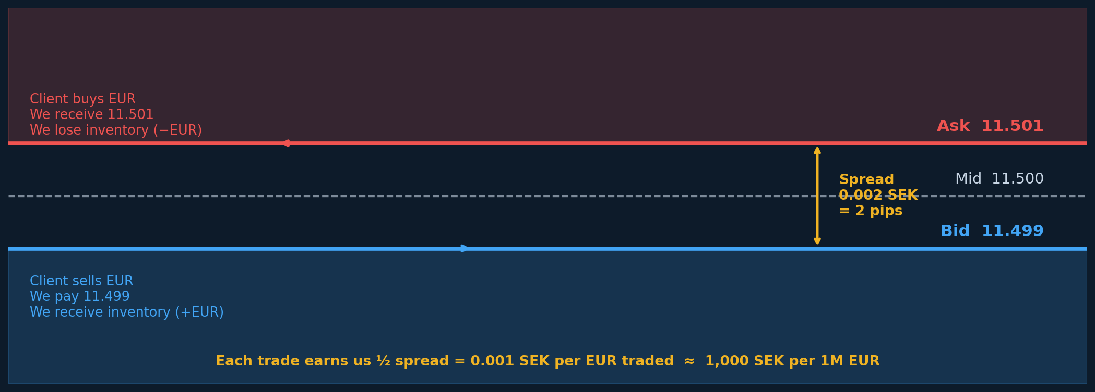
Every trade earns us the spread — but also changes our position
EUR/SEK mid ≈ 11.50 | 1 pip = 0.0001 SEK/EUR | on 1M EUR, 2 pips = 2,000 SEK profit

Slide 4
Inventory is the core risk
What happens when we trade?
Each trade moves our position. If we buy 5M EUR, we are now 'long'.
The euro might weaken while we hold it — that's a loss.
The key insight
We can't control when clients call us.
But we can control how attractive our prices are.
Wider bid → fewer clients sell to us → we don't get longer.
Tighter ask → more clients buy from us → we reduce our long position.
This is the lever the model optimises.

Slide 5
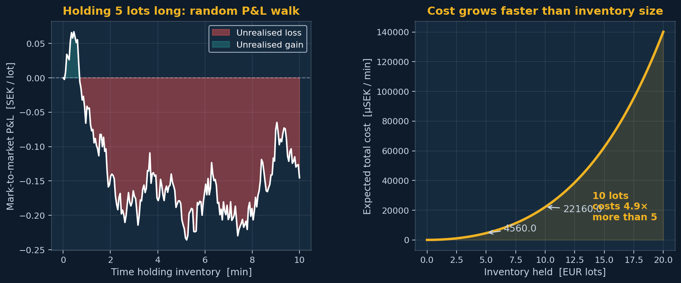
The longer and larger the position, the more it costs
Left: one realisation of the P&L from holding 5 lots. Right: expected total cost — grows faster than the position size.

Slide 6
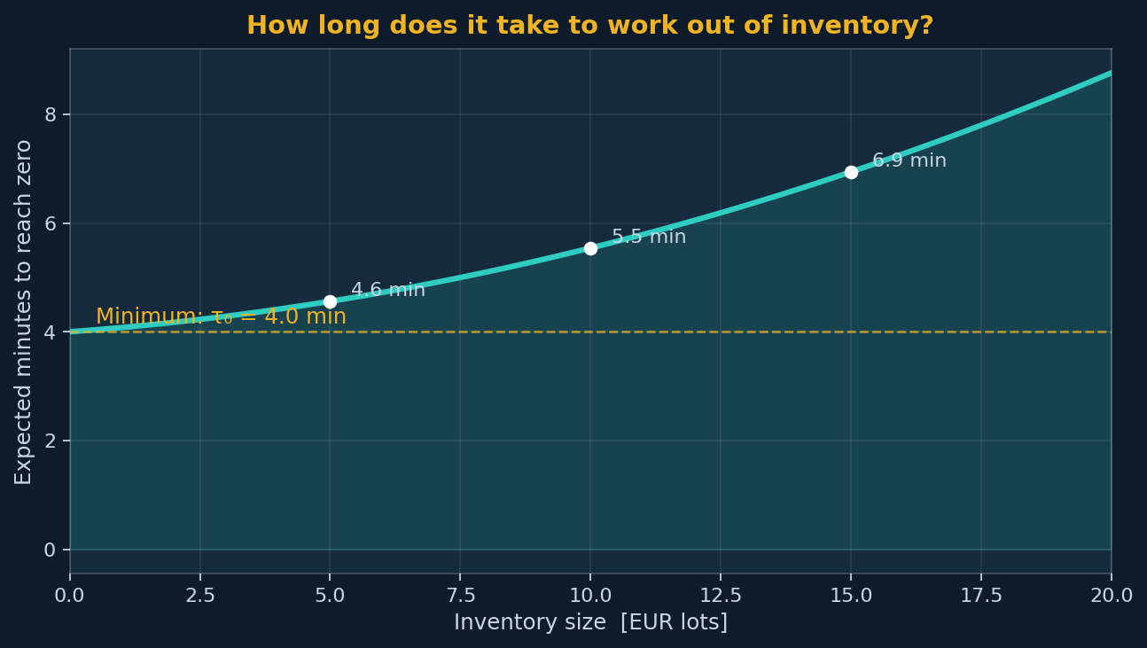
Bigger positions take longer to work off
Estimated from historical data: how many minutes on average until inventory returns to zero, starting from a given position.

Slide 7
Clients respond to our prices
The fill rate
If we quote tight (aggressive), more clients trade with us.
If we quote wide (conservative), fewer clients trade.
This is the fundamental tension: margin per trade vs. number of trades.
Size matters
Larger trades are harder to fill — fewer counterparties exist.
Larger trades also move our inventory more, so they deserve wider quotes.

Slide 8
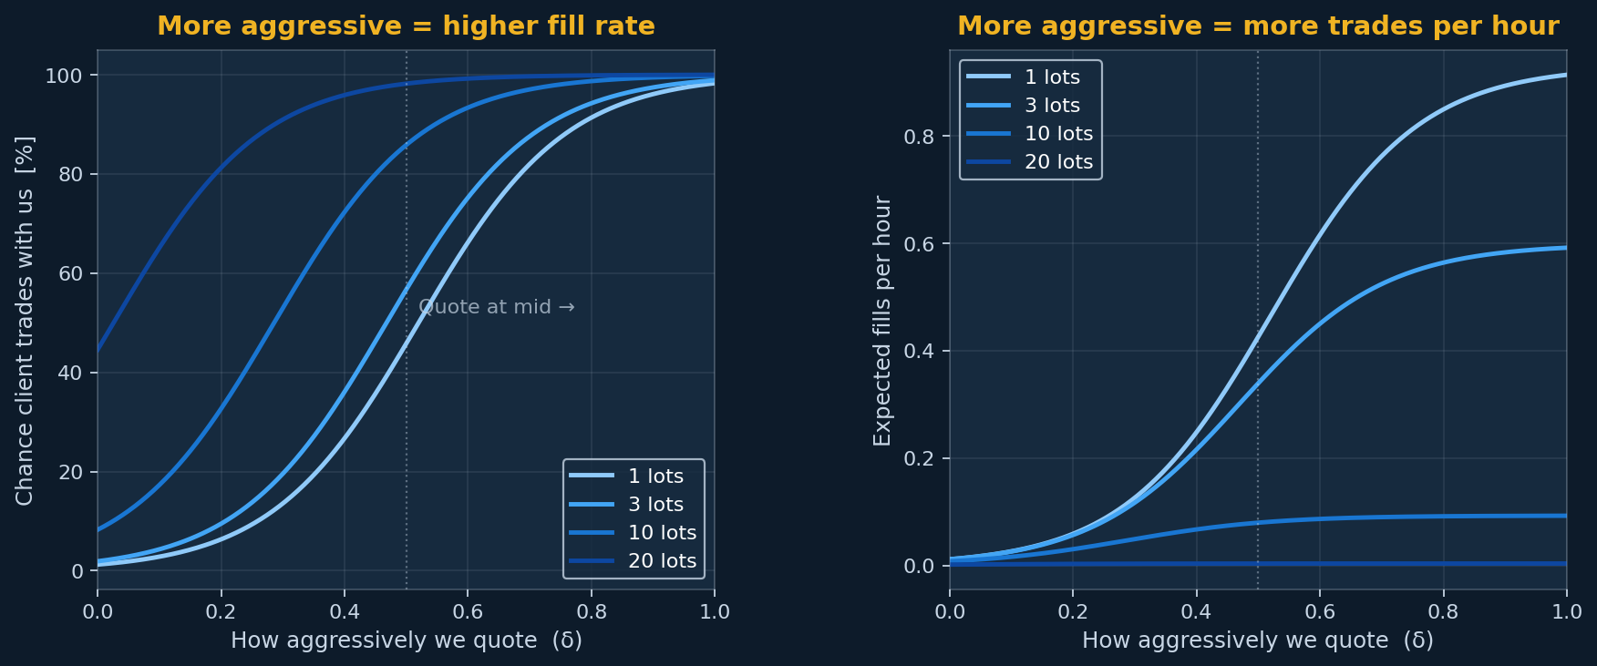
How fill probability and trade frequency depend on our quote
Left: probability a client trades with us. Right: expected number of trades per hour. δ = 0.5 means quoting exactly at mid.

Slide 9
One question: what is the best quote right now?
The answer depends on inventory
When we hold a lot of long EUR, we should discourage more buying.
— We widen our bid (we pay less, so fewer clients sell to us).
— We tighten our ask (we charge less, so more clients buy from us).
When we are short EUR, the reverse applies.
When flat, we quote symmetrically to maximise flow income.
The model finds the exact optimal quote for every inventory level
…and for every trade size simultaneously.
It accounts for the cost of holding, the expected flow, and how prices move.

Slide 10
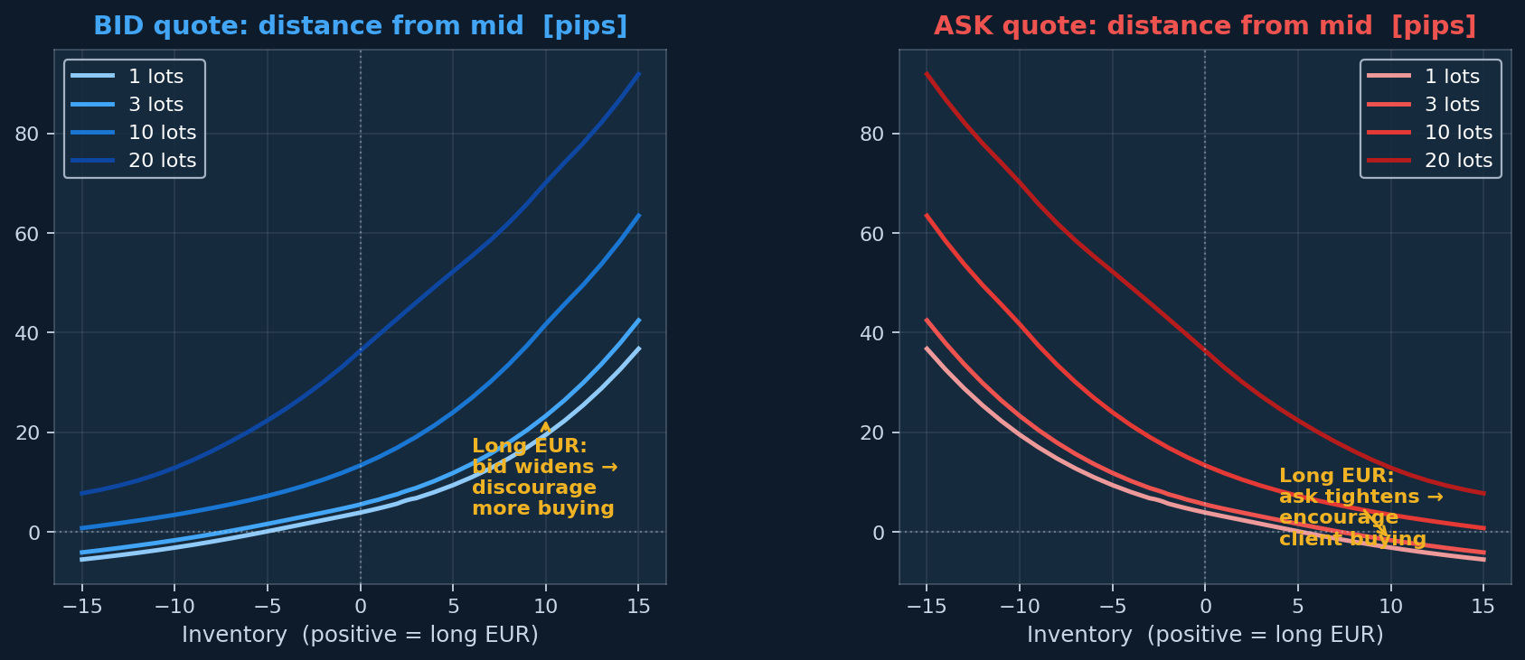
Solved: how far from mid we quote at each inventory level
Positive = quoting further from mid (wider, more conservative). The model automatically widens the side that would worsen the inventory.

Slide 11
The quote determines how often clients actually trade
What is the implied hit ratio?
Once the model picks a quote, we can ask: how likely is it a client trades?
This is the implied hit ratio — a direct consequence of the chosen delta.
What it reveals
When long EUR, we widen the bid. Fewer clients sell to us — the bid hit rate falls.
At the same time, we tighten the ask. More clients buy from us — ask hit rate rises.
The model is actively steering flow to reduce inventory.
Larger sizes always have lower hit rates
Bigger trades are riskier and harder to fill — the model quotes them wider.

Slide 12
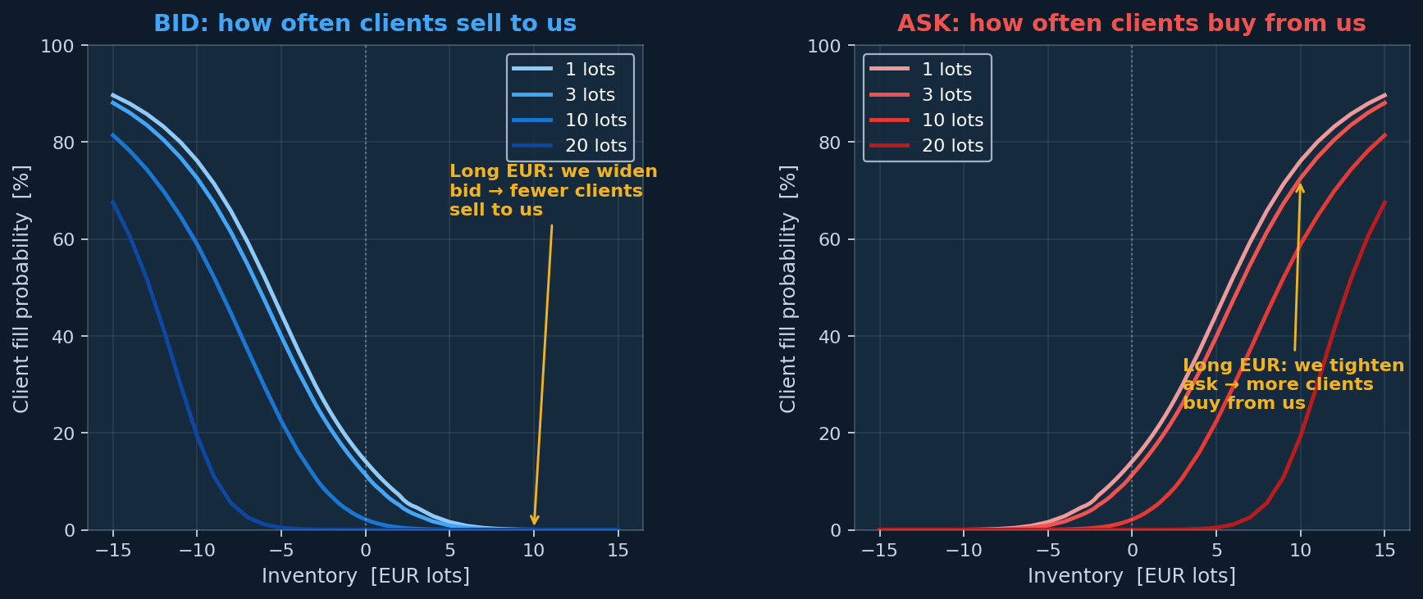
Implied hit ratios: how often clients trade at each inventory level
The model steers flow — when long, it raises ask hit rate and lowers bid hit rate simultaneously.

Slide 13
The dark pool: a passive, anonymous venue
What is a dark pool?
Some clients route orders through anonymous electronic venues.
We can leave a passive order there — if a client crosses our price, we fill.
No spread cost — we trade at mid. We just need someone to be on the other side.
How we use it
When long EUR, we post a sell order. If a client buys, we reduce our position for free.
When short EUR, we post a buy order to try to cover.
The model decides the optimal posting size at each inventory level.
The catch
Fills are random — we post a size but might get less.
— The larger the post, the less likely a full fill.

Slide 14
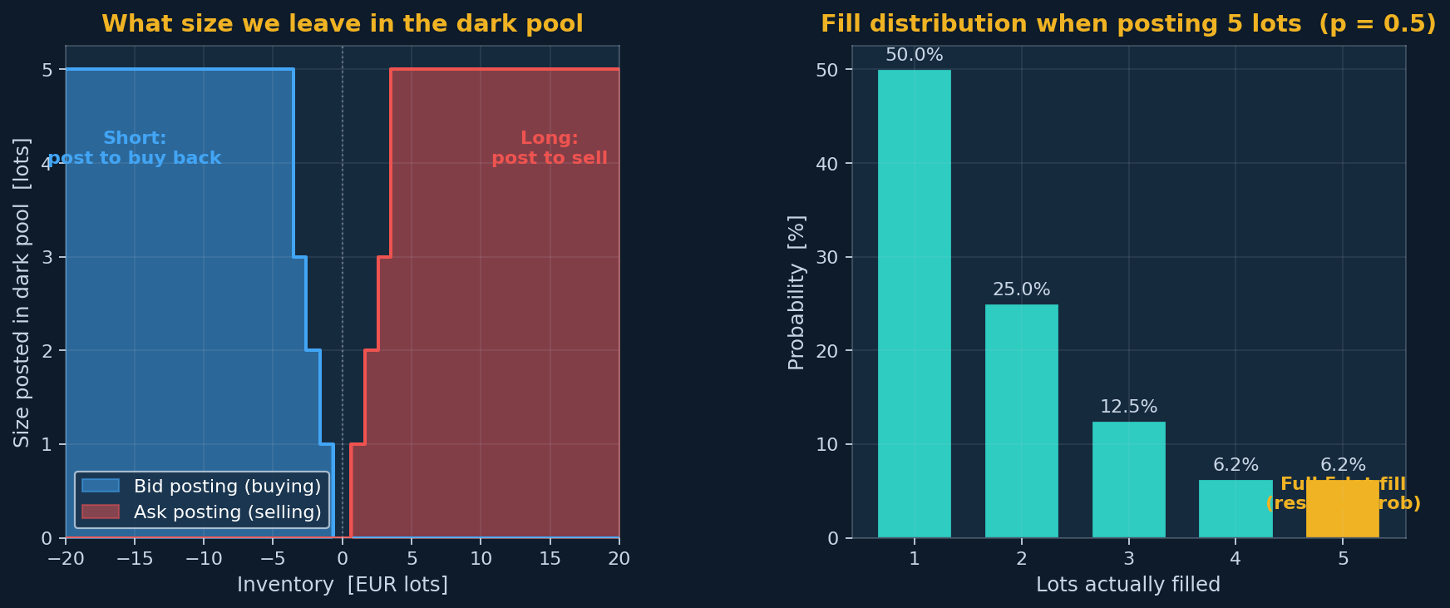
Dark pool posting strategy and fill distribution
Left: size posted at each inventory level — buy when short, sell when long. Right: geometric fill distribution when posting 5 lots.

Slide 15
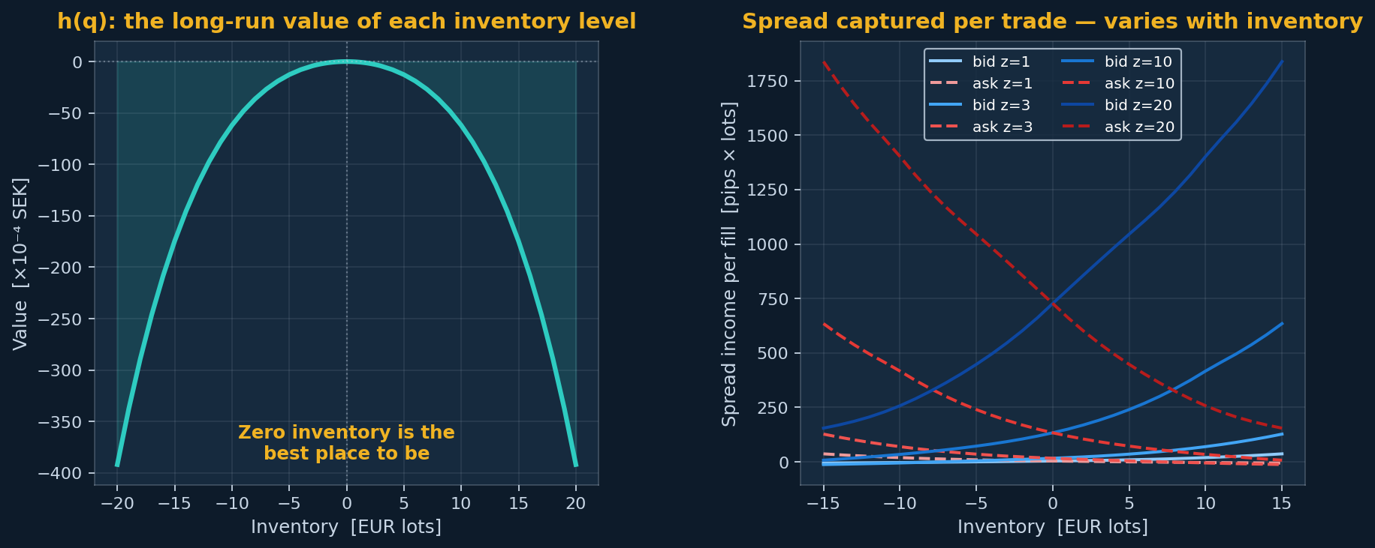
The model also tells us what each inventory level is worth
Left: h(q) — the long-run value advantage of being flat vs holding inventory. Right: how much spread income we capture per fill.

Slide 16
In practice, clients trade many different sizes
The ladder
We quote six sizes simultaneously: 1, 2, 3, 5, 10 and 20 million EUR.
Each size has its own quote, its own fill curve, its own risk.
Consistency rules
A 5M trade must never get a tighter quote than a 1M trade.
The model enforces this automatically — no manual intervention needed.
— As inventory shifts, all six rungs update together, coherently.
6
trade sizes quoted simultaneously

Slide 17
The algorithm: iterate until the quotes stabilise
We cannot solve this analytically
Start with flat quotes everywhere.
Compute the best response to those quotes — update the whole ladder.
Repeat. After ~100 iterations the quotes stop changing.
That is the optimal policy.
Convergence is fast
The solver runs in C++ and completes in under a second.
It is re-run whenever market conditions change.
< 1s
solve time on a laptop

Slide 18
Every parameter comes from data
Fill curves
Fit to our RFQ history: how often clients traded at different spread levels.
Internalization time
How long until inventory returns to zero — measured directly from trading records.
Volatility
One-minute EUR/SEK spot volatility, estimated from price data.
Adverse selection (markout)
How much the price moves after a client trade — a direct data regression.

Slide 19
Questions?
Model: stationary HJB · C++23 solver · pybind11 · Streamlit UI

