Slide 1
CptS 427 / 527 : Computer Security
Announcements
HA03 due by EOD on 07/10
First milestone reports graded
  Most received 3s, some 2s, no 1s
Two weeks of class and one week of demos
Notes:
Template-WSU Hrz 201.ppt

Slide 2
CptS 427 / 527 : Computer Security
Crypto History
Notes:
Template-WSU Hrz 201.ppt

Slide 3
Today’s Topics
Overview
  Randomness
  Historic Cryptosystems
  Threats to historic cryptosystems
Notes:
Template-WSU Hrz 201.ppt

Slide 4
Randomness
Used frequently in crypto
  Generates keys, nonces, canaries etc.
Criteria
  Uniformity: random characters must be uniformly distributed
  Independence: each value should be statistically independent from others
  Unpredictability: random text shouldn’t be predictable
Applications
  Encryption (SSL, Public Key, Symmetric Key, Auth protocols)
  Salts
  Unbiased sequencing
Notes:
Template-WSU Hrz 201.ppt

Slide 5
True Randomness
TRNG: True Random Number Generator
Based on truly random process, often based on physical processes
  E.g. rolling dice, flipping a coin, reading thermal noise from a resistor
Intel Ivy Bridge has RdRand instruction that maybe TRNG
Notes:
Template-WSU Hrz 201.ppt

Slide 6
Pseudo Randomness
True randomness is difficult to achieve
PRNG: Pseudo Random Number Generator
  Based on a deterministic algorithm
  Requires a seed value to provide randomness to the algorithm
CSPRNG: Cryptographically Secure Pseudo Random Number Generator
  PRNG that’s made suitable for crypto apps
Notes:
Template-WSU Hrz 201.ppt

Slide 7
PRNG in Linux
Linux PRNG: /dev/random and /dev/urandom
Entropy sources
  Translates system events to bits
  Add bits to entropy pool
    Primary, secondary, and universal
  /proc/sys/kernel/random/entropy_avail
Takes an item from the entropy pool, hash SHA-1 thrice
Returns a pseudo random number
Notes:
Template-WSU Hrz 201.ppt

Slide 8
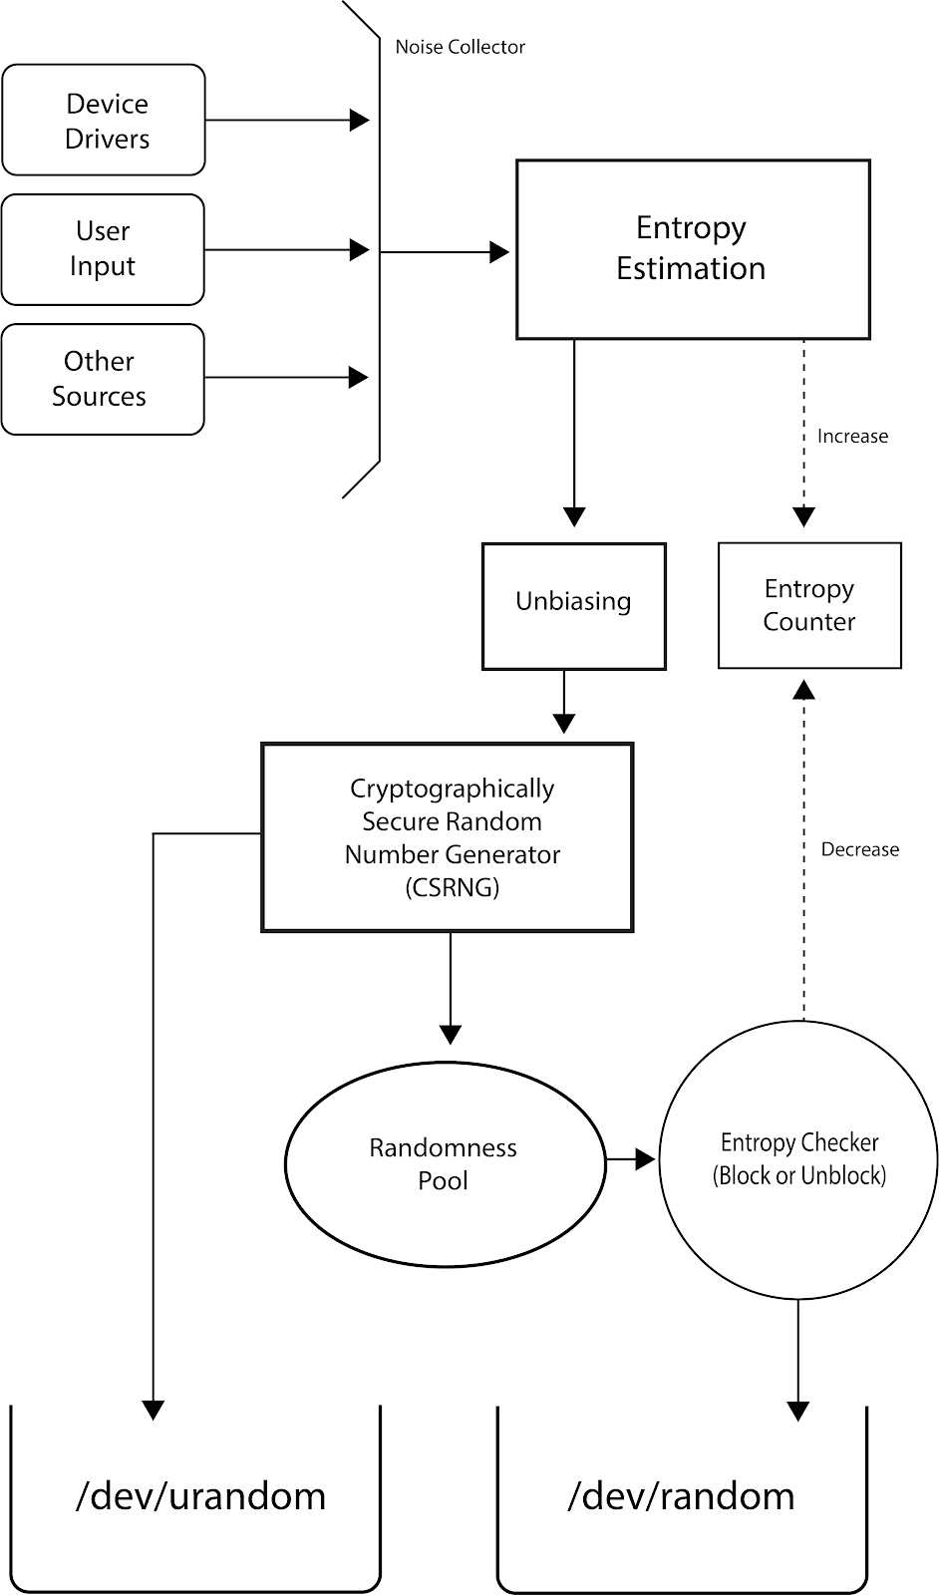

Slide 9
Intel Ivy Bridge: RdRand
Entropy obtained from thermal noise from the processor
Entropy processed by AES and MAC protocols
Resultant random number is sent to a destination register
20x slower than Python CSPRNG
Used to be considered TRNG
Destination register can be compromised (CVE-2020-0543)
Notes:
Template-WSU Hrz 201.ppt

Slide 10
Failures of Randomness
CVE-2008-0166
  Debian OpenSSL 2008 vulnerability
  Caused by a dev accidentally removing randomization code
Mining of keys by Heninger et al.
  5.8 million public keys collected and analyzed
    5.57% of TLS hosts have same keys
    Could predict keys for 0.575% TLS hosts
      Amounts to 333,500 compromised hosts
Notes:
Template-WSU Hrz 201.ppt

Slide 11
Historic Cryptosystems
One Time Pad
Substitution Cipher
Transposition Cipher
Notes:
Template-WSU Hrz 201.ppt

Slide 12
One-Time Pad Cipher
Cipher is a key that is used once and not more
  Encrypt: cipher = (message + key) mod 26
  Decrypt: message = (cipher - key) mod 26
  Key is a predetermined random value that’s shared with trusted parties
    Key should be as long as the message at least
  Provides perfect secrecy if a truly random value is used for the key
    Cannot be cracked
  Key management is a problem
Commonly used throughout 20th century
  US, USSR, Germany
Notes:
Template-WSU Hrz 201.ppt

Slide 13
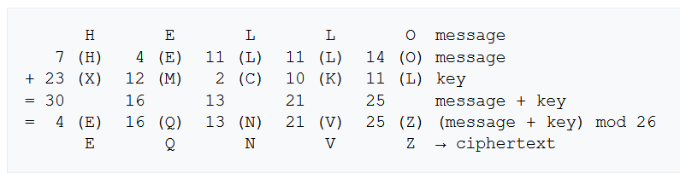
One-Time Pad: Encrypt
Notes:
Template-WSU Hrz 201.ppt

Slide 14
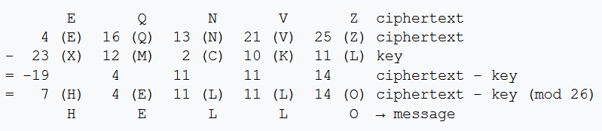
One-Time Pad: Decrypt
Notes:
Template-WSU Hrz 201.ppt

Slide 15
Substitution Cipher
Plain text substituted with cipher text
Relatively weak due to less number of possible keys
Susceptible to cryptanalysis attacks due to standard patterns of ciphers
Caesar cipher is an example; used from 108 BCE to 879 CE
Example (shift by 23 letters in English alphabet)
  Plain
  Cipher
T H I S C L A S S I S G R E A T
Q E F P Z I X P P F P D O B X Q
Notes:
Template-WSU Hrz 201.ppt

Slide 16
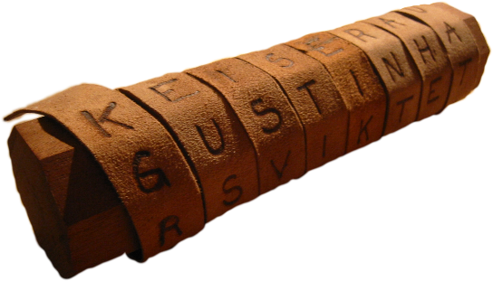
Transposition Cipher
Cipher text is a permutation of the plain text
  Permutation: shuffling
Relatively weak due to less number of possible keys
Susceptible to cryptanalysis attacks due to availability of plain text in cipher text
Scytale (Greek for ‘cylinder’) is a popular example; used by ancient Greeks
  Paper contains cipher that can be decrypted by using a stick of correct diameter
Plaintext:
A T T A C K A T D A W N
A C D
T A K T A N
T A W
A C D T A K T A N T A W
Encryption:
Ciphertext:
Notes:
Template-WSU Hrz 201.ppt

Slide 17
Next lecture
Symmetric Key algorithms
Notes:
Template-WSU Hrz 201.ppt

Slide 18
Any questions?
Notes:
Template-WSU Hrz 201.ppt

