Slide 1
CptS 427 / 527 : Computer Security
Asymmetric Key Cryptosystems
Notes:
Template-WSU Hrz 201.ppt

Slide 2
Today’s Topics
Overview
  RSA
  Diffie Hellman
  X.509 Certificate format
Notes:
Template-WSU Hrz 201.ppt

Slide 3
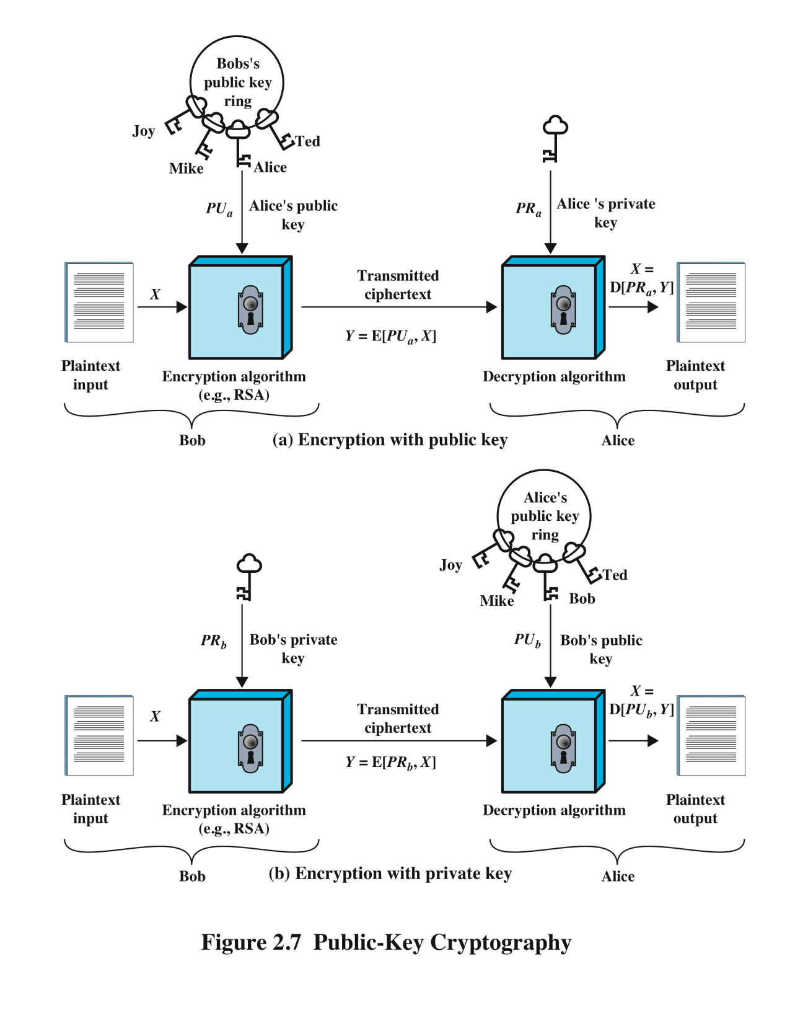
Asymmetric Key Systems
Notes:
Template-WSU Hrz 201.ppt

Slide 4
Asymmetric Key Systems
Motivation
  Key management is hard
    Increases vulnerability of symmetric key systems
Also known as public key systems
Public key: shared with the public
Private key: withheld by a member
Notes:
Template-WSU Hrz 201.ppt

Slide 5
RSA
Rivest-Shamir-Aldeman algorithm, developed in 1977
Popularly used in encryption of online sessions and digital signatures
Algorithm is based on factoring large numbers
Slow
  At least 20 times slower than AES
Notes:
Template-WSU Hrz 201.ppt

Slide 6
RSA
Algorithm’s abstract
  Encryption: C = Me mod n
  Decryption: M = C^{d} mod n
  ‘n’ is a random root
Initialization
  Select large primes p, q and calculate n = p * q
  Compute φ (n) = (p-1)(q-1)
  Compute e such that gcd(e, φ(n)) == 1
  Compute d such that (d * e) mod φ(n) == 1
Setting keys
  Public key: PU = {e, n}
  Private key: PR = {d, n}
Notes:
Template-WSU Hrz 201.ppt

Slide 7
RSA Complexity
Complexity
  Encryption: C = Me mod n
  Decryption: M = C^{d} mod n
M = C^{d} mod n
  But C = Me mod n
  Therefore, M = (Me mod n)^{d mod n}
    M = {M^{(e*d)}} mod n
      Euler’s theorem
Notes:
Template-WSU Hrz 201.ppt

Slide 8
Attacking RSA
Known limits
  RSA-512 cracked in 2002
  RSA-768 cracked in 2009
  RSA-1024 cracked in 2010
How?
  Reverse engineering
  PU = {e, n} and PE = {d, n}
  Obtain ‘n’
    Factoring ‘n’ provides ‘p’ and ‘q’
    Using ‘n’, ‘p’, and ‘q’ we can reverse engineer φ (n)
    Game over once you get φ (n)
RSA is no longer sufficient by itself but still is a part of layered security strategies
Notes:
Template-WSU Hrz 201.ppt

Slide 9
Diffie-Hellman
Developed in 1976
Enables users to securely create shared keys
  Used in groups where the private key needs to be shared
Uses discrete logarithms
  log_{b} a = k ∃ b^{k} = a
Provides ‘Forward Secrecy’
  ‘a’ generates a session that produces secrets ‘b’, ‘c’, and ‘d’
  Forward secrecy guarantees ‘a’ will not be compromised even if ‘b’, ‘c’, or ‘d’ are compromised
Notes:
Template-WSU Hrz 201.ppt

Slide 10
Diffie-Hellman
Algorithm abstract
  Alice and Bob agree on a random prime ‘q’ and a root ‘h’
  Alice creates random number X_{a}
  Bob creates random number X_{b}
  Alice computes and sends nonce Y_{a} = (h^{Xa}) mod q
  Bob computes and sends nonce Y_{b} = (h^{Xb}) mod q
  Alice receives Bob’s nonce and computes K_{a} = (Y_{b}^{Xa}) mod q
  Bob receives Alice’s nonce and computes K_{b} = (Y_{a}^{Xb}) mod q
  Result is two keys K_{a} and K_{b}
    One key can be made public
    Other can be kept private, shared by Alice and Bob
Notes:
Template-WSU Hrz 201.ppt

Slide 11
Diffie-Hellman Complexity
Algorithm abstract
  Y_{a} = (h^{Xa}) mod q
  K_{a} = (Y_{b}^{Xa}) mod q
    K_{a} = {(h^^{Xa} mod q)^{Xb}} mod q
    K_{a} = h^{(Xa * Xb)} mod q
  Y_{b} = (h^{Xb}) mod q
  K_{b} = (Y_{a}^{Xb}) mod q
    K_{b} = {(h^^{Xb} mod q)^{Xa}} mod q
    K_{b} = h^{(Xb * Xa)} mod q
Notes:
Template-WSU Hrz 201.ppt

Slide 12
Attacking Diffie-Hellman
Obtain random prime ‘q’ and root ‘h’
  Game over
Reverse engineer
  First: Y_{a} and Y_{b}
  Then: X_{a} and X_{b}
  Finally: K_{a} and K_{b}
No verified case study of cracking Diffie-Hellman
  Several outlets claim NSA has cracked it
https://arstechnica.com/information-technology/2015/11/op-ed-how-did-they-break-diffie-hellman/
Notes:
Template-WSU Hrz 201.ppt

Slide 13
Digital Certificates
RSA and Diffie-Hellman key distribution is vulnerable to MitM attacks without authentication
Certificates help develop ‘trusted roots’ against MitM, spoofing, or tampering
Utilizes a centrally trusted Certificate Authority (CA)
  VeriSign, Comodo, GoDaddy etc
X.509 is a popular digital cert implementation
Notes:
Template-WSU Hrz 201.ppt

Slide 14
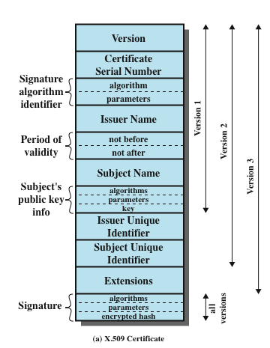
X.509 Certificate Format
Issuer = CA
Subject = user
Fields
  Signature: CA’s private key
Extensions
  Many features
    E.g. extend validity if X and Y
Notes:
Template-WSU Hrz 201.ppt

Slide 15
Digital Certificate Problems
CA can be spoofed
  Issue spoofed certificates
  Compromise the entire ecosystem
  The same can be achieved with spoofing certificates for well known websites
Example
  Browser has public keys of well known CAs
  When a user visits a page, browser checks the page’s certificate and validates the cert with stored public key
  An attacker can spoof the certificate for a famous website
http://arstechnica.com/security/2011/09/comodo-hacker-i-hacked-diginotar-too-other-cas-breached/
Notes:
Template-WSU Hrz 201.ppt

Slide 16
Digital Certificate Improvements
Certificate Revocation Lists (CRLs). E.g.: https://isc.sans.edu/crls.html
  Lists cert IDs which are known to be revoked
    Any cert that is spoofed or tampered will be revoked
  Hosted on CA site
  Cross check certs with CRLs before using
Online Certificate Status Protocol (OCSP)
  Use protocol messages to check for cert revocation
  Requires less bandwidth than CRLs
  Real time revocation checking
Problems
  CA compromise or CRL / OCSP unavailable for a few hours
  https://www.imperialviolet.org/2012/02/05/crlsets.html
Notes:
Template-WSU Hrz 201.ppt

Slide 17
Digital Certificate Alternatives
HTTP Public Key Pinning (HPKP)
  Browser ‘pins’ hash of public key before the site domain name
  Works for preconfigured popular sites
  If live key != pinned key → reject
  Problem: first visit is still vulnerable
  https://blog.qualys.com/ssllabs/2016/09/06/is-http-public-key-pinning-dead
Transparent certificates
  Transparent certs aim to protect certs by monitoring / auditing
  Auditing via logs; e.g. https://crt.sh/
  Problem: bureaucratic overhead vs security
Notes:
Template-WSU Hrz 201.ppt

Slide 18
Next lecture
Message Authentication Codes (MACs)
Notes:
Template-WSU Hrz 201.ppt

Slide 19
Any questions?
Notes:
Template-WSU Hrz 201.ppt

