Slide 1
CptS 427 / 527 : Computer Security
Announcements
Quiz 05: begins 14:10 and ends 14:25
HA03 due tomorrow (7/10) by 11:59 PM
Notes:
Template-WSU Hrz 201.ppt

Slide 2
CptS 427 / 527 : Computer Security
Properties of Hashing and TLS
Notes:
Template-WSU Hrz 201.ppt

Slide 3
Today’s Topics
Overview
  Properties of Hash Functions
  SHA-512
  TLS
Notes:
Template-WSU Hrz 201.ppt

Slide 4
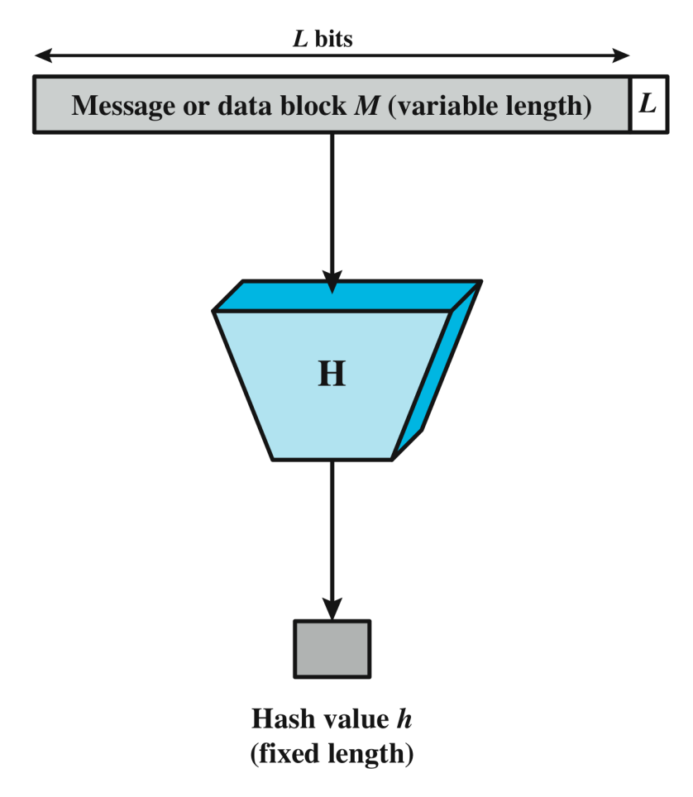
Hash Functions Recap
One-way function, h = H(M)
Creates a unique ‘digest’ of a message
Used in
  HMACs
  Password storage
  Digital checksums
Popular implementations
  SHA and MD5
Notes:
Template-WSU Hrz 201.ppt

Slide 5
Properties of Hash Functions
Preimage Resistance
  Given a hash, the plaintext shouldn’t be decipherable
  If h = H(M), and given h, it should be impossible to find M
Example
  Given: 799772e0410af26e43ee279af9f630150c7bb8bb
  Actual message:
    ‘This is a test message to demonstrate hash functions’
Notes:
Template-WSU Hrz 201.ppt

Slide 6
Properties of Hash Functions
Duplicity Resistance aka Second Preimage Resistance
  For a given message, a has function should always produce the same hash
  Given M1, H(M1) should always be h
Example
  Given
    ‘This is a test message to demonstrate hash functions’
  SHA-1 should always hash the message to
    799772e0410af26e43ee279af9f630150c7bb8bb
Notes:
Template-WSU Hrz 201.ppt

Slide 7
Properties of Hash Functions
Collision Resistance
  For two unequal messages, their hashes should never be the same
  Given M1 != M2, H(M1) should never be the same as H(M2)
Example
  Given
    ‘This is a test message to demonstrate hash functions’
    799772e0410af26e43ee279af9f630150c7bb8bb
  Should be impossible to find the same hash for a message that is not:
    ‘This is a test message to demonstrate hash functions’
Notes:
Template-WSU Hrz 201.ppt

Slide 8
Hash Functions
MD5
  128 bits
  No longer collision resistant
    ‘Flame’ malware: produces same MD5 checksum as a legitimate Windows Update
Secure Hashing Algorithm (SHA-1)
  160 bits
  Popular in current online use
  No longer collision resistant
    MS and Google stopped using SHA-1 in 2017
    https://www.schneier.com/blog/archives/2012/10/when_will_we_se.html
    $700k to compute a collision for SHA-1
Notes:
Template-WSU Hrz 201.ppt

Slide 9
Hash Functions
SHA-2
  256 or 512 bits
  No collision resistance
SHA-3
  No fixed hash length
    Changes from instance to instance
    Common: SHA3-224, 256, 384, 512
  Collision resistant until recently
    Quantum computers have started being able to compute collisions
Notes:
Template-WSU Hrz 201.ppt

Slide 10
CptS 427 / 527 : Computer Security
Announcements
HA03 graded
  1 (10%), 2 (50%), 3(40%)
  common issues: installing and running bWAPP on lamp
Second milestone report due 7/17
HA04 due 7/24
Notes:
Template-WSU Hrz 201.ppt

Slide 11
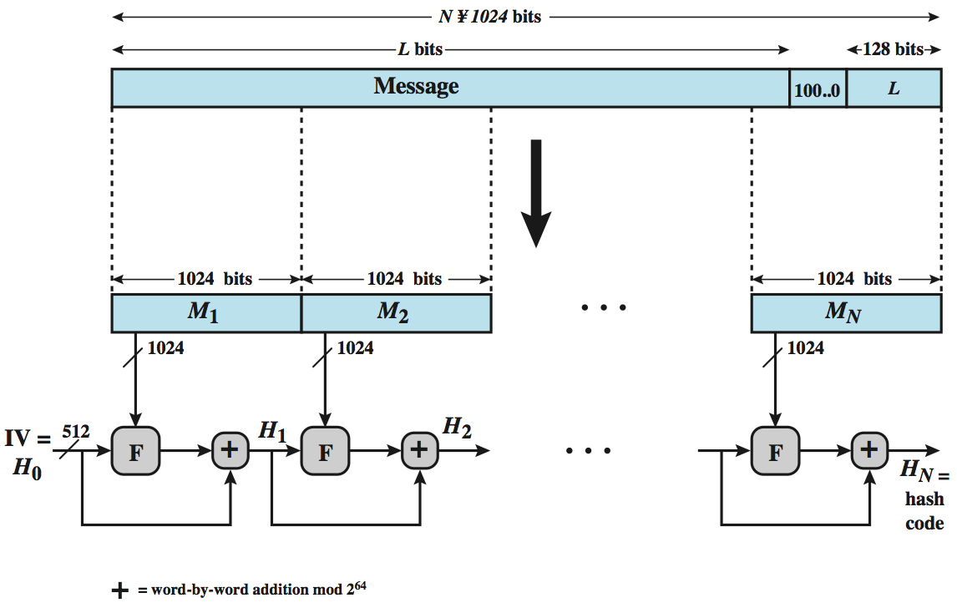
SHA-512 Hash Function
Notes:
Template-WSU Hrz 201.ppt

Slide 12
Security for Transmission
TCP/IP Stack
Security Protocols
How to securely transmit across a network?
  Ensure CIA of transmission
Application
(HTTP,SMTP)
HTTPS/
DNSSEC
Transport
(TCP/UDP)
Transport
(TCP/UDP)
Internet
(IP)
Internet
(IPSEC)
Network
(Ethernet)
Network
(802.11i)
Unsecure
Secure
Notes:
Template-WSU Hrz 201.ppt

Slide 13
Transport Layer Security (TLS)
An improvement of SSL (Secure Socket Layer)
Runs over TCP
Datagram TLS available for UDP
Implementations exist for connecting to HTTPS and other app layer protocols
Provides
  Integrity and Auth using MACs
  Confidentiality using encryption
Notes:
Template-WSU Hrz 201.ppt

Slide 14
Transport Layer Security (TLS)
TLS / SSL Versions
  SSL 1.0 / 2.0 / 3.0: several cracks available widely
  TLS 1.0: BEAST vulnerability
  TLS 1.1: fixes issues exploited by BEAST
  TLS 1.2: upgrades from SHA-1 to SHA-2
  TLS 1.3: improved ciphers by reducing handshakes involved
Notes:
Template-WSU Hrz 201.ppt

Slide 15
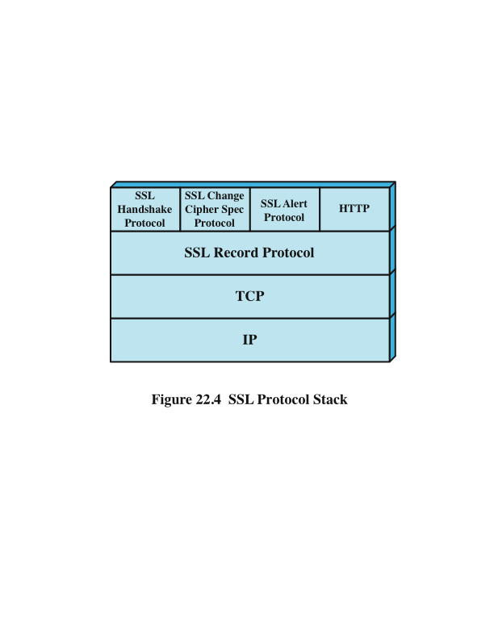
Transport Layer Security (TLS) Stack
Notes:
Template-WSU Hrz 201.ppt

Slide 16
Transport Layer Security (TLS)
TLS transmits payloads as ‘records’
  Records are compressed and encrypted
Record types
  TLS handshake
  HTTPS data
  System events e.g. alerts (bad certificate, decryption error etc.)
  Cipher switch specifications
Notes:
Template-WSU Hrz 201.ppt

Slide 17
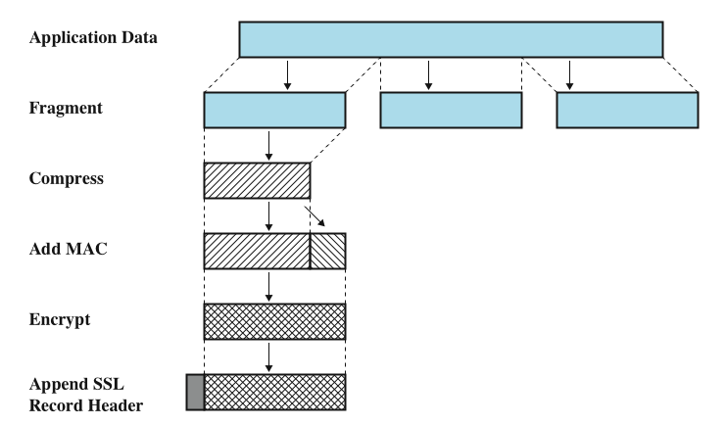
Transport Layer Security (TLS)
Notes:
Template-WSU Hrz 201.ppt

Slide 18
Transport Layer Security (TLS) Handshake
TLS creates a stateful connection
Handshake facilitates ‘statefulness’ by negotiating
  TLS version
  Ciphers
    RSA / DH for key exchange
    AES / RC4 for bulk encryption
    SHA-512 HMACs for integrity & auth
    Format: [SSL/TLS]_[key_exchange]_[signature_algorithm]_WITH_[symmetric cipher]_[auth]
      TLS_RSA_WITH_AES_128_CBC_SHA
  Certificates
  Preshared key
  Session ID
Notes:
Template-WSU Hrz 201.ppt

Slide 19
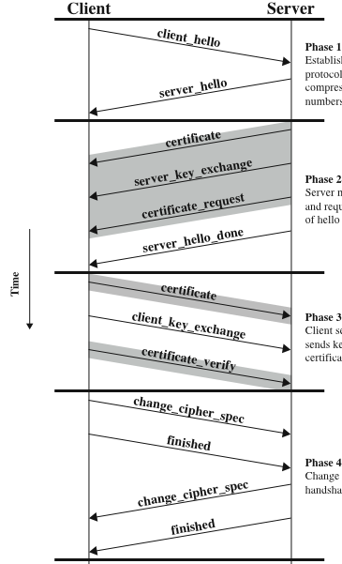
Transport Layer Security (TLS) Handshake
Proposes
1) version,
2) ciphers,
3) random number
Specifies:
1) version,
2) cipher,
3) random number
4) session id
Notes:
Template-WSU Hrz 201.ppt

Slide 20
Authenticated Encryption and Assoc. Data (AEAD)
Provides a sequence for security
  First authenticate then encrypt? or
  Encrypt first and authenticate next? Or
  Do both at the same time?
Example implementations
  Galois Counter Mode (GCM) E t A
  Offset Codebook Mode (OCB) A t E
  ChaCha20 and Poly1305 (E & A)
Notes:
Template-WSU Hrz 201.ppt

Slide 21
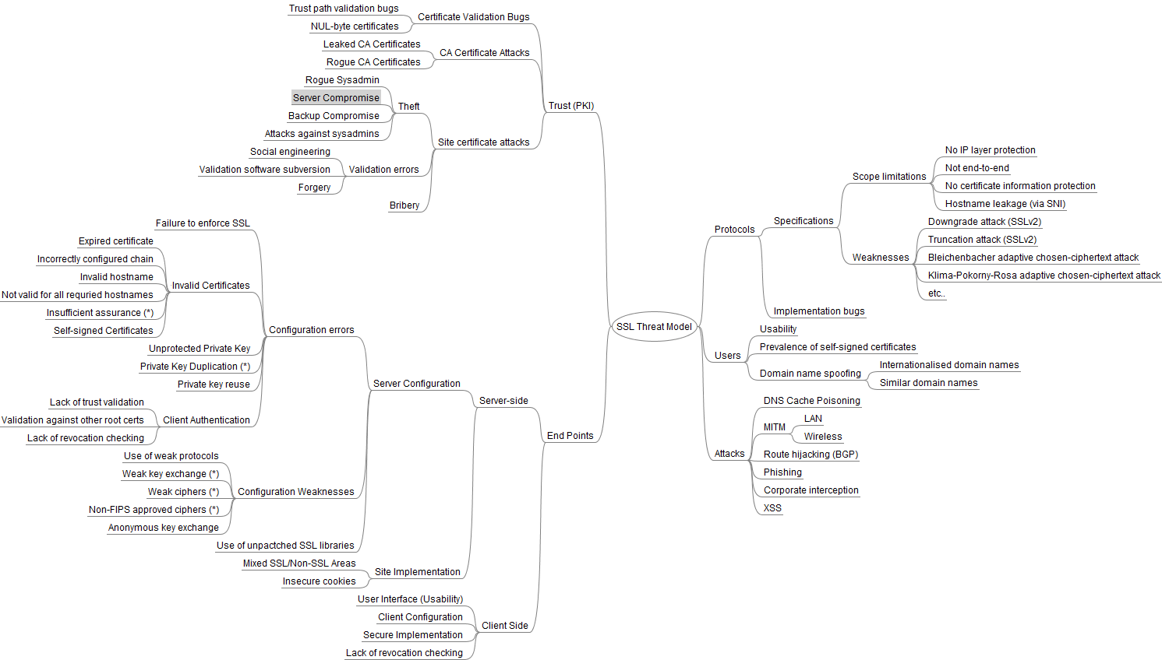
SSL Threats
https://www.ssllabs.com/projects/ssl-threat-model/
Notes:
Template-WSU Hrz 201.ppt

Slide 22
Attack on TLS/SSL
POODLE
  Padding Oracle on Downgraded Legacy Encryption
  SSLv3 still used as a legacy fallback in Windows Server versions
BEAST/CRIME attacks
  Compromising IV and/or index registers
    Reverse engineer
Need
  Ability to inject and run scripts from some web location
Notes:
Template-WSU Hrz 201.ppt

Slide 23
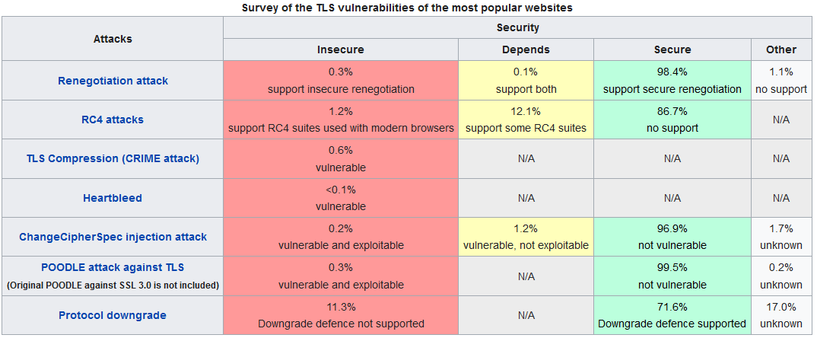
TLS Threats
https://www.ssllabs.com/ssl-pulse/
Notes:
Template-WSU Hrz 201.ppt

Slide 24
Next lecture
Blockchains
Notes:
Template-WSU Hrz 201.ppt

Slide 25
Any questions?
Notes:
Template-WSU Hrz 201.ppt

