Slide 1
CptS 427 / 527 : Computer Security
Fundamentals of Cyber Security
Notes:
Template-WSU Hrz 201.ppt

Slide 2
Today’s Topics
Review:
  CIA Triad
  Saltzer & Schroeder Principles
Notes:
Template-WSU Hrz 201.ppt

Slide 3
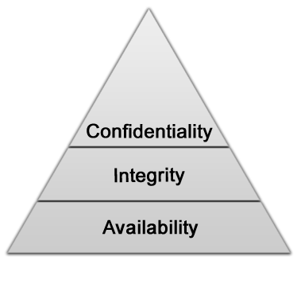
CIA Triad
First cornerstone of cybersecurity
No aspect can be lacking
If we MUST prioritize:
  Availability > Integrity > Confidentiality
Formulated by NIST in 1974
Notes:
Template-WSU Hrz 201.ppt

Slide 4
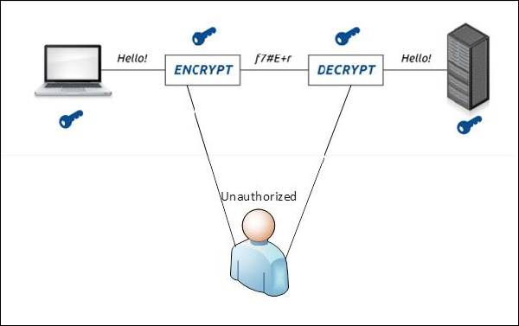
Availability
Provide access when necessary
  X should be available at Y
  K should be available at all times except 1,2,3…
  Z should NOT be available at B
  X, K, Z are resources (data, service, memory...)
  Y and B are aspects (users, time, location…)
Examples:
  Server-client communication
  Service-user interaction
Notes:
Template-WSU Hrz 201.ppt

Slide 5
Integrity
Maintain accuracy, completeness, and termination of data
  Throughout its lifecycle
  A data set {A,B,C} shouldn’t become {A,B} or {A,B,C,D}
  A data item X shouldn’t become Y
  A data feeder loop shouldn’t run infinitely
Examples:
  Server-client communication
  Service-user interaction
Notes:
Template-WSU Hrz 201.ppt

Slide 6
Confidentiality
Unintended access should not be possible
  Uphold privacy
  Resource meant for A shouldn’t be reachable by B
Examples:
  Server-client communication
  Service-user interaction
Notes:
Template-WSU Hrz 201.ppt

Slide 7
Security Design Principles
Second cornerstone of cybersecurity
Need not satisfyall
There are no priority rules
Formulated by Saltzer and Schroeder in 1975
  Also known as Saltzer & Schroeder principles
  Economy of mechanisms
  Fail-safe defaults
  Complete mediation
  Open design
  Separation of privilege & least privilege
  Least common mechanism
  Psychological acceptability / viability
  Work factor
  Compromise recording
Notes:
Template-WSU Hrz 201.ppt

Slide 8
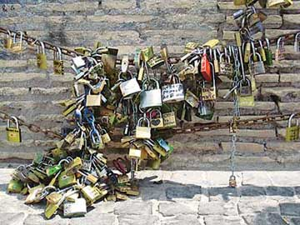
Economy of mechanisms
Mechanisms should be as simple, small as possible
Complicated security tends to be:
  Unused
  Hard to test and validate
Example:
  ICS Testbed at TAMUC
Notes:
Template-WSU Hrz 201.ppt

Slide 9

Fail-safe defaults
A system should fail into the correct state
Wrong state fails cause loss of resources
Examples:
  Default deny access for critical resources
  Default allow access for public resources
Notes:
Template-WSU Hrz 201.ppt

Slide 10
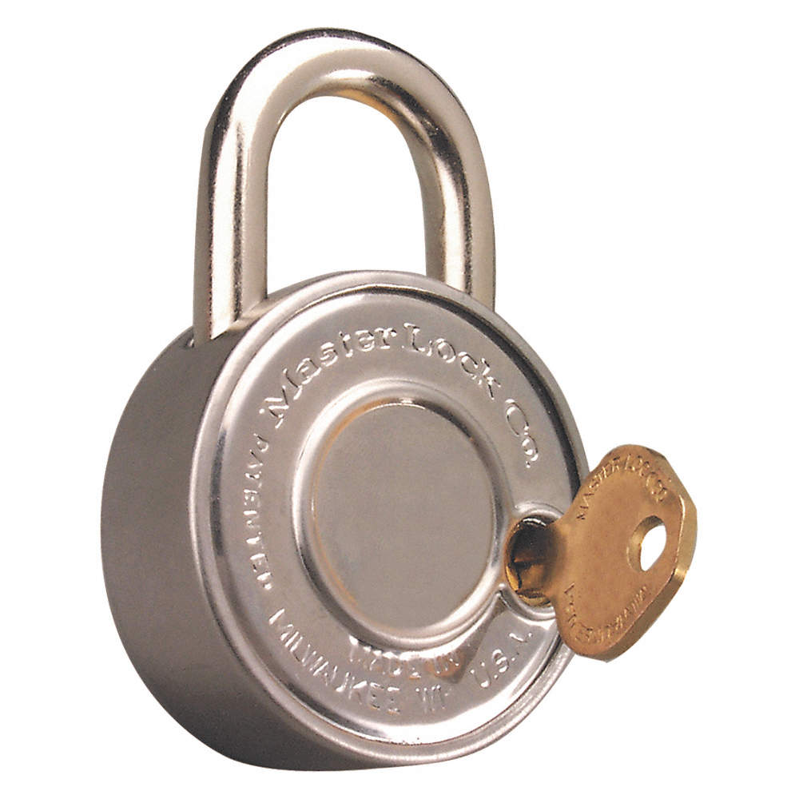
Complete Mediation
Every access attempt should be validated in real-time
Dependence on cache should be avoided
Example:
  Passwords (real-time vs storing)
Notes:
Template-WSU Hrz 201.ppt

Slide 11

Open Design
Security designs should always be open
‘Security by obscurity’ should be avoided
Example:
  Unix VS Windows
Notes:
Template-WSU Hrz 201.ppt

Slide 12
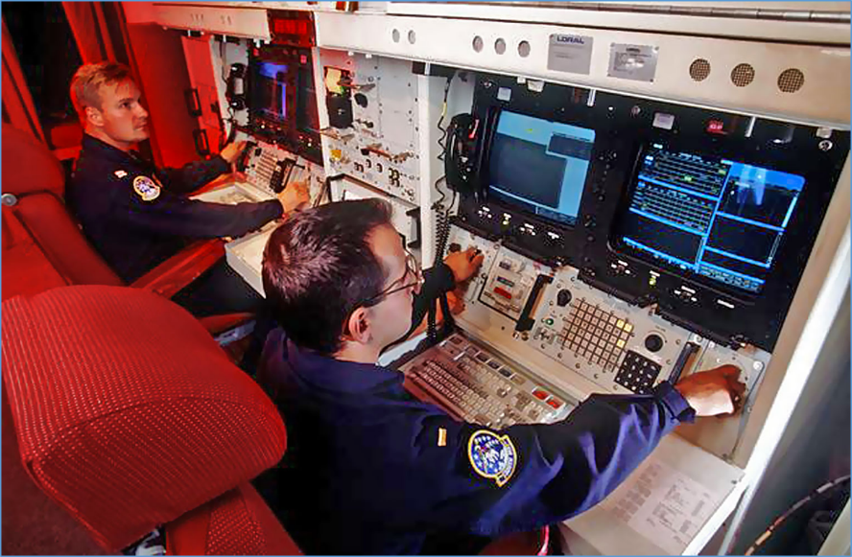
Separation of Privilege
Each resource or function should have a separate privilege
Examples:
  Security clearance levels
  Access grant levels
Notes:
Template-WSU Hrz 201.ppt

Slide 13

Least Privilege
Resources / users should have least required privileges
Avoid blanket accesses
  Don’t do: chmod –R 777 ./*
Example:
  Roles and permissions
    Regular user shouldn’t have admin rights
Notes:
Template-WSU Hrz 201.ppt

Slide 14

Least Common Mechanism
Minimize shared functions
Avoid shared functions unless absolutely needed
Examples:
  Virtualization
  Compartmentalization
Notes:
Template-WSU Hrz 201.ppt

Slide 15
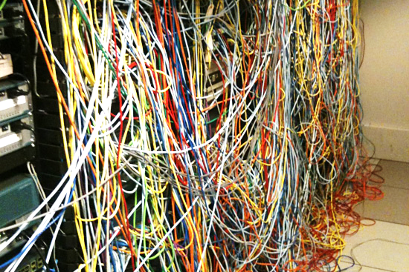
Psychological Acceptability / Viability
Mechanisms shouldn’t be traumatic and frustrating for users
Mechanisms shouldn’t interfere with user’s workflow
Examples:
  Screen locks in 15s
  Password renewal in 7 days
  Forcing users to use a particular
  web browser
Notes:
Template-WSU Hrz 201.ppt

Slide 16
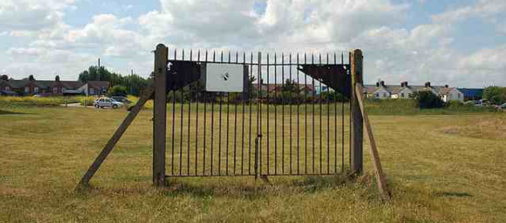
Work Factor
Compare benefit of exploiting vs resources needed to exploit for an attacker
Examples:
  Public computer vs an engineering computer
Notes:
Template-WSU Hrz 201.ppt

Slide 17

Compromise Recording
Better to develop systems that reliably record compromise events than try to develop completely secure systems
Debated principle
Examples:
  Early Microsoft VS Apple
Notes:
Template-WSU Hrz 201.ppt

Slide 18
Relevance of Principles
Hard to enforce all the principles in a single system in the real world
Security engineers often must prioritize based on relevance
Notes:
Template-WSU Hrz 201.ppt

Slide 19
Relevance Exercises
Implementing an encryption algorithm
  Economy of mechanisms
  Fail-safe defaults
  Complete mediation
  Open design
  Separation of privilege & least privilege
  Least common mechanism
  Psychological acceptability / viability
  Work factor
  Compromise recording
Notes:
Template-WSU Hrz 201.ppt

Slide 20
Relevance Exercises
Implementing an encryption algorithm
  Economy of mechanisms
  Fail-safe defaults
  Complete mediation
  Open design
  Separation of privilege & least privilege
  Least common mechanism
  Psychological acceptability / viability
  Work factor
  Compromise recording
Relevant
Not
Relevant
Arguable
Notes:
Template-WSU Hrz 201.ppt

Slide 21
Relevance Exercises
Open-source software
  Economy of mechanisms
  Fail-safe defaults
  Complete mediation
  Open design
  Separation of privilege & least privilege
  Least common mechanism
  Psychological acceptability / viability
  Work factor
  Compromise recording
Notes:
Template-WSU Hrz 201.ppt

Slide 22
Relevance Exercises
Open-source software
  Economy of mechanisms
  Fail-safe defaults
  Complete mediation
  Open design
  Separation of privilege & least privilege
  Least common mechanism
  Psychological acceptability / viability
  Work factor
  Compromise recording
Relevant
Not
Relevant
Arguable
Notes:
Template-WSU Hrz 201.ppt

Slide 23
Relevance Exercises
System does not log user out after a long idle time
  Economy of mechanisms
  Fail-safe defaults
  Complete mediation
  Open design
  Separation of privilege & least privilege
  Least common mechanism
  Psychological acceptability / viability
  Work factor
  Compromise recording
Notes:
Template-WSU Hrz 201.ppt

Slide 24
Relevance Exercises
System does not log user out after a long idle time
  Economy of mechanisms
  Fail-safe defaults
  Complete mediation
  Open design
  Separation of privilege & least privilege
  Least common mechanism
  Psychological acceptability / viability
  Work factor
  Compromise recording
Relevant
Not
Relevant
Arguable
Notes:
Template-WSU Hrz 201.ppt

Slide 25
Relevance Exercises
Windows UAC (‘Are you sure?’ pop-up)
  Economy of mechanisms
  Fail-safe defaults
  Complete mediation
  Open design
  Separation of privilege & least privilege
  Least common mechanism
  Psychological acceptability / viability
  Work factor
  Compromise recording
Notes:
Template-WSU Hrz 201.ppt

Slide 26
Relevance Exercises
Windows UAC (‘Are you sure?’ pop-up)
  Economy of mechanisms
  Fail-safe defaults
  Complete mediation
  Open design
  Separation of privilege & least privilege
  Least common mechanism
  Psychological acceptability / viability
  Work factor
  Compromise recording
Relevant
Not
Relevant
Arguable
Notes:
Template-WSU Hrz 201.ppt

Slide 27
Relevance Exercises
Implementing a Network Firewall
  Economy of mechanisms
  Fail-safe defaults
  Complete mediation
  Open design
  Separation of privilege & least privilege
  Least common mechanism
  Psychological acceptability / viability
  Work factor
  Compromise recording
Notes:
Template-WSU Hrz 201.ppt

Slide 28
Relevance Exercises
Implementing a Network Firewall
  Economy of mechanisms
  Fail-safe defaults
  Complete mediation
  Open design
  Separation of privilege & least privilege
  Least common mechanism
  Psychological acceptability / viability
  Work factor
  Compromise recording
Relevant
Not
Relevant
Arguable
Notes:
Template-WSU Hrz 201.ppt

Slide 29
Relevance Exercises
A web application has a single admin account
  Economy of mechanisms
  Fail-safe defaults
  Complete mediation
  Open design
  Separation of privilege & least privilege
  Least common mechanism
  Psychological acceptability / viability
  Work factor
  Compromise recording
Notes:
Template-WSU Hrz 201.ppt

Slide 30
Relevance Exercises
A web application has a single admin account
  Economy of mechanisms
  Fail-safe defaults
  Complete mediation
  Open design
  Separation of privilege & least privilege
  Least common mechanism
  Psychological acceptability / viability
  Work factor
  Compromise recording
Relevant
Not
Relevant
Arguable
Notes:
Template-WSU Hrz 201.ppt

Slide 31
Relevance Exercises
A music app requires permission to access camera and phone contacts
  Economy of mechanisms
  Fail-safe defaults
  Complete mediation
  Open design
  Separation of privilege & least privilege
  Least common mechanism
  Psychological acceptability / viability
  Work factor
  Compromise recording
Notes:
Template-WSU Hrz 201.ppt

Slide 32
Relevance Exercises
A music app requires permission to access camera and phone contacts
  Economy of mechanisms
  Fail-safe defaults
  Complete mediation
  Open design
  Separation of privilege & least privilege
  Least common mechanism
  Psychological acceptability / viability
  Work factor
  Compromise recording
Relevant
Not
Relevant
Arguable
Notes:
Template-WSU Hrz 201.ppt

Slide 33
Relevance Exercises
All services of the network utilize the same login server
  Economy of mechanisms
  Fail-safe defaults
  Complete mediation
  Open design
  Separation of privilege & least privilege
  Least common mechanism
  Psychological acceptability / viability
  Work factor
  Compromise recording
Notes:
Template-WSU Hrz 201.ppt

Slide 34
Relevance Exercises
All services of the network utilize the same login server
  Economy of mechanisms
  Fail-safe defaults
  Complete mediation
  Open design
  Separation of privilege & least privilege
  Least common mechanism
  Psychological acceptability / viability
  Work factor
  Compromise recording
Relevant
Not
Relevant
Arguable
Notes:
Template-WSU Hrz 201.ppt

Slide 35
Any questions?
Notes:
Template-WSU Hrz 201.ppt

