Slide 1
CptS 427 / 527 : Computer Security
Announcements
Quiz 02 begins at 14:10 and ends at 14:25
Project proposal is due EOD tomorrow (6/19 at 11:59 PM)
Notes:
Template-WSU Hrz 201.ppt

Slide 2
CptS 427 / 527 : Computer Security
Access Control
Notes:
Template-WSU Hrz 201.ppt

Slide 3
Today’s Topics
Access Control
  MAC
  RBAC
  AppArmor
  HEAC
Access Control Exploits
  Meltdown & Specter
Notes:
Template-WSU Hrz 201.ppt

Slide 4
Mandatory Access Control
Security administrator controls granting of privileges
Multilevel security
  Every object has several levels of privileges
Different implementations provide different security features
  Bell-LaPadula: confidentiality
  Biba: integrity
  Chinese Wall: solves conflict-of-interest
Problems
  Rigid and inconvenient to use
  Significant bureaucratic overhead
Notes:
Template-WSU Hrz 201.ppt

Slide 5
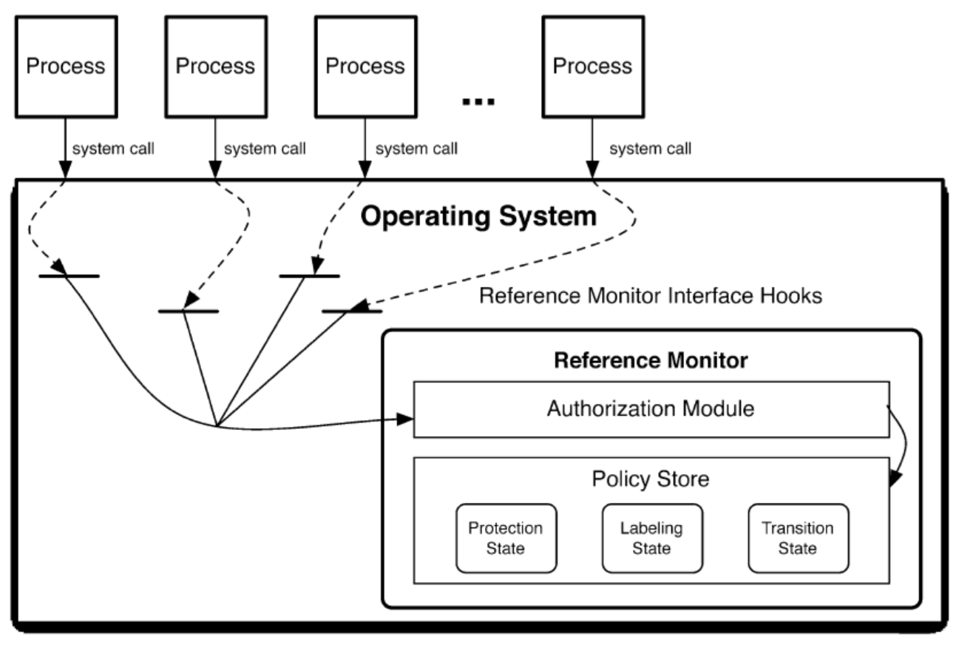
MAC Example: SELinux
Notes:
Template-WSU Hrz 201.ppt

Slide 6
Bell-LaPadula Model
Confidentiality focus
Developed by US military
Properties
  For a security level, subject can ‘read’ lower levels but not upper levels
  Cannot write any other levels
Notes:
Template-WSU Hrz 201.ppt

Slide 7
Biba Model
Integrity focus
Properties
  For a security level, subjects cannot read/write any other levels
Notes:
Template-WSU Hrz 201.ppt

Slide 8
Chinese Wall Model
Conflicts of interest focus
Properties
  For a security level, subject can ‘read’ lower levels but not upper levels
    If allowed by conflict rules
  Cannot write any other levels
Notes:
Template-WSU Hrz 201.ppt

Slide 9
Role Based Access Control (RBAC)
Created to suit large organizational needs
Roles instead of groups
  Roles: collection of permissions
  Groups: collection of users
Types
  Flat: no inheritance
  Hierarchical: roles can inherit permissions
Sessions
  Users may have multiple roles
  One user can access various privileges
Notes:
Template-WSU Hrz 201.ppt

Slide 10
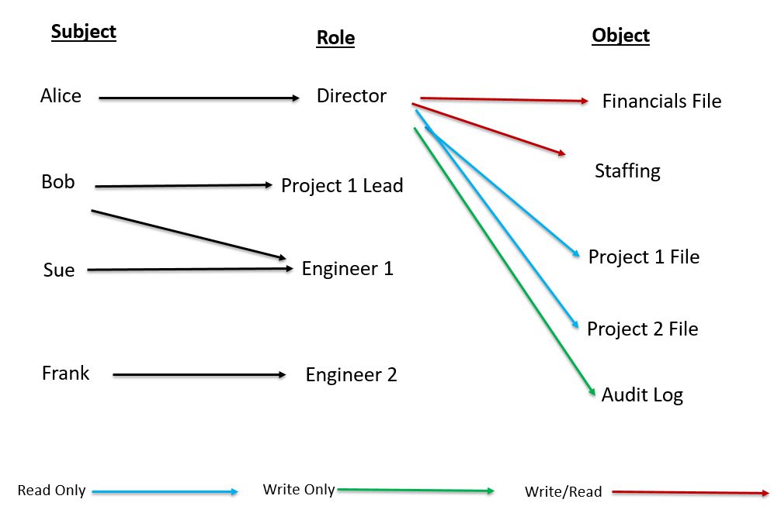
RBAC Example
Notes:
Template-WSU Hrz 201.ppt

Slide 11
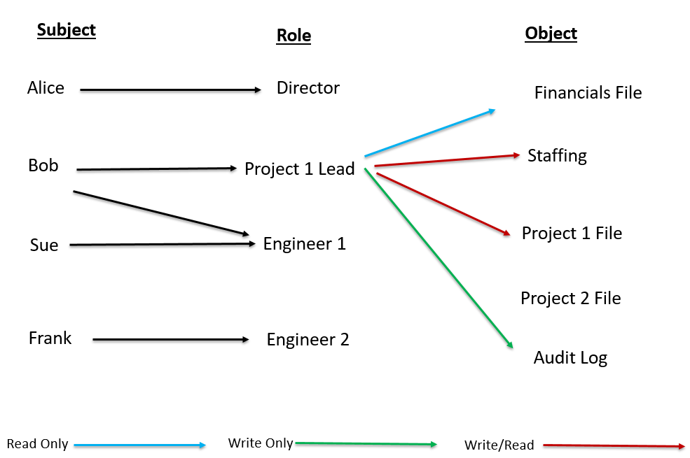
RBAC Example
Notes:
Template-WSU Hrz 201.ppt

Slide 12
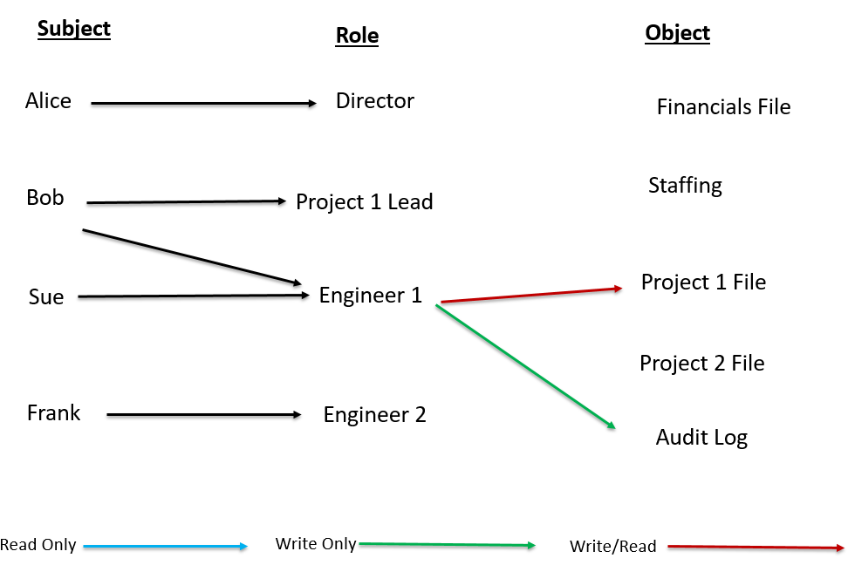
RBAC Example
Notes:
Template-WSU Hrz 201.ppt

Slide 13
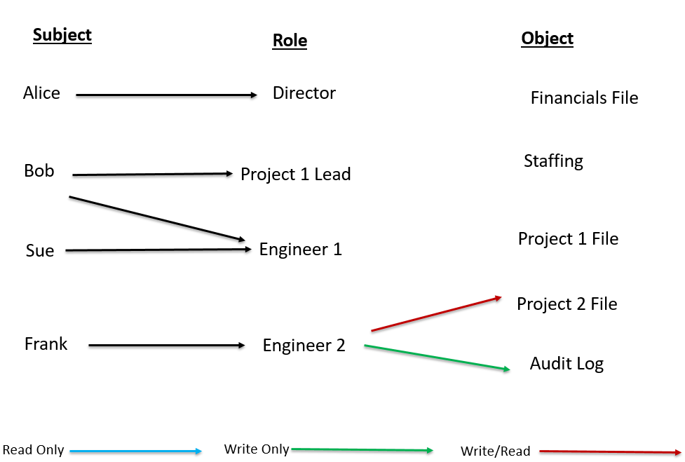
RBAC Example
Notes:
Template-WSU Hrz 201.ppt

Slide 14
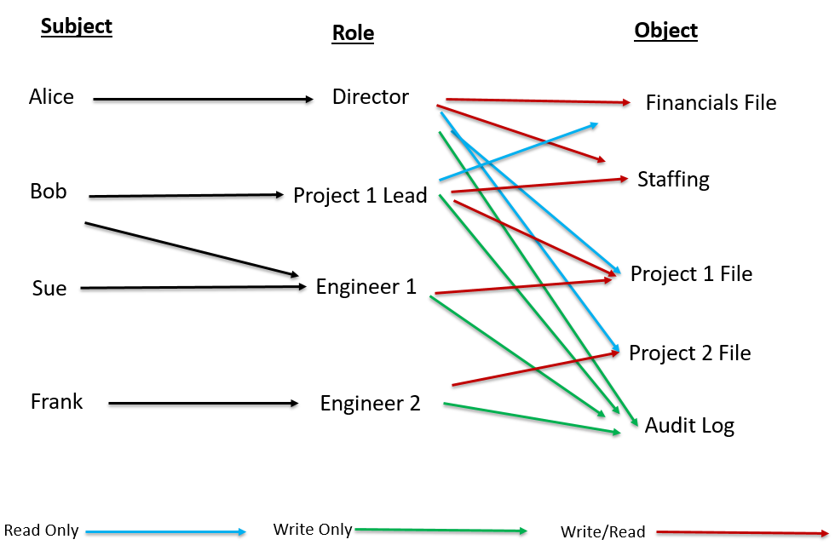
RBAC Example
Notes:
Template-WSU Hrz 201.ppt

Slide 15
Role Based Access Control (RBAC)
Strengths
  Flexible config.
  Efficient to use in complex / larger systems
  Can allow granular config. when needed
Drawbacks
  Overkill for simple / smaller systems
  Bureaucratic overhead higher than DAC
Notes:
Template-WSU Hrz 201.ppt

Slide 16
Bureaucratic Overhead
What is it?
  Time taken to:
    devise policies
    determine roles
    assign roles to users
    evaluate petitions/requests for changes
Project idea
  Determine and quantify the relationship between complexity of systems and bureaucratic overhead
Notes:
Template-WSU Hrz 201.ppt

Slide 17
AppArmor
Linux kernel module that enables improved security
  Provides DAC, MAC, RBAC
  Flexible alternative to SELinux
Access privileges are defined in a ‘profile’
Profiles can be defined for subjects and objects
Modes
  Complain: produces logs of accessed objects; testing
  Enforce: block access to objects; production
Profiles and rules can be listed in /etc/apparmor.d/
Manual: https://wiki.ubuntu.com/AppArmor
Notes:
Template-WSU Hrz 201.ppt

Slide 18
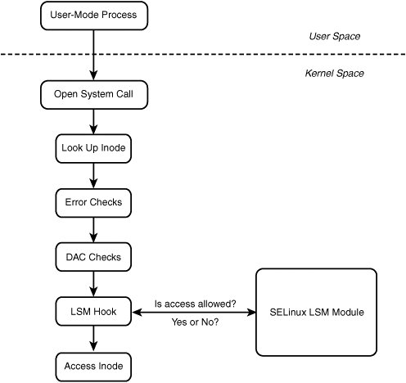
AppArmor
Notes:
Template-WSU Hrz 201.ppt

Slide 19
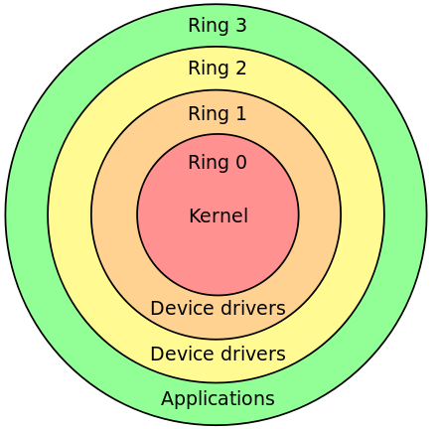
Hardware Enforced Access Control
Hardware enforced privilege levels aka ‘rings’
  Ring 3: user space
    Web browsers, office apps, etc
  Ring 0: kernel space
    Privileged instructions, memory mgmt., I/O, etc
  CPU checks if the instruction matches privilege level
  Crossing rings: use system calls and hardware interrupts
    X86 Architecture’s Privilege Rings
Notes:
Template-WSU Hrz 201.ppt

Slide 20
Hardware Enforced Access Control
Strengths
  Most secure form of access control
  Efficient at protecting a small set of functions
  Programming in assembly
Drawbacks
  CPU-intensive → slower
  Programming in assembly
Notes:
Template-WSU Hrz 201.ppt

Slide 21
Meltdown & Specter
Access control exploits
Exploits ‘out-of-order’ execution of modern CPUs to bypass access control
Modus Operandi
  Use cache timing as a side channel attack to obtain exe traces
    Flush, reload, observe, and gather
  Use exe traces to determine which objects are vulnerable
  Insert code to compromise the vulnerable object’s memory
  Obtain secrets stored in compromised object’s memory
Notes:
Template-WSU Hrz 201.ppt

Slide 22
Meltdown & Specter
Differences between Meltdown and Specter
  Meltdown exploits isolation between user apps and kernel objs
    Used to compromise a device’s secrets
  Specter exploits isolation between multiple user apps
    Used to compromise a user’s secrets on different apps
    Harder to do than Meltdown
    Harder to defend against (mitigate) than Meltdown
Notes:
Template-WSU Hrz 201.ppt

Slide 23
In Order CPU Execution
Executes instructions in the received order
  Inst1
  Inst2
  Inst3
    MicroInst3.1
    MicroInst3.2
  Inst4
Instructions can access privileged kernel objects
Becoming obsolete as the processing is slower
Notes:
Template-WSU Hrz 201.ppt

Slide 24
Out of Order CPU Execution
Executes instructions speculatively
Speculative execution using ‘branch prediction’
  Inst1
  Inst2
  Inst4
Instructions can access privileged kernel objects
Branch prediction utilizes ‘CPU caches’
Used by most modern CPUs due to faster processing times
  Inst3
    MicroInst3.1
    MicroInst3.2
Notes:
Template-WSU Hrz 201.ppt

Slide 25
Meltdown & Specter
What allows these vulnerabilities?
  CPU manufacturers not wiping caches
Which systems are effected?
  Most devices
  And by extension, anything you do on the devices
How to fix?
  Manufacturers can modify CPU chips to wipe caches
    Several manufacturers applied firmware patches
  OS-level security fixes (some Unix distros)
    Implement KPTI (Kernel-Page Table Isolation)
      Separate page tables for user(s) and kernel
    Implement KASLR (Kernel-Address Space Layout Randomization)
      Make memory addresses unpredictable
Notes:
Template-WSU Hrz 201.ppt

Slide 26
More Info
More info, including practical demos and proof-of-concept code bases can be found at
  https://meltdownattack.com/
Hands on tutorial exercises can be found at (not 100% free)
  https://seedsecuritylabs.org/Labs_16.04/System/Meltdown_Attack/
Notes:
Template-WSU Hrz 201.ppt

Slide 27
Next lecture
Software vulnerabilities
Notes:
Template-WSU Hrz 201.ppt

Slide 28
Any questions?
Notes:
Template-WSU Hrz 201.ppt

