Slide 1
MAPT Phylogenetic Analysis
Jackson Sheppard
1/7/22

Slide 2
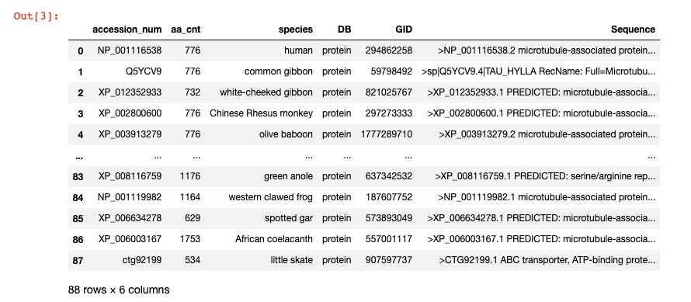
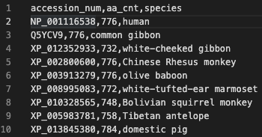
Summary
Initial attempt:
Search NCBI for all accession numbers in Reg’s phylogenetic tree, take most recent NCBI entry
Use NCBI web-based MSA and Phylogenetic analysis tools
Found large mismatch between returned sequence lengths and the lengths indicated in Reg’s result

Slide 3
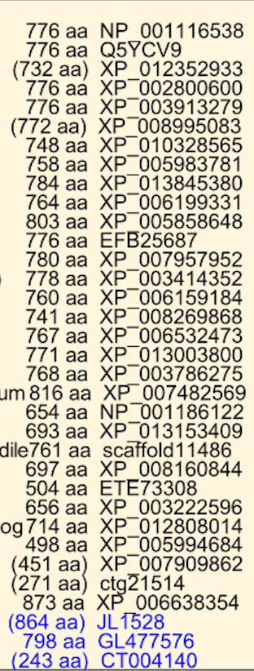
Replication – Similar Result using MUSCLE
Reg’s Result

Slide 4
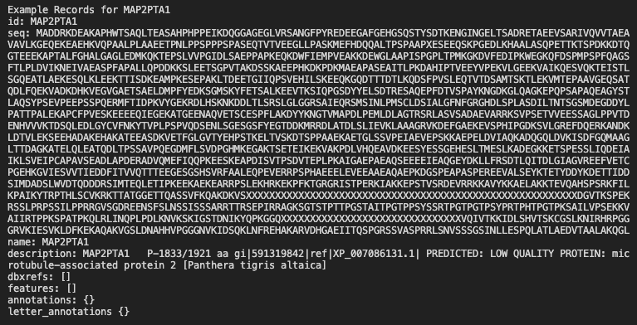
Next Steps/Current Issues
Obtaining exact matches for Reg’s input sequences, starting from:

Slide 5
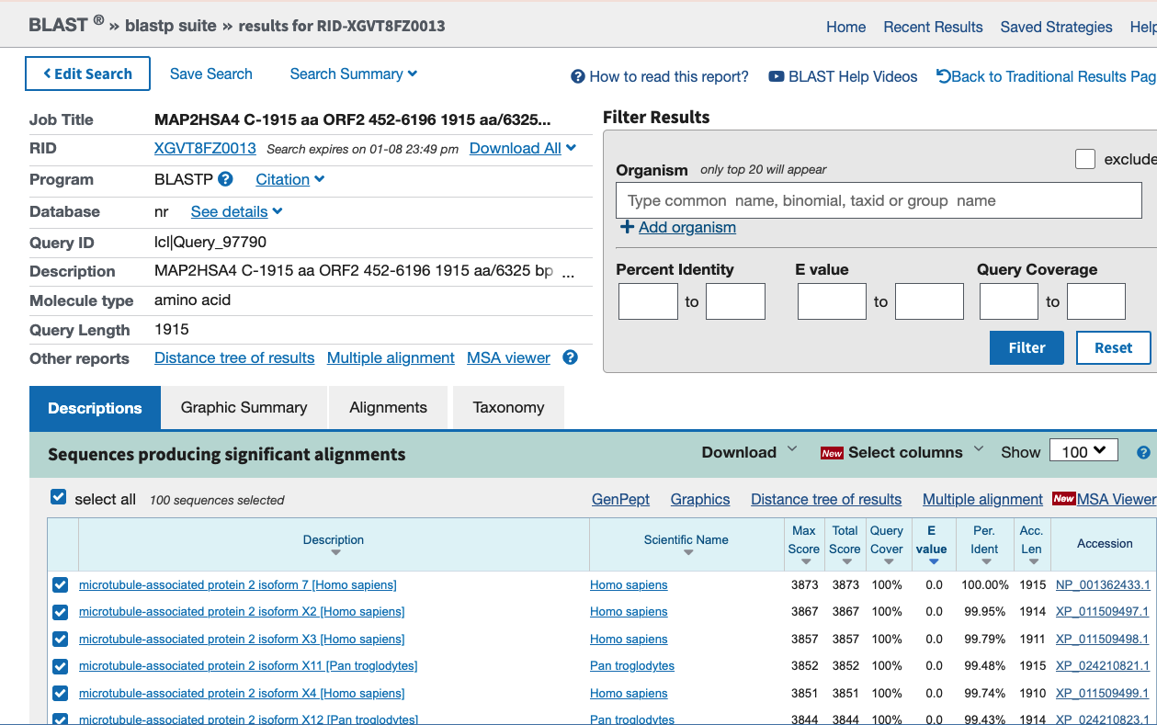
Next Steps/Current Issues
Procedure:
Run blastp query for each of Reg’s original sequences
Select highest match (100%), ensure
sequences match
Find desired result using blastp web tool:
e.g for MAP2HSA4
Homo sapiens (human) chromosome 2,
GRCh37.p10 Primary Assembly 1915 bp)

Slide 6
Extending to a Programmatic Approach
Using blastp command line interface:
$ blastp -db nr -query temp.fasta -out temp.out -remote
Error: [blastp] internal_error: (Severe Error) Blast search error: Details: search failed. # Informational Message: [blastsrv4.REAL]: Error: CPU usage limit was exceeded, resulting in SIGXCPU (24).
Number of ”high-scoring segment pairs (HSPs)” is too large to return the results
Look for option to only take top 10 results (TODO)

Slide 7
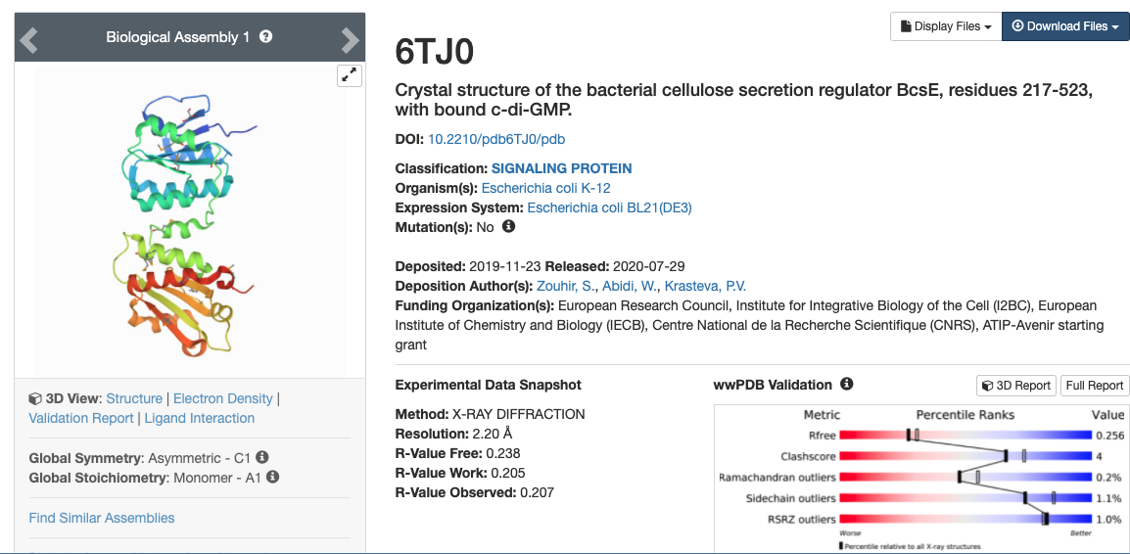
Leveraging a Python Interface: PyPDB
Python interface to RCSB Protein Data Bank (PDB)
Sequence search formerly used BLAST, now using MMseqs2
Still learning the usage:
q = pypdb.Query(sequence, query_type="sequence", return_type="entry")
print(q.search())
Returns matches by PDB ID:
['6TJO', '6TJX', '7NRQ’, … ]
First result shows not ordered
by percent match

Slide 8
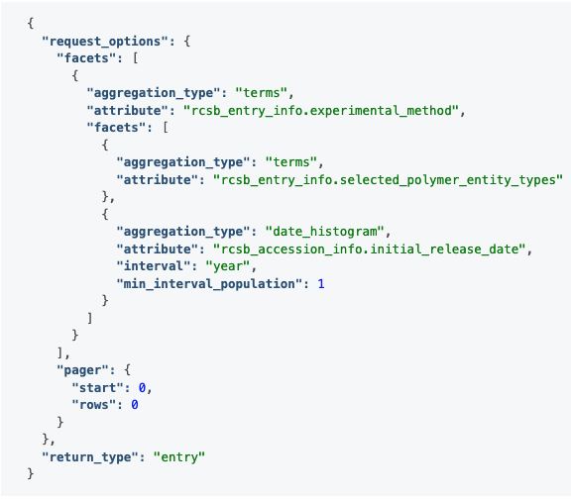
Next Steps
First Idea:
Get percent match for input sequence and each returned PDB sequence using BLAST and save the highest match
Should not be necessary – PDB searches must have their own scoring system
Better Approach:
Use the full RCSB PDB Search API (REST)
NB: argument `exact_match`
Build a JSON file with search terms and parameters
Once protein sequence list is cleaned/finalized,
Run RAxML:
$ raxmlHPC_820_64.exe -# 100 -s alignment.afa.PHY
-n alignment.afa.txt -f a -m PROTGAMMAWAG
-x 173617 -p 173617

Slide 9
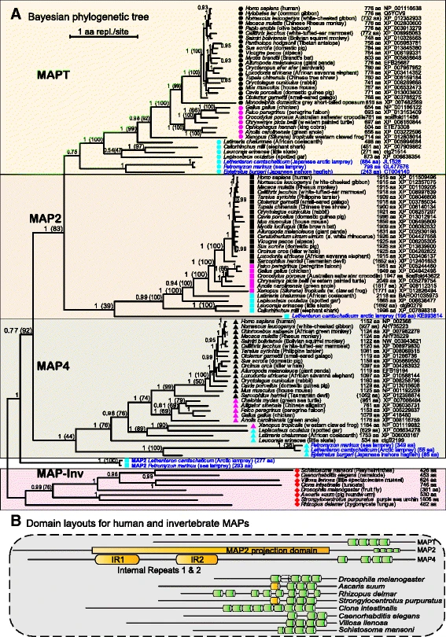
Big Picture
Still working in the realm of data cleaning
and preprocessing
Purpose of Phylogenetic Analysis:
Understand genetic deviations over the
evolution of a particular species
Unsupervised clustering approach,
what does Reg’s result indicate?
Confirming 4 clusters? (MAP-Inv, MAP4, MAP2,
MAPT)
Reg Morgan: Confirmed order/timing of
MAPT molecular evolution
Phosphorylation Sites – Modulates tau’s
Intracellular interactions and regulates IDR
Properties
Phylogenetic Map -> Phosphorylation sites?

