Slide 1
MAPT Phylogenetic Analysis
Jackson Sheppard
Song-I Han Group Meeting 12/8/21

Slide 2
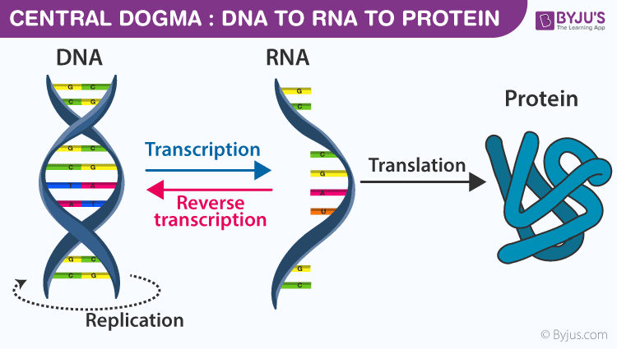
Background
“An evolutionary roadmap to the microtubule-associated protein MAP tau”, by Sundermann, Fernandez, and Morgan
Computational analysis of tau molecular evolution
Determine conserved regions of tau over vertebrate evolution
How does this relate to site-specific interactions and the the tendency of the protein to take on ”disordered conformational states”
Central Dogma of Biochemistry: DNA -> RNA -> Protein
All functional information contained in the protein sequence

Slide 3
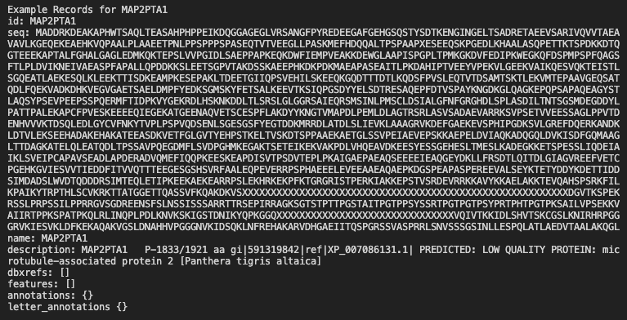
Morgan’s Methods
Acquire protein sequences for 296 tau sequences (99 sequences in final tree)
Ranging from early non-vertebrates (with MAP4/MAP2 variants of tau) to humans with the MAPT variant
Lots of preprocessing: transcription of DNA sequences to give additional non-vertebrate tau sequences, etc.
Multiple Sequence Alignment
MAFFT, T-Coffee (M-Coffee mode),
HMMalign, COBALT (Web-based at
NCBI)
Phylogenetic Analysis
RAxML (Maximum Likelihood Analysis)
Estimating parameters of an assumed
probability distribution

Slide 4
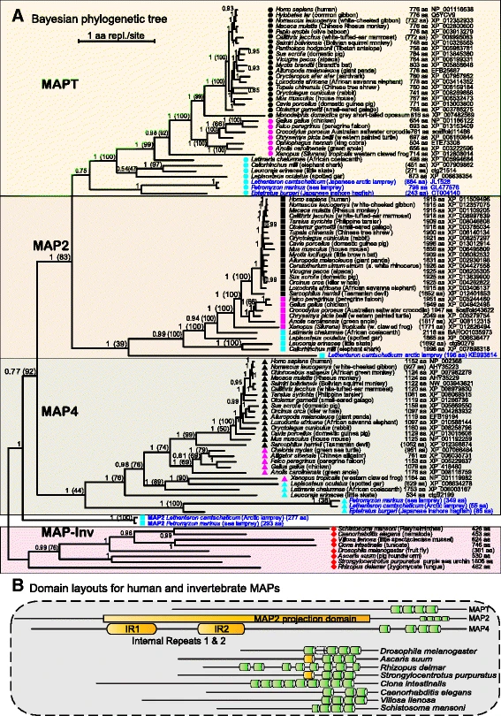
Morgan’s Results

Slide 5
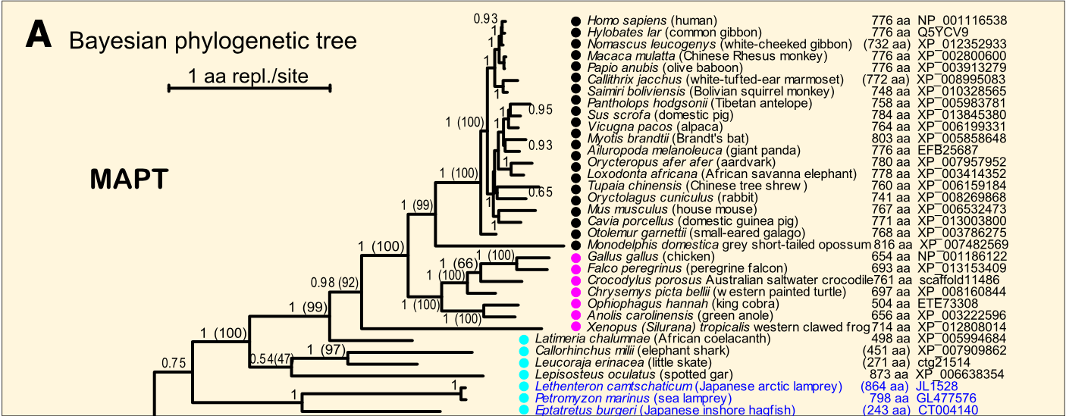
Morgan’s Results: MAPT Only
Similar to hierarchical clustering – Finding groupings of related tau sequences without specifying the number
of clusters
Actual hierarchical clustering relies on the “Genomic Tree” which describes major genetic re-arrangements
Phylogenetic analysis used primarily for slow evolution within the genome

Slide 6
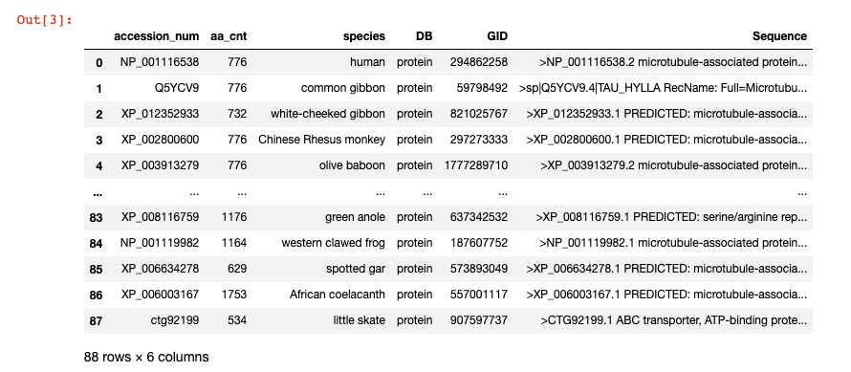
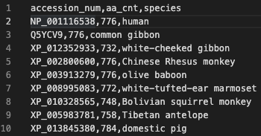
Replicating The Result
Data Pipeline:
Protein Name List FASTA Sequences
Acquired with NCBI Sequence Search API

Slide 7
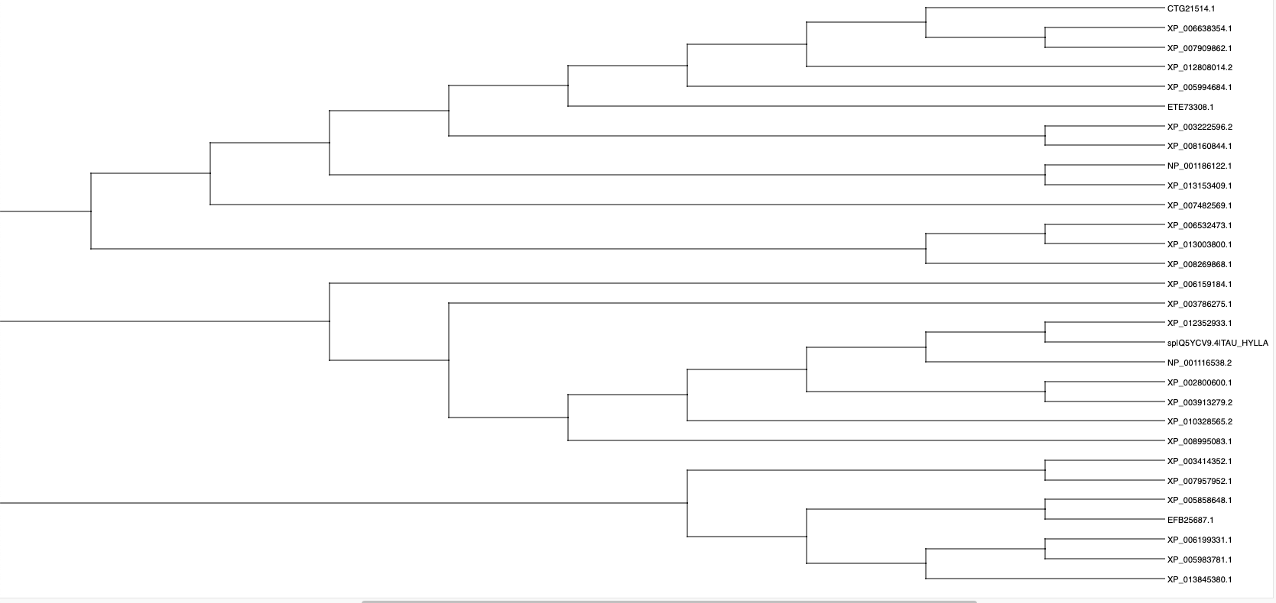
Data Pipeline, cont.
FASTA Sequences Aligned FASTA Sequences Phylogenetic Tree
Initial Attempt: MUSCLE Alignment and phylogenetic analysis
All-In-One API tool

Slide 8
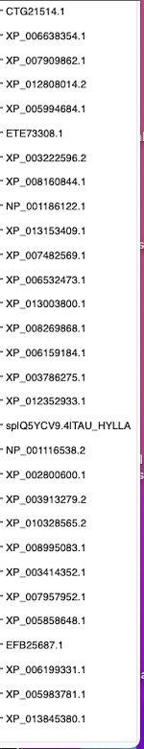
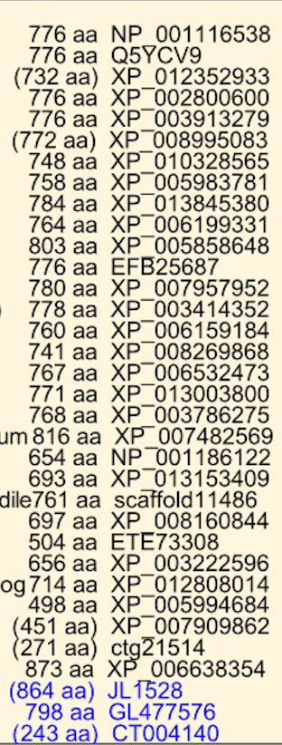
Qualitative Comparison with Morgan’s MAPT Cluster
Somewhat similar - Need to perform quantitative analysis of this

Slide 9
Refining The Pipeline
Need to use same alignment algorithm as Reg Morgan
Why is this even necessary? Why not simply use Python string-matching for given amino acid sequences? Computationally intensive -> probabilistic approach needed?
Iused MUSCLE alignment (ran as a binary to perform alignment only)
Visualized using the NCBI MSA Viewer:
Visualization of conserved
regions of tau sequence

Slide 10
Built-In Phylogenetic Tool on NCBI’s MSA Viewer

Slide 11
Next Steps
Previous work mostly in the realm of “data exploration”
Mostly using built-in phylogenetic tools from alignment algorithms
Further explore RAxML and features
Systematic Replication of Reg Morgan’s Pipeline:
Verification and comparison of Morgan’s input sequence file to those in NCBI protein databases
So far lots to wrangle/clean – Translated DNA/RNA Sequences, unnamed sequences, missing sequences, etc.
More specific details on the alignment algorithm choice
Add RAxML into the pipeline with the following arguments (provided by Morgan)
Quantitative comparison of output phylogenetic trees
raxmlHPC_820_64.exe -# 100 -s alignment.afa.PHY -n alignment.afa.txt -f a -m PROTGAMMAWAG -x 173617 -p 173617

Slide 12
Tools
GitHub Repository: https://github.com/jsheppard95/MAPT_Phylogeny
NCBI Web Interface (Protein sequence queries, both web-based and as command line tools): https://www.ncbi.nlm.nih.gov/
MUSCLE API Documentation: https://www.ebi.ac.uk/seqdb/confluence/display/JDSAT/MUSCLE+Help+and+Documentation
MUSCLE Binary Documentation: https://petrov.stanford.edu/software/src/muscle3.6/muscle3.6.html
NCBI MSA Viewer: https://www.ncbi.nlm.nih.gov/tools/msaviewer/
Biopython Sequence File Processing Tools: https://github.com/biopython/biopython

