Slide 1
Genetic variants associated with risk factors for Alzheimer’s Disease
EN.580.688
4/15/2020
Jong Shin

Slide 2
Alzheimer’s disease (AD) is a progressive, neurodegenerative disease
Most common cause of dementia (60-80% of demetia cases)
In the US,
the 6th leading cause of death
1 in 10 over the age of 65 has AD
2-in-3 people with AD are women
Typical life expectancy after an Alzheimer’s diagnosis is 4-to-8 years
Cannot be cured, prevented or slowed
https://www.alz.org/alzheimers-dementia/facts-figures

Slide 3
The cause of AD is still unknown
AD first described by Dr. Alois Alzheimer in 1906
National Institute on Aging (NIA) began funding Alzheimer’s Disease Centers in 1984
FDA approves first Alzheimer’s drug in 1993
Much research has been done, but no practical progression made
https://www.alzheimers.net/history-of-alzheimers/

Slide 4
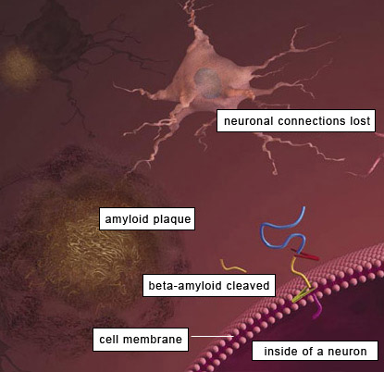
Two main caterogies of AD
Early-onset AD (<= 65 yr)
Caused by rare and dominantly inherited mutations
APP
PSEN1
PSEN2
Strong genetic component
Can be further subcategorized as familial or sporadic

Slide 5
Two main caterogies of AD
Late-onset AD (> 65 yr)
Genetically far more complex
Most cases are sporadic with no family history of the disease
Before the large-scale GWAS, APOE e4 only well-established risk factor

Slide 6
Aim
Build a predictive model to classify AD from the non-AD variant fingerprints
Identify genes that are associated with AD
Identify disease phenotypes that frequently occur with AD
Identify specific variants present with AD

Slide 7
Assumption
Assume that genetic risk factors lead to AD
AD
APP
APOE e4
PSEN1/2
GRASP results
ClinVar

Slide 8
Method
Acquisition of dataset
openSNP (~13 genetic data; relatives of AD)
Personal Genome Project (~900 genetic data)
Annotation
ClinVar (genomic variation)
Gene Ontology (gene function)
GRASP (genetic association between SNPs and phenotypes)
PhD-SNPg (prediction of pathogenic variants)
FTHMM (prediction of functional effects of protein missense mutation)
gnomAD (prevalence)
PolyPhen-2 (prediction of damaging variants)
Prediction
PCA (clustering)
SVM, KNN (classification)

Slide 9
Overview of project planning
Risk Variant #1
Non-AD Variant #1 (n=7)
Non-AD Variant #2 (n=5)
Risk Variant #2
Non-AD Variant #1 (n=10)
Non-AD Variant #2 (n=5)
Non-AD Variant #3 (n=2)
Non-AD Variant #4 (n=1)
Non-AD Variant #3 (n=3)
Non-AD Variant #4 (n=2)
Sample #1
Risk variant 1
Risk variant 2
Sample #2
Risk variant 1
Risk variant 3
Rank the list of non-AD variants from annotation
Does this person have AD? If so, which genes/variants are involved with which genetic risk factors?
Feed features to prediction algorithms

Slide 10
What could be the problems?
How can you assure that the pattern you see is representative of AD and not of a general population?
Solution: subtract the “background” from the result
Why would this be any different than what is already published?
Answer: this looks at specific variants rather than genes associated with the disease
(Poblador-Plou 2014)

Slide 11
Questions?

