Slide 1
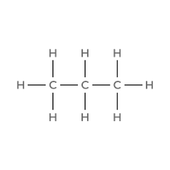


01
PROPANE
1. Molecular Formula
2. Lewis Structure
C₃H₈
3. Condensed Structural Formula
4. Bond-Line Formula
CH₃CH₂CH₃
atom count verified valence checked bond order checked same connectivity confirmed

Slide 2
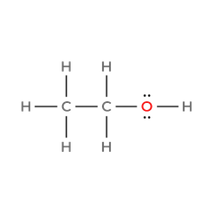

02
ETHANOL
1. Molecular Formula
2. Lewis Structure
C₂H₆O
3. Condensed Structural Formula
4. Bond-Line Formula
CH₃CH₂OH
atom count verified valence checked bond order checked same connectivity confirmed

Slide 3
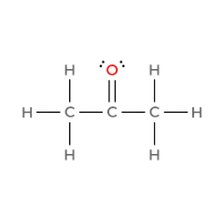

03
ACETONE
(propan-2-one)
1. Molecular Formula
2. Lewis Structure
C₃H₆O
3. Condensed Structural Formula
4. Bond-Line Formula
CH₃C(=O)CH₃
atom count verified valence checked bond order checked same connectivity confirmed

Slide 4
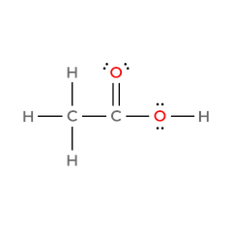

04
ACETIC ACID
(ethanoic acid)
1. Molecular Formula
2. Lewis Structure
C₂H₄O₂
3. Condensed Structural Formula
4. Bond-Line Formula
CH₃C(=O)OH
atom count verified valence checked bond order checked same connectivity confirmed

Slide 5
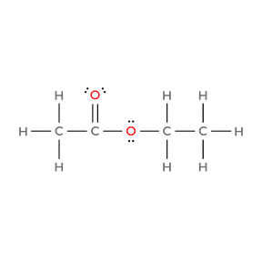

05
ETHYL ACETATE
(ethyl ethanoate)
1. Molecular Formula
2. Lewis Structure
C₄H₈O₂
3. Condensed Structural Formula
4. Bond-Line Formula
CH₃C(=O)OCH₂CH₃
atom count verified valence checked bond order checked same connectivity confirmed

Slide 6
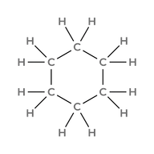

06
CYCLOHEXANE
1. Molecular Formula
2. Lewis Structure
C₆H₁₂
3. Condensed Structural Formula
4. Bond-Line Formula
cyclo-(CH₂)₆
atom count verified valence checked bond order checked same connectivity confirmed

Slide 7
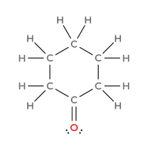

07
CYCLOHEXANONE
1. Molecular Formula
2. Lewis Structure
C₆H₁₀O
3. Condensed Structural Formula
4. Bond-Line Formula
cyclo-(CH₂)₅C=O
atom count verified valence checked bond order checked same connectivity confirmed

Slide 8
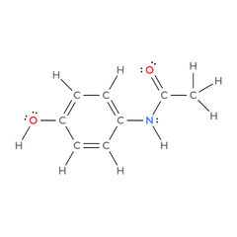

08
ACETAMINOPHEN
(paracetamol)
1. Molecular Formula
2. Lewis Structure
C₈H₉NO₂
3. Condensed Structural Formula
4. Bond-Line Formula
CH₃C(=O)NH-C₆H₄-OH
(para, 1,4)
atom count verified valence checked bond order checked same connectivity confirmed

Slide 9
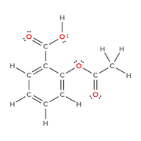
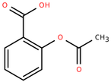
09
ASPIRIN
(acetylsalicyclic acid)
1. Molecular Formula
2. Lewis Structure
C₉H₈O₄
3. Condensed Structural Formula
4. Bond-Line Formula
CH₃C(=O)O-C₆H₄-COOH
(ortho, 1,2)
atom count verified valence checked bond order checked same connectivity confirmed

Slide 10
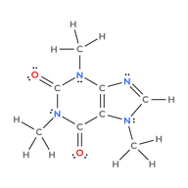
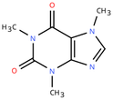
10
CAFFEINE
1. Molecular Formula
2. Lewis Structure
C₈H₁₀N₄O₂
3. Condensed Structural Formula
4. Bond-Line Formula
C₅H(CH₃)₃N₄O₂
atom count verified valence checked bond order checked same connectivity confirmed

