Slide 1
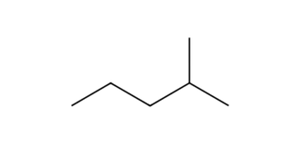
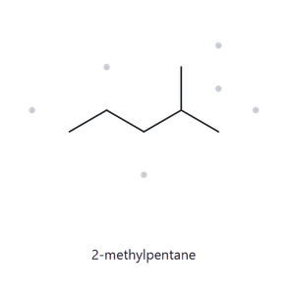


PART A · STRUCTURE ➜ NAME
A01 · Foundation · C₆H₁₄
1 · NUMBERED PARENT
2 · NAMING TRAIL
Parent: The longest chain is 5 C, so the parent is pentane. Two 5-C paths exist (the one through the left end of the zigzag, and the one that runs through the upward methyl). Each leaves exactly one methyl as a branch, so they lead to the same name.
Numbering: Numbering left to right puts the methyl on C4. Numbering right to left puts it on C2. The first point of difference is 2 < 4, so number from the right.
Substituents: One methyl on C2, so the name is 2-methylpentane.
3
5
4
2
1
3 · MY NAME
4 · THE ALKANE CHECK
2-methylpentane
Returned Name :
MATCH
longest chain confirmed lowest locants alphabetical order punctuation formula counted

Slide 2
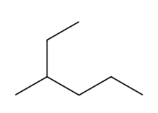
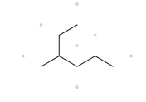
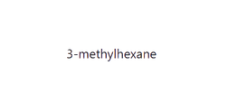
PART A · STRUCTURE ➜ NAME
A02 · Foundation · C₇H₁₆
1 · NUMBERED PARENT
2 · NAMING TRAIL
1
Parent: The longest chain is 6 C, so the parent is hexane. Going through the methyl gives only 5 C (methyl, C3, C4, C5, C6) or 4 C (methyl, C3, C2, C1), so the 6-C chain is the only longest one.
Numbering: Numbering from the upper-right end puts the methyl on C3. Numbering from the lower-right end puts it on C4. The first point of difference is 3 < 4, so number from the upper-right end.
Substituents: One methyl on C3, so the name is 3-methylhexane.
2
3
4
5
6
3 · MY NAME
4 · THE ALKANE CHECK
3-methylhexane
Returned Name :
MATCH
longest chain confirmed lowest locants alphabetical order punctuation formula counted

Slide 3
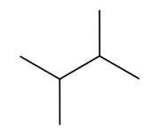
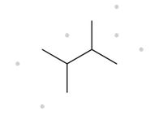

PART A · STRUCTURE ➜ NAME
A03 · Foundation · C₆H₁₄
1 · NUMBERED PARENT
2 · NAMING TRAIL
Parent: The longest chain is 4 C, so the parent is butane. Several 4-C paths exist, since you can run through either the upward or the downward methyl instead of the end carbons. Each one leaves two methyl groups as branches, so they all lead to the same name.
Numbering: Numbering left to right gives methyls on C2 and C3. Numbering right to left also gives C2 and C3. There is no point of difference, so either direction works.
Substituents: methyl on C2 and methyl on C3, so the name is 2,3-dimethylbutane.
1
2
3
4
3 · MY NAME
4 · THE ALKANE CHECK
2,3-dimethylbutane
Returned Name :
MATCH
longest chain confirmed lowest locants alphabetical order punctuation formula counted

Slide 4
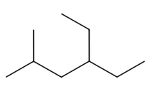
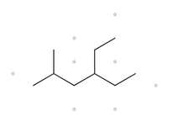

PART A · STRUCTURE ➜ NAME
A04 · Developing · C₉H₂₀
1 · NUMBERED PARENT
2 · NAMING TRAIL
Parent: The longest chain is 6 C, so the parent is hexane. Several 6-C paths exist, since you can run through the ethyl branch or the methyl branch instead of the zigzag ends. Each one leaves one methyl and one ethyl as branches, so they all lead to the same name. The path through the ethyl and the zigzag’s right end is only 5 C, so it is not a candidate.
Numbering: Left to right gives substituents at 2,4. Right to left gives 3,5. The first point of difference is 2 < 3, so number from the left.
Substituents: Methyl on C2 and ethyl on C4. List them alphabetically (ethyl before methyl): 4-ethyl-2-methylhexane.
3
5
6
1
2
4
3 · MY NAME
4 · THE ALKANE CHECK
4-ethyl-2-methylhexane
Returned Name :
MATCH
longest chain confirmed lowest locants alphabetical order punctuation formula counted

Slide 5
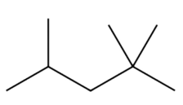
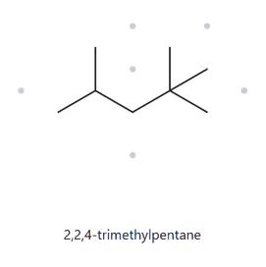
PART A · STRUCTURE ➜ NAME
A05 · Developing · C₈H₁₈
1 · NUMBERED PARENT
2 · NAMING TRAIL
Parent: The longest chain is 5 C, so the parent is pentane. Several 5-C paths exist, since you can run through either upward methyl on the quaternary carbon instead of the right-hand end. Each one leaves three methyls as branches, so they all lead to the same name.
Numbering: Left to right gives methyls at 2,4,4. Right to left gives 2,2,4. The first point of difference is 2 < 4 (second locant), so number from the right.
Substituents: Two methyls on C2 and one on C4. Use “tri” and repeat the locant for the two methyls on the same carbon: 2,2,4-trimethylpentane.
3
4
2
5
1
3 · MY NAME
4 · THE ALKANE CHECK
2,2,4-trimethylpentane
Returned Name :
MATCH
longest chain confirmed lowest locants alphabetical order punctuation formula counted

Slide 6
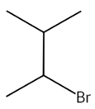
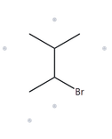

PART A · STRUCTURE ➜ NAME
A06 · Developing · C₅H₁₁Br
1 · NUMBERED PARENT
2 · NAMING TRAIL
4
Parent: The longest chain is 4 C, so the parent is butane. Two 4-C paths exist, and each leaves one methyl as a branch, so they lead to the same name. Br is a substituent, not part of the chain.
Numbering: Left to right gives bromo on C2 and methyl on C3. Right to left gives methyl on C2 and bromo on C3. Both sets are 2,3, so the tie goes to alphabetical order: bromo comes first, so it gets C2. Number from the lower-left end.
Substituents: Bromo on C2 and methyl on C3, so the name is 2-bromo-3-methylbutane.
3
2
1
3 · MY NAME
4 · THE ALKANE CHECK
2-bromo-3-methylbutane
Returned Name :
MATCH
longest chain confirmed lowest locants alphabetical order punctuation formula counted

Slide 7
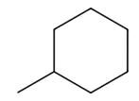
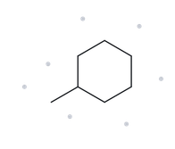
PART A · STRUCTURE ➜ NAME
A07 · Developing · C₇H₁₄
1 · NUMBERED PARENT
2 · NAMING TRAIL
3
Parent: The ring has 6 C and the only chain outside it is a 1-C methyl, so the ring is the parent: cyclohexane.
Numbering: With one substituent, it takes C1 by default, so no locant is written.
Substituents: One methyl, so the name is methylcyclohexane (not 1-methylcyclohexane).
2
4
1
5
6
3 · MY NAME
4 · THE ALKANE CHECK
methylcyclohexane
Returned Name :
MATCH
longest chain confirmed lowest locants alphabetical order punctuation formula counted

Slide 8
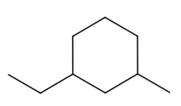
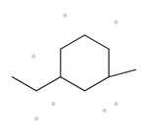
PART A · STRUCTURE ➜ NAME
A08 · Challenge · C₉H₁₈
1 · NUMBERED PARENT
2 · NAMING TRAIL
5
Parent: The ring has 6 C and the largest substituent is only 2 C, so the ring is the parent: cyclohexane.
Numbering: The two substituents are 1,3 to each other whichever way you go, so the locants tie at 1,3. The tie goes to alphabetical order: ethyl comes before methyl, so ethyl gets C1 and methyl gets C3.
Substituents: Ethyl on C1 and methyl on C3, listed alphabetically: 1-ethyl-3-methylcyclohexane.
6
4
1
3
2
3 · MY NAME
4 · THE ALKANE CHECK
1-ethyl-3-methylcyclohexane
Returned Name :
MATCH
longest chain confirmed lowest locants alphabetical order punctuation formula counted

Slide 9
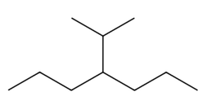
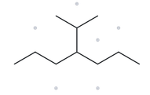


PART A · STRUCTURE ➜ NAME
A09 · Challenge · C₁₀H₂₂
1 · NUMBERED PARENT
2 · NAMING TRAIL
Parent: The longest chain is 7 C, so the parent is heptane. Going up through the isopropyl gives at most 6 C (CH₃, CH, C4, C5, C6, C7), so the 7-C chain is the longest.
Numbering: The branch is at C4 from either end, so there is no point of difference and either direction works.
Substituents: The branch is a 3-carbon group attached through its middle carbon. Longest chain in the branch starting at the attachment carbon: 2 C, so the base is ethyl. The attachment carbon is C1 of that ethyl, and it carries one methyl, so the group is 1-methylethyl. Because the substituent name is complex, it goes in parentheses with the locant for the main chain: 4-(1-methylethyl)heptane.
2
6
1
4
7
3
5
3 · MY NAME
4 · THE ALKANE CHECK
4-(1-methylethyl)
heptane
Returned Name :
MIS-MATCH
longest chain confirmed lowest locants alphabetical order punctuation formula counted

Slide 10
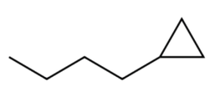
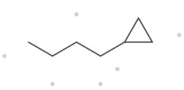

PART A · STRUCTURE ➜ NAME
A10 · Challenge · C₇H₁₄
1 · NUMBERED PARENT
2 · NAMING TRAIL
3
Parent: The ring has 3 C and the chain has 4 C. Current IUPAC recommendations prefer the ring as the parent, so the parent is cyclopropane.
Numbering: With one substituent, it takes C1, so no locant is written.
Substituents: One unbranched 4-carbon group, butyl, so the name is butylcyclopropane.
1
2
3 · MY NAME
4 · THE ALKANE CHECK
butylcyclopropane
Returned Name :
MATCH
longest chain confirmed lowest locants alphabetical order punctuation formula counted

Slide 11
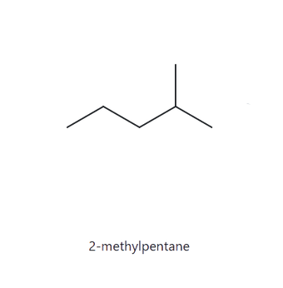
PART B · NAME ➜ STRUCTURE
B01 · Foundation · C₆H₁₄
1 · NAME DECODED
2 · BOND-LINE STRUCTURE (THE ALKANE)
Parent: pentane, a 5-carbon chain.
Substituents: methyl on C2.
Expected formula: 5+ 1 = 6 C. For an open-chain alkane, CₙH₂ₙ₊₂ gives 2(6) + 2 = 14 H, so C₆H₁₄.
3 · FORMULA CHECK
4 · BACK CHECK
Counted from the drawing: C₆H₁₄
  3 CH₃ (C1, C5 and the methyl branch) = 9 H
  2 CH₂ (C3, C4) = 4 H
  1 CH (C2) = 1 H
  Total = 14 H
Open chain: CₙH₂ₙ₊₂ = C₆H₁₄ ✓
Returned by The Alkane:
Same as the given name
parent length matches substituent positions match formula agrees back-check recorded

Slide 12
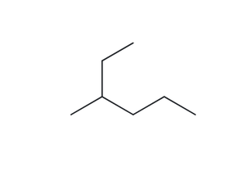
PART B · NAME ➜ STRUCTURE
B02 · Foundation · C₇H₁₆
1 · NAME DECODED
2 · BOND-LINE STRUCTURE (THE ALKANE)
Parent: hexane, a 6-carbon chain.
Substituents: methyl on C3.
Expected formula: 6 + 1 = 7 C. For an open-chain alkane, CₙH₂ₙ₊₂ gives 2(7) + 2 = 16 H, so C₇H₁₆.
3 · FORMULA CHECK
4 · BACK CHECK
Counted from the drawing: C₇H₁₆
  3 CH₃ (C1, C6 and the methyl branch) = 9 H
  3 CH₂ (C2, C4, C5) = 6 H
  1 CH (C3) = 1 H
  Total = 16 H
Open chain: CₙH₂ₙ₊₂ = C₇H₁₆
Returned by The Alkane:
Same as the given name
parent length matches substituent positions match formula agrees back-check recorded

Slide 13
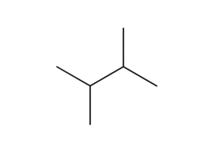
PART B · NAME ➜ STRUCTURE
B03 · Foundation · C₆H₁₄
1 · NAME DECODED
2 · BOND-LINE STRUCTURE (THE ALKANE)
Parent: butane, a 4-carbon chain.
Substituents: methyl on C2 and methyl on C3 (two methyls, so “di”).
Expected formula: 4 + 2 = 6 C. For an open-chain alkane, CₙH₂ₙ₊₂ gives 2(6) + 2 = 14 H, so C₆H₁₄.
3 · FORMULA CHECK
4 · BACK CHECK
Counted from the drawing: C₆H₁₄
  4 CH₃ (C1, C4 and the two methyl branches) = 12 H
  2 CH (C2, C3) = 2 H
  Total = 14 H
Open chain: CₙH₂ₙ₊₂ = C₆H₁₄ ✓
Returned by The Alkane:
Same as the given name
parent length matches substituent positions match formula agrees back-check recorded

Slide 14
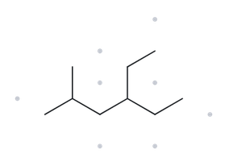
PART B · NAME ➜ STRUCTURE
B04 · Developing · C₉H₂₀
1 · NAME DECODED
2 · BOND-LINE STRUCTURE (THE ALKANE)
Parent: hexane, a 6-carbon chain.
Substituents: methyl on C2; ethyl on C4 (listed alphabetically, ethyl before methyl).
Expected formula: 6 + 1 + 2 = 9 C. For an open-chain alkane, CₙH₂ₙ₊₂ gives 2(9) + 2 = 20 H, so C₉H₂₀.
3 · FORMULA CHECK
4 · BACK CHECK
Counted from the drawing: C₉H₂₀
  4 CH₃ (C1, C6, the methyl branch, the ethyl’s end carbon) = 12 H
  3 CH₂ (C3, C5, the ethyl’s first carbon) = 6 H
  2 CH (C2, C4) = 2 H
  Total = 20 H
Open chain: CₙH₂ₙ₊₂ = C₉H₂₀ ✓
Returned by The Alkane:
Same as the given name
parent length matches substituent positions match formula agrees back-check recorded

Slide 15
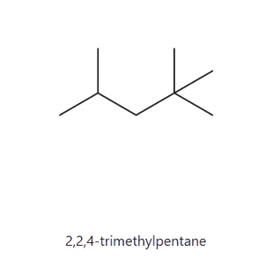
PART B · NAME ➜ STRUCTURE
B05 · Developing · C₈H₁₈
1 · NAME DECODED
2 · BOND-LINE STRUCTURE (THE ALKANE)
Parent: pentane, a 5-carbon chain.
Substituents: two methyls on C2 and one methyl on C4 (three methyls, so “tri”).
Expected formula: 5 + 3 = 8 C. For an open-chain alkane, CₙH₂ₙ₊₂ gives 2(8) + 2 = 18 H, so C₈H₁₈.
3 · FORMULA CHECK
4 · BACK CHECK
Counted from the drawing: C₈H₁₈
  5 CH₃ (C1, C5 and the three methyl branches) = 15 H
  1 CH₂ (C3) = 2 H
  1 CH (C4) = 1 H
  1 C with no H (C2, quaternary) = 0 H
  Total = 18 H
Open chain: CₙH₂ₙ₊₂ = C₈H₁₈ ✓
Carbon count: 5 + 1 + 1 + 1 = 8 C ✓
Returned by The Alkane:
Same as the given name
parent length matches substituent positions match formula agrees back-check recorded

Slide 16
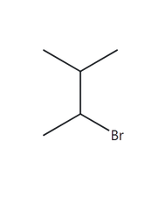
PART B · NAME ➜ STRUCTURE
B06 · Developing · C₅H₁₁Br
1 · NAME DECODED
2 · BOND-LINE STRUCTURE (THE ALKANE)
Parent: butane → a 4-carbon chain.
Substituents: bromo on C2; methyl on C3.
Expected formula: 4 + 1 = 5 C; one chain → C₅H₁₂; Br replaces one H → C₅H₁₁Br
3 · FORMULA CHECK
4 · BACK CHECK
Counted from the drawing: C₅H₁₁Br
  3 CH₃ (C1, C4, the methyl branch) = 9 H
  2 CH (C2 and C3) = 2 H
  Total = 11 H, plus 1 Br
Open chain: CₙH₂ₙ₊₂ = C₅H₁₂; minus one H for Br = C₅H₁₁Br ✓
Returned by The Alkane:
Same as the given name
parent length matches substituent positions match formula agrees back-check recorded

Slide 17
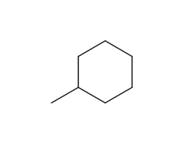
PART B · NAME ➜ STRUCTURE
B07 · Developing · C₇H₁₄
1 · NAME DECODED
2 · BOND-LINE STRUCTURE (THE ALKANE)
Parent: cyclohexane → a 6-carbon ring.
Substituents: methyl on C1 (the locant is not written, since there is only one substituent).
Expected formula: 6 + 1 = 7 C; one ring → C₆H₁₂; the methyl replaces one H → C₇H₁₄
3 · FORMULA CHECK
4 · BACK CHECK
Counted from the drawing: C₇H₁₄
  1 CH (C1) = 1 H
  5 CH₂ (C2 to C6) = 10 H
  1 CH₃ (methyl) = 3 H
  Total = 14 H
One ring: CₙH₂ₙ = C₆H₁₂; the methyl replaces one H and adds CH₃, so C₆H₁₁ + CH₃ = C₇H₁₄ ✓
Returned by The Alkane:
Same as the given name
parent length matches substituent positions match formula agrees back-check recorded

Slide 18
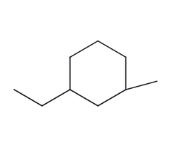
PART B · NAME ➜ STRUCTURE
B08 · Challenge · C₉H₁₈
1 · NAME DECODED
2 · BOND-LINE STRUCTURE (THE ALKANE)
Parent: cyclohexane → a 6-carbon ring.
Substituents: ethyl on C1; methyl on C3 (listed alphabetically).
Expected formula: 6 + 2 + 1 = 9 C; one ring → C₆H₁₂; ethyl and methyl each replace one H → C₉H₁₈
3 · FORMULA CHECK
4 · BACK CHECK
Counted from the drawing: C₉H₁₈
  2 ring CH (C1, C3) = 2 H
  4 ring CH₂ (C2, C4, C5, C6) = 8 H
  1 ethyl CH₂ = 2 H
  2 CH₃ (ethyl end, methyl) = 6 H
  Total = 18 H
One ring: CₙH₂ₙ = C₆H₁₂; minus two H for the substituents = C₆H₁₀, plus C₂H₅ and CH₃ = C₉H₁₈ ✓
Returned by The Alkane:
Same as the given name
parent length matches substituent positions match formula agrees back-check recorded

Slide 19
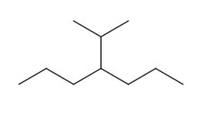

PART B · NAME ➜ STRUCTURE
B09 · Challenge · C₁₀H₂₂
1 · NAME DECODED
2 · BOND-LINE STRUCTURE (THE ALKANE)
Parent: heptane → a 7-carbon chain.
Substituents: 1-methylethyl (isopropyl) on C4.
Expected formula: 7 + 3 = 10 C; open chain → C₇H₁₆; the branch replaces one H → C₁₀H₂₂
3 · FORMULA CHECK
4 · BACK CHECK
Counted from the drawing: C₁₀H₂₂
  4 CH₃ (C1, C7, two isopropyl methyls) = 12 H
  4 CH₂ (C2, C3, C5, C6) = 8 H
  2 CH (C4, isopropyl CH) = 2 H
  Total = 22 H
Open chain: CₙH₂ₙ₊₂ = C₁₀H₂₂ ✓
Returned by The Alkane:
NOT same as the given name
parent length matches substituent positions match formula agrees back-check recorded

Slide 20
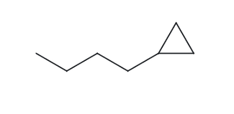
PART B · NAME ➜ STRUCTURE
B10 · Challenge · C₇H₁₄
1 · NAME DECODED
2 · BOND-LINE STRUCTURE (THE ALKANE)
Parent: cyclopropane → a 3-carbon ring.
Substituents: butyl on C1 (the locant is not written, since there is only one substituent).
Expected formula: 3 + 4 = 7 C; one ring → C₃H₆; butyl replaces one H → C₇H₁₄
3 · FORMULA CHECK
4 · BACK CHECK
Counted from the drawing: C₇H₁₄
  1 ring CH (C1) = 1 H
  2 ring CH₂ (C2, C3) = 4 H
  3 chain CH₂ = 6 H
  1 CH₃ = 3 H
  Total = 14 H
One ring: CₙH₂ₙ = C₃H₆; butyl replaces one H, so C₃H₅ + C₄H₉ = C₇H₁₄ ✓
Returned by The Alkane:
Same as the given name
parent length matches substituent positions match formula agrees back-check recorded

