Slide 1
4 | 4 | 6 | 6
1 | 4 | 6 | 6
1 | 9 | 9 | 6
1 | 5 | 5 | 5
3 | 3 | 7 | 5
2 | 3 | 7 | 7
9 | 4 | 4 | 7
2 | 9 | 9 | 9
7 | 7 | 13 | 11
3 | 7 | 13 | 13
10 | 13 | 13 | 13
3 | 14 | 14 | 14
+
=
Raster 1
Raster 2
Output
4 | 4 | 6 | 6
1 | 4 | 6 | 6
1 | 9 | 9 | 6
1 | 5 | 5 | 5
3 | 3 | 7 | 5
2 | 3 | 7 | 7
9 | 4 | 4 | 7
2 | 9 | 9 | 9
12 | 12 | 42 | 30
2 | 12 | 42 | 42
9 | 36 | 36 | 42
2 | 45 | 45 | 45
*
=
Raster 1
Raster 2
Output
Multiband Raster
Multiband Raster
4 | 4 | 6 | 6
1 | 4 | 6 | 6
1 | 9 | 9 | 6
1 | 5 | 5 | 5
3 | 3 | 7 | 5
2 | 3 | 7 | 7
9 | 4 | 4 | 7
2 | 9 | 9 | 9
20 | 20 | 30 | 30
5 | 20 | 30 | 30
5 | 45 | 45 | 30
5 | 25 | 25 | 25
15 | 15 | 35 | 25
10 | 15 | 35 | 35
45 | 20 | 20 | 35
10 | 45 | 45 | 45
*
5
=
Constant
Band1
Band2
Band1
Band2
Raster 1
Output
Notes:
Arithmetic Examples

Slide 2
4 | 4 | 6 | 6
1 | 4 | 6 | 6
1 | 9 | 9 | 6
1 | 5 | 5 | 5
1.39 | 1.39 | 1.79 | 1.79
0 | 1.39 | 1.79 | 1.79
0 | 2.19 | 2.19 | 1.79
0 | 1.61 | 1.61 | 1.61
LN Transformation
=
Input Raster
Output
4 | 4 | 6 | 6
1 | 4 | 6 | 6
1 | 9 | 9 | 6
1 | 5 | 5 | 5
54.6 | 54.6 | 403.4 | 403.4
2.72 | 54.6 | 403.4 | 403.4
2.72 | 8103.1 | 8103.1 | 403.4
2.72 | 148.41 | 148.41 | 148.41
EXP Transformation
=
Input Raster
Output
Multiband Raster
Multiband Raster
4 | 4 | 6 | 6
1 | 4 | 6 | 6
1 | 9 | 9 | 6
1 | 5 | 5 | 5
3 | 3 | 7 | 5
2 | 3 | 7 | 7
9 | 4 | 4 | 7
2 | 9 | 9 | 9
0.07 | 0.07 | 0.10 | 0.10
0.02 | 0.07 | 0.10 | 0.10
0.02 | 0.16 | 0.16 | 0.10
0.02 | 0.09 | 0.09 | 0.09
0.05 | 0.05 | 0.12 | 0.09
0.03 | 0.05 | 0.12 | 0.12
0.16 | 0.07 | 0.07 | 0.12
0.03 | 0.16 | 0.16 | 0.16
Radians
Transformation
=
Band1
Band2
Band1
Band2
Input Raster
Output
Notes:
Math Transformations

Slide 3
4 | 4 | 6 | 6
1 | 4 | 6 | 6
1 | 9 | 9 | 6
1 | 5 | 5 | 5
3 | 3 | 7 | 5
2 | 3 | 7 | 7
9 | 4 | 4 | 7
2 | 9 | 9 | 9
1 | 1 | 0 | 1
0 | 1 | 0 | 0
0 | 1 | 1 | 0
0 | 0 | 0 | 0
>
=
Raster 1
Raster 2
Output
1 | 1 | 1 | 1
0 | 1 | 0 | 1
1 | 1 | 0 | 0
1 | 0 | 0 | 1
1 | 0 | 0 | 1
1 | 0 | 1 | 0
1 | 1 | 0 | 0
1 | 0 | 1 | 0
1 | 0 | 0 | 1
0 | 0 | 0 | 0
1 | 1 | 0 | 0
1 | 0 | 0 | 1
AND
=
Raster 1
Raster 2
Output
Multiband Raster
Multiband Raster
4 | 4 | 6 | 6
1 | 4 | 6 | 6
1 | 9 | 9 | 6
1 | 5 | 5 | 5
3 | 3 | 7 | 5
2 | 3 | 7 | 7
9 | 4 | 4 | 7
2 | 9 | 9 | 9
0 | 0 | 1 | 1
0 | 0 | 1 | 1
0 | 1 | 1 | 1
0 | 0 | 0 | 0
0 | 0 | 1 | 0
0 | 0 | 1 | 1
1 | 0 | 0 | 1
0 | 1 | 1 | 1
<=
6
=
Constant
Band1
Band2
Band1
Band2
Raster 1
Output
Notes:
Logical Analysis-_

Slide 4
1 | 1 | 1 | 1
0 | 1 | 0 | 1
1 | 1 | 0 | 0
1 | 0 | 0 | 1
4 | 4 | 6 | 6
1 | 4 | 6 | 6
1 | 9 | 9 | 6
1 | 5 | 5 | 5
3 | 3 | 7 | 5
2 | 3 | 7 | 7
9 | 4 | 4 | 7
2 | 9 | 9 | 9
4 | 4 | 6 | 6
2 | 4 | 7 | 6
1 | 9 | 4 | 7
1 | 9 | 9 | 5
=
Conditional Raster
True Raster
False Raster
Output
Notes:
Conditional analysis

Slide 5
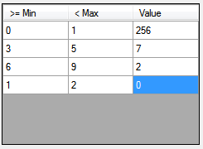
3 | 3 | 7 | 5
2 | 3 | 7 | 7
0 | 4 | 4 | 7
2 | 9 | 9 | 9
7 | 7 | 2 | 5
2 | 7 | 2 | 2
256 | 7 | 7 | 2
2 | 9 | 9 | 9
=
In Raster
Remap Table
Output
Notes:
Remap analysis

Slide 6
Focal sum for a 3 by 3 analysis window
 | 3 | 7 | 7
 | 4 | 4 | 7
 | 9 | 9 | 9
 |  | 59
In Raster
Out Raster
Focal STD for a 3 by 3 analysis window
 | 3 | 7 | 7
 | 4 | 4 | 7
 | 9 | 9 | 9
 |  | 2.2
In Raster
Out Raster
Notes:
Focal analysis

Slide 7
Focal entropy for a 3 by 3 analysis window
 | 3 | 7 | 7
 | 4 | 4 | 7
 | 9 | 9 | 9
 |  | 1.3
In Raster
Out Raster
Notes:
Focal analysis

Slide 8
Focal Statistics
Max
Min
Sum
Mode
Median
Mean
Variance
STD
Unique
Entropy
Probability
Notes:
Focal statistic equations

Slide 9
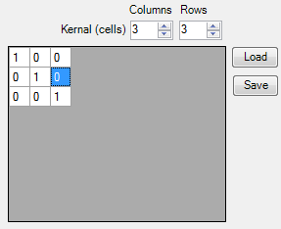
Convolution Kernel
 | 3 | 7 | 7
 | 4 | 4 | 7
 | 9 | 9 | 9
 |  | 16
=
In Raster
Convolution Kernel
Output
Notes:
Convolution Analysis

Slide 10
Sum
4 | 4 | 6 | 6
1 | 4 | 6 | 6
1 | 9 | 9 | 6
1 | 5 | 5 | 5
3 | 3 | 7 | 5
2 | 3 | 7 | 7
9 | 4 | 4 | 7
2 | 9 | 9 | 9
8 | 8 | 10 | 10
12 | 8 | 10 | 10
12 | 0 | 0 | 10
12 | 13 | 13 | 13
15 | 15 | 23 | 21
15 | 15 | 23 | 23
22 | 13 | 13 | 23
15 | 27 | 27 | 27
=
Band1
Band2
Band3
Output
Max
4 | 4 | 6 | 6
1 | 4 | 6 | 6
1 | 9 | 9 | 6
1 | 5 | 5 | 5
3 | 3 | 7 | 5
2 | 3 | 7 | 7
9 | 4 | 4 | 7
2 | 9 | 9 | 9
8 | 8 | 10 | 10
12 | 8 | 10 | 10
12 | 0 | 0 | 10
12 | 13 | 13 | 13
8 | 8 | 10 | 10
12 | 8 | 10 | 10
12 | 9 | 9 | 10
12 | 13 | 13 | 13
=
Band1
Band2
Band3
Output
MaxBand
4 | 4 | 6 | 6
1 | 4 | 6 | 6
1 | 9 | 9 | 6
1 | 5 | 5 | 5
3 | 3 | 7 | 5
2 | 3 | 7 | 7
9 | 4 | 4 | 7
2 | 9 | 9 | 9
8 | 8 | 10 | 10
12 | 8 | 10 | 10
12 | 0 | 0 | 10
12 | 13 | 13 | 13
3 | 3 | 3 | 3
3 | 3 | 3 | 3
3 | 1 | 1 | 3
3 | 3 | 3 | 3
=
Band1
Band2
Band3
Output
Notes:
Local Stats Analysis

Slide 11
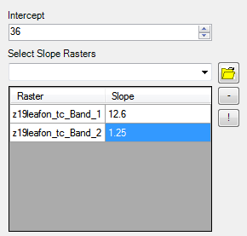
Linear Transform
4 | 4 | 6 | 6
1 | 4 | 6 | 6
1 | 9 | 9 | 6
1 | 5 | 5 | 5
3 | 3 | 7 | 5
2 | 3 | 7 | 7
9 | 4 | 4 | 7
2 | 9 | 9 | 9
90.2 | 90.2 | 120.4 | 117.9
51.1 | 90.2 | 120.4 | 120.4
59.9 | 154.4 | 154.4 | 120.4
51.1 | 110.3 | 110.3 | 110.3
=
Band1
Band2
Transform Table
Output
Notes:
Linear transform

Slide 12
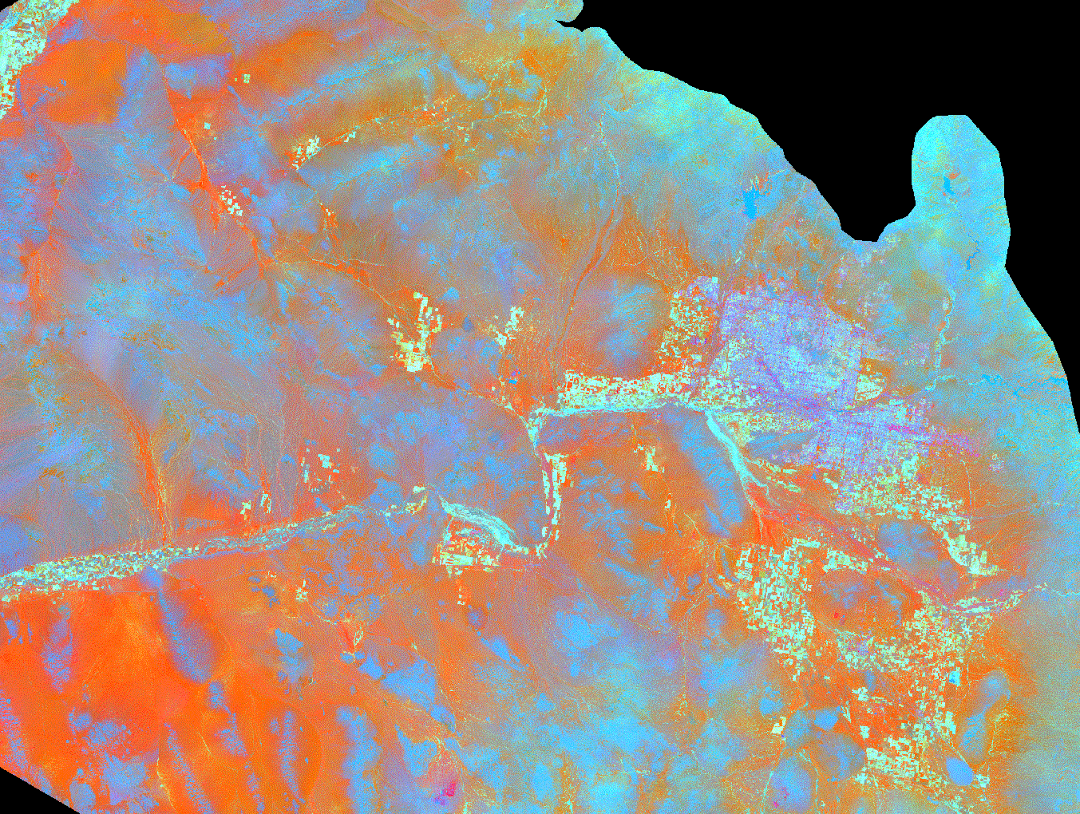



Clip
+
=
Raster to Clip
Clipping Polygon
Output
Erase
+
=
Raster to Clip
Clipping Polygon
Output
Notes:
Clip analysis

Slide 13
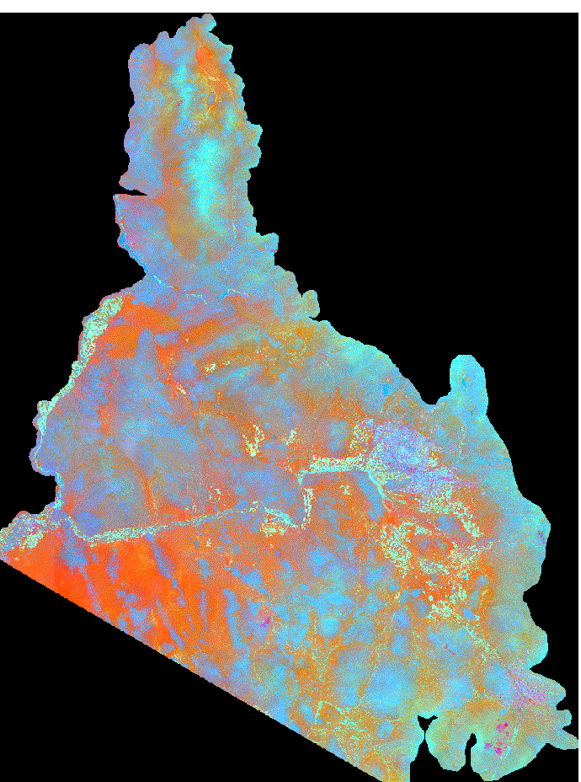
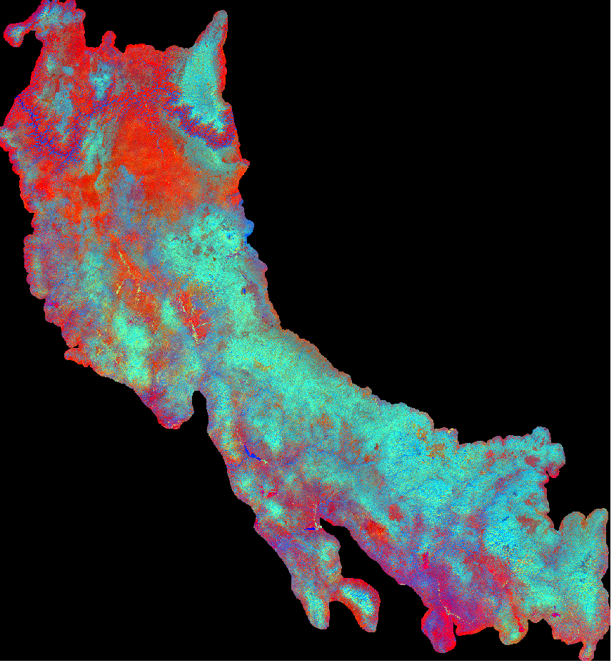
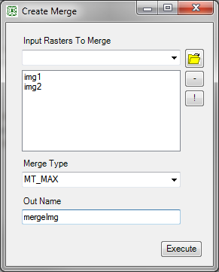
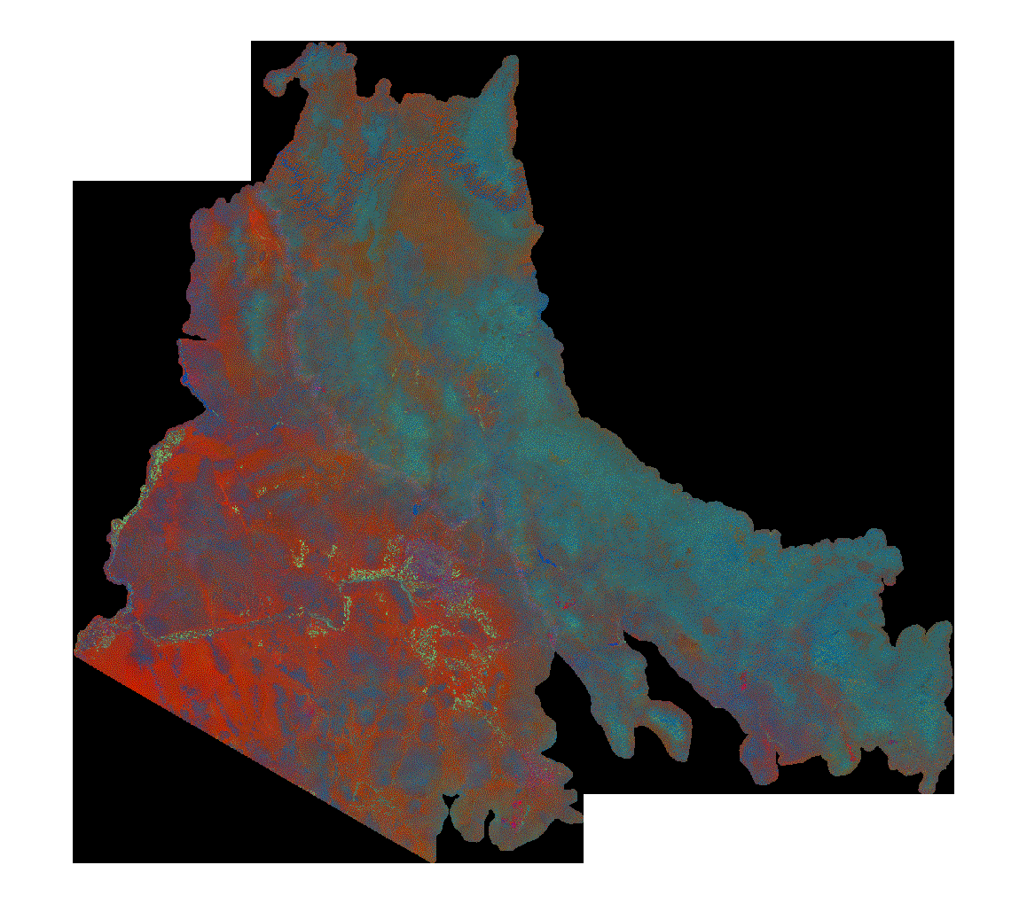
Merge
=
img1
img2
Merge tool
output
Notes:
merge

Slide 14
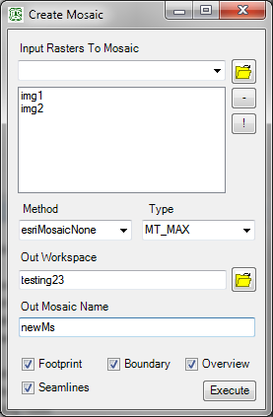
Mosaic
=
img1
img2
output
Mosaic tool
Notes:
mosaic

Slide 15
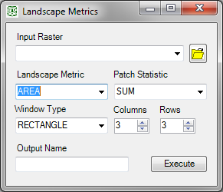

Slide 16
Landscape region metric for a 3 by 3 analysis window
 | 3 | 7 | 7
 | 4 | 4 | 7
 | 9 | 9 | 9
 |  | 4
In Raster
Out Raster
Notes:
Landscape metrics

Slide 17
Patch Statistics
Max
Min
Sum
Mode
Median
Mean
Variance
STD
Unique
Entropy
Probability
Notes:
Focal statistic equations

Slide 18
