Slide 1

CWP Workshop
6 January 2020
Golden, Colorado

Slide 2
Today’s Workshop – Rough Schedule
From 8.30am – Coffee and Madagascar Package Installation
9.00-9.15am – Introduction (Shragge)
9.15-10.15am – Using Madagascar on the Command Line (Girard)
10.15-10.30am – Break (informal)
10.30-11.30am – Introduction to Python and SConstruct (Shragge)
11.30-12.30pm – Madagascar+SConstruct (Girard) – Exercise I
12.30-1.30pm – Lunch
1.30-2.30pm – Seismic Modelling (Girard) – Exercise II
2.30-3.30pm – Adding your own programs (Shragge) – Exercise III
3.30pm onward – Wrap up / Sundowner (by donation)

Slide 3
Today’s Workshop – Rough Schedule
From 8.30am – Coffee and Madagascar Package Installation
9.00-9.15am – Introduction (Shragge)
9.15-10.15am – Using Madagascar on the Command Line (Girard)
10.15-10.30am – Break (informal)
10.30-11.30am – Introduction to Python and SConstruct (Shragge)
11.30-12.30pm – Madagascar+SConstruct (Girard) – Exercise I
12.30-1.30pm – Lunch
1.30-2.30pm – Seismic Modelling (Girard) – Exercise II
2.30-3.30pm – Adding your own programs (Shragge) – Exercise III
3.30pm onward – Wrap up / Sundowner (by donation)

Slide 4

What is Science?
Science is the systematic enterprise of gathering knowledge about the universe and organizing and condensing that knowledge into testable laws and theories.

Slide 5
What is Science?
Science is the systematic enterprise of gathering knowledge about the universe and organizing and condensing that knowledge into testable laws and theories. The success and credibility of science are anchored in the willingness of scientists to expose their ideas and results to independent testing and replication by other scientists.

Slide 6
What is Science?
Science is the systematic enterprise of gathering knowledge about the universe and organizing and condensing that knowledge into testable laws and theories. The success and credibility of science are anchored in the willingness of scientists to expose their ideas and results to independent testing and replication by other scientists. This requires the complete and open exchange of data, procedures and materials.

Slide 7
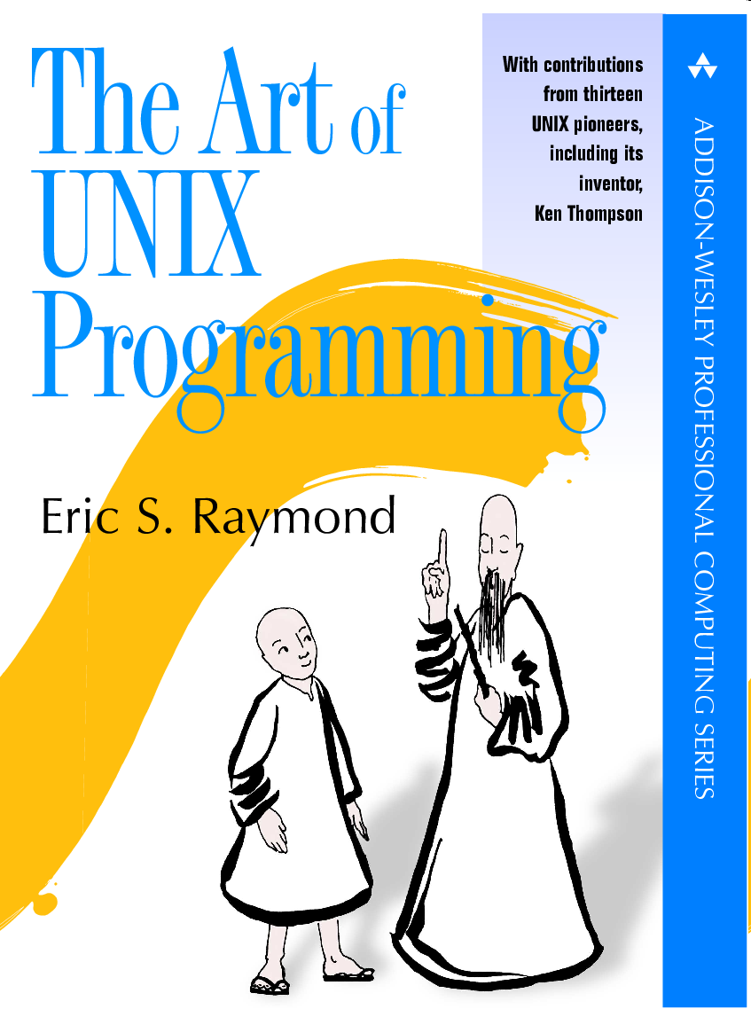
Software versus Science
“Abandoning the habit of secrecy in favor of process transparency and peer review was the crucial step by which alchemy became chemistry.

Slide 8
Software versus Science
“Abandoning the habit of secrecy in favor of process transparency and peer review was the crucial step by which alchemy became chemistry. In the same way, it is beginning to appear that open-source development may signal the long-awaited maturation of software development as a discipline.”Eric Raymond

Slide 9
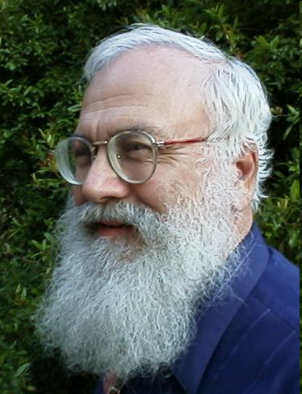
Claerbout’s Principle
“An article about computational science in a scientific publication is not the scholarship itself, it is merely advertising of the scholarship.

Slide 10
Claerbout’s Principle
“An article about computational science in a scientific publication is not the scholarship itself, it is merely advertising of the scholarship. The actual scholarship is the complete software development environment and the complete set of instructions which generated the figures.”
(Buckheit and Donoho, 1995)

Slide 11
Reproducible Research
“It is a big chore for one researcher to reproduce the analysis and computational results of another […] I discovered that this problem has a simple technological solution: illustrations (figures) in a technical document are made by programs and command scripts that along with required data should be linked to the document itself […] This is hardly any extra work for the author, but it makes the document much more valuable to readers who possess the document in electronic form because they are able to track down the computations that lead to the illustrations.”
(Claerbout, 1991)

Slide 12
Research Pyramid
Test
Publish
Implement

Slide 13
Research Pyramid
Workflows
Examples
Papers
Programs

Slide 14
Research Pyramid
500 Workflows
5,000 Figures
150
Papers
1,000 Programs
LaTeX
Python
SCons
Unix
C

Slide 16
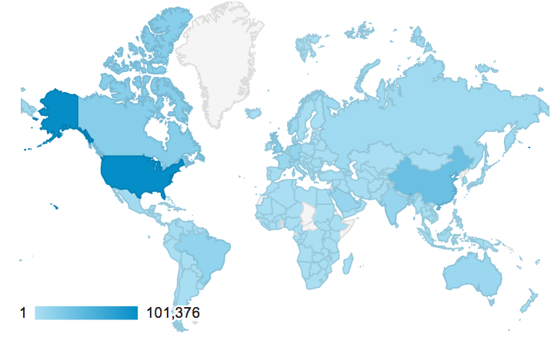
Madagascar Website Visits

Slide 17
Contributors
Salah Al-Hadab, Tariq Alkhalifah, Vladimir Bashkardin,
Filippo Broggini, Jules Browaeys, Cody Brown, William Burnett, Yihua Cai, Maria Cameron, Lorenzo Casasanta, Yangkang Chen, Zhonghuan Chen, Jiubing Cheng, Luke Decker, Joseph Dellinger, Esteban Diaz, Gang Fang, Sergey Fomel, Jeff Godwin, Gilles Hennenfent, Jie Hou, Jingwei Hu, Yin Huang, Trevor Irons, Jim Jennings, Jun Ji, Long Jin, Parvaneh Karimi, Roman Kazinnik,
Alexander Klokov, Siwei Li, Guochang Liu, Yang Liu, Yujin Liu, Xuxin Ma, Douglas McCowan, Henryk Modzelewski, Jack Poulson, James Rickett, Sean Ross-Ross, Colin Russell, Christos Saragiotis, Paul Sava, Karl Schleicher, Reza Shahidi, Jeffrey Shragge, Eduardo Filpo Silva, Xiaolei Song, Yanadet Sripanich, Junzhe Sun, Ioan Vlad, Robin Weiss, Zedong Wu, Jia Yan, Lexing Ying, …

Slide 18
CWP Workshop
6 January 2020
Golden, Colorado

