Slide 1
Machine Learning Introduction
GPGN535
Ge Jin, Geophysics Department

Slide 2
Acknowledgement
Géron, A., 2019. Hands-On Machine Learning with Scikit-Learn, Keras, and TensorFlow: Concepts, Tools, and Techniques to Build Intelligent Systems. O'Reilly Media.
Nadima Dwihusna, Master Thesis

Slide 3
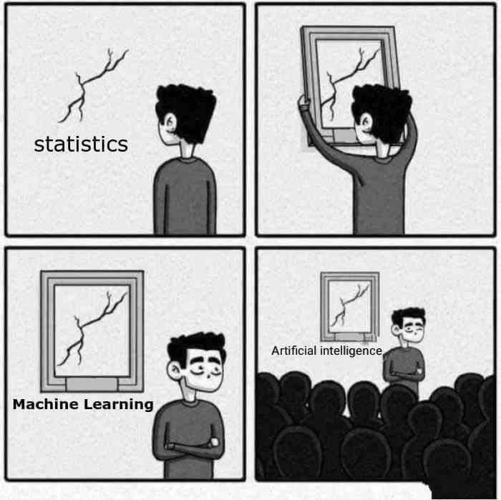
Machine learning and statistics
[Machine Learning is the] field of study that gives computers the ability to learn without being explicitly programmed.
--- Arthur Samuel, 1959

Slide 4
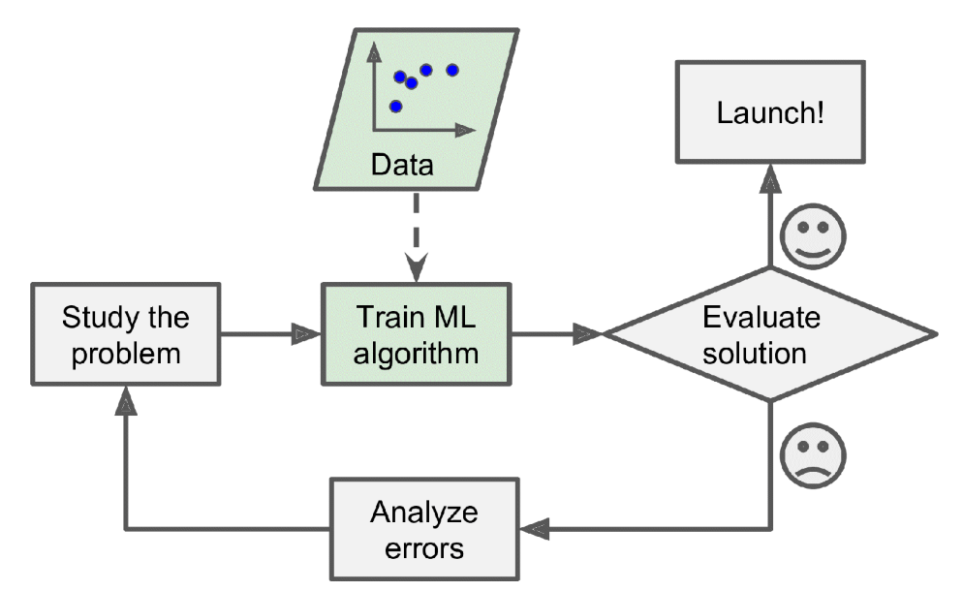
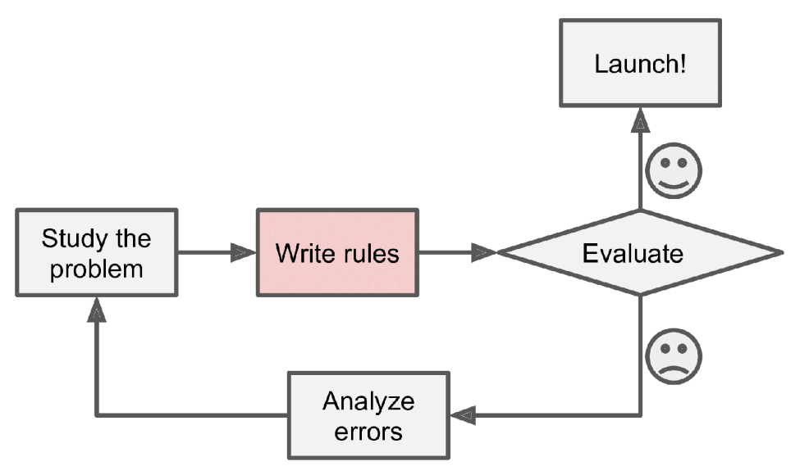
Traditional approach VS machine learning

Slide 5
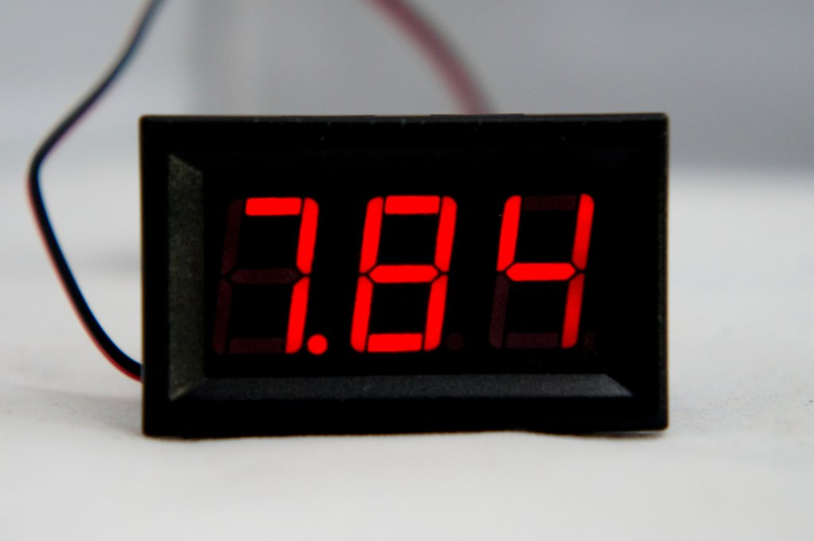
A simple problem
7.84

Slide 6
Traditional approach
1
6
2
4
7
0110011
5
3
4

Slide 7
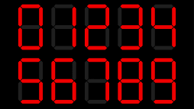
Machine learning approach
Training
Machine Learning Model
4

Slide 8
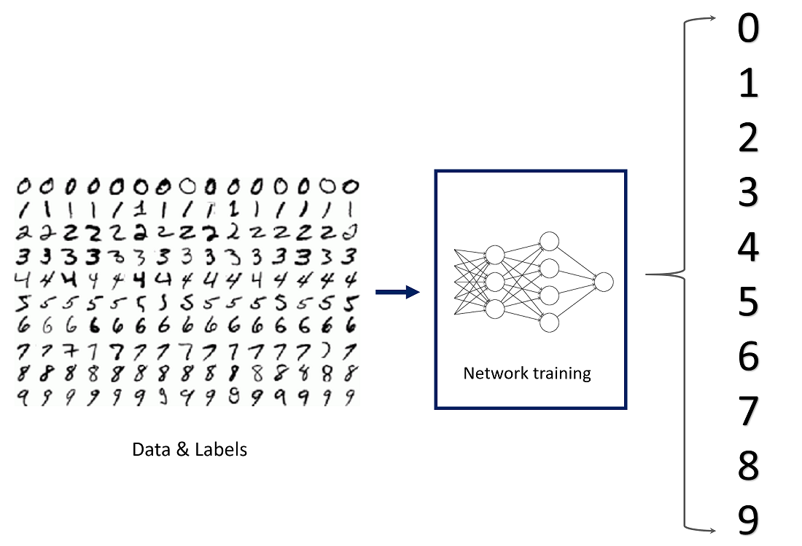
Handwriting recognition

Slide 9
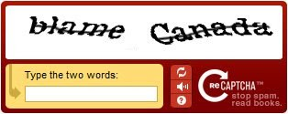
Collection the data: be smart

Slide 10
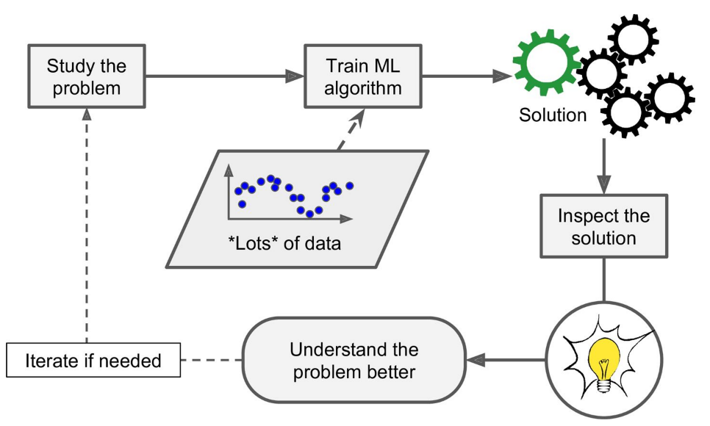
Data mining: gaining insights

Slide 11
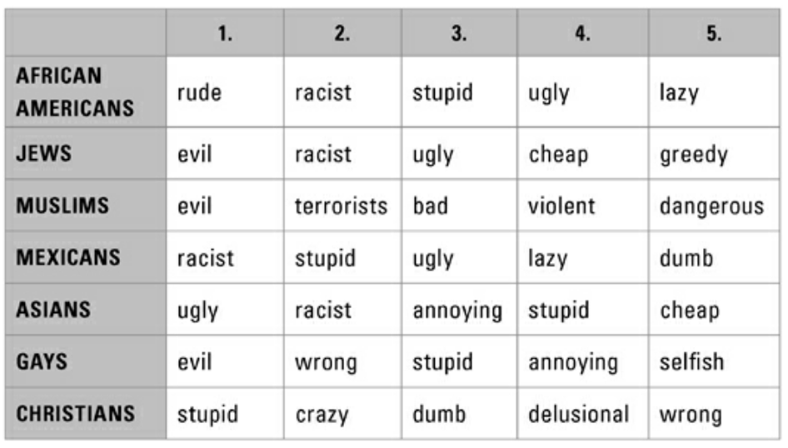
Races stereotypes obtained from google search: why are [race] [adj.]?
Stephens-Davidowitz, S. and Pabon, A., 2017. Everybody lies: Big data, new data, and what the internet can tell us about who we really are. New York: HarperCollins.

Slide 12
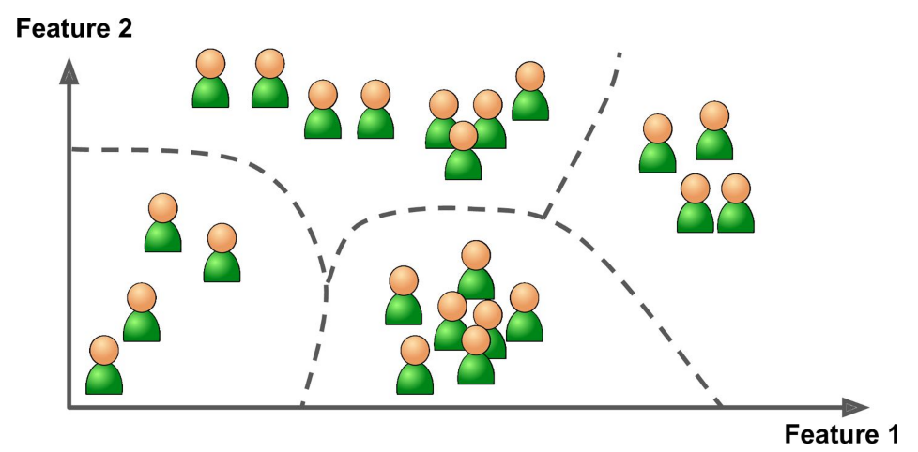
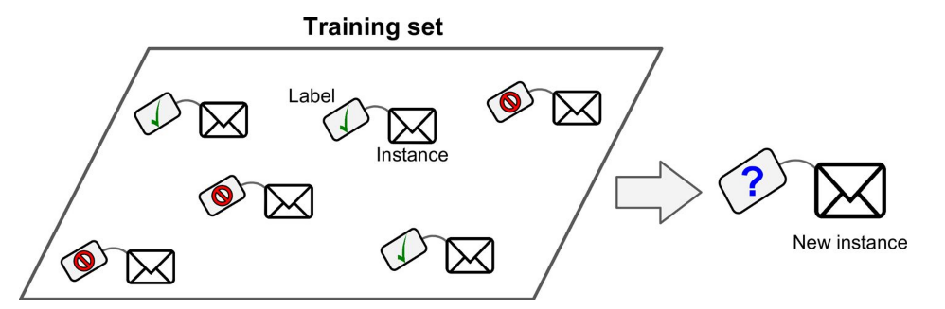
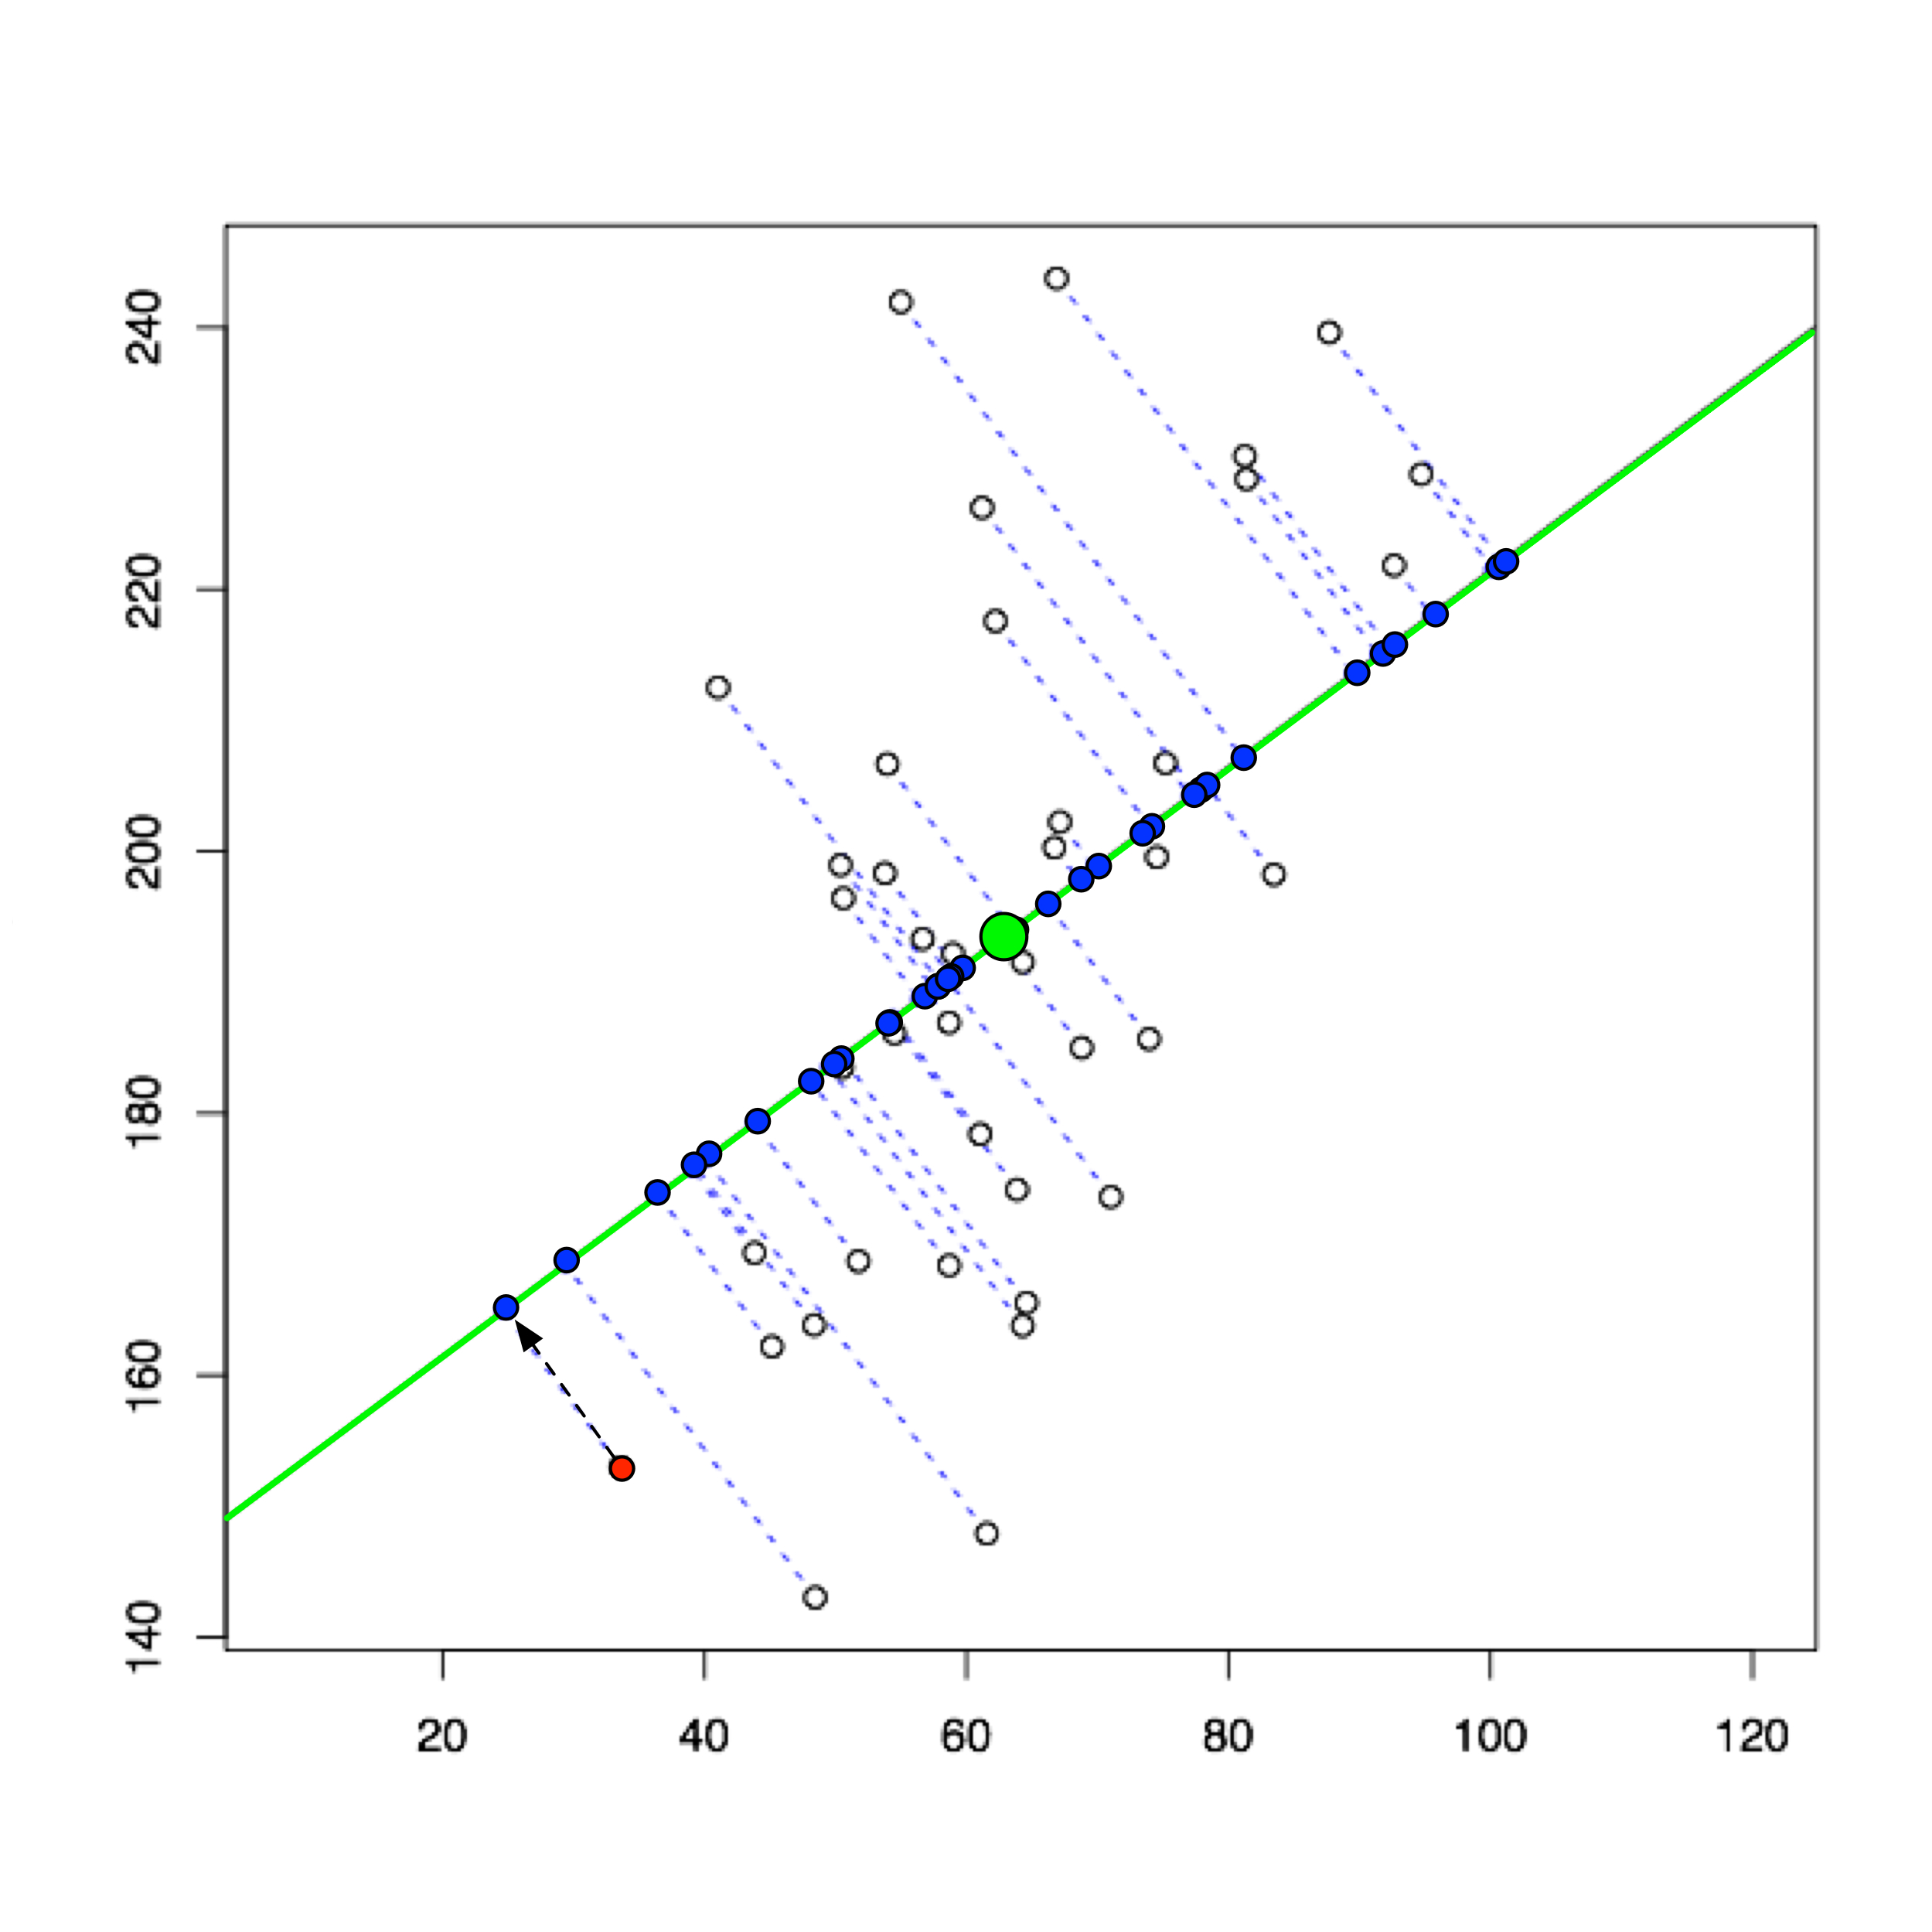
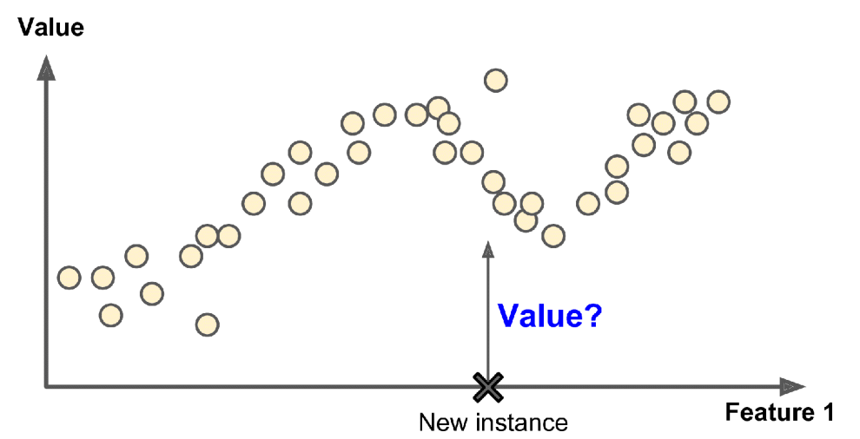
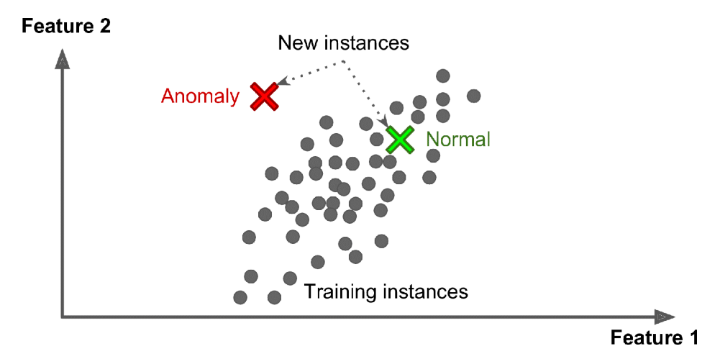
Unsupervised learning
Supervised learning
Clustering
Classification
PCA
Regression
Anomaly detection

Slide 13
Typical supervised learning input format
Features
Data samples

Slide 14
Standard machine-learning workflow

