Slide 1

Expanding London’s Shared Cycle Scheme
Joshua Rawlings

Slide 2
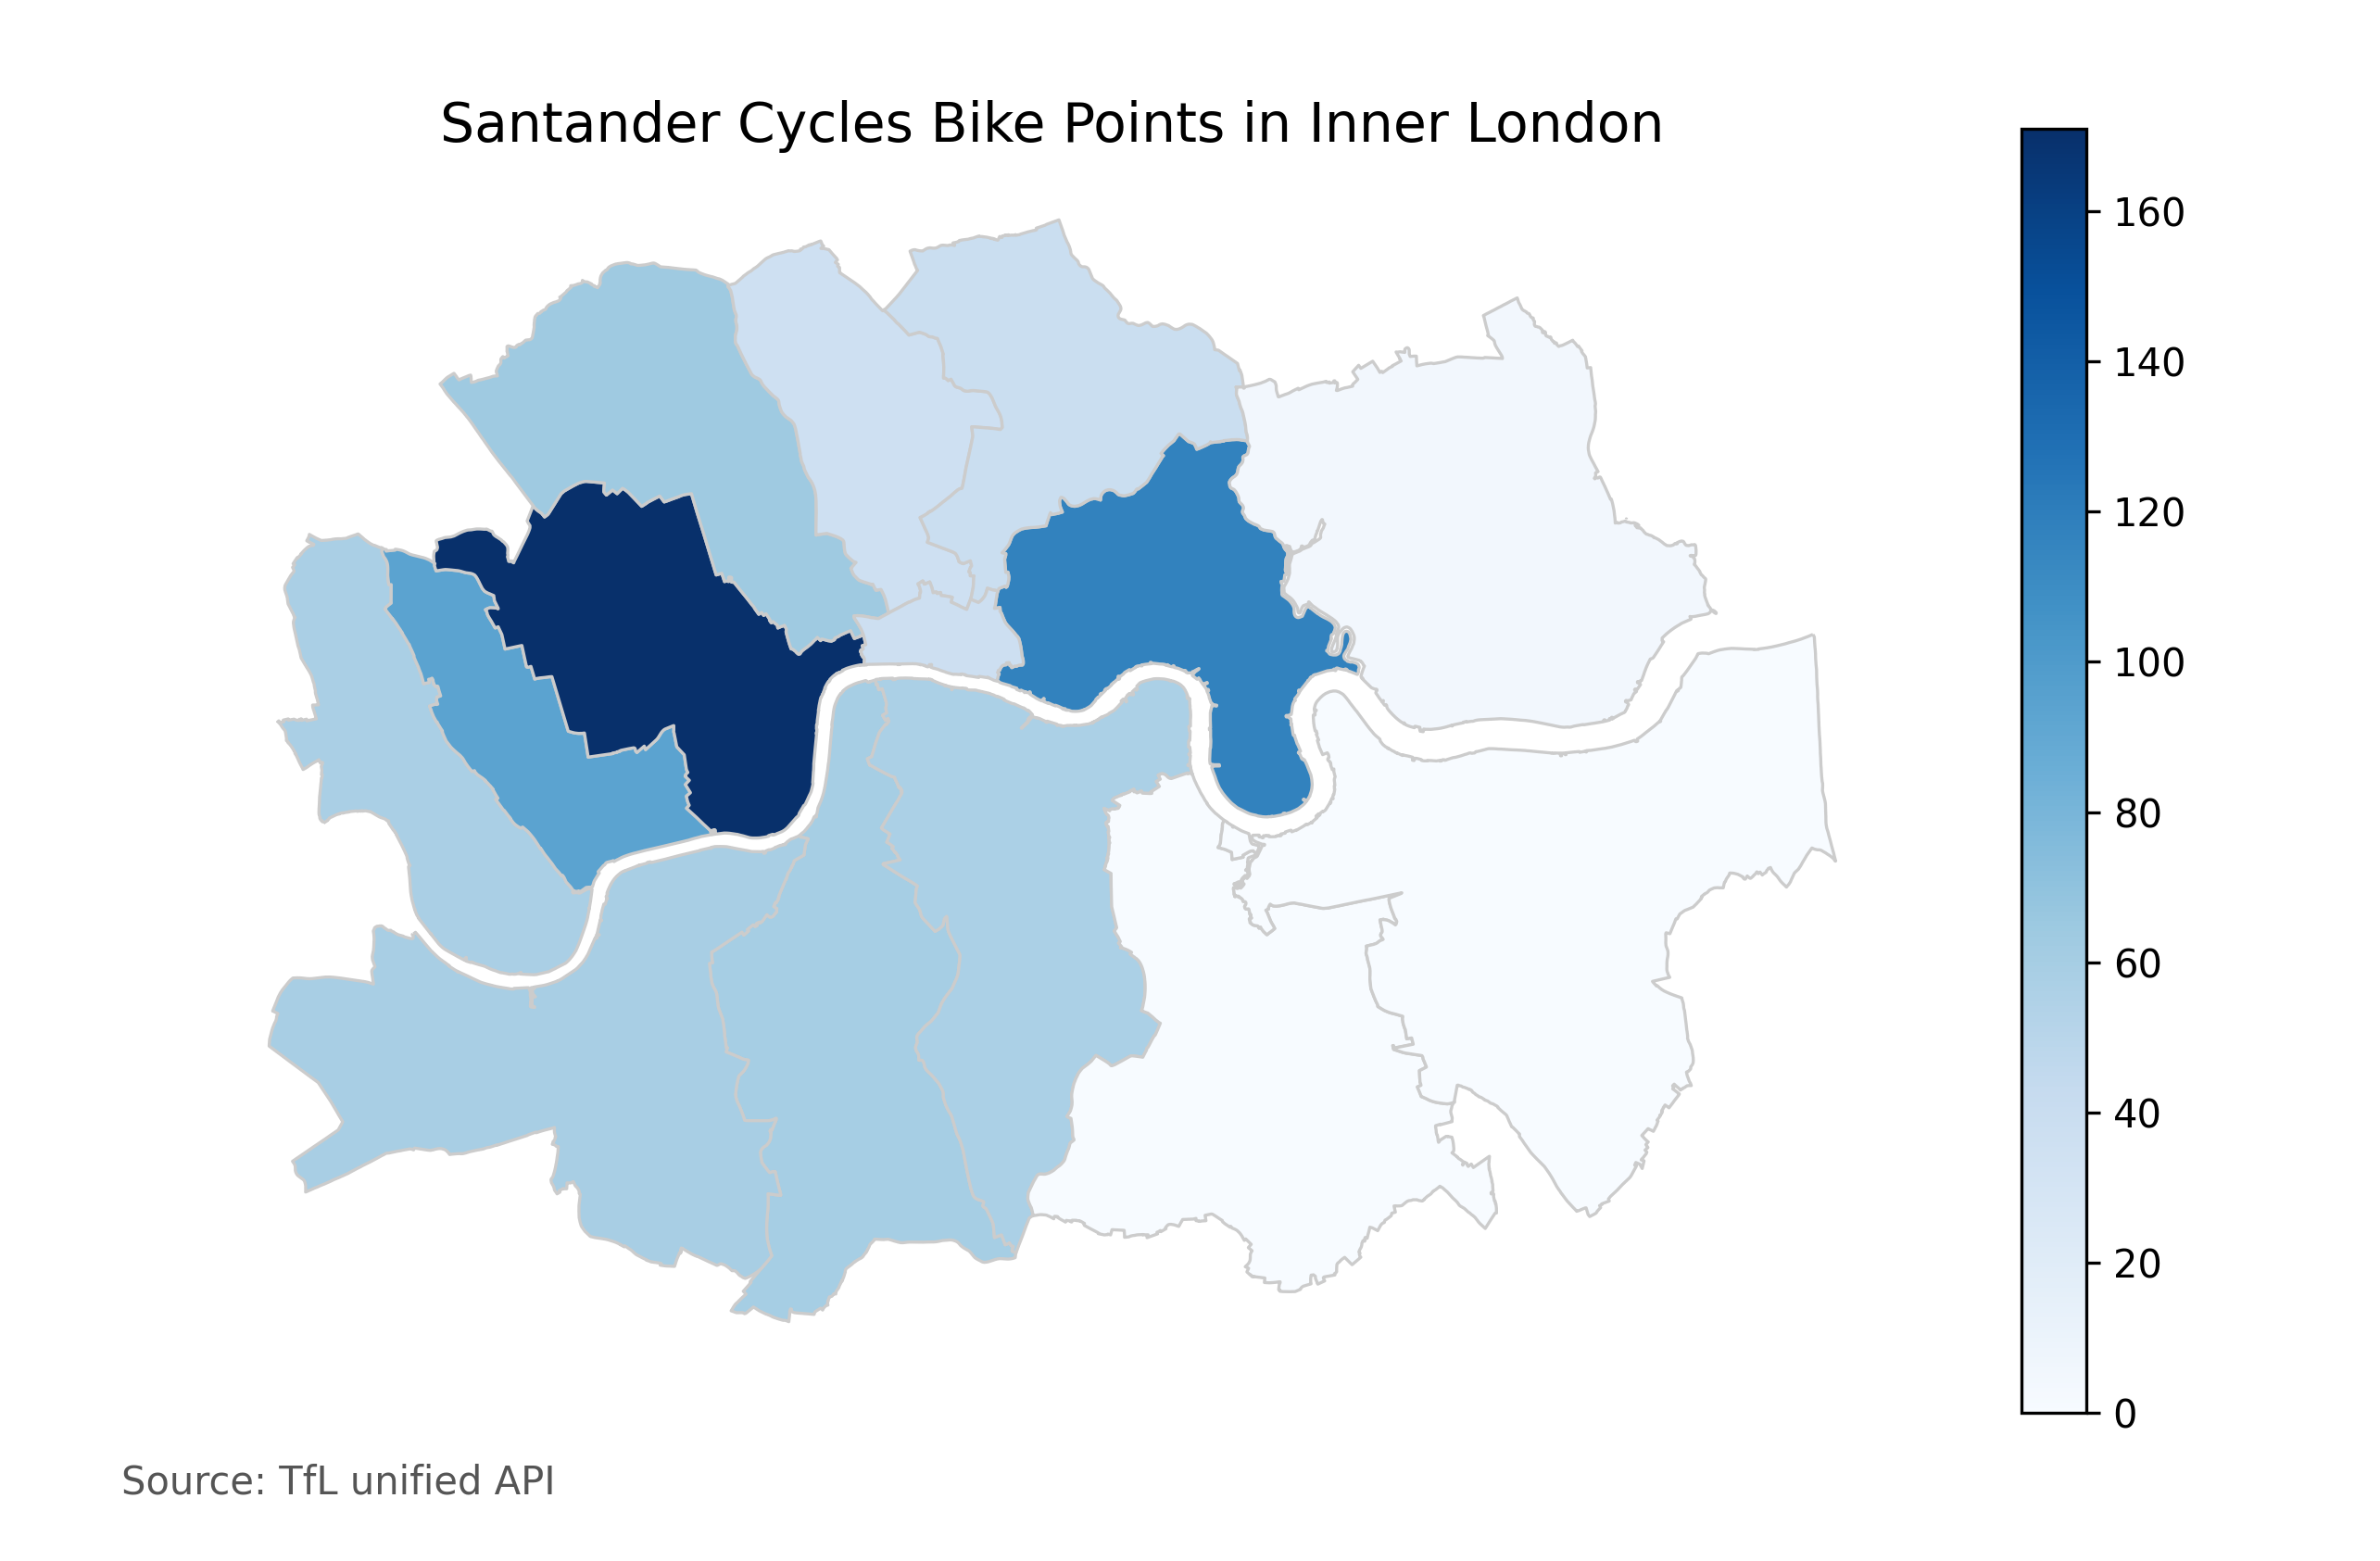
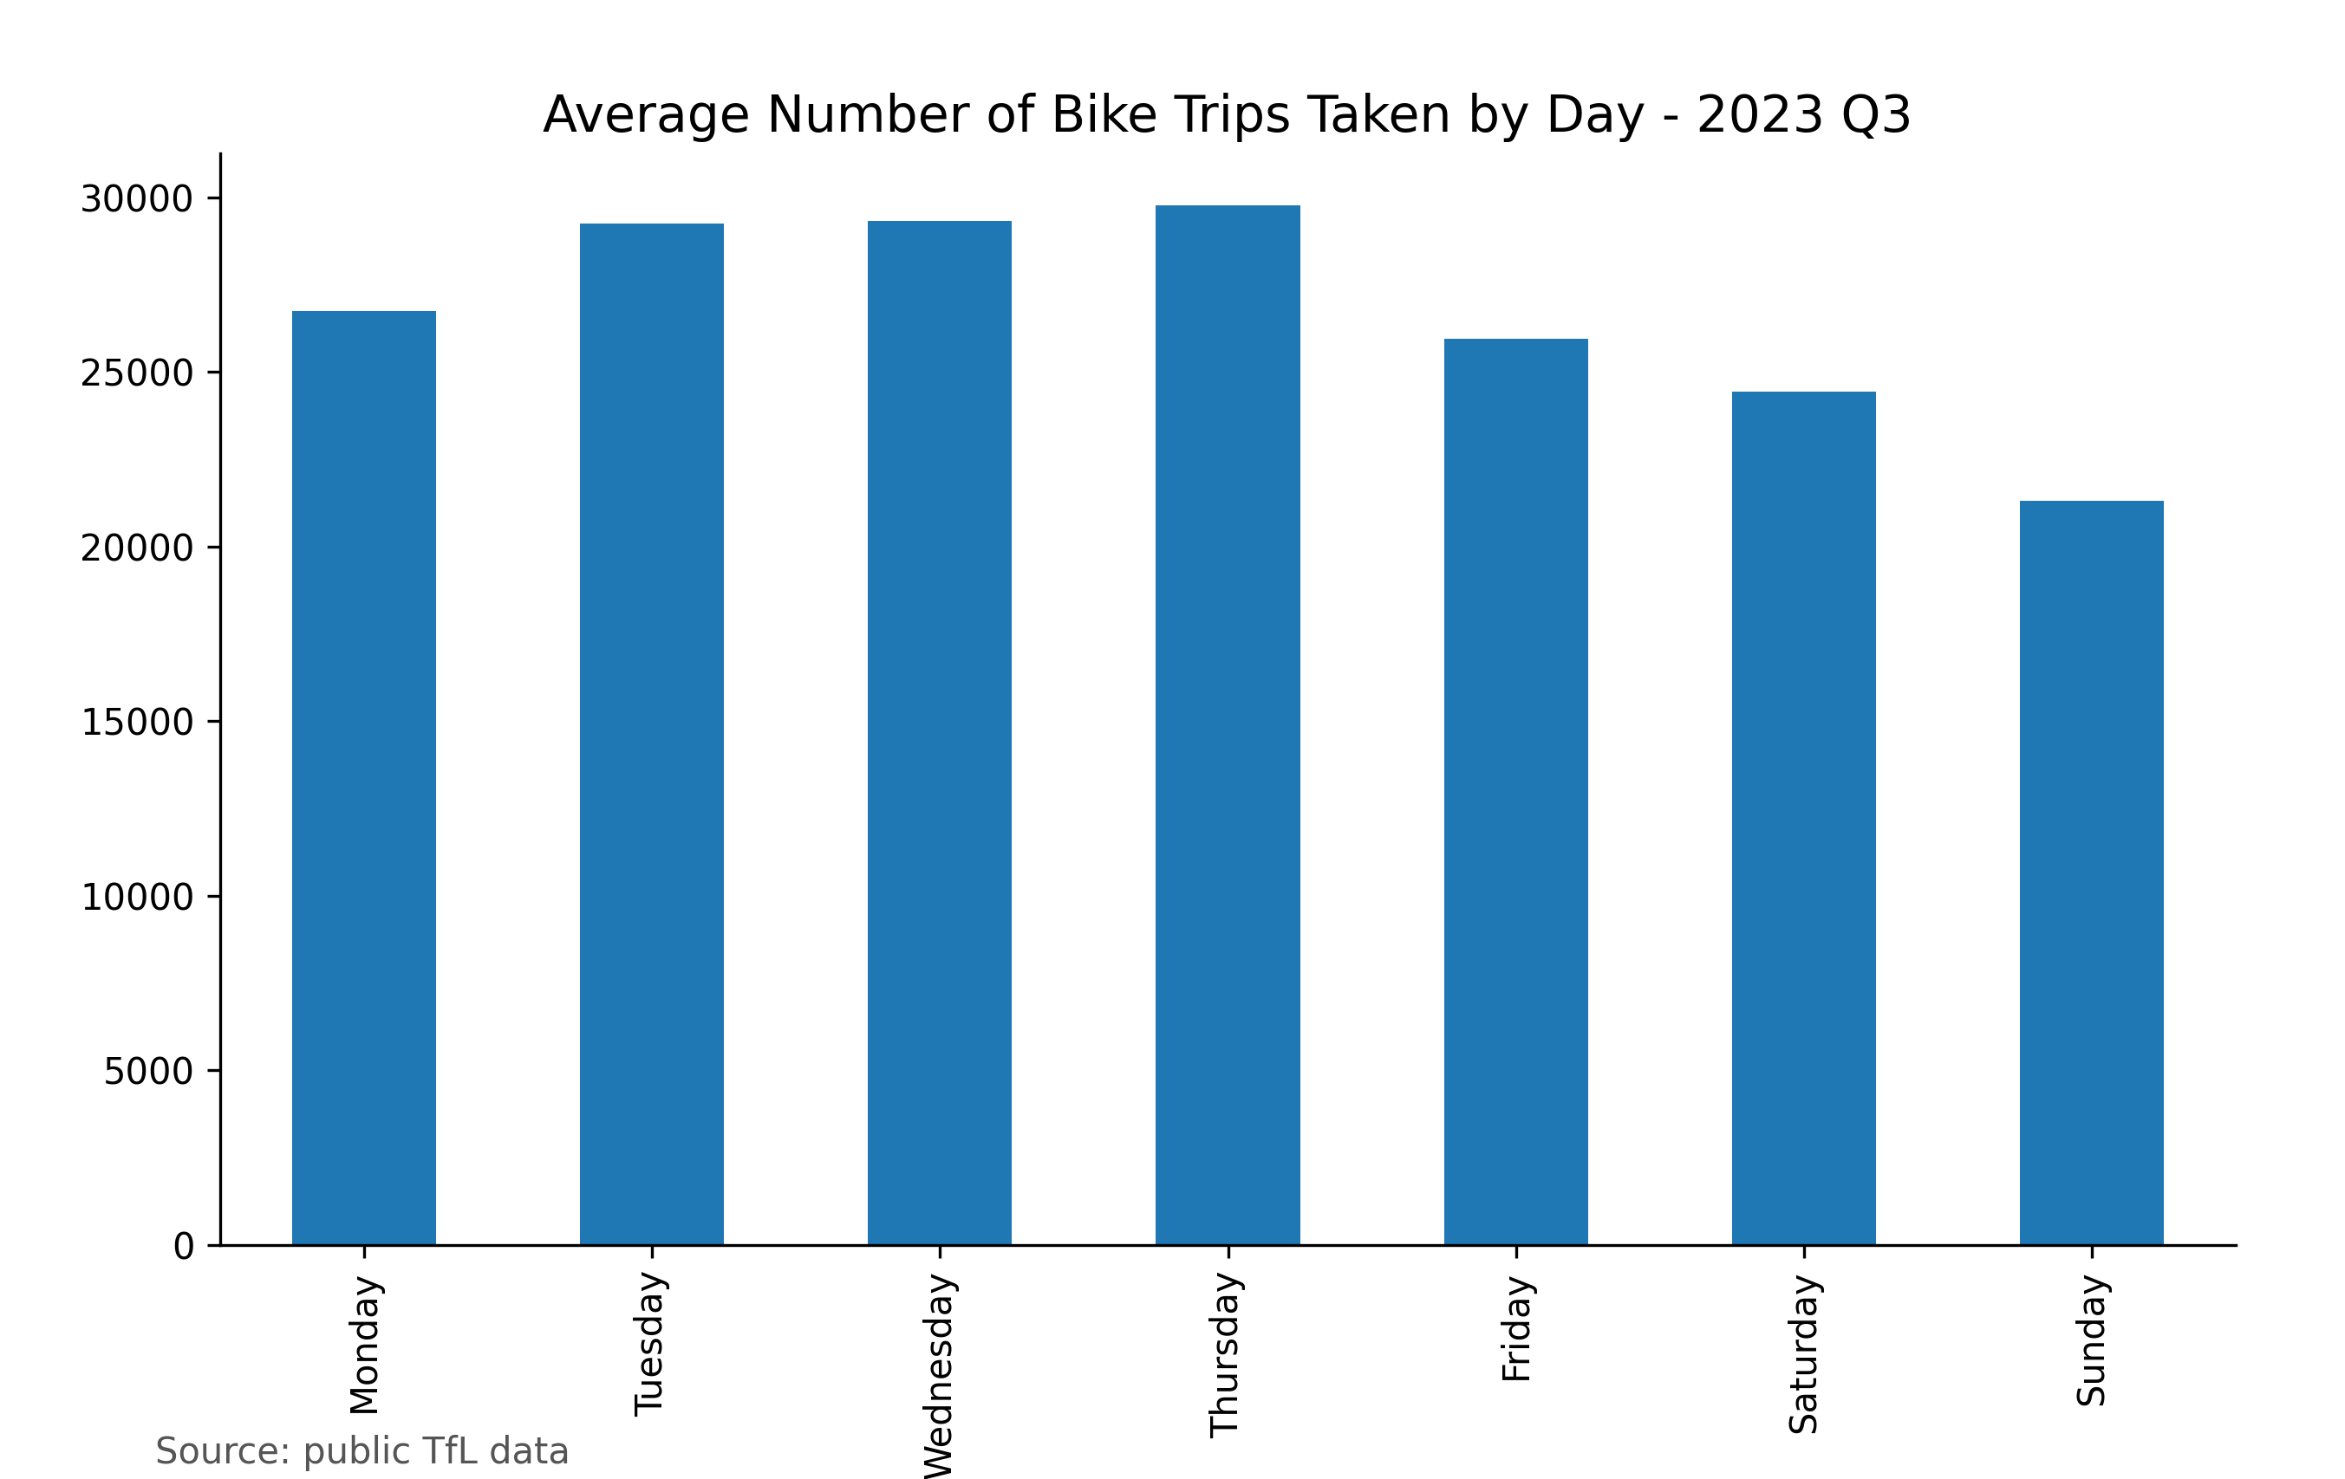
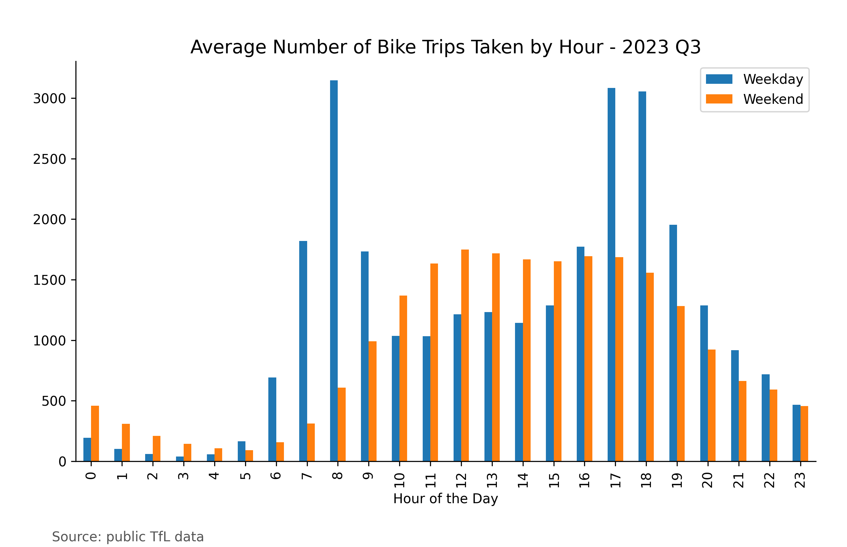
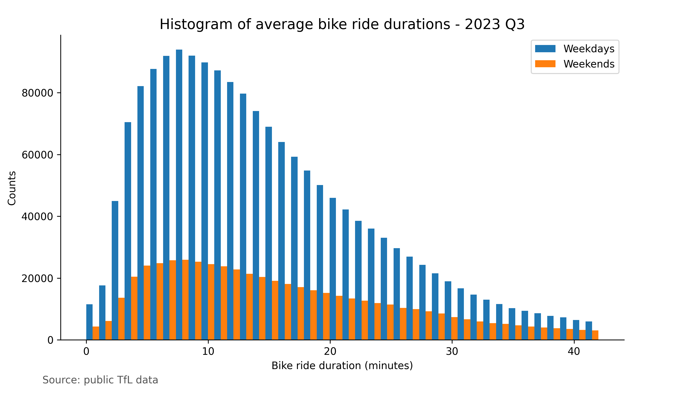
There are around 800 bike docks in operation in inner London, there are currently none in Lewisham and Greenwich
There are around 28,000 trips per day on weekdays and 23,000 on weekends reflecting the use for both commuting and leisure
The most popular time for using the bikes is between 8am in the morning and between 5 and 6pm in the evening on weekdays.
Weekend journeys tend to be longer at 38 minutes and 1 second compared 24 minutes and 13 seconds for weekday trips

Slide 3
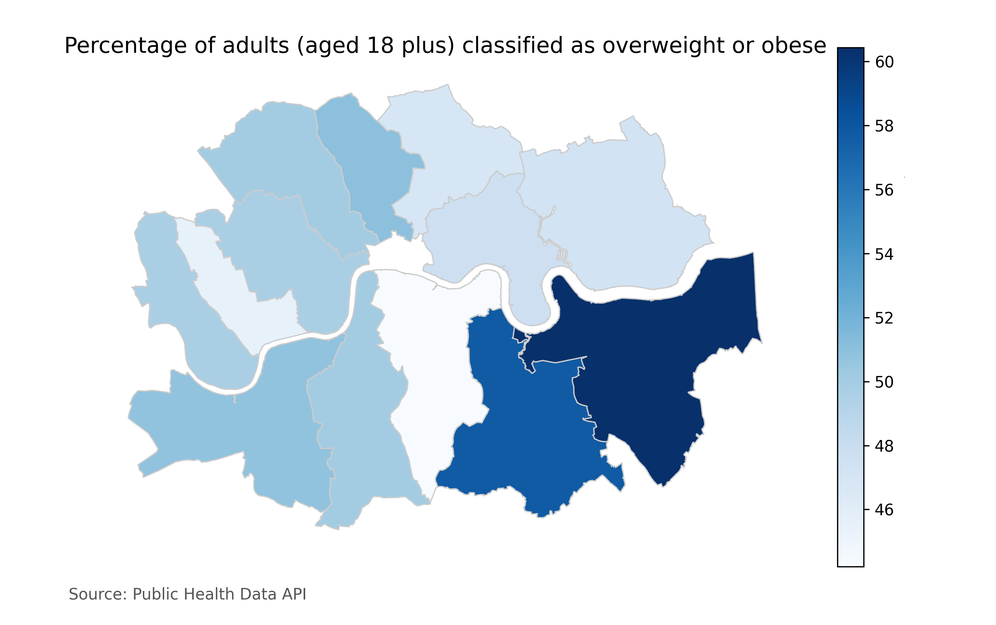
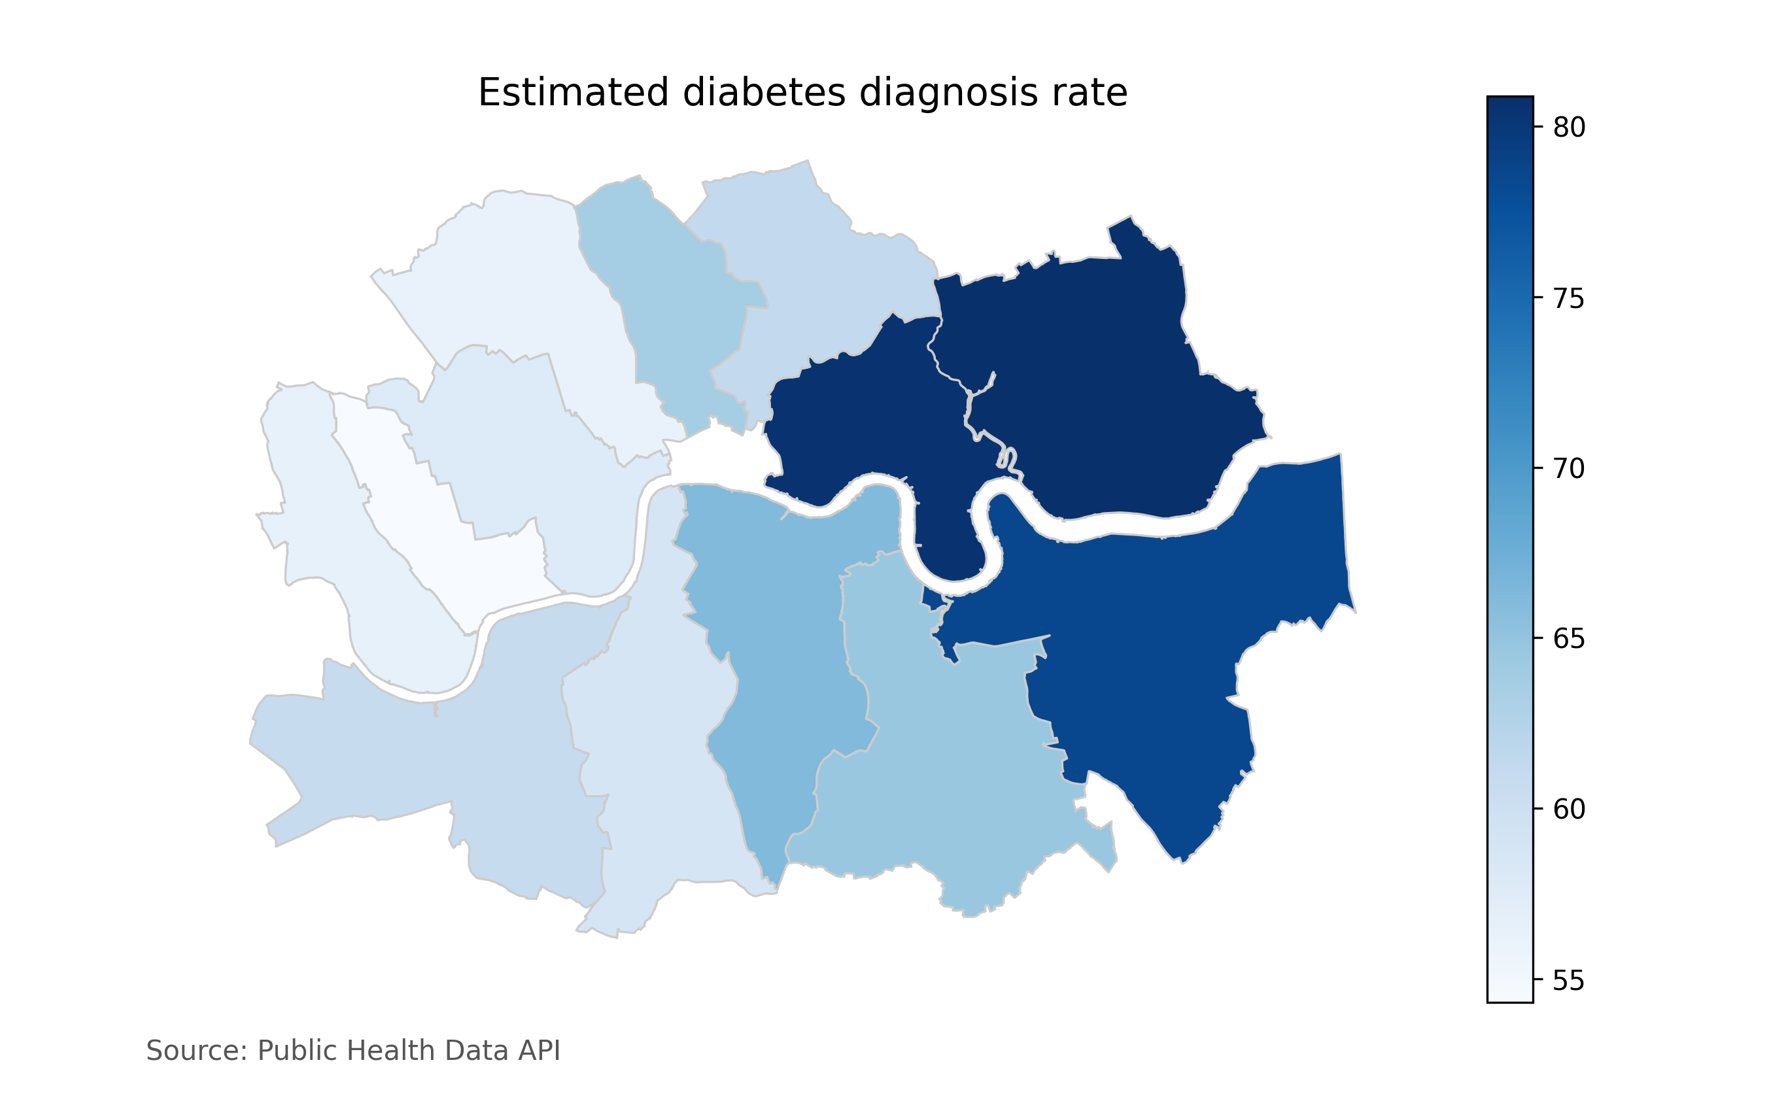
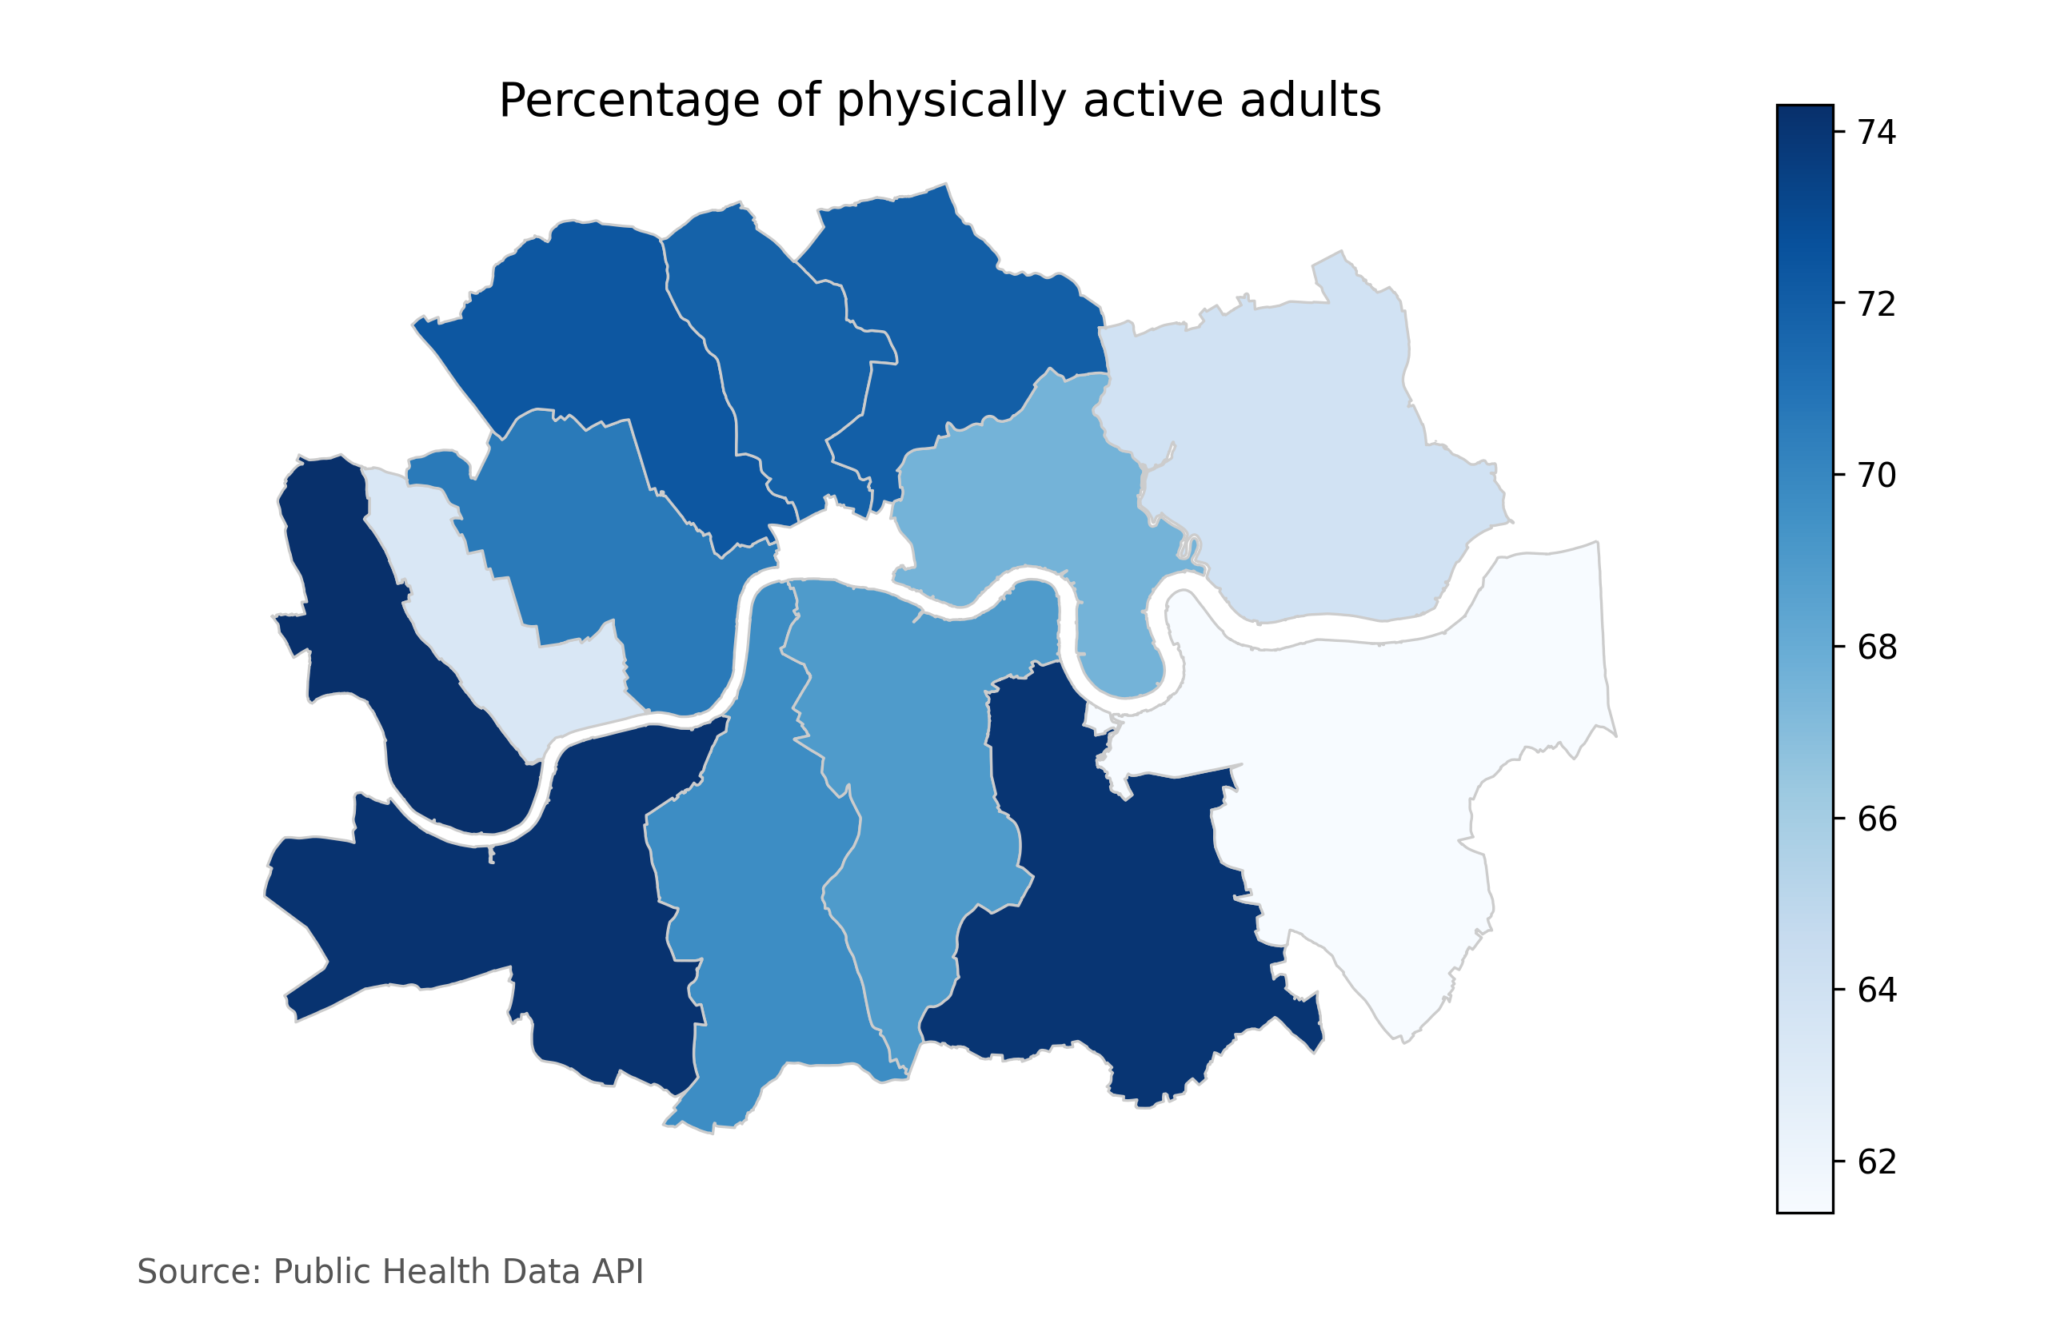
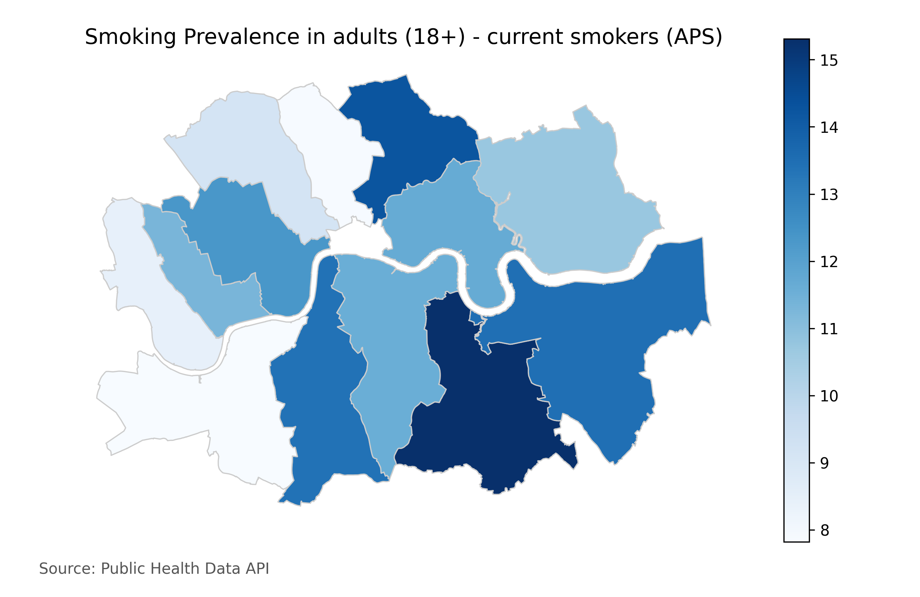
Residents in Greenwich and Lewisham are more likely to be classified as overweight compared to those in Southwark
Residents in Newham, Greenwich and Tower Hamlets are more likely to be diagnosed with diabetes than those in West London
Residents in Greenwich are less physically active compared to other South London Boroughs
Smoking is more prevalent in the Southeast boroughs of inner London

Slide 4
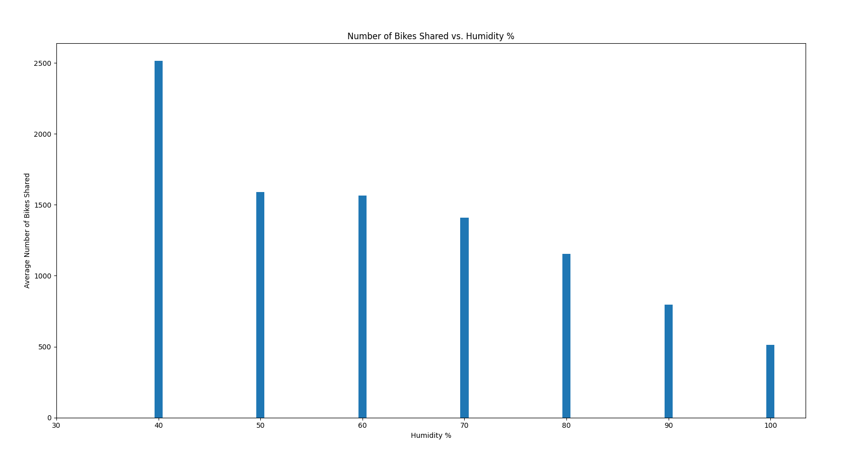
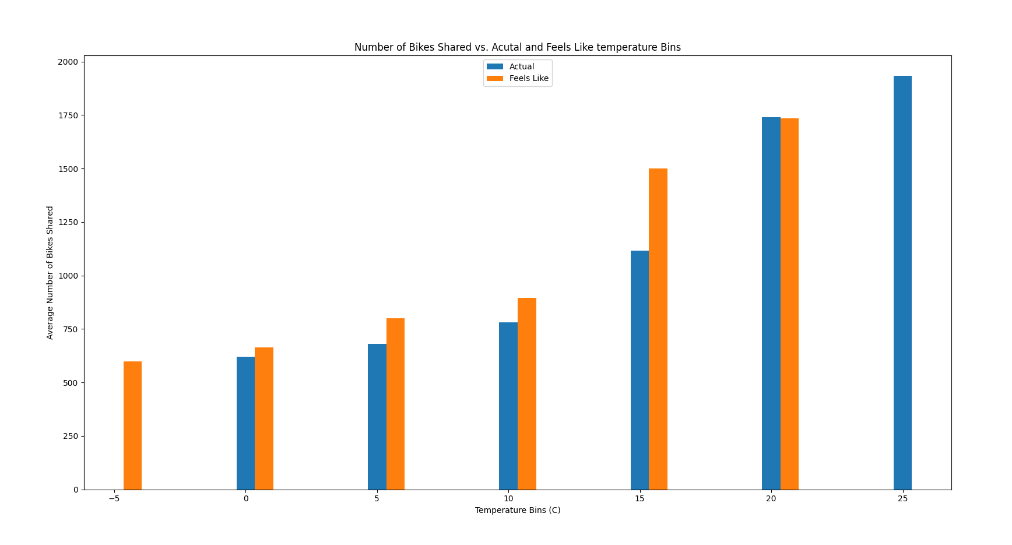
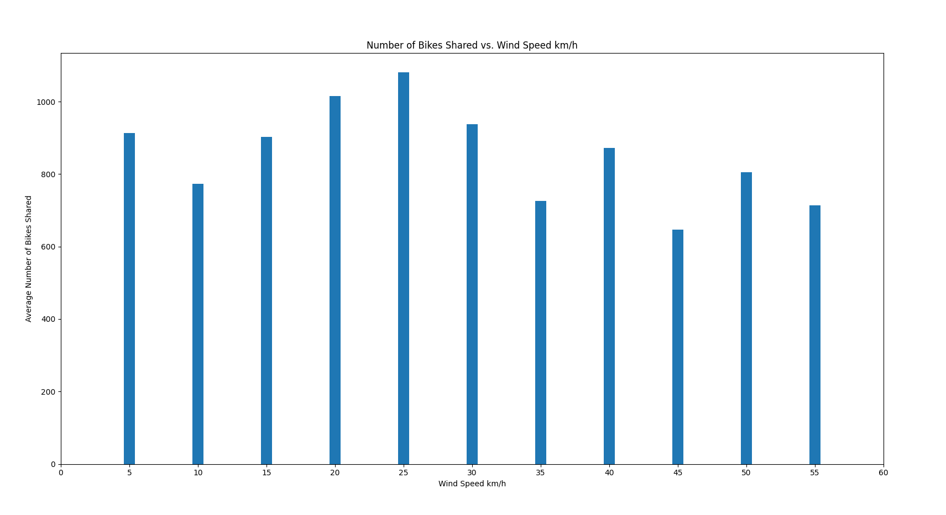
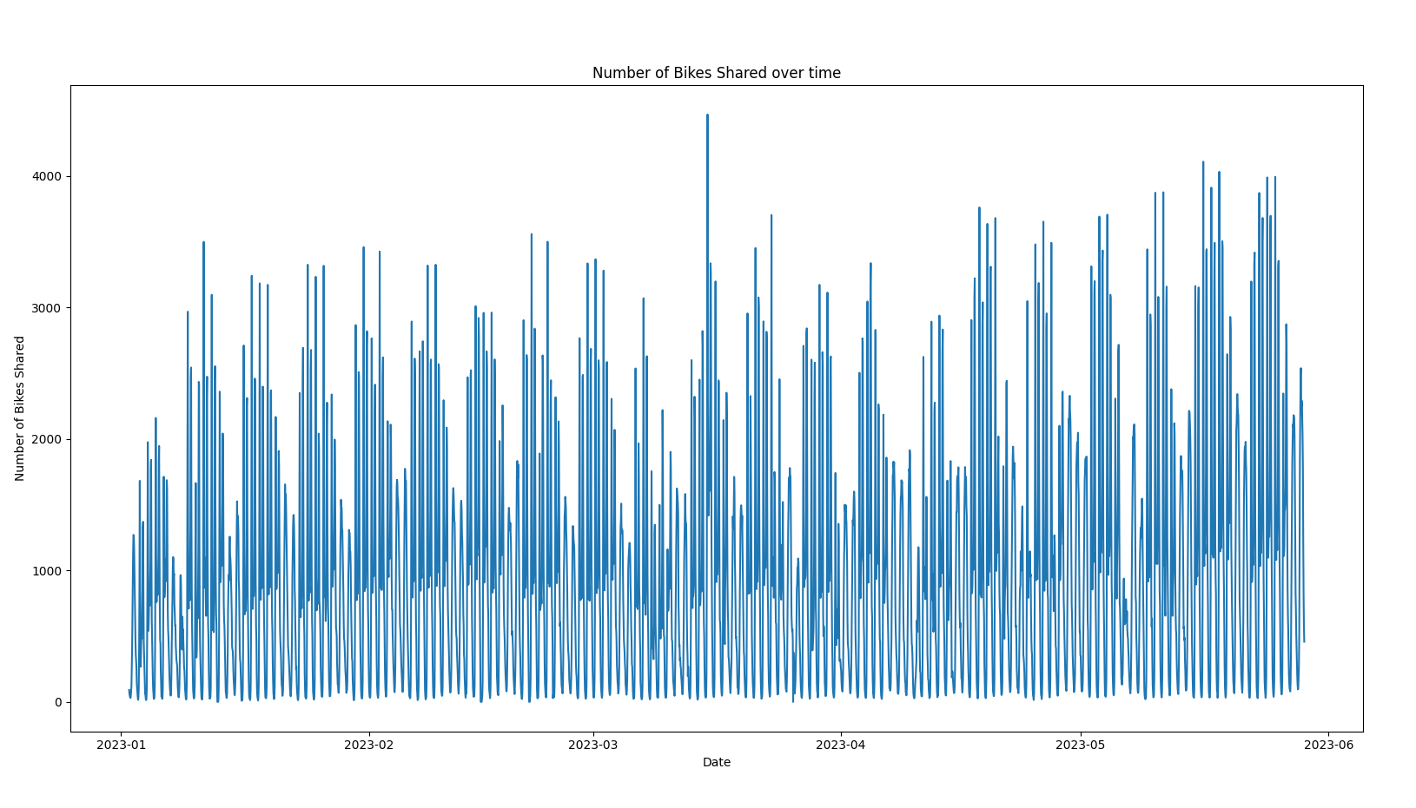
In my dataset there is negative correlation between the average number of trips and humidity
There is a positive correlation between temperature – both actual and apparent and number of trips
There isn’t a clear relationship between wind speed and number of bike trips but at higher speeds there are generally less trips.
The number of bike trips by day looks seasonal and is something we should capture in any model or analysis that consider

Slide 5
