Slide 1

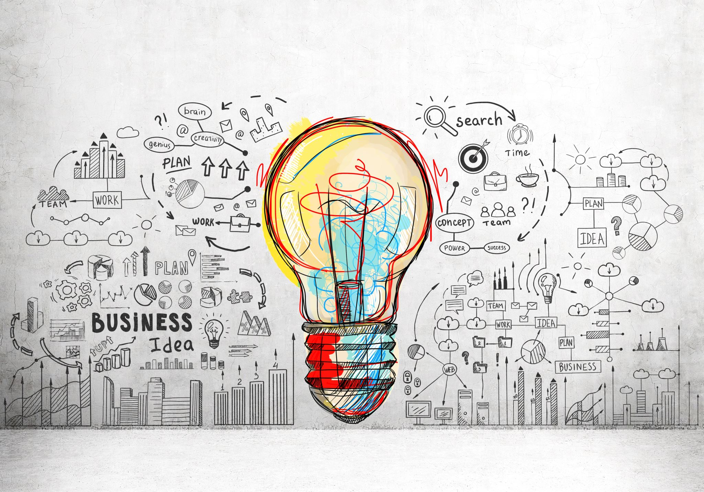
Data science democratization
Strategy & Execution

Slide 2
What is data science democratization?
Empowering expert and citizen data scientists and data engineers
Develop a community of practice
Provide resources & training for the data science community
Create an organizational knowledge center
Provide guidance and oversight for citizen and junior data scientists
Facilitate data science within the organization
Collaborate with Tech to design and build a modern data platform
Provide POV on data & tool selection (e.g., ML pipelines and user-friendly platforms)
Upskill to create citizen data scientists
Data science governance
External evaluations and adoption of best practices
Version control, data drift, model drift
Data integrity and security
2
Notes:
Have MJ weigh-in on this slide

Slide 3
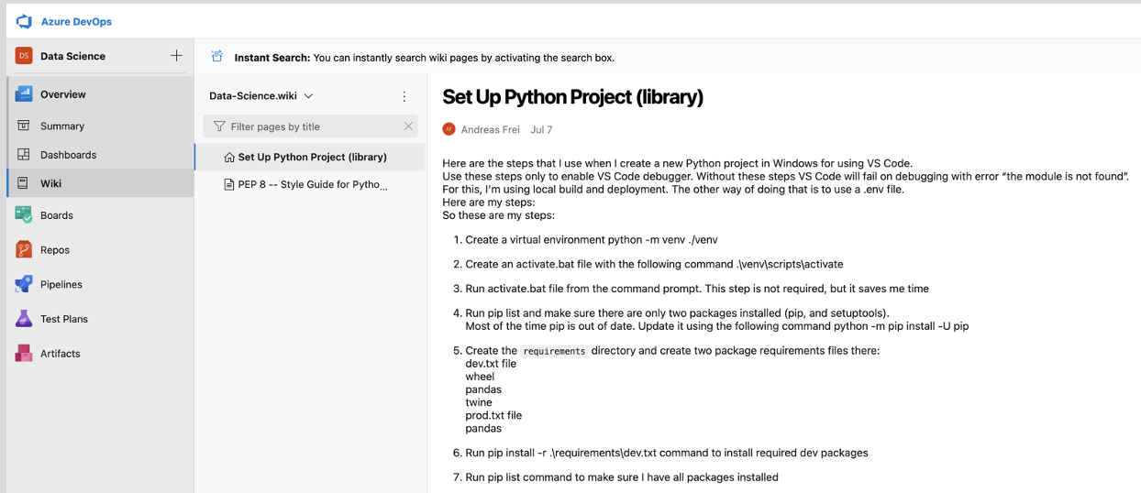
Community of practice examples
Shareable repository consisting of searchable research findings, proprietary modules, training materials, sharable Jupyter notebooks, code repositories, templates & protocols outlining best practices, methods, & standards, etc.
Data science upskilling with for all levels (e.g., Microsoft modules)
Standardized and regularly updated content for onboarding new data scientists
Standardized assessments & interview protocols for vetting candidates and assessing current employee capabilities and interest (e.g., Harvey ball assessment against data science taxonomy)
Compare to strategic roadmap to identify gaps and build plan around hiring and upskilling
3
Notes:
Have MJ weigh-in on this slide

Slide 4

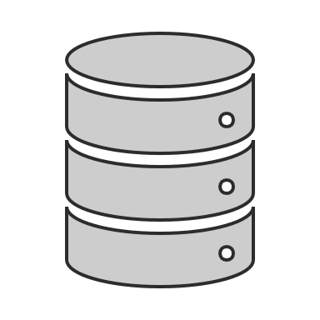
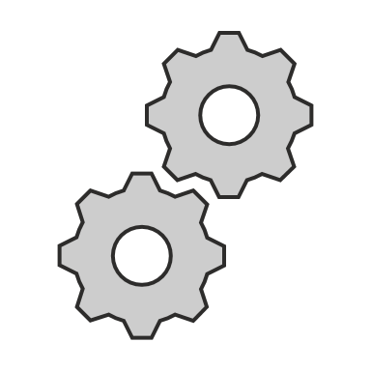
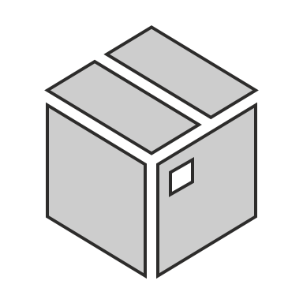

AutoML & automated data pipelines
AutoML provides a framework and architecture to support model building and deployment with significantly less effort for those who are strong business analysts, but who lack deep technical expertise (e.g., coding, ML/AI).
Define Objectives
Problem Definition
Success Criteria
Collect Data
Data Source
Extraction
Cleaning
Encoding
Model Data
Exploratory Data Analysis
Feature Engineering and Selection
Model Build and Selection
Model Validation and Assessment
Deploy Model
Model Selection
Documentation
Code or API Distribution
Monitor Model
Maintenance Plan
Performance Monitoring
Data Monitoring
Model Adjustments
4
Notes:
Have MJ weigh-in on this slide

Slide 5
The citizen data scientist
Citizen data scientist persona
Business SME / domain expertise
Can specify business requirements
Interest in more advanced techniques
Lack formal data science training
Tend to have low or no coding skills
May have some statistical knowledge, but lack ML & AI expertise
Have strong capability to “story tell”
Tend to have good “soft skills”
5

Slide 6
Data science facilitation benefits
The Citizen Data Scientist is an “upskilled” version of the Business Analyst:
Stronger ML modeling and validation skills
Stronger coding skills (e.g., SQL & Python)
Benefits of “upskilling” include:
Less reliance on expensive and hard to get data scientists
Efficiency gains and quicker turn-arounds
More effective story telling leading to improved decision-making
Employees feel empowered
Potential to improve retention
Data scientist relieved from support role
Citizen data scientist has more autonomy than business analyst
6

Slide 7
Data science governance
Version control for models, data, and code
Reliability and validity methods and standards for hypothesis testing
Best practices in data exploration and cleaning
E.g., outliers, anomalies, missing values, inconsistent formats, etc.
Best practices in feature engineering
Best practices in model training, validation, and monitoring
Best practices in data visualization
Coding standards
Documentation standards
7

Slide 8
Democratization example plan
Identify 2-3 business SMEs and begin upskilling using resources such as Microsoft training for Auto ML
Set up Azure ML workspace and train data science team on using the Azure Auto ML SDK via Microsoft Data science team to work with the business SMEs to leverage the no code/ low code Azure ML Studio
Provide guidance, supervision, and consultation
Begin creating Wikis in our Azure DevOps with data science content and resources
Publish data science projects for transparency and so we don’t reinvent the wheel
Publish methods & standards for conducting POCs, etc. to ensure best practices are employed
Publish tutorials and other related content
Work closely with the business to identify and prioritize our data science roadmap
Provide opportunities for analysts to leverage the platform for quick hypothesis tests
Include data engineering in the data science meetings, especially when conducting POC design sessions
Consider conducting 1-2 hackathons per year
Provide mentorship and consultation to employees regarding the science and application of data science
Consider having an external evaluation of our maturity 6-12 months out
8

